Slide 1
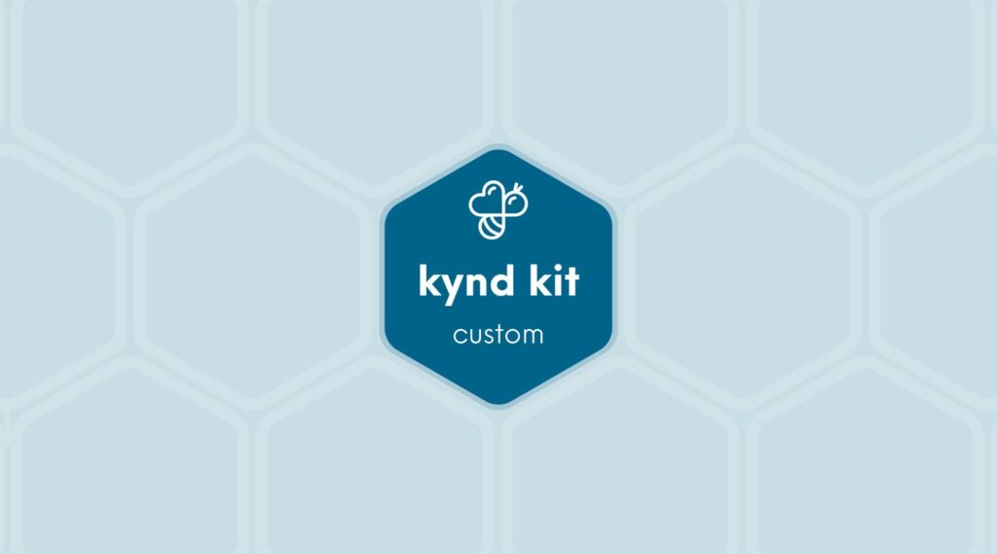
CUSTOM
AAA Teen Mental Health [Custom]
10 STEPS

Slide 2

STEP 1 OF 10
About Project Helping
Kynd Kits are a program of Project Helping, a mental wellness nonprofit. Our mission is to make it ridiculously easy to volunteer because doing good is good for your mental wellness!
Learn More at ProjectHelping.org
When You Build a Kynd Kit - The Cycle of Impact

Slide 3
STEP 2 OF 10
Teen Mental Health [+]
Before You Build
There are many different categories of mental illness, and those who struggle with any of them do not do so by choice.
1 in 6 U.S. youth aged 6-17 experience a mental health disorder each year. Among high school-age youths aged 14–18 years, 1,952 suicides occurred in 2021, making suicide the third leading cause of death for this age group
This kit is designed to go to a teen struggling with their mental wellness. It shows support of their mental health journey.

Slide 4

STEP 3 OF 10
Tips for Building Your Kit
Helpful Tip for Building Your Kynd Kit
• Avoid politics and religion entirely.
• Use appropriate humor.
• Can't think of what to write, draw a picture!
• Use words of affirmation!
• Place a piece of paper in any canvas bag before drawing on the outside. This way, the marker will not bleed through the other side of the bag.
• Please keep your designs gender-neutral, inclusive, and age-appropriate.
Spanish Translation Options

Slide 5

STEP 4 OF 10
Write a Note to the Recipient and Decorate the Envelope
Write a card and decorate the envelope using the enclosed materials. Express your encouragement and include a hopeful message.
Please ensure your message is age-appropriate and avoids references to religion or politics.

Slide 6

STEP 4 OF 10
Write a Note to the Recipient and Decorate the Envelope (continued)

Slide 7

STEP 5 OF 10
Decorate the Bag
Decorate the kraft bag(s). This is what the final kit is distributed in, so try to make this fun and colorful for the recipient to open.
Please note: we are currently transitioning from plastic ziplock bags to kraft bags. Some kits may still include the plastic bag for you to decorate while we complete this transition.

Slide 8



STEP 5 OF 10
Decorate the Bag (continued)

Slide 9

STEP 6 OF 10
Decorate the Canvas Bag
Use the permanent markers to decorate the canvas bag.
Tip: Place a piece of paper in the bag before decorating to prevent the markers from bleeding through.

Slide 10

STEP 6 OF 10
Decorate the Canvas Bag (continued)

Slide 11
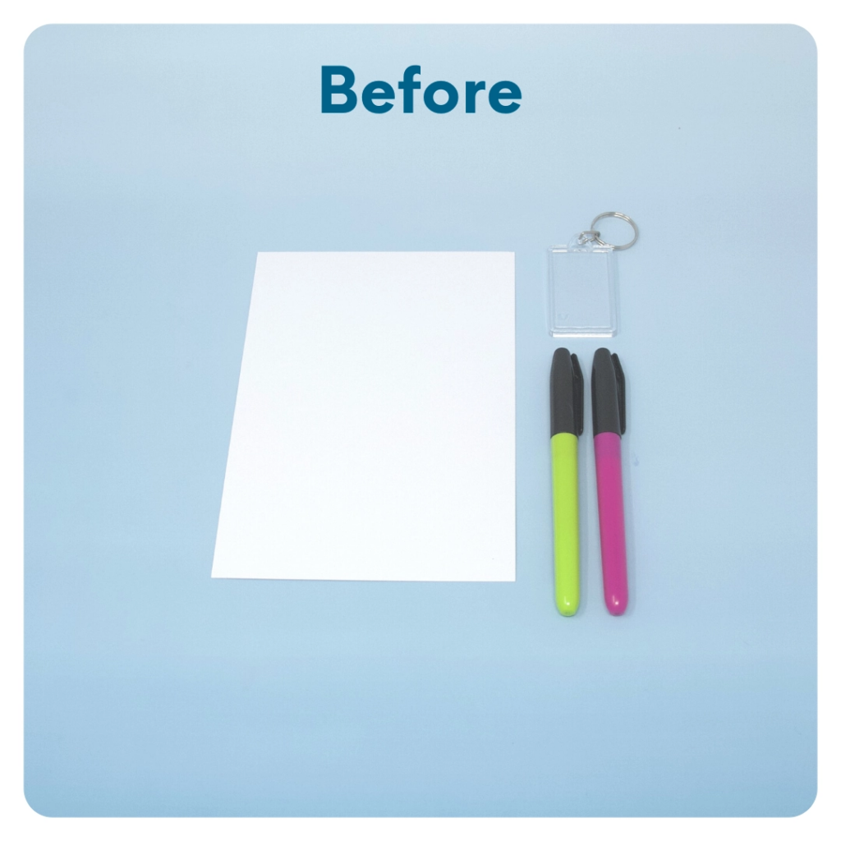
STEP 7 OF 10
Create a Keychain
Cut out the paper to fit the shape of the keychain. Decorate the front and back of the paper with a picture or uplifting message. Place the image inside the keychain and close the keychain.

Slide 12
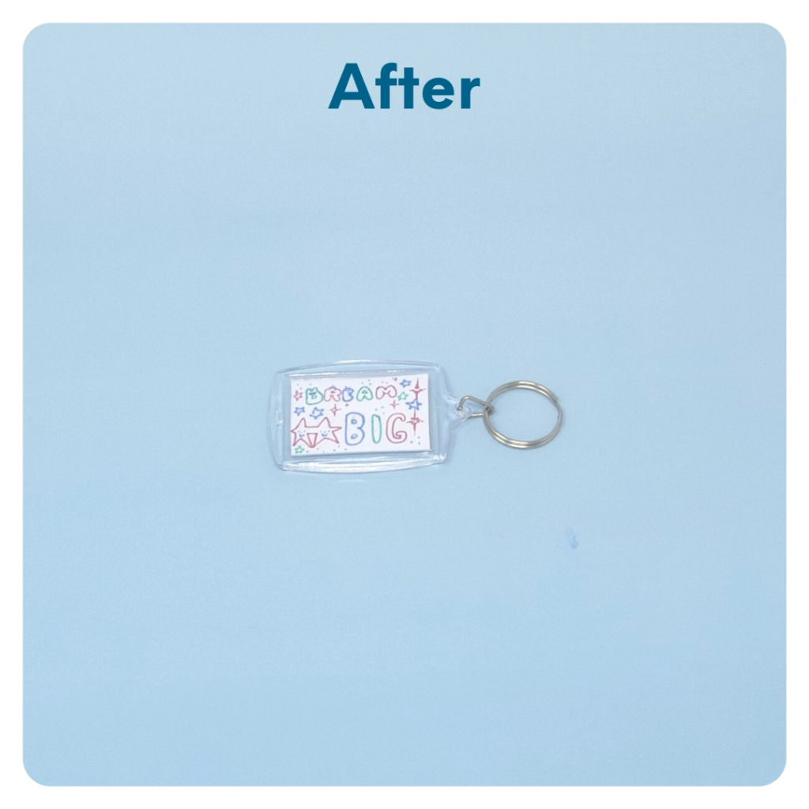
STEP 7 OF 10
Create a Keychain (continued)

Slide 13
STEP 8 OF 10
Pack the Teen Mental Health Kit
Pack all of the materials into the decorated plastic bag and put it back into the original box.
• Please only include items that are UNOPENED and UNUSED
• Add any optional items you would like.
Optional Items to Add:
• Self care items
• Journal
• Puzzle books
• Fidget toys
Items not to include:
• Perishable items
• Sharp objects
• Nut food products
• Religious or political items

Slide 14
STEP 9 OF 10
Register My Kit (Optional)
Register your kit. To register and track your kits, you must visit the online instructions. Registering your kit is optional.

Slide 15
STEP 10 OF 10
Thank You!
When you build a Kynd Kit, you create layers of impact for yourself and the community. We appreciate your time and your support of our mission.
Cheers,
The Project Helping team

