Slide 1
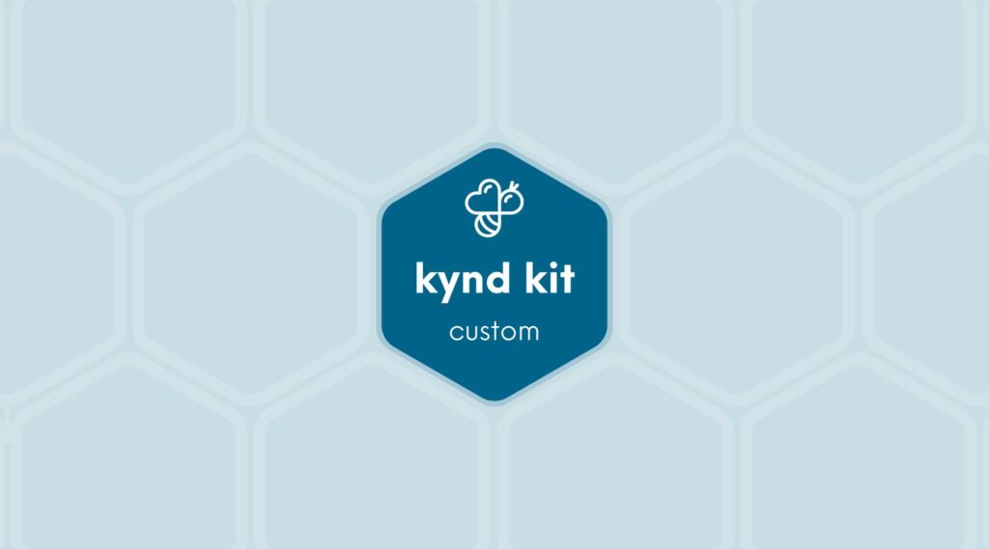
CLASSIC
Adobe Crafts for Seniors Kit
5 STEPS

Slide 2

STEP 1 OF 5
About Project Helping
Kynd Kits are a program of Project Helping, a mental wellness nonprofit. Our mission is to make it ridiculously easy to volunteer because doing good is good for your mental wellness!
Learn More at ProjectHelping.org
When You Build a Kynd Kit - The Cycle of Impact

Slide 3

STEP 2 OF 5
Tips for Building Your Kit
Helpful Tip for Building Your Kynd Kit
• Avoid politics and religion entirely.
• Use appropriate humor.
• Can't think of what to write, draw a picture!
• Use words of affirmation!
• Place a piece of paper in any canvas bag before drawing on the outside. This way, the marker will not bleed through the other side of the bag.
• Please keep your designs gender-neutral, inclusive, and age-appropriate.
Spanish Translation Options

Slide 4
STEP 3 OF 5
Crafts for Seniors
Custom Kit Instructions
Your Crafts for Seniors kit includes three projects that will brighten the days of older adults served by nonprofits. Please return each project in its own Ziploc bag so we can share them easily with different organizations.
Craft #1: Create Origami
Please make at least 15 Korean hanbok by following the instructions in one of the YouTube videos below (or you may also use other instructions that you find).
Instruction Link 1
Instruction Link 2
PDF Instructions

Slide 5
STEP 3 OF 5
Crafts for Seniors (continued)
With the remaining origami paper, please feel free to make whatever you would like to donate. You can look online for instructions and also watch YouTube and other videos. Please put all of your origami items together in one ziploc bag when you return the kit.
Craft #2: Decorate Bookmarks
Please decorate the paper inserts and then place them in the plastic sleeves. You may use the included stickers, pens, and/or your own art supplies. Please put all of the bookmarks together in one ziploc bag when you return the kit.
Craft #3: Make Cards
Please write a friendly note or make a general holiday card. Please do not include religious or political messages. You may use the included stickers, pens, and/or your own art supplies. You can also make something with the origami paper and glue/tape it to a card. Please put all of the cards together in one ziploc bag when you return the kit.
Decorate the ziplock bags (optional)
Using the provided supplies to decorate the 3 ziplock bags.
Pack your Crafts for Seniors Kit
Pack all the materials into the decorated plastic bags and put it back into the original box, being sure to separate the 3 crafts into the 3 bags.
• Please only include items that are UNOPENED and UNUSED

Slide 6
STEP 4 OF 5
Register My Kit (Optional)
Register your kit. To register and track your kits, you must visit the online instructions. Registering your kit is optional.

Slide 7
STEP 5 OF 5
Thank You!
When you build a Kynd Kit, you create layers of impact for yourself and the community. We appreciate your time and your support of our mission.
Cheers,
The Project Helping team

