Slide 1
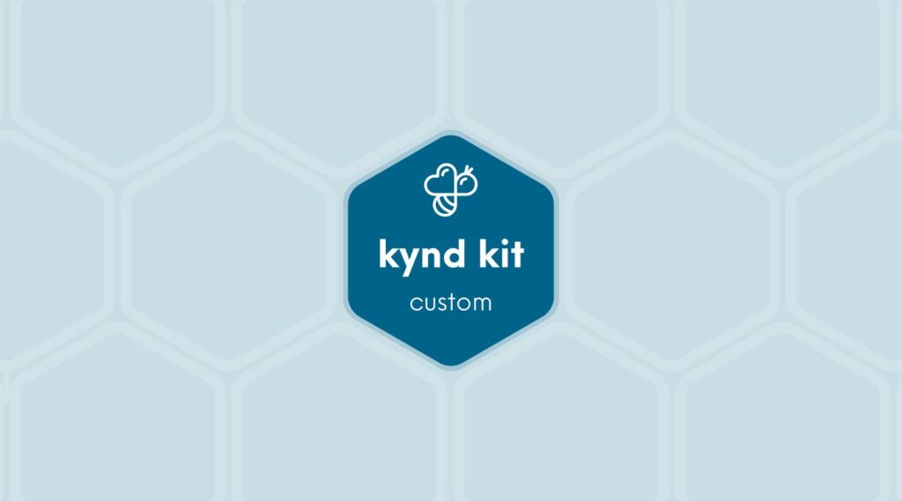
CUSTOM
Allstate &#8211; Back to School Backpack
8 STEPS

Slide 2

STEP 1 OF 8
About Project Helping
Kynd Kits are a program of Project Helping, a mental wellness nonprofit. Our mission is to make it ridiculously easy to volunteer because doing good is good for your mental wellness!
Learn More at ProjectHelping.org
When You Build a Kynd Kit - The Cycle of Impact

Slide 3

STEP 2 OF 8
Tips for Building Your Kit
Helpful Tip for Building Your Kynd Kit
• Avoid politics and religion entirely.
• Use appropriate humor.
• Can't think of what to write, draw a picture!
• Use words of affirmation!
• Place a piece of paper in any canvas bag before drawing on the outside. This way, the marker will not bleed through the other side of the bag.
• Please keep your designs gender-neutral, inclusive, and age-appropriate.
Spanish Translation Options

Slide 4
STEP 3 OF 8
Back to School [Max]
Before You Build
The average American family spends nearly $700 on the back-to-school season for one child. Such costs threaten to overwhelm many families with lower incomes. With the growing expectation that kids will have access to technology at home, some cost projections are even higher. This sometimes puts pressure on teachers to buy and provide school supplies out of their own pockets.
Create and personalize a Kynd Kit to provide children in need with a brand-new backpack filled with school supplies and self-care essentials.

Slide 5

STEP 4 OF 8
Write a Note to the Recipient and Decorate the Envelope
Write a card and decorate the envelope using the enclosed materials. Express your encouragement and include a hopeful message.
Please ensure your message is age-appropriate and avoids references to religion or politics.

Slide 6

STEP 4 OF 8
Write a Note to the Recipient and Decorate the Envelope (continued)

Slide 7
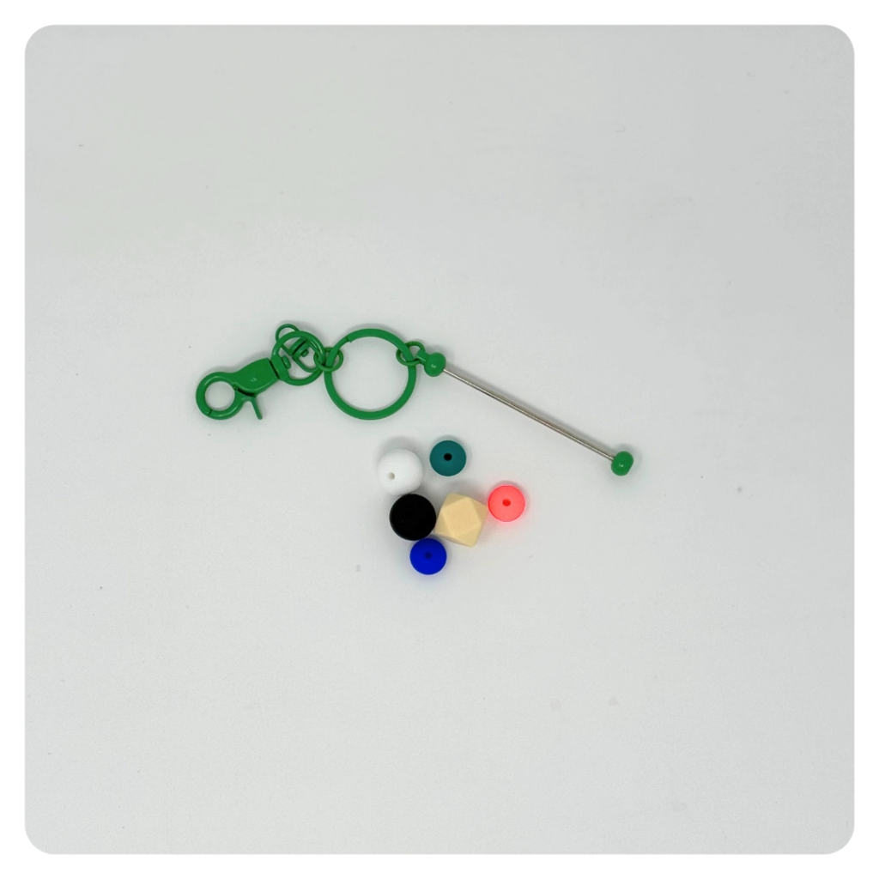
STEP 5 OF 8
Build a Fidget Keychain
Use the key chain and silicone beads to create a fidget key chain. This makes a fun, soothing tool for someone who could use a little calm and kyndness on the go.

Slide 8
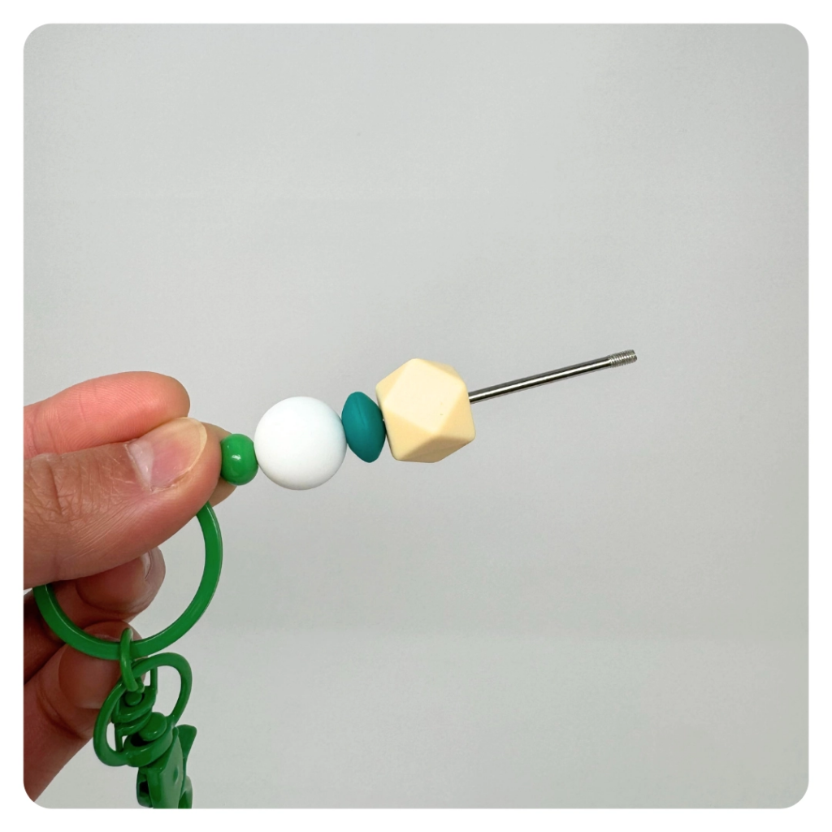
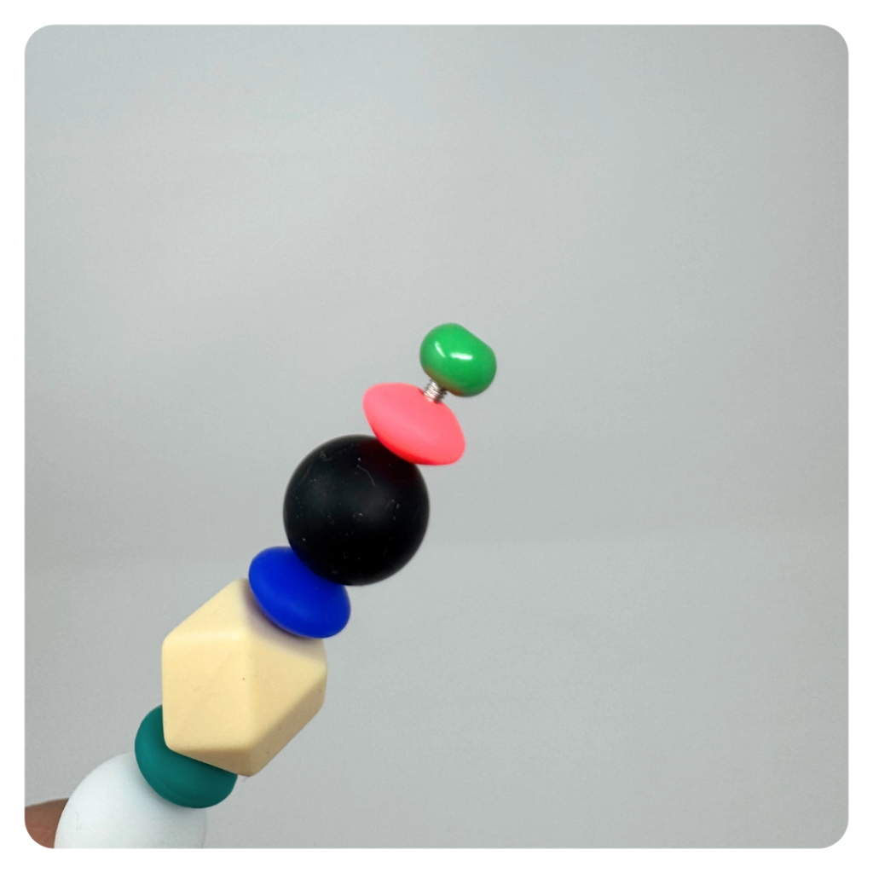
STEP 5 OF 8
Build a Fidget Keychain (continued)

Slide 9
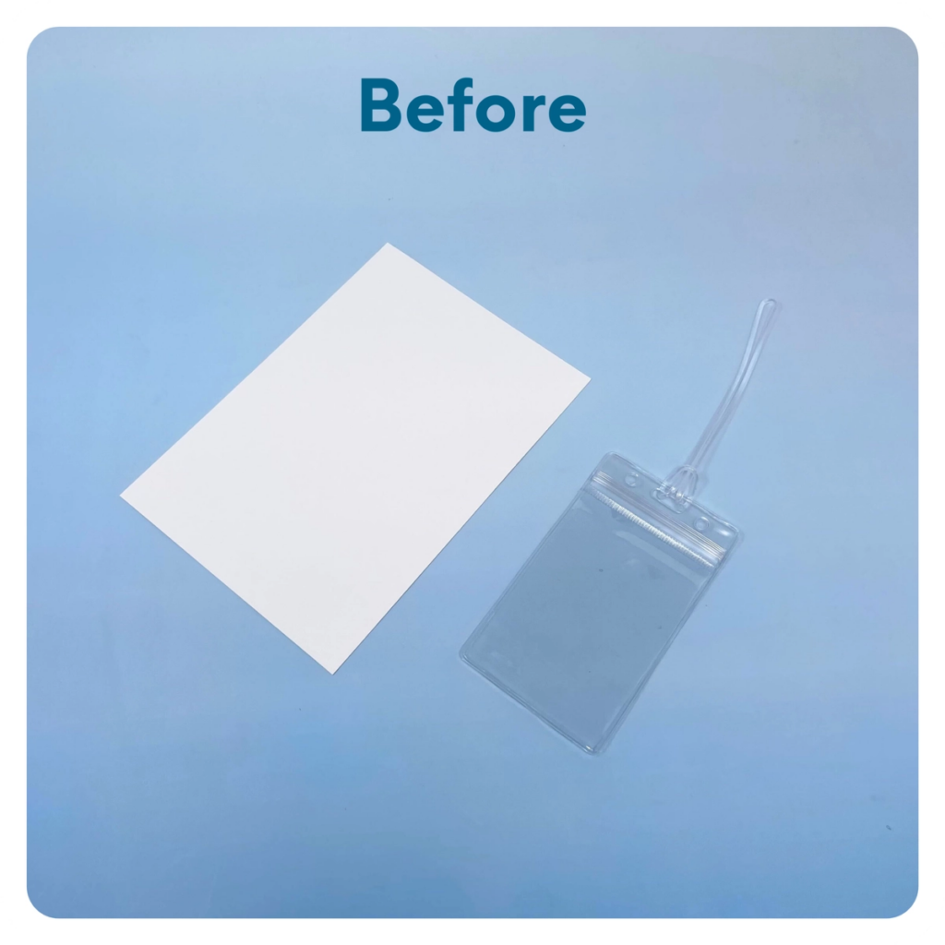
STEP 6 OF 8
Luggage Tag
Cut one of the blank cards to fit the luggage tag. Write an encouraging message, put it inside the luggage tag, and attach it to the outside of the backpack.

Slide 10
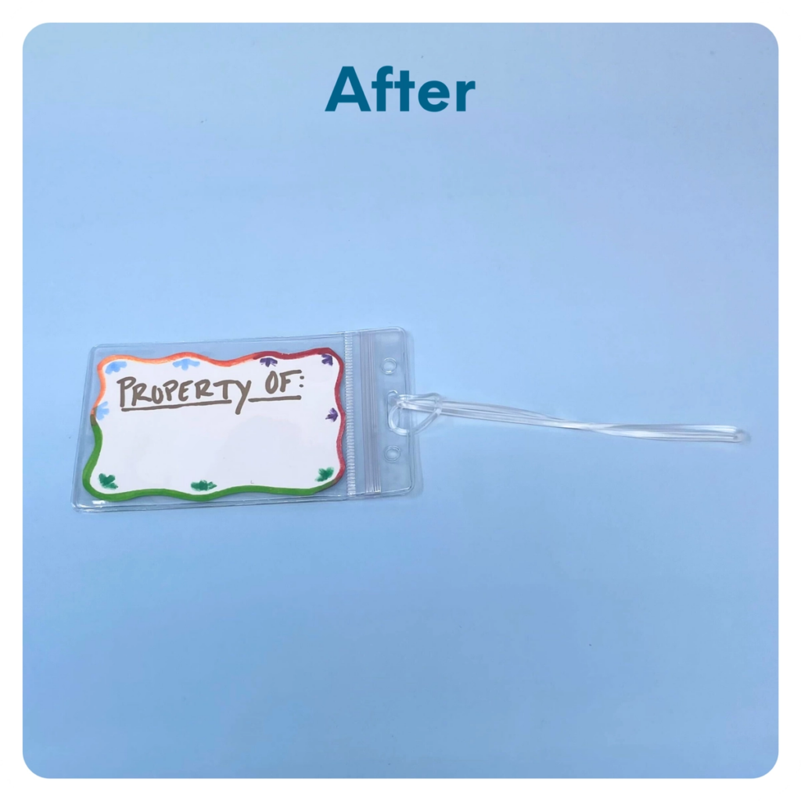
STEP 6 OF 8
Luggage Tag (continued)

Slide 11
STEP 7 OF 8
Pack Back to School [Max]
Pack all of the materials into the backpack
• Please only include items that are UNOPENED and UNUSED
• Add any optional items you would like.
Optional Items to Add:
• School supplies (flashcards, pens, pencils, sticky notes, folders, etc.)
• Books
• Hygiene items
• Self-care items
Items not to include:
• Perishable items
• Sharp objects
• Nut food products
• Religious or political items

Slide 12
STEP 8 OF 8
Thank You!
When you build a Kynd Kit, you create layers of impact for yourself and the community. We appreciate your time and your support of our mission.
Cheers,
The Project Helping team

