Slide 1
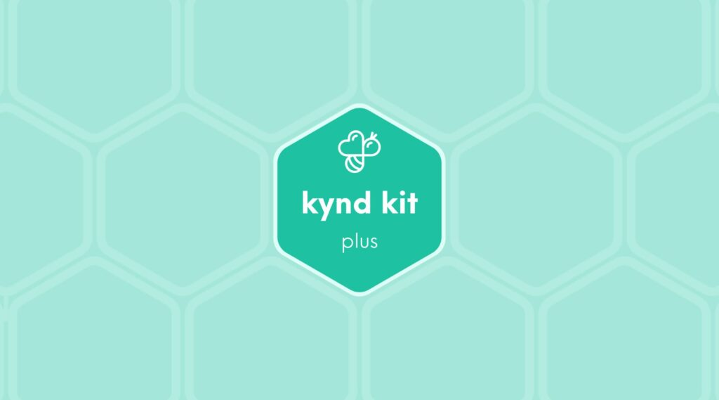
PLUS
Autism Support [Plus]
10 STEPS

Slide 2
STEP 1 OF 10
Autism Support [Plus]
Autism Sensory Support [Plus]
Before You Build
About the Recipient
In 2023, the CDC reported that approximately 1 in 36 children in the U.S. is diagnosed with an autism spectrum disorder. Boys are four times more likely to be diagnosed with autism than girls.
On average, autism costs an estimated $60,000 a year through childhood, with the bulk of the costs in special services and lost wages related to increased demands on one or both parents. Costs increase with the occurrence of intellectual disability.

Slide 3
STEP 1 OF 10
Autism Support [Plus] (continued)
This Kynd Kit includes materials to make a care package for a child with autism and one for a parent or caregiver of an autistic child.

Slide 4

STEP 2 OF 10
Affirmation Notebook
DIY Affirmations
Find the mini affirmation notebook in your kit. Decorate the front cover with drawings, stickers, or a positive message. Then, open it up and write 3–6 affirmations inside—more if you'd like! These can be encouraging words, self-love reminders, or anything that lifts the spirit.
Do you still have affirmation cards in your kit? If your kit includes affirmation cards instead of a notebook, go ahead and write a special affirmation on each card.

Slide 5


STEP 2 OF 10
Affirmation Notebook (continued)

Slide 6

STEP 3 OF 10
Decorate the Bag
Decorate the kraft bag(s). This is what the final kit is distributed in, so try to make this fun and colorful for the recipient to open.
Please note: we are currently transitioning from plastic ziplock bags to kraft bags. Some kits may still include the plastic bag for you to decorate while we complete this transition.

Slide 7



STEP 3 OF 10
Decorate the Bag (continued)

Slide 8

STEP 4 OF 10
Write a Note to the Recipient and Decorate the Envelope
Write a card and decorate the envelope using the enclosed materials. Express your encouragement and include a hopeful message.
Please ensure your message is age-appropriate and avoids references to religion or politics.

Slide 9

STEP 4 OF 10
Write a Note to the Recipient and Decorate the Envelope (continued)

Slide 10

STEP 5 OF 10
Surprise Kyndness Notebook
Decorate the outside of the journal with a picture or uplifting message. Use random pages in the journal to write short, uplifting messages, draw small, colorful images, or create fun writing prompts for the recipient.

Slide 11

STEP 5 OF 10
Surprise Kyndness Notebook (continued)

Slide 12
STEP 6 OF 10
DIY Sensory Tube
Materials
• Glue
• Glitter
• Food Coloring
• Sensory Tube and Cap
• Water
Assemble the Sensory Tube
• Add glitter to the sensory tube (as much as you'd like)
• Add 3-5 drops of food coloring (too much will make the glitter hard to see)
• Fill the tube with water
• Squeeze in a dab of glue
• Line the cap with glue to seal the sensory tube
• Give the sensory tube a good shake to mix it all up
• Add the completed sensory tube to the mini plastic bag

Slide 13
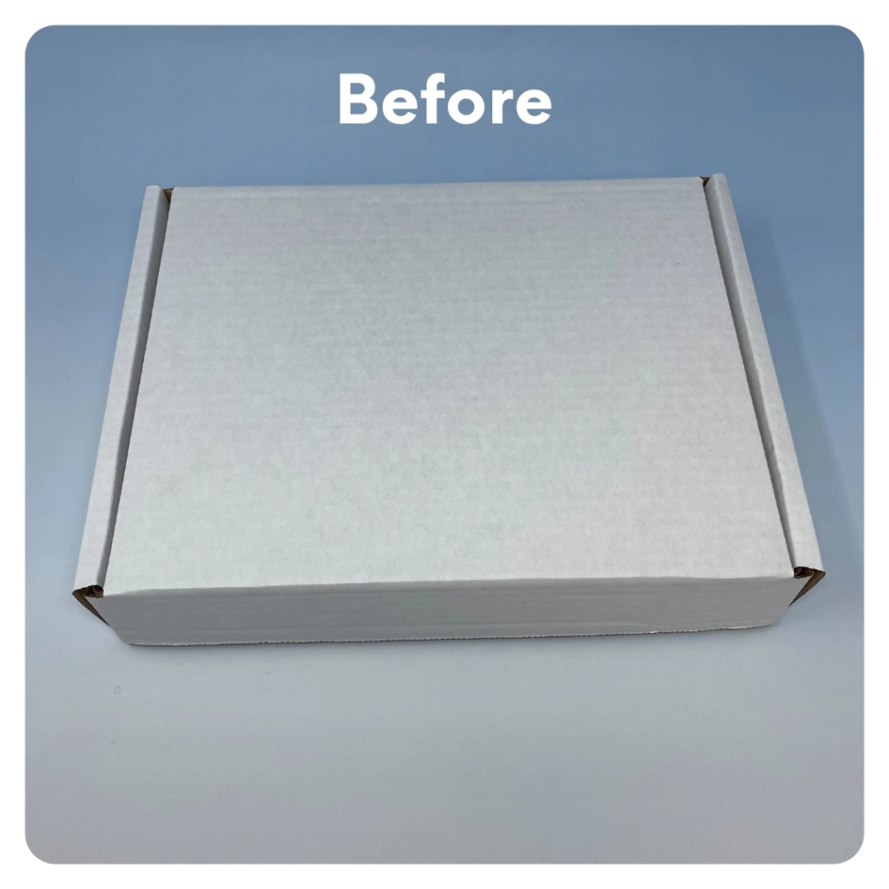
STEP 7 OF 10
Decorate Box
Decorate the outside of the box. Make it fun and colorful for the recipient.

Slide 14
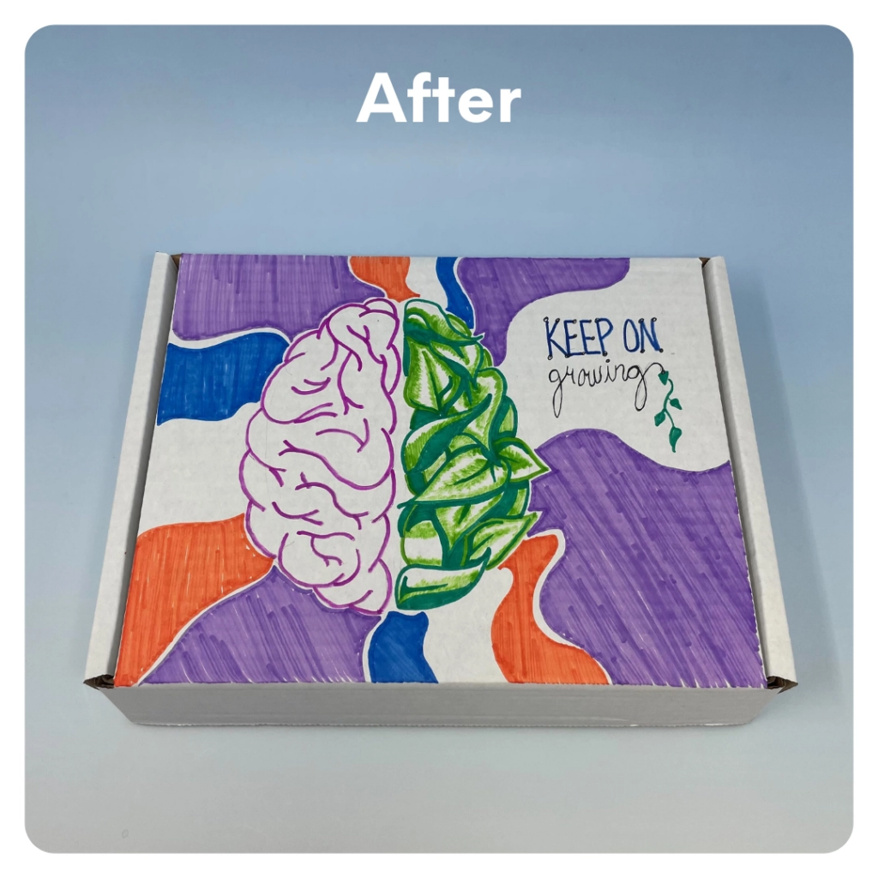
STEP 7 OF 10
Decorate Box (continued)

Slide 15
STEP 8 OF 10
Pack Autism Support Kit
You have created one completed kit for a child with autism and one kit for their caregiver. Below is a list of optional items you can include in each bag.
Optional items to add (child's bag):
• A card written to the child
• Scratch coloring pad/Tic Tac Toe game (other game items)
• Kid's coloring book and crayons
• Sensory items (sensory noodle, sensory tube, Silly Putty/Play-Doh, fidget toys)
Optional items to add (caregiver's bag):
• Card written for the caregiver
• Puzzle book
• Adult coloring book and colored pencils
• Autism caregiver mental health resource guide
• Notebook

Slide 16
STEP 8 OF 10
Pack Autism Support Kit (continued)
• Self-care items (shower steamer, lotion, stress dice, sheet mask)
• Affirmation card
Items not to include:
• Perishable items
• Sharp objects
• Nut food products
• Religious or political items

Slide 17
STEP 9 OF 10
Register My Kit (Optional)
Register your kit. To register and track your kits, you must visit the online instructions. Registering your kit is optional.

Slide 18
STEP 10 OF 10
Thank You!
When you build a Kynd Kit, you create layers of impact for yourself and the community. We appreciate your time and your support of our mission.
Cheers,
The Project Helping team

