Slide 1

MAX
Cancer Treatment Comfort [Max]
12 STEPS

Slide 2

STEP 1 OF 12
About Project Helping
Kynd Kits are a program of Project Helping, a mental wellness nonprofit. Our mission is to make it ridiculously easy to volunteer because doing good is good for your mental wellness!
Learn More at ProjectHelping.org
When You Build a Kynd Kit - The Cycle of Impact

Slide 3

STEP 2 OF 12
Tips for Building Your Kit
Helpful Tip for Building Your Kynd Kit
• Avoid politics and religion entirely.
• Use appropriate humor.
• Can't think of what to write, draw a picture!
• Use words of affirmation!
• Place a piece of paper in any canvas bag before drawing on the outside. This way, the marker will not bleed through the other side of the bag.
• Please keep your designs gender-neutral, inclusive, and age-appropriate.
Spanish Translation Options

Slide 4
STEP 3 OF 12
Cancer Treatment Comfort Kit [Max]
Before You Build
We have included a list of items in your chemo care kits that could help a patient before, during, and after treatment. Each person reacts differently to treatments, so we have provided a variety of items that a loved one might need and want during treatments.
“What can I do to help?” Cancer caregivers – family and friends of cancer patients – want to provide meaningful support but oftentimes are at a loss for what to say or do. In fact, there are a lot of different things you can do to help your loved one through chemotherapy or “chemo” and other treatments.

Slide 5

STEP 4 OF 12
Write a Note to the Recipient and Decorate the Envelope
Write a card and decorate the envelope using the enclosed materials. Express your encouragement and include a hopeful message.
Please ensure your message is age-appropriate and avoids references to religion or politics.

Slide 6

STEP 4 OF 12
Write a Note to the Recipient and Decorate the Envelope (continued)

Slide 7
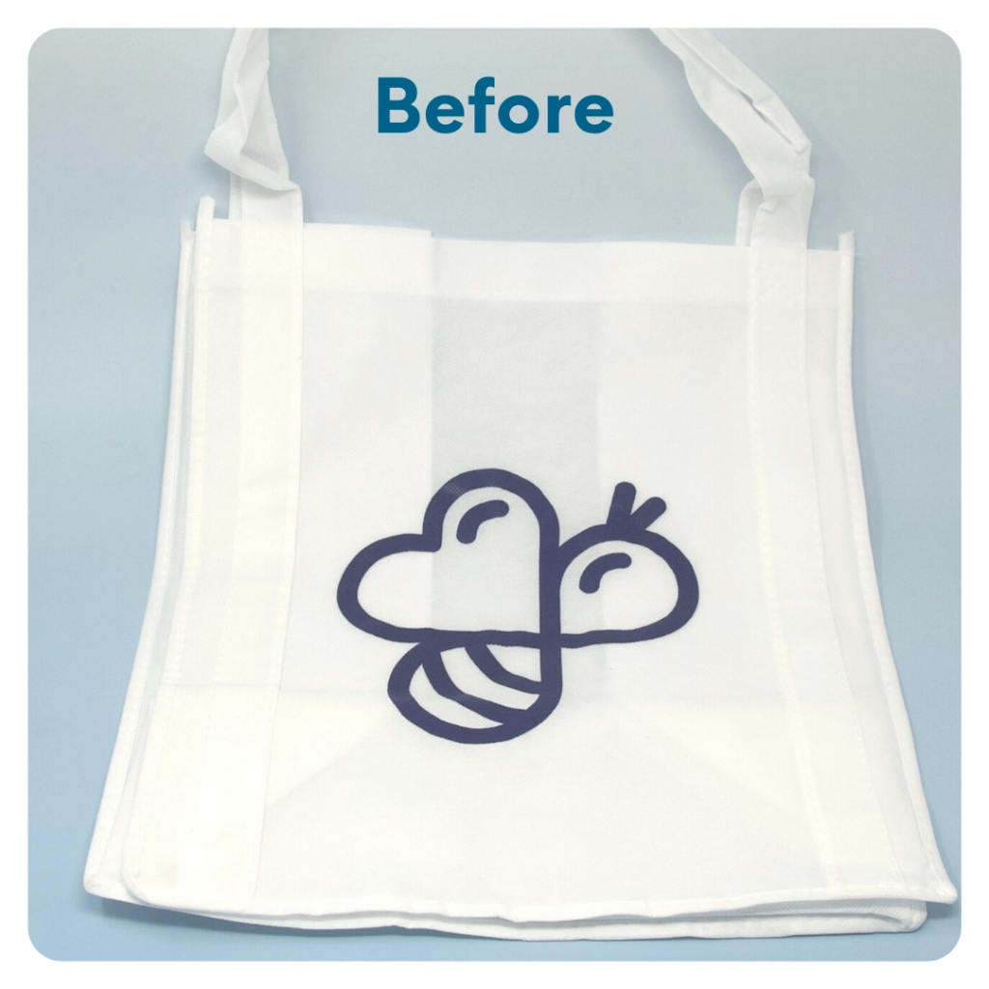
STEP 5 OF 12
DIY Tote Bag
Decorate the Canvas Tote
Decorate the canvas tote to make it fun and colorful! Tip: place a piece of paper in the tote before decorating. This will prevent the marker from bleeding through the tote.

Slide 8

STEP 5 OF 12
DIY Tote Bag (continued)

Slide 9

STEP 6 OF 12
Surprise Kyndness Notebook
Decorate the outside of the journal with a picture or uplifting message. Use random pages in the journal to write short, uplifting messages, draw small, colorful images, or create fun writing prompts for the recipient.

Slide 10

STEP 6 OF 12
Surprise Kyndness Notebook (continued)

Slide 11
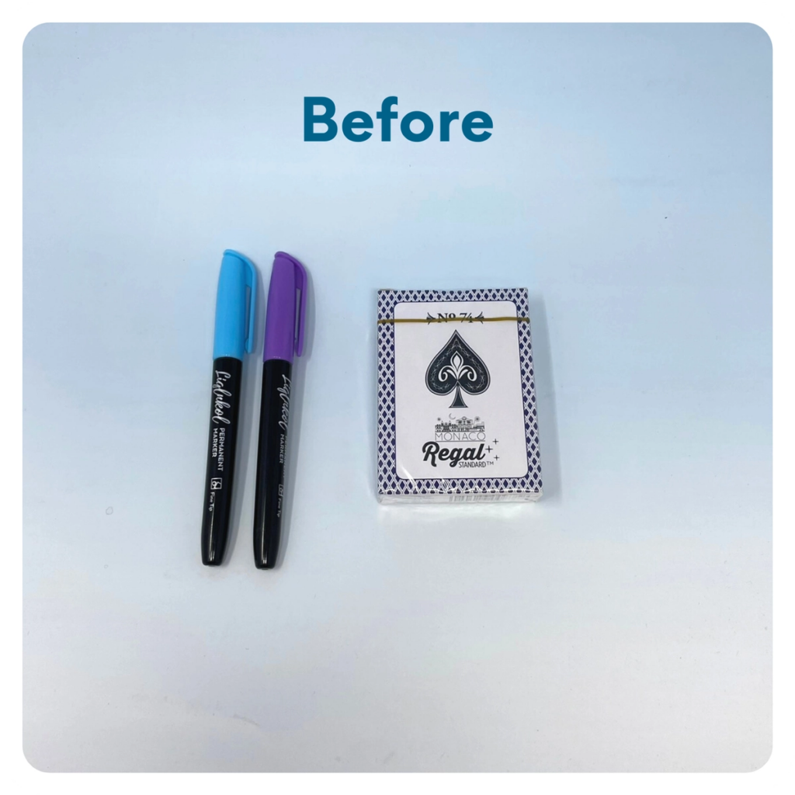
STEP 7 OF 12
Decorate the Playing Cards
Write encouraging messages, affirmations, jokes, or pictures on the faces of the playing cards for players to see when they are playing a card game.

Slide 12
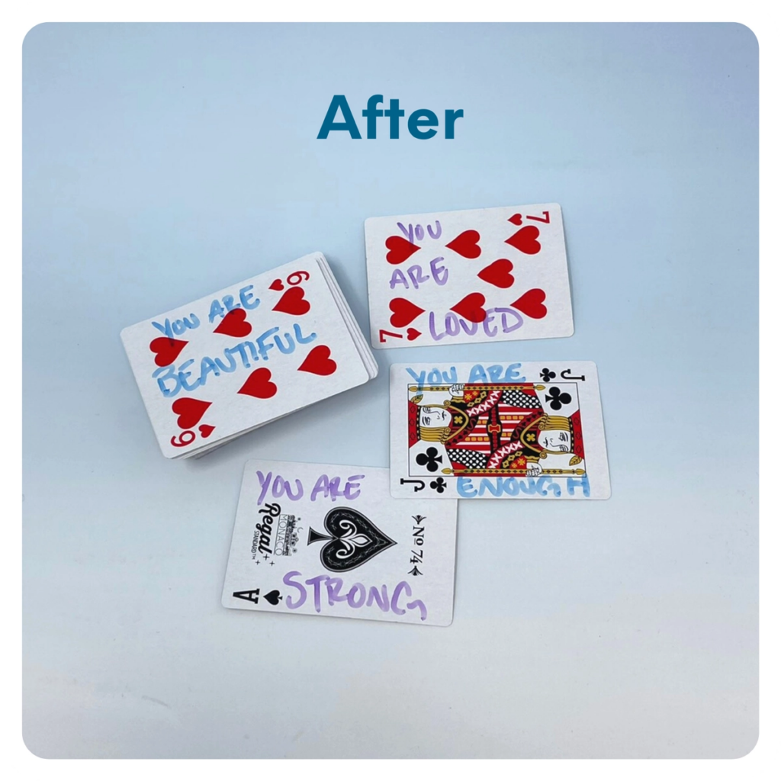
STEP 7 OF 12
Decorate the Playing Cards (continued)

Slide 13
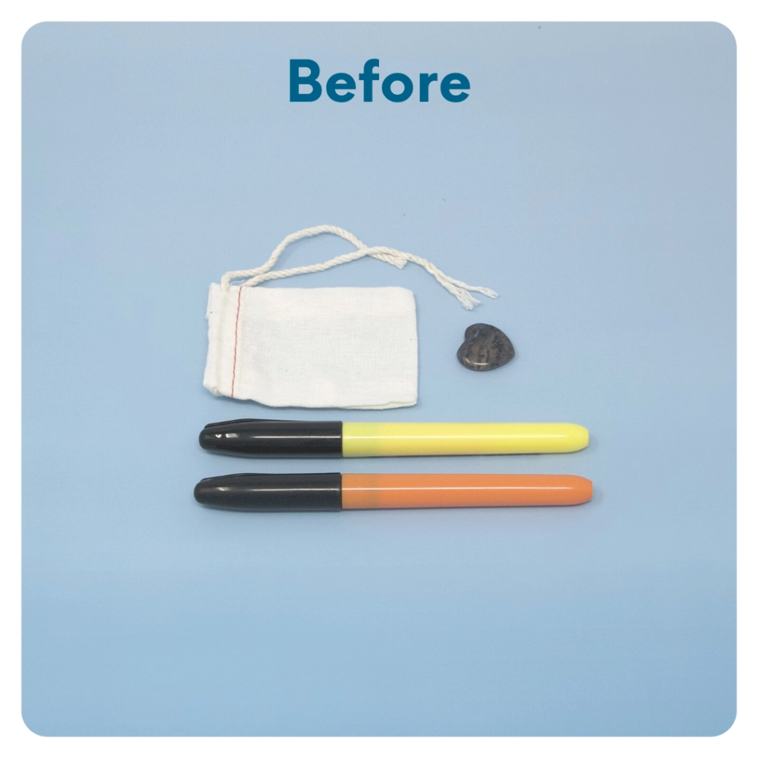
STEP 8 OF 12
Worry Stone
Worry stones are smooth, polished rocks used for relaxation or anxiety relief to help one feel grounded. The stone is meant to be kept in one’s pocket. The physical act of massaging a worry stone for several minutes is proven to provide therapeutic & psychological benefits that help soothe your nervous system, reduce stress and anxiety, and help clear your mind so you can focus and think clearly.
On one side of the drawstring bag write an inspirational or calming word. Examples: hope, love, grow, breathe, dream, courage, wonder.

Slide 14
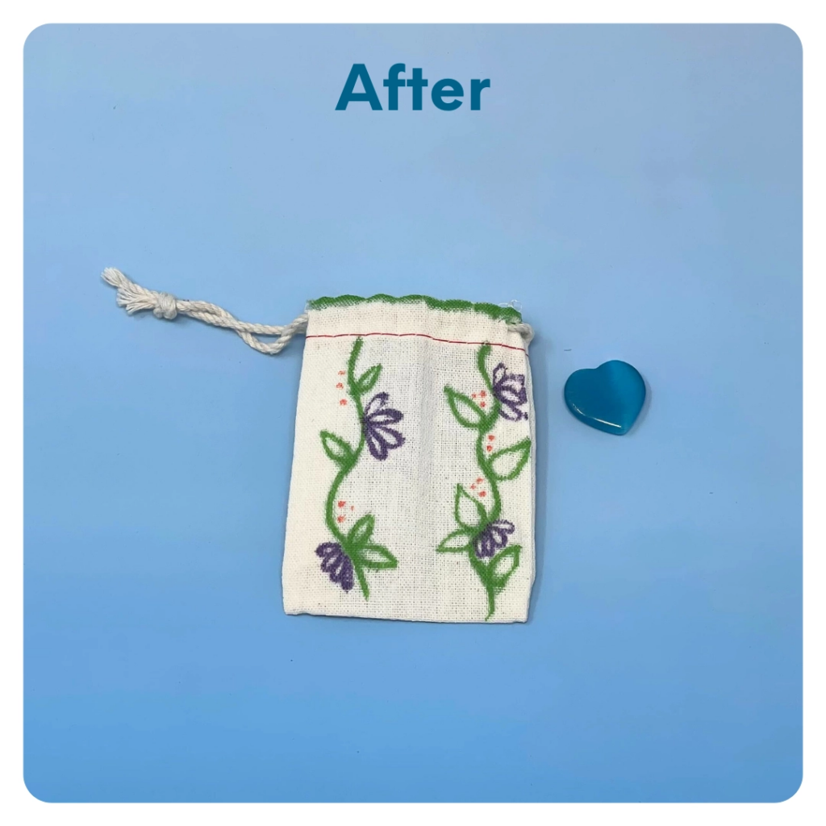
STEP 8 OF 12
Worry Stone (continued)
Tip: Place a piece of paper or cardboard in the bag before decorating to prevent the marker from bleeding through.

Slide 15

STEP 9 OF 12
Affirmation Notebook
DIY Affirmations
Find the mini affirmation notebook in your kit. Decorate the front cover with drawings, stickers, or a positive message. Then, open it up and write 3–6 affirmations inside—more if you'd like! These can be encouraging words, self-love reminders, or anything that lifts the spirit.
Do you still have affirmation cards in your kit? If your kit includes affirmation cards instead of a notebook, go ahead and write a special affirmation on each card.

Slide 16


STEP 9 OF 12
Affirmation Notebook (continued)

Slide 17
STEP 10 OF 12
Pack Cancer Comfort [Max]
Pack all of the materials into the decorated tote and put it back into the original box.
• Please only include items that are UNOPENED and UNUSED
• Add any optional items you would like.
Optional Items to Add:
• Games and activity books
• Stamps
• Snacks
• Craft and art supplies
• Self-care items
Items not to include:
• Perishable items
• Sharp objects
• Nut food products
• Religious or political items

Slide 18
STEP 11 OF 12
Register My Kit (Optional)
Register your kit. To register and track your kits, you must visit the online instructions. Registering your kit is optional.

Slide 19
STEP 12 OF 12
Thank You!
When you build a Kynd Kit, you create layers of impact for yourself and the community. We appreciate your time and your support of our mission.
Cheers,
The Project Helping team

