Slide 1

CLASSIC
Career Readiness [Classic]
13 STEPS

Slide 2

STEP 1 OF 13
About Project Helping
Kynd Kits are a program of Project Helping, a mental wellness nonprofit. Our mission is to make it ridiculously easy to volunteer because doing good is good for your mental wellness!
Learn More at ProjectHelping.org
When You Build a Kynd Kit - The Cycle of Impact

Slide 3

STEP 2 OF 13
Tips for Building Your Kit
Helpful Tip for Building Your Kynd Kit
• Avoid politics and religion entirely.
• Use appropriate humor.
• Can't think of what to write, draw a picture!
• Use words of affirmation!
• Place a piece of paper in any canvas bag before drawing on the outside. This way, the marker will not bleed through the other side of the bag.
• Please keep your designs gender-neutral, inclusive, and age-appropriate.
Spanish Translation Options

Slide 4
STEP 3 OF 13
Career Readiness [Classic]
Before You Build
About the Recipient
The Career Readiness kit was designed in partnership with Dress for Success. The mission of Dress for Success is to empower women to achieve economic independence by providing a network of support, professional attire, and the development tools to help women thrive in work and in life.

Slide 5
STEP 3 OF 13
Career Readiness [Classic] (continued)
Use the contents of this Kynd Kit to build a care package to help someone with resume preparation and interview readiness. This Kynd Kit will go to Dress for Success to help community members across the country during their search for a career. This can also go to a similar organization in your community!

Slide 6

STEP 4 OF 13
Decorate the Bag
Decorate the kraft bag(s). This is what the final kit is distributed in, so try to make this fun and colorful for the recipient to open.
Please note: we are currently transitioning from plastic ziplock bags to kraft bags. Some kits may still include the plastic bag for you to decorate while we complete this transition.

Slide 7



STEP 4 OF 13
Decorate the Bag (continued)

Slide 8

STEP 5 OF 13
Write a Note to the Recipient and Decorate the Envelope
Write a card and decorate the envelope using the enclosed materials. Express your encouragement and include a hopeful message.
Please ensure your message is age-appropriate and avoids references to religion or politics.

Slide 9

STEP 5 OF 13
Write a Note to the Recipient and Decorate the Envelope (continued)

Slide 10

STEP 6 OF 13
Surprise Kyndness Notebook
Decorate the outside of the journal with a picture or uplifting message. Use random pages in the journal to write short, uplifting messages, draw small, colorful images, or create fun writing prompts for the recipient.

Slide 11

STEP 6 OF 13
Surprise Kyndness Notebook (continued)

Slide 12
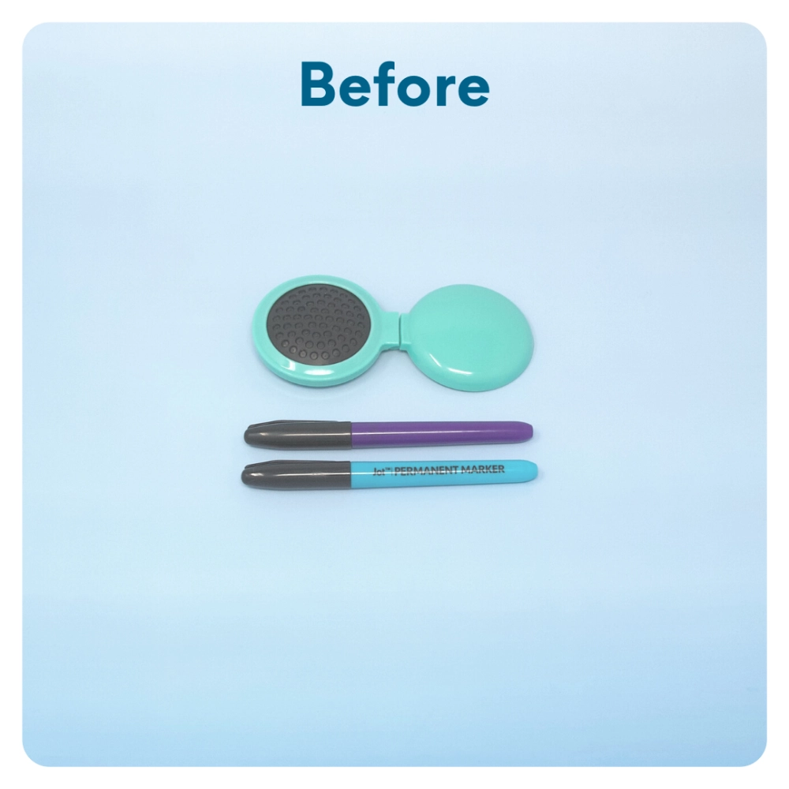
STEP 7 OF 13
Uplifting Self-Image
Decorate the comb or hairbrush with an uplifting message that the recipient will see each time they use it.

Slide 13
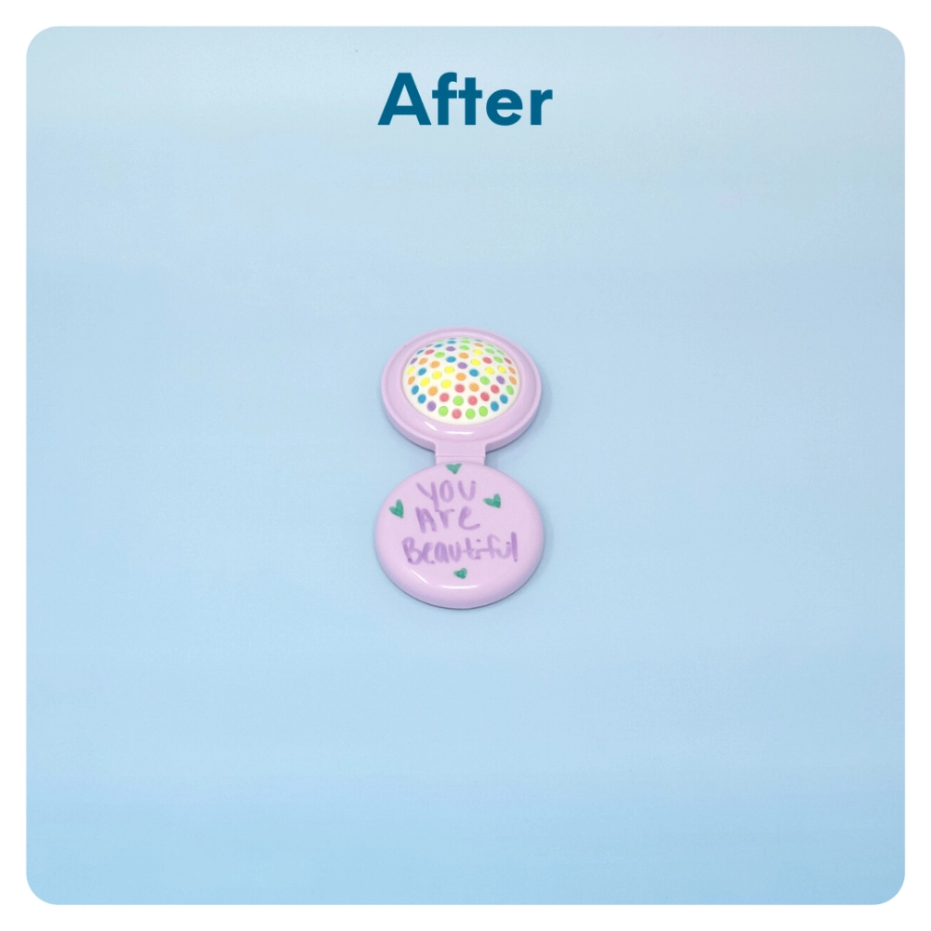
STEP 7 OF 13
Uplifting Self-Image (continued)

Slide 14
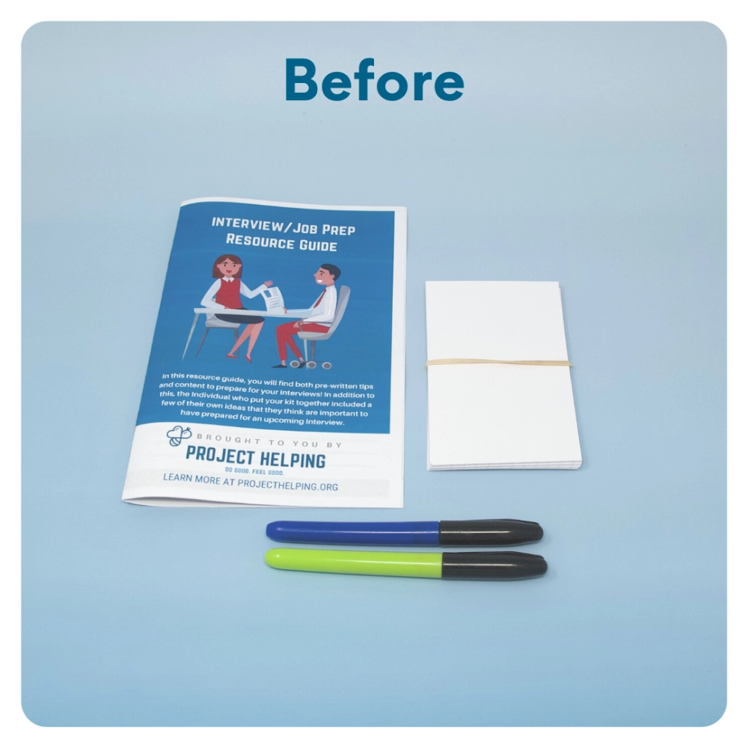
STEP 8 OF 13
Make Interview Prep Flashcards
Materials: Index Cards (3x5) FULL PACK
Write common interview questions on the front of the index cards. On the back of the cards, write common or suggested responses to these questions.

Slide 15
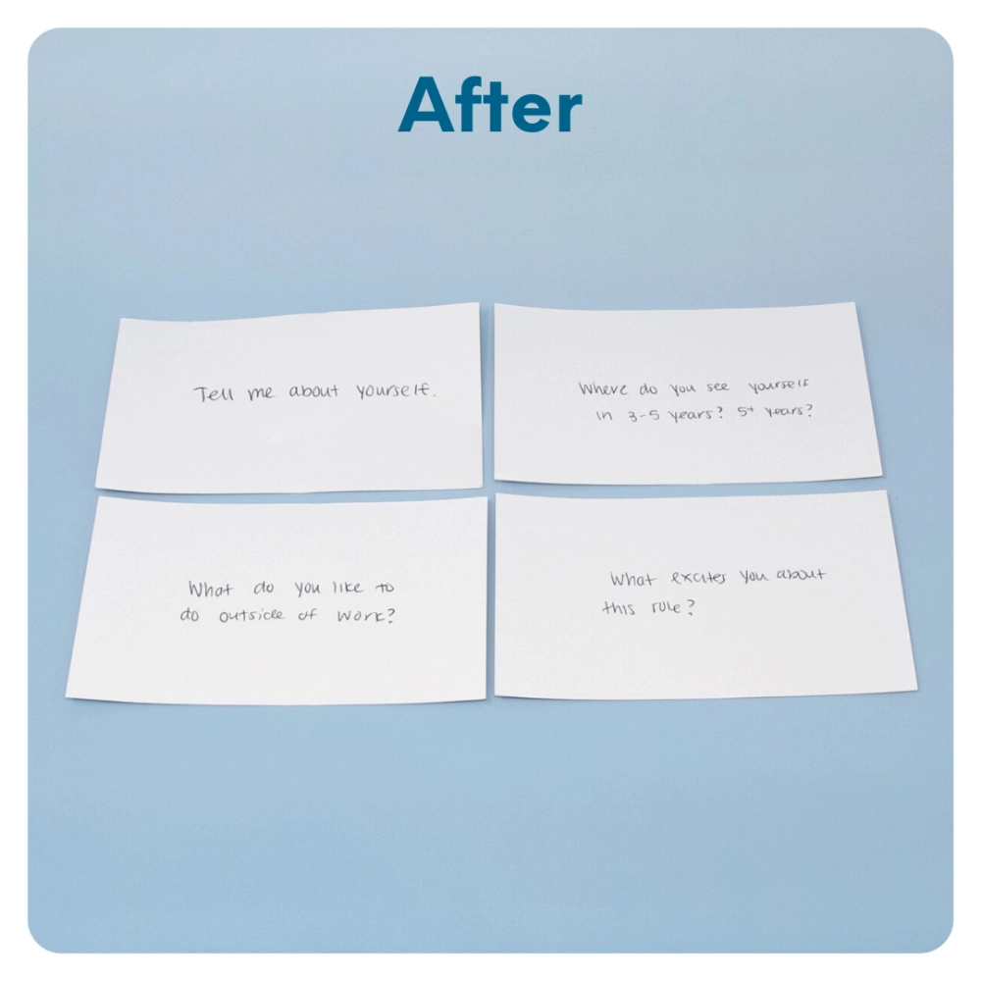
STEP 8 OF 13
Make Interview Prep Flashcards (continued)

Slide 16
STEP 9 OF 13
Interview Prep Workbook
Go through the workbook and add your answers and advice where you can.

Slide 17
STEP 10 OF 13
Optional Clothing Donation
Your completed Career Readiness Kits will be delivered to Dress for Success locations nationwide.
The mission of Dress for Success is to empower women to achieve economic independence by providing a network of support, professional attire, and the development tools to help women thrive in work and life.
You can add clothing donations to your kit when it is returned, and they will be delivered to Dress for Success along with your kit.
CLOTHING ACCEPTED
• Interview appropriate business suits and blouses
• Business separates, including skirts, dresses, blazers, slacks, and jackets

Slide 18
STEP 10 OF 13
Optional Clothing Donation (continued)
• Work appropriate shoes
• Jewelry, scarves, and belts
• Work-appropriate handbags, purses, briefcases or portfolios
CLOTHING NOT ACCEPTED
• Anything older than 5 years
• Clothes and shoes that are out of season
• Undergarments (we accept monetary donations to purchase these items)
• Casual clothing (t-shirts, shorts, capris, denim, pajamas, workout attire, etc.)
• Items that are worn out, dirty, or need repair

Slide 19
STEP 11 OF 13
Pack Career Readiness Kit
Pack all the materials into the decorated plastic bag and put it back into the original box.
• Please only include items that are UNOPENED and UNUSED
Optional Items to Add:
• Interview clothing
Items not to include:
• Perishable items

Slide 20
STEP 12 OF 13
Register My Kit (Optional)
Register your kit. To register and track your kits, you must visit the online instructions. Registering your kit is optional.

Slide 21
STEP 13 OF 13
Thank You!
When you build a Kynd Kit, you create layers of impact for yourself and the community. We appreciate your time and your support of our mission.
Cheers,
The Project Helping team

