Slide 1

CLASSIC
Chemo Care [Classic]
12 STEPS

Slide 2

STEP 1 OF 12
About Project Helping
Kynd Kits are a program of Project Helping, a mental wellness nonprofit. Our mission is to make it ridiculously easy to volunteer because doing good is good for your mental wellness!
Learn More at ProjectHelping.org
When You Build a Kynd Kit - The Cycle of Impact

Slide 3

STEP 2 OF 12
Tips for Building Your Kit
Helpful Tip for Building Your Kynd Kit
• Avoid politics and religion entirely.
• Use appropriate humor.
• Can't think of what to write, draw a picture!
• Use words of affirmation!
• Place a piece of paper in any canvas bag before drawing on the outside. This way, the marker will not bleed through the other side of the bag.
• Please keep your designs gender-neutral, inclusive, and age-appropriate.
Spanish Translation Options

Slide 4
STEP 3 OF 12
Chemo Care [Classic]
Before You Build
About the Recipient
We have included a list of items in your chemo care kits that could help a patient before, during, and after treatment based on the unexpected side effects from the treatment. Because different people react differently to treatments, we have provided a variety of items that a loved one might need and want during treatments.

Slide 5
STEP 3 OF 12
Chemo Care [Classic] (continued)
“What can I do to help?” Cancer caregivers – family and friends of cancer patients – want to provide meaningful support but often times are at a loss for what to say or do. In fact, there are a lot of different things you can do to help your loved one through chemotherapy or “chemo” and other treatments.

Slide 6

STEP 4 OF 12
Decorate the Bag
Decorate the kraft bag(s). This is what the final kit is distributed in, so try to make this fun and colorful for the recipient to open.
Please note: we are currently transitioning from plastic ziplock bags to kraft bags. Some kits may still include the plastic bag for you to decorate while we complete this transition.

Slide 7



STEP 4 OF 12
Decorate the Bag (continued)

Slide 8

STEP 5 OF 12
Write a Note to the Recipient and Decorate the Envelope
Write a card and decorate the envelope using the enclosed materials. Express your encouragement and include a hopeful message.
Please ensure your message is age-appropriate and avoids references to religion or politics.

Slide 9

STEP 5 OF 12
Write a Note to the Recipient and Decorate the Envelope (continued)

Slide 10

STEP 6 OF 12
Surprise Kyndness Notebook
Decorate the outside of the journal with a picture or uplifting message. Use random pages in the journal to write short, uplifting messages, draw small, colorful images, or create fun writing prompts for the recipient.

Slide 11

STEP 6 OF 12
Surprise Kyndness Notebook (continued)

Slide 12
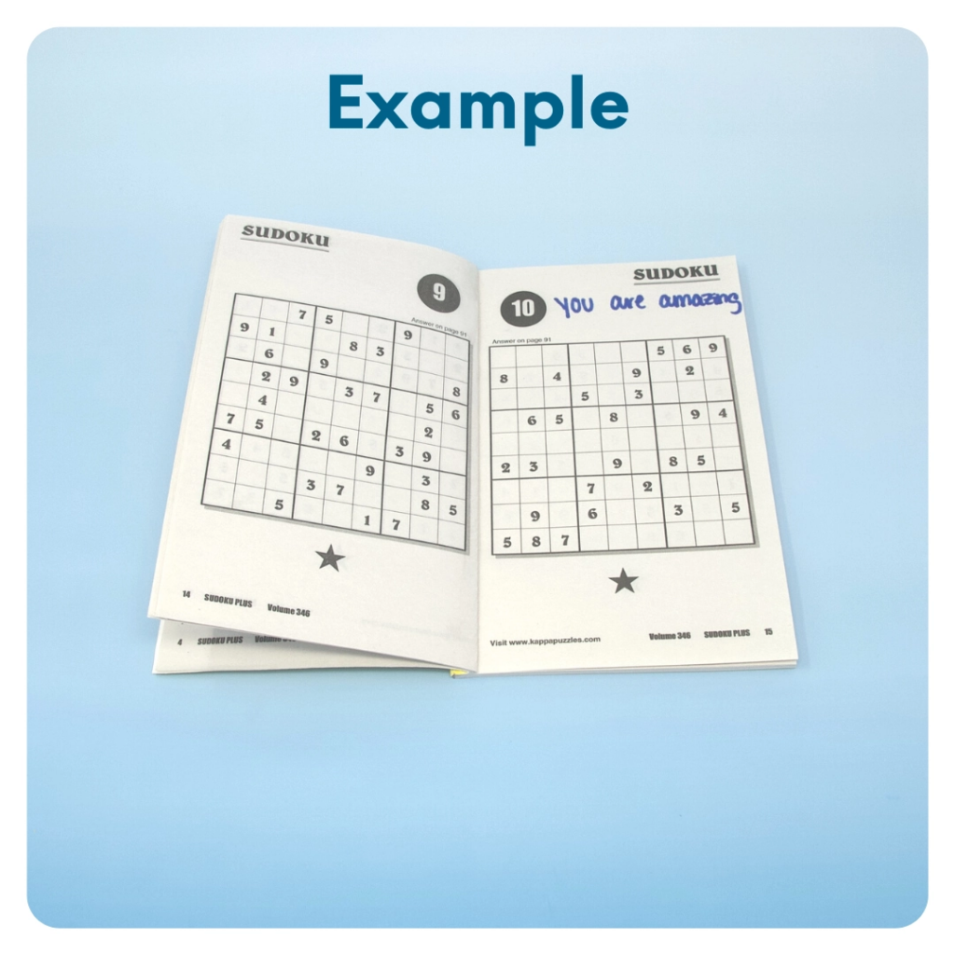
STEP 7 OF 12
Surprise Kyndness Puzzle Book
Go through the pages of the Sudoku or puzzle book and write uplifting messages, draw small, colorful images, or create fun writing prompts for the recipient.

Slide 13
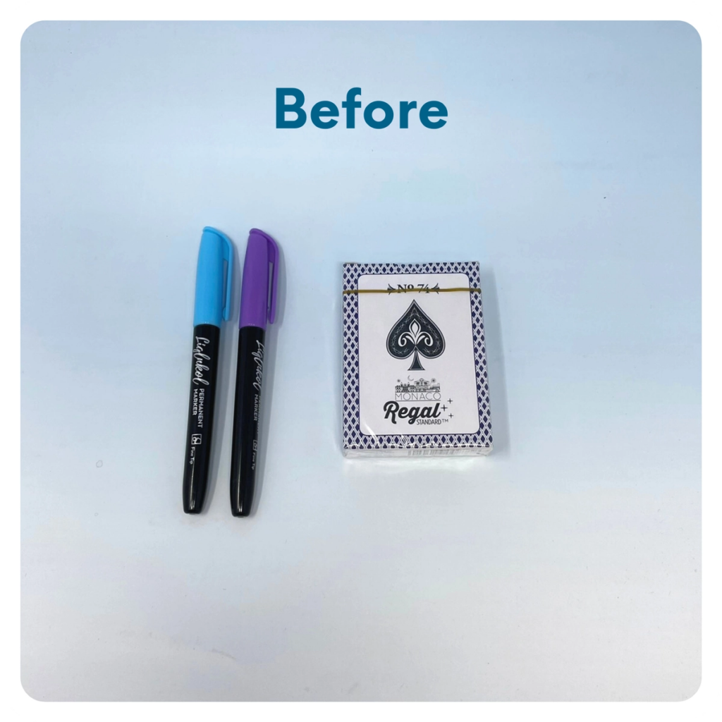
STEP 8 OF 12
Decorate the Playing Cards
Write encouraging messages, affirmations, jokes, or pictures on the faces of the playing cards for players to see when they are playing a card game.

Slide 14
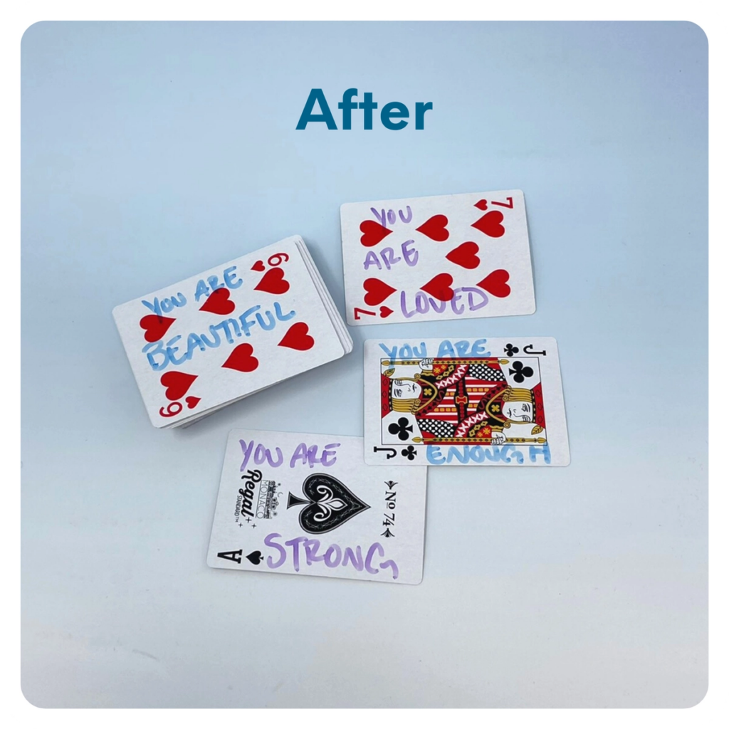
STEP 8 OF 12
Decorate the Playing Cards (continued)

Slide 15
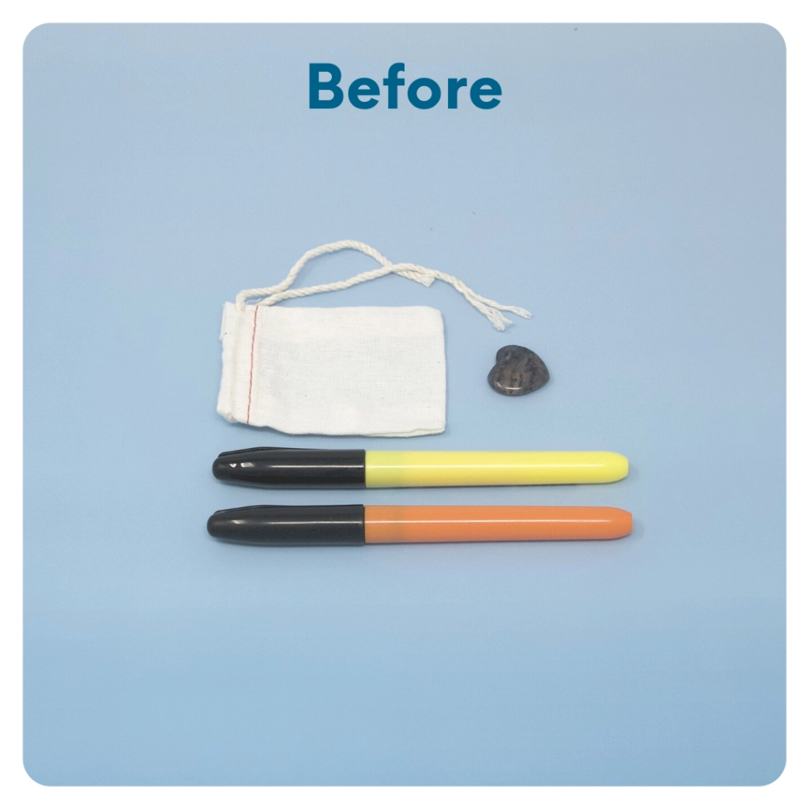
STEP 9 OF 12
Worry Stone
Worry stones are smooth, polished rocks used for relaxation or anxiety relief to help one feel grounded. The stone is meant to be kept in one’s pocket. The physical act of massaging a worry stone for several minutes is proven to provide therapeutic & psychological benefits that help soothe your nervous system, reduce stress and anxiety, and help clear your mind so you can focus and think clearly.
On one side of the drawstring bag write an inspirational or calming word. Examples: hope, love, grow, breathe, dream, courage, wonder.

Slide 16
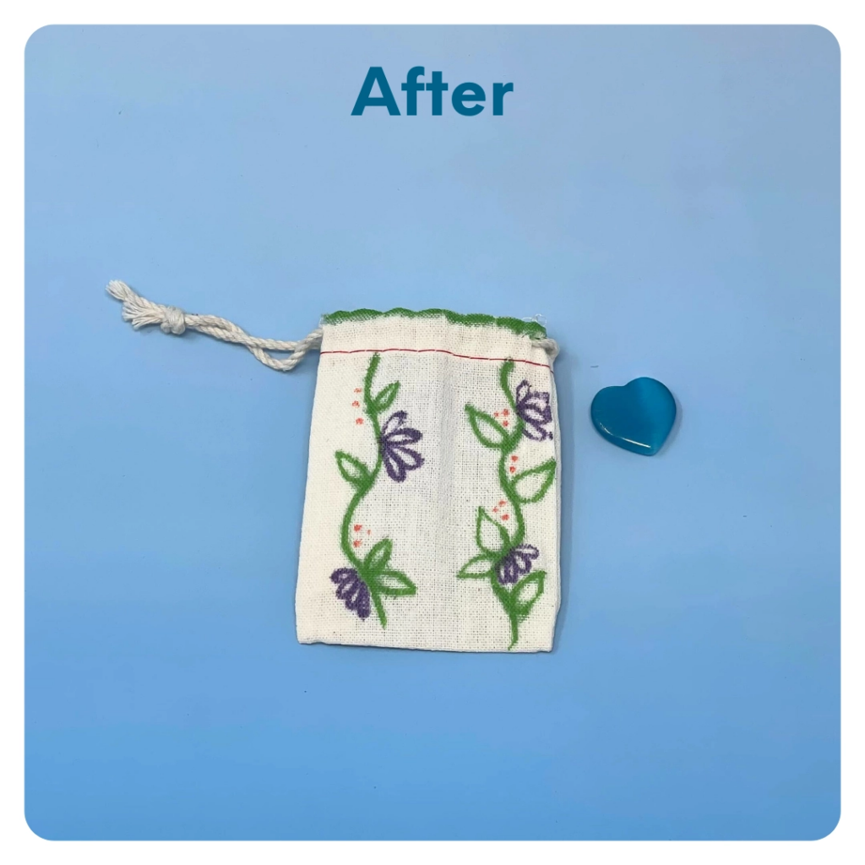
STEP 9 OF 12
Worry Stone (continued)
Tip: Place a piece of paper or cardboard in the bag before decorating to prevent the marker from bleeding through.

Slide 17
STEP 10 OF 12
Pack the Chemo Care Kit
Pack all of the materials into the decorated plastic bag and put it back into the original box.
• Please only include items that are UNOPENED and UNUSED
• Add any optional items you would like.
Optional Items to Add:
• High protein snacks
• Gum/mints
• Self-care items
Items not to include:
• Perishable items
• Sharp objects
• Nut food products
• Religious or political items

Slide 18
STEP 11 OF 12
Register My Kit (Optional)
Register your kit. To register and track your kits, you must visit the online instructions. Registering your kit is optional.

Slide 19
STEP 12 OF 12
Thank You!
When you build a Kynd Kit, you create layers of impact for yourself and the community. We appreciate your time and your support of our mission.
Cheers,
The Project Helping team

