Slide 1

CLASSIC
Childhood Chemo Care [Classic]
11 STEPS

Slide 2

STEP 1 OF 11
About Project Helping
Kynd Kits are a program of Project Helping, a mental wellness nonprofit. Our mission is to make it ridiculously easy to volunteer because doing good is good for your mental wellness!
Learn More at ProjectHelping.org
When You Build a Kynd Kit - The Cycle of Impact

Slide 3

STEP 2 OF 11
Tips for Building Your Kit
Helpful Tip for Building Your Kynd Kit
• Avoid politics and religion entirely.
• Use appropriate humor.
• Can't think of what to write, draw a picture!
• Use words of affirmation!
• Place a piece of paper in any canvas bag before drawing on the outside. This way, the marker will not bleed through the other side of the bag.
• Please keep your designs gender-neutral, inclusive, and age-appropriate.
Spanish Translation Options

Slide 4
STEP 3 OF 11
Childhood Chemo Care [Classic]
Before You Build
About the Recipient
This Kynd Kit was designed to bring comfort and encouragement to a child undergoing chemotherapy. Each item you decorate will support a young patient during long treatment days, helping them feel seen, supported and a little more like a kid. As you build, imagine the joy and relief your care will bring - whether its a playful distraction or a heartfelt note. Your time and intention will make a meaningful difference.

Slide 5
STEP 4 OF 11
Example Phrases To Use
Before You Build
These kits will be shared with families and individuals facing difficult or uncertain times in the hospital. Your thoughtful, kind words can make a difficult day a little brighter—thank you for helping spread care and compassion.
DO
• Be positive: Focus on hope, comfort, and inner strength.
• Use affirming and uplifting words: Offer gentle encouragement and warmth.
• Keep it simple and sincere: Short, heartfelt messages are best.
• Use inclusive language: Avoid assumptions, as well as political, religious, or gendered terms.

Slide 6
STEP 4 OF 11
Example Phrases To Use (continued)
• Keep the tone gentle and compassionate: Avoid intensity or emotional pressure.
AVOID
• Mentioning illness, diagnosis, or recovery (e.g., “hope you heal soon”).
• Giving advice, instructions, or making assumptions about feelings.
• Using humor, sarcasm, or quotes from public figures.
• Including personal information or full names.
• Using timelines or future outcomes (e.g., “You’ll be home soon,” “Things will get better soon”).
SAMPLE NOTES “You are surrounded by care and kindness.” “Wishing you calm, strength, and comfort today.” “You are not alone—there are people thinking of you.” “May this note remind you that you’re cared for and supported.”

Slide 7
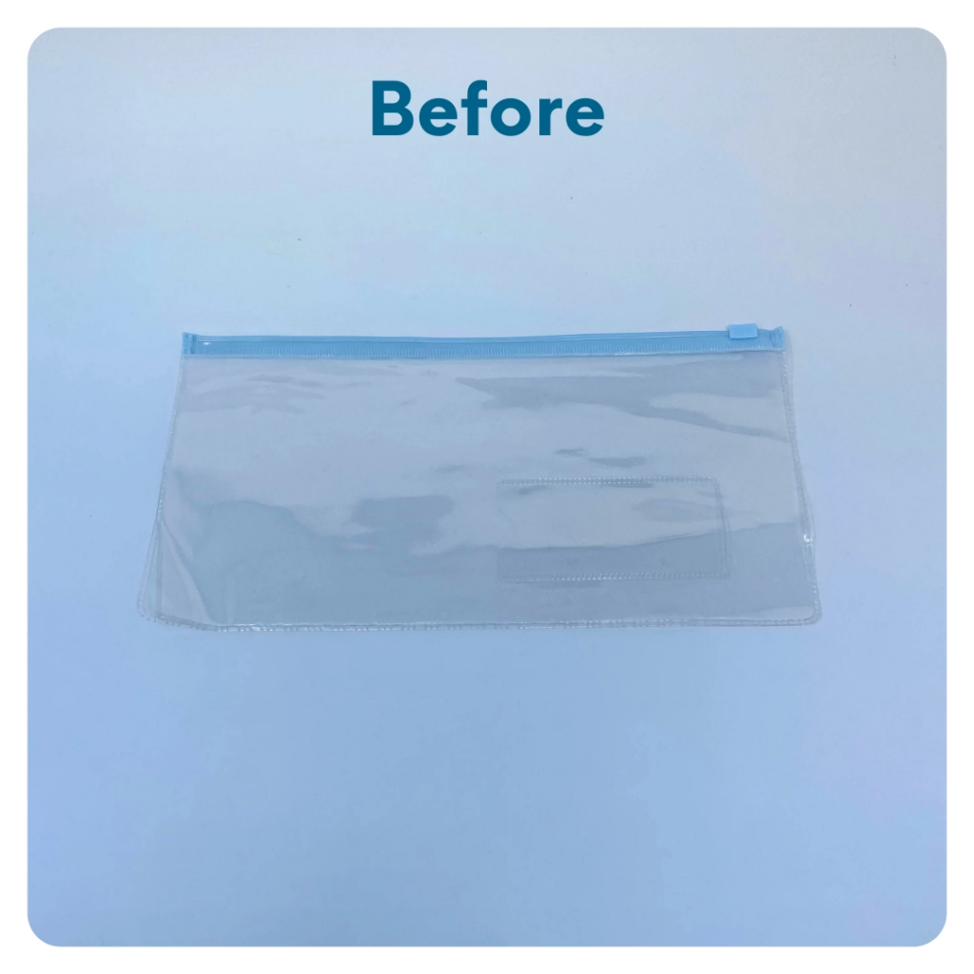
STEP 5 OF 11
Decorate the Clear Zipper Pouch
Use the permanent markers to decorate the plastic pouch. Tip: Be creative and use other supplies (no glitter) you may have on hand to make it colorful.

Slide 8
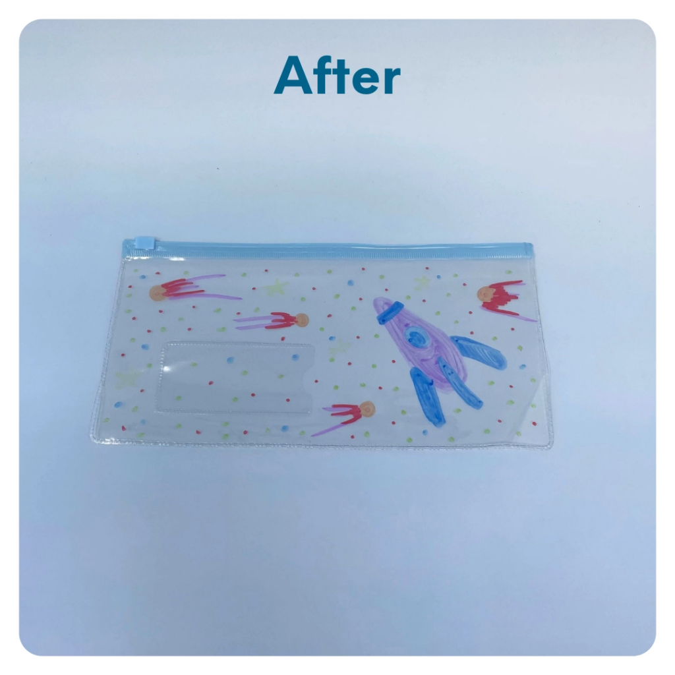
STEP 5 OF 11
Decorate the Clear Zipper Pouch (continued)

Slide 9

STEP 6 OF 11
Write a Note to the Recipient and Decorate the Envelope
Write a card and decorate the envelope using the enclosed materials. Express your encouragement and include a hopeful message.
Please ensure your message is age-appropriate and avoids references to religion or politics.

Slide 10

STEP 6 OF 11
Write a Note to the Recipient and Decorate the Envelope (continued)

Slide 11
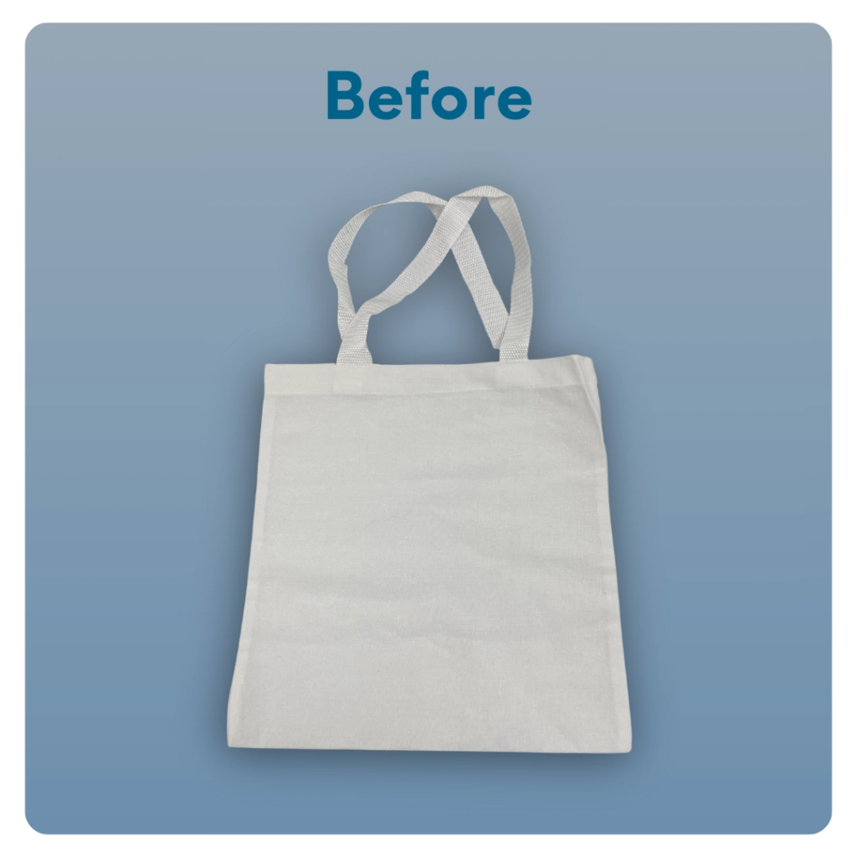
STEP 7 OF 11
Decorate The Small Canvas Tote
Decorate the canvas tote to make it fun and colorful! Tip: place a piece of paper in the tote before decorating. This will prevent the marker from bleeding through the tote.

Slide 12
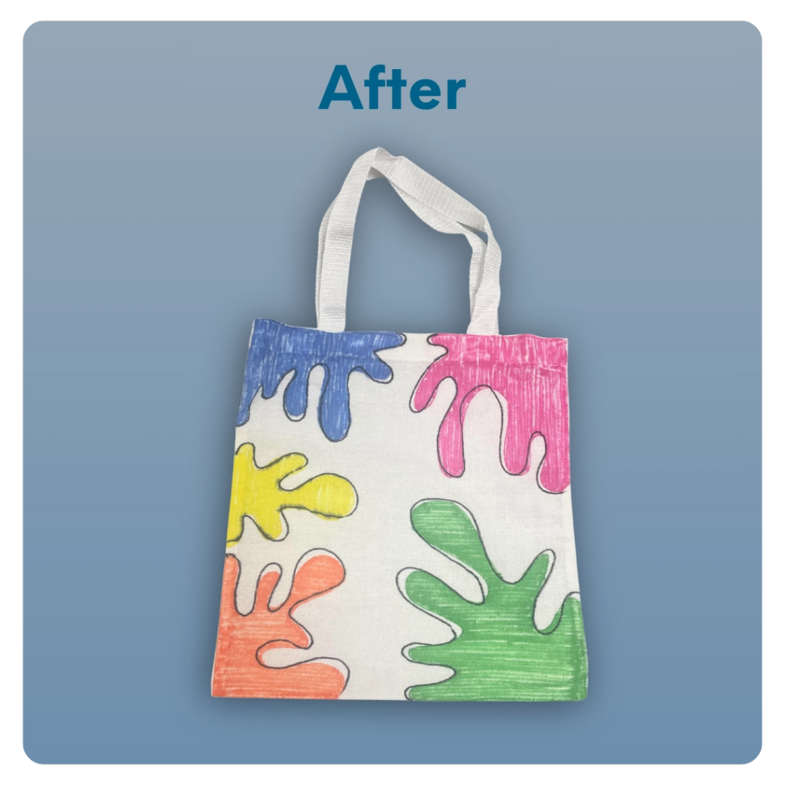
STEP 7 OF 11
Decorate The Small Canvas Tote (continued)

Slide 13
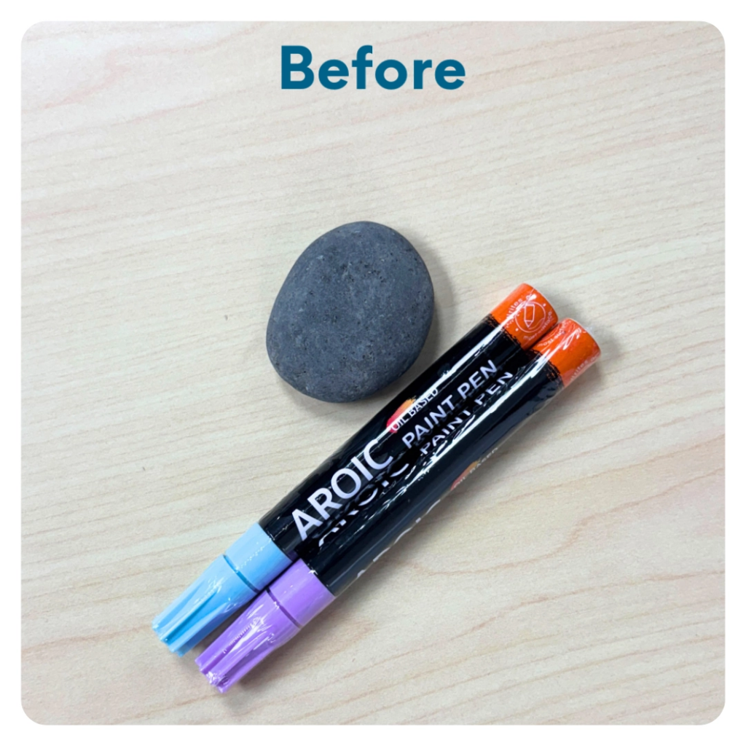
STEP 8 OF 11
Kyndness Rock
Use the paint pens to decorate your river rock with an uplifting message or design. Share it with someone who could use a smile, or leave it in a public place as a surprise reminder that kyndness is all around.

Slide 14
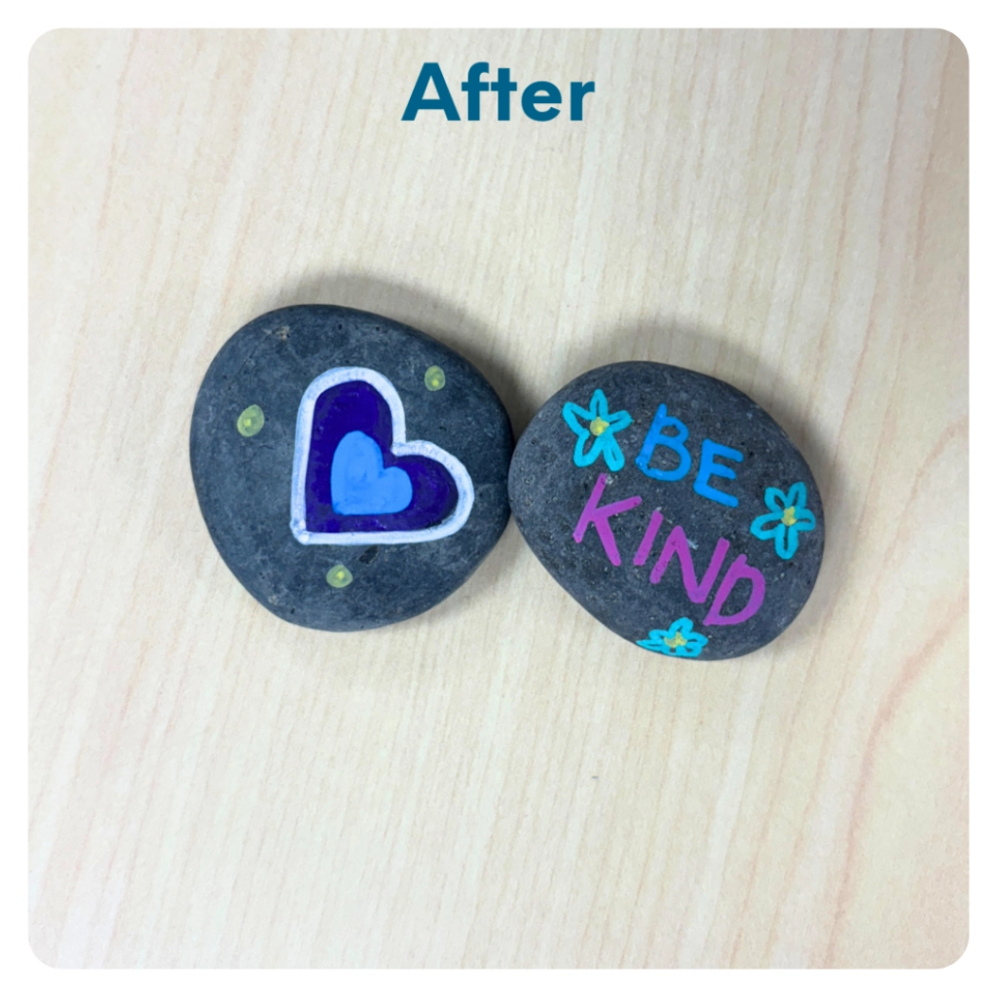
STEP 8 OF 11
Kyndness Rock (continued)

Slide 15
STEP 9 OF 11
Pack the Childhood Chemo Care Kit
Pack all of the kit materials into the decorated tote bag and add back into the box.
Optional Items to Add:
• High protein snacks
• Gum/mints
• Self-care items
Do not include:
• Perishable items
• Sharp objects
• Nut products
• Religious or political items

Slide 16
STEP 10 OF 11
Register My Kit (Optional)
Register your kit. To register and track your kits, you must visit the online instructions. Registering your kit is optional.

Slide 17
STEP 11 OF 11
Thank You!
When you build a Kynd Kit, you create layers of impact for yourself and the community. We appreciate your time and your support of our mission.
Cheers,
The Project Helping team

