Slide 1

PLUS
Children’s Hospital Activity Bag [Plus]
13 STEPS

Slide 2

STEP 1 OF 13
About Project Helping
Kynd Kits are a program of Project Helping, a mental wellness nonprofit. Our mission is to make it ridiculously easy to volunteer because doing good is good for your mental wellness!
Learn More at ProjectHelping.org
When You Build a Kynd Kit - The Cycle of Impact

Slide 3

STEP 2 OF 13
Tips for Building Your Kit
Helpful Tip for Building Your Kynd Kit
• Avoid politics and religion entirely.
• Use appropriate humor.
• Can't think of what to write, draw a picture!
• Use words of affirmation!
• Place a piece of paper in any canvas bag before drawing on the outside. This way, the marker will not bleed through the other side of the bag.
• Please keep your designs gender-neutral, inclusive, and age-appropriate.
Spanish Translation Options

Slide 4
STEP 3 OF 13
Children's Hospital Activity Bag [+]
Before You Build
Each year in the U.S. there are an estimated 15,780 children between the ages of birth and 19 years of age who are diagnosed with cancer. Approximately 1 in 285 children in the U.S. will be diagnosed with cancer before their 20th birthday and globally there are more than 300,000 children diagnosed with cancer each year.
The children and their families spend a great deal of time waiting for treatment, tests, and procedures. These bags help them pass the time while in the waiting room or hospital room.

Slide 5
STEP 4 OF 13
Example Phrases To Use
Before You Build
These kits will be shared with families and individuals facing difficult or uncertain times in the hospital. Your thoughtful, kind words can make a difficult day a little brighter—thank you for helping spread care and compassion.
DO
• Be positive: Focus on hope, comfort, and inner strength.
• Use affirming and uplifting words: Offer gentle encouragement and warmth.
• Keep it simple and sincere: Short, heartfelt messages are best.
• Use inclusive language: Avoid assumptions, as well as political, religious, or gendered terms.

Slide 6
STEP 4 OF 13
Example Phrases To Use (continued)
• Keep the tone gentle and compassionate: Avoid intensity or emotional pressure.
AVOID
• Mentioning illness, diagnosis, or recovery (e.g., “hope you heal soon”).
• Giving advice, instructions, or making assumptions about feelings.
• Using humor, sarcasm, or quotes from public figures.
• Including personal information or full names.
• Using timelines or future outcomes (e.g., “You’ll be home soon,” “Things will get better soon”).
SAMPLE NOTES “You are surrounded by care and kindness.” “Wishing you calm, strength, and comfort today.” “You are not alone—there are people thinking of you.” “May this note remind you that you’re cared for and supported.”

Slide 7

STEP 5 OF 13
Write a Note to the Recipient and Decorate the Envelope
Write a card and decorate the envelope using the enclosed materials. Express your encouragement and include a hopeful message.
Please ensure your message is age-appropriate and avoids references to religion or politics.

Slide 8

STEP 5 OF 13
Write a Note to the Recipient and Decorate the Envelope (continued)

Slide 9
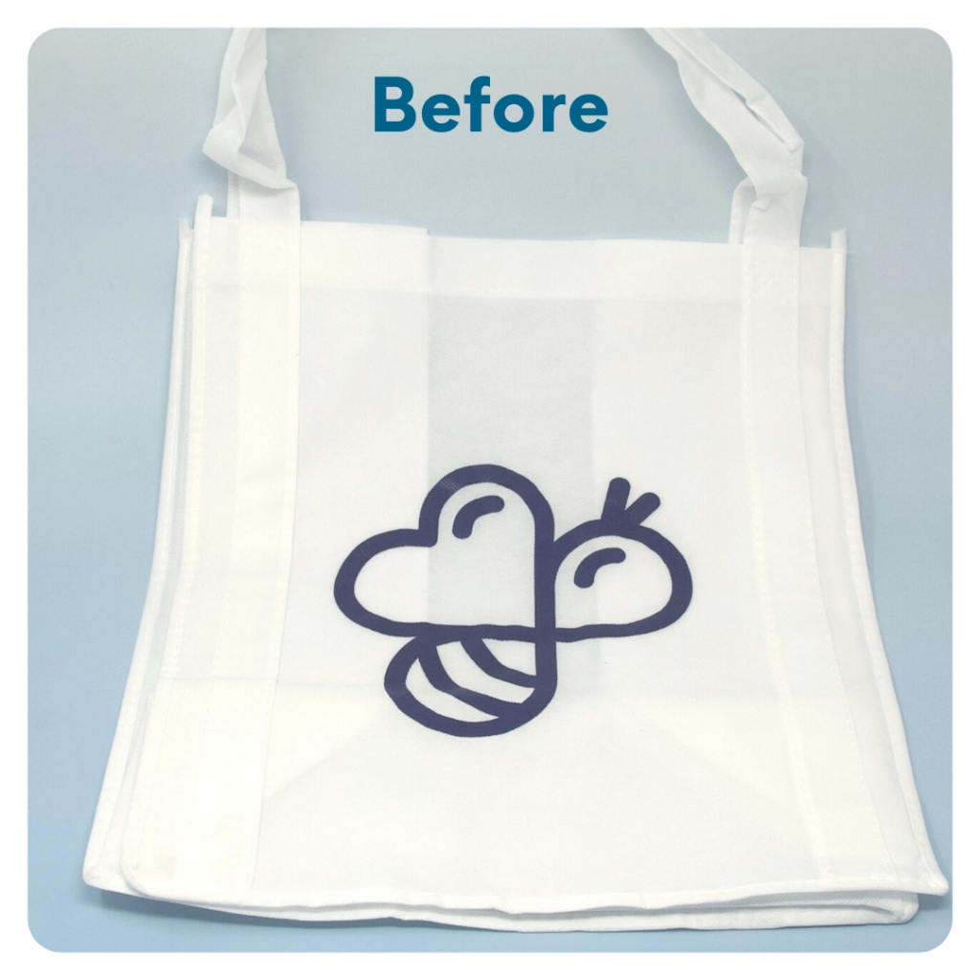
STEP 6 OF 13
DIY Tote Bag
Decorate the Canvas Tote
Decorate the canvas tote to make it fun and colorful! Tip: place a piece of paper in the tote before decorating. This will prevent the marker from bleeding through the tote.

Slide 10

STEP 6 OF 13
DIY Tote Bag (continued)

Slide 11
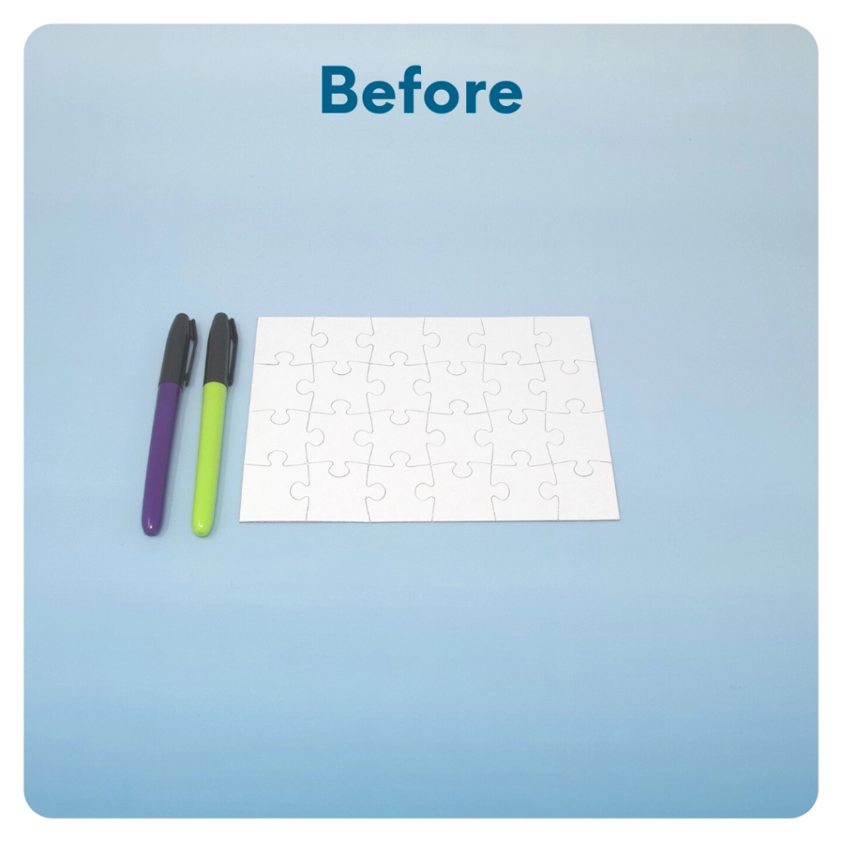
STEP 7 OF 13
DIY Jigsaw Puzzle
Start with the puzzle assembled. Decorate the whole puzzle, filling it with color or messaging from edge to edge. The small sorting envelope will hold the pieces of the completed puzzle. Decorate one side of the envelope with the same image or wording as the puzzle. Take the puzzle apart and put it in the envelope.

Slide 12
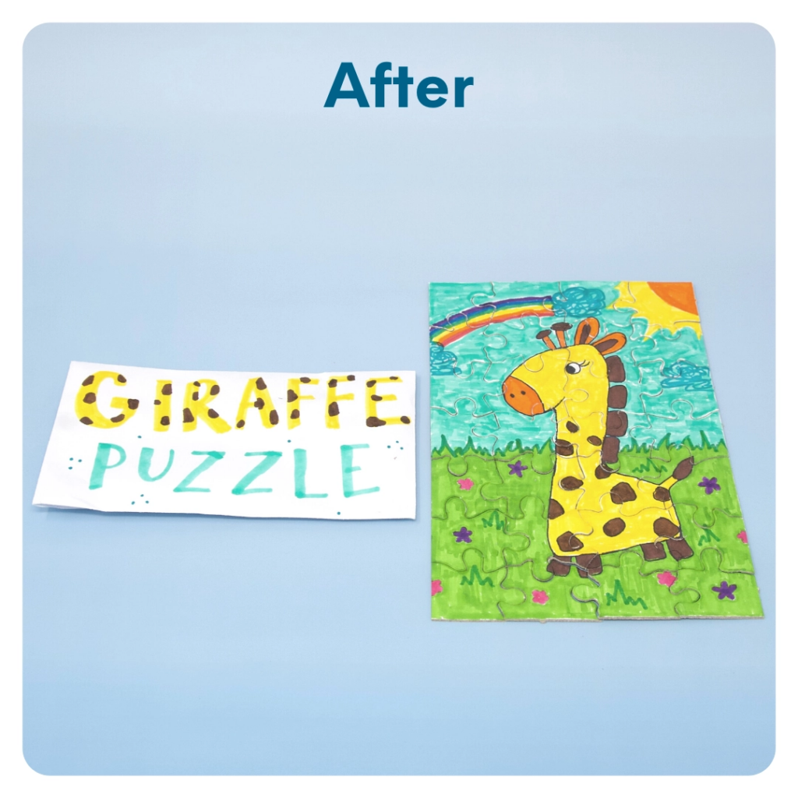
STEP 7 OF 13
DIY Jigsaw Puzzle (continued)

Slide 13
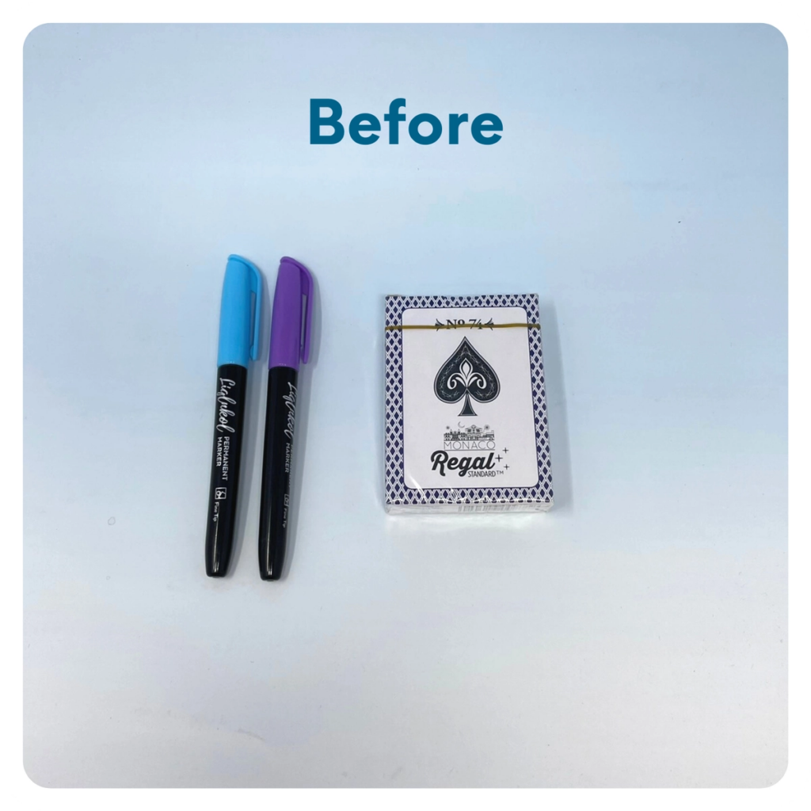
STEP 8 OF 13
Decorate the Playing Cards
Write encouraging messages, affirmations, jokes, or pictures on the faces of the playing cards for players to see when they are playing a card game.

Slide 14
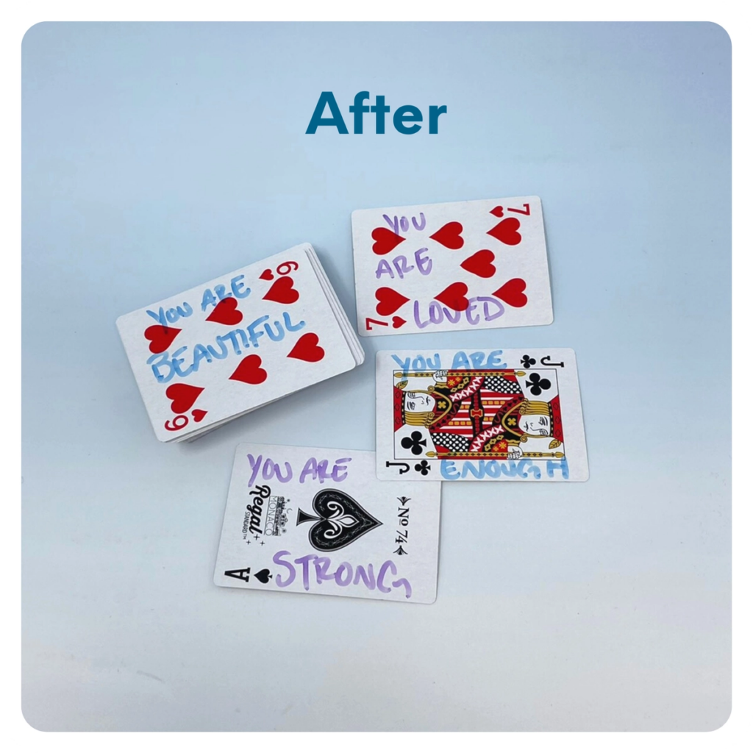
STEP 8 OF 13
Decorate the Playing Cards (continued)

Slide 15
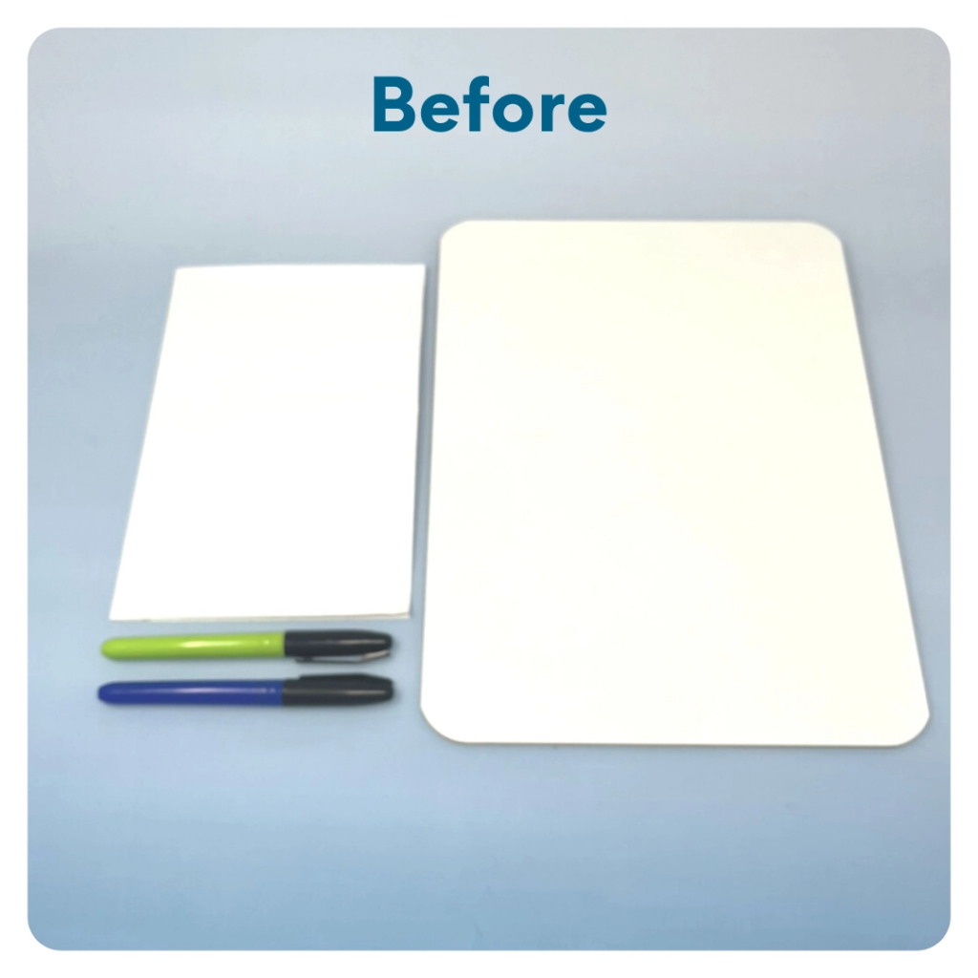
STEP 9 OF 13
Mini White Board
Stick the white 5 x 8 stickers to the back of the whiteboard. Use the crayons, colored pencils, or other writing materials to decorate the stickers with an uplifting message or picture for the recipient to see while using the board.

Slide 16
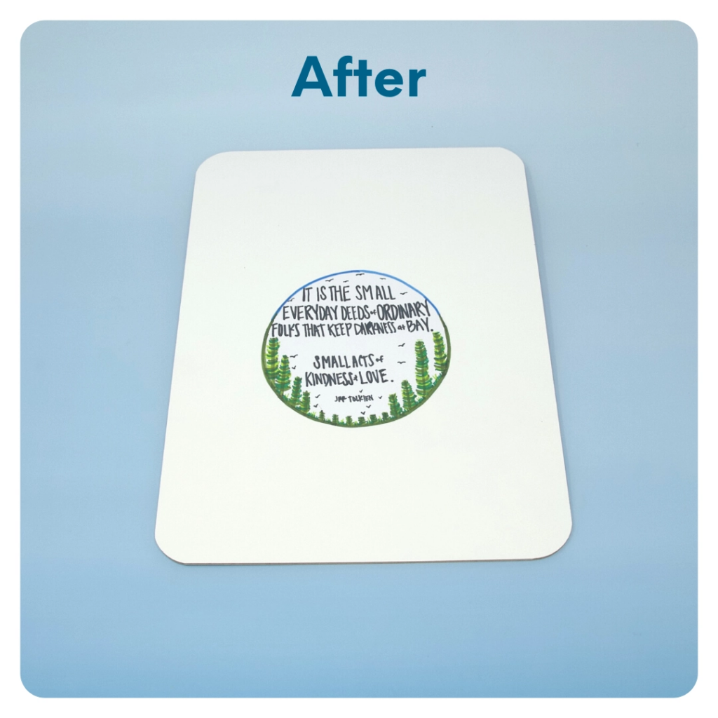
STEP 9 OF 13
Mini White Board (continued)

Slide 17

STEP 10 OF 13
Decorate the Canvas Bag
Use the permanent markers to decorate the canvas bag.
Tip: Place a piece of paper in the bag before decorating to prevent the markers from bleeding through.

Slide 18

STEP 10 OF 13
Decorate the Canvas Bag (continued)

Slide 19
STEP 11 OF 13
Pack Children's Hospital Activity Bag [Plus]
Pack all of the materials into the decorated tote bag and put them into the original box.
• Please only include items that are UNOPENED and UNUSED
• Add any optional items you would like.
Optional Items to Add:
• Fidget toys
• Card games
• DVDs
• Activity books
• Coloring utensils
• Craft supplies
Items not to include:
• Perishable items
• Sharp objects
• Nut food products
• Religious or political items

Slide 20
STEP 12 OF 13
Register My Kit (Optional)
Register your kit. To register and track your kits, you must visit the online instructions. Registering your kit is optional.

Slide 21
STEP 13 OF 13
Thank You!
When you build a Kynd Kit, you create layers of impact for yourself and the community. We appreciate your time and your support of our mission.
Cheers,
The Project Helping team

