Slide 1

PLUS
Children’s Hospital Colorado Parent Support [Plus]
12 STEPS

Slide 2

STEP 1 OF 12
About Project Helping
Kynd Kits are a program of Project Helping, a mental wellness nonprofit. Our mission is to make it ridiculously easy to volunteer because doing good is good for your mental wellness!
Learn More at ProjectHelping.org
When You Build a Kynd Kit - The Cycle of Impact

Slide 3

STEP 2 OF 12
Tips for Building Your Kit
Helpful Tip for Building Your Kynd Kit
• Avoid politics and religion entirely.
• Use appropriate humor.
• Can't think of what to write, draw a picture!
• Use words of affirmation!
• Place a piece of paper in any canvas bag before drawing on the outside. This way, the marker will not bleed through the other side of the bag.
• Please keep your designs gender-neutral, inclusive, and age-appropriate.
Spanish Translation Options

Slide 4
STEP 3 OF 12
Children's Hospital Colorado Parent Support [+]
Before You Build
Created in partnership with Children’s Hospital Colorado’s Pediatric Mental Health Institute, this kit is designed to support parents while their child is receiving care for a mental health concern. Parents and caregivers often experience high levels of stress, uncertainty, and isolation during this time.

Slide 5
STEP 3 OF 12
Children's Hospital Colorado Parent Support [+] (continued)
According to the CDC, 1 in 5 children experiences a mental health disorder in a given year, and hospitalizations for youth mental health needs have risen sharply in the past decade. While treatment focuses on helping children heal, it’s equally important to provide comfort and encouragement to the adults standing beside them.
As you assemble this kit, take a moment to reflect on the strength and resilience of parents navigating this journey. Your time and care help them feel seen, supported, and not alone.

Slide 6
STEP 4 OF 12
Example Phrases To Use
Before You Build
These kits will be shared with families and individuals facing difficult or uncertain times in the hospital. Your thoughtful, kind words can make a difficult day a little brighter—thank you for helping spread care and compassion.
DO
• Be positive: Focus on hope, comfort, and inner strength.
• Use affirming and uplifting words: Offer gentle encouragement and warmth.
• Keep it simple and sincere: Short, heartfelt messages are best.
• Use inclusive language: Avoid assumptions, as well as political, religious, or gendered terms.

Slide 7
STEP 4 OF 12
Example Phrases To Use (continued)
• Keep the tone gentle and compassionate: Avoid intensity or emotional pressure.
AVOID
• Mentioning illness, diagnosis, or recovery (e.g., “hope you heal soon”).
• Giving advice, instructions, or making assumptions about feelings.
• Using humor, sarcasm, or quotes from public figures.
• Including personal information or full names.
• Using timelines or future outcomes (e.g., “You’ll be home soon,” “Things will get better soon”).
SAMPLE NOTES “You are surrounded by care and kindness.” “Wishing you calm, strength, and comfort today.” “You are not alone—there are people thinking of you.” “May this note remind you that you’re cared for and supported.”

Slide 8

STEP 5 OF 12
Decorate the Bag
Decorate the kraft bag(s). This is what the final kit is distributed in, so try to make this fun and colorful for the recipient to open.
Please note: we are currently transitioning from plastic ziplock bags to kraft bags. Some kits may still include the plastic bag for you to decorate while we complete this transition.

Slide 9



STEP 5 OF 12
Decorate the Bag (continued)

Slide 10

STEP 6 OF 12
Write a Note to the Recipient and Decorate the Envelope
Write a card and decorate the envelope using the enclosed materials. Express your encouragement and include a hopeful message.
Please ensure your message is age-appropriate and avoids references to religion or politics.

Slide 11

STEP 6 OF 12
Write a Note to the Recipient and Decorate the Envelope (continued)

Slide 12

STEP 7 OF 12
Surprise Kyndness Notebook
Decorate the outside of the journal with a picture or uplifting message. Use random pages in the journal to write short, uplifting messages, draw small, colorful images, or create fun writing prompts for the recipient.

Slide 13

STEP 7 OF 12
Surprise Kyndness Notebook (continued)

Slide 14
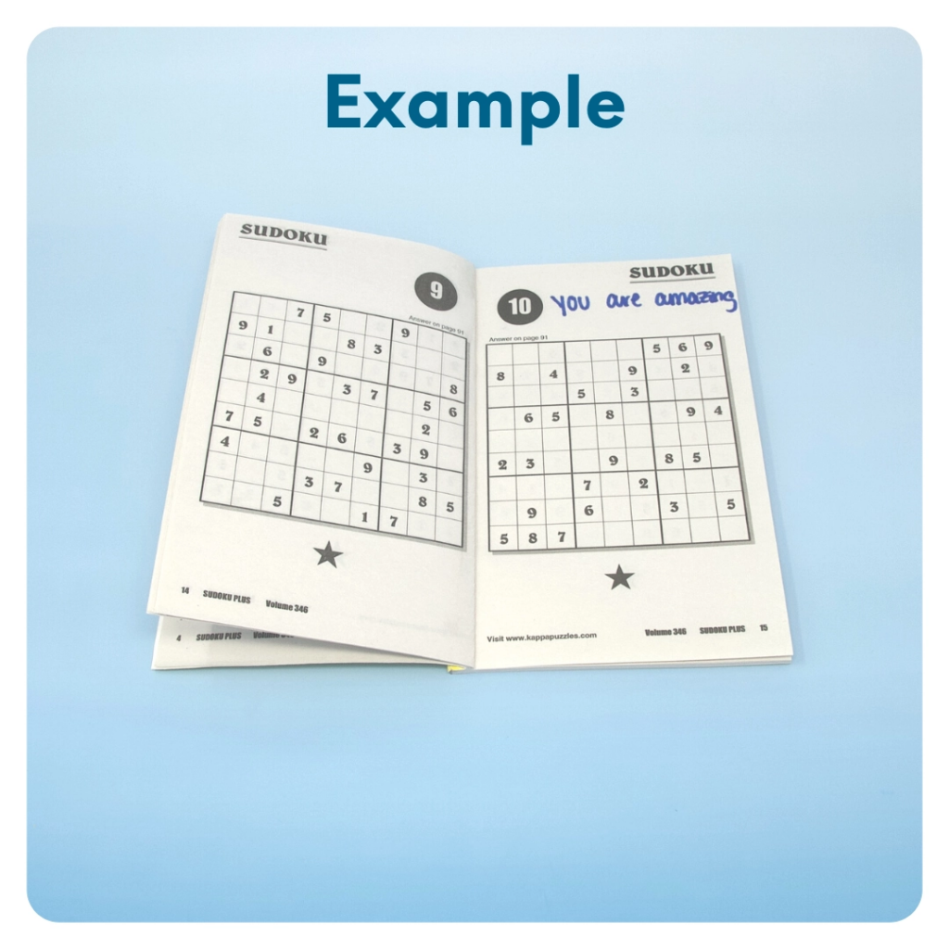
STEP 8 OF 12
Surprise Kyndness Puzzle Book
Go through the pages of the Sudoku or puzzle book and write uplifting messages, draw small, colorful images, or create fun writing prompts for the recipient.

Slide 15
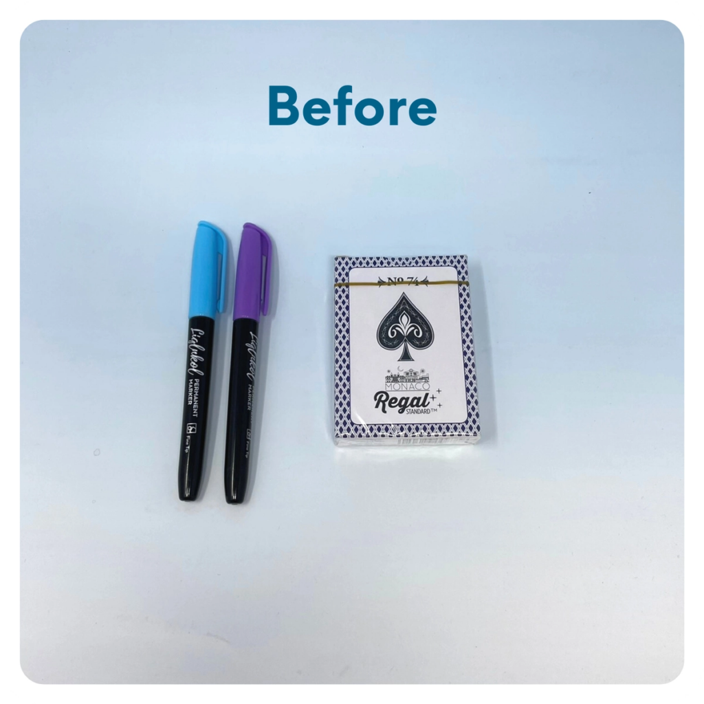
STEP 9 OF 12
Decorate the Playing Cards
Write encouraging messages, affirmations, jokes, or pictures on the faces of the playing cards for players to see when they are playing a card game.

Slide 16
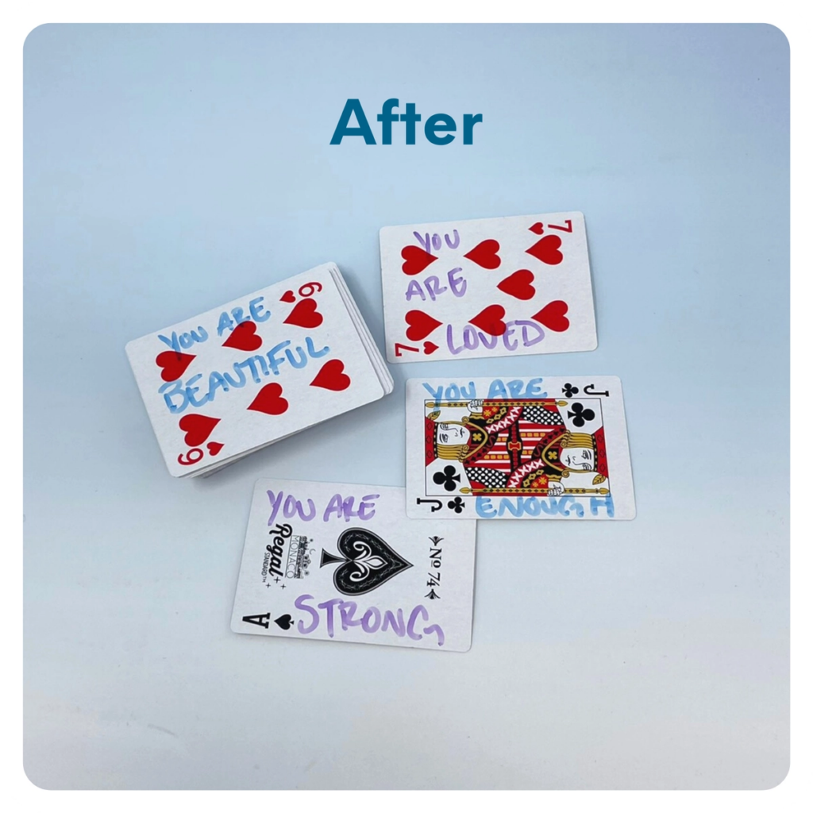
STEP 9 OF 12
Decorate the Playing Cards (continued)

Slide 17
STEP 10 OF 12
Pack the Parent Support [Plus] Kit
Pack all the materials into the decorated plastic bag and put it back into the original box.
• Please only include items that are UNOPENED and UNUSED
Optional Items to Add:
• Self care items
• Stress relief items
• Journals
• Coffee/snacks
Items not to include:
• Perishable items
• Sharp objects
• Nut food products
• Religious or political items

Slide 18
STEP 11 OF 12
Register My Kit (Optional)
Register your kit. To register and track your kits, you must visit the online instructions. Registering your kit is optional.

Slide 19
STEP 12 OF 12
Thank You!
When you build a Kynd Kit, you create layers of impact for yourself and the community. We appreciate your time and your support of our mission.
Cheers,
The Project Helping team

