Slide 1

CLASSIC
Children&#8217;s Hospital Sensory Bag [Classic]
9 STEPS

Slide 2

STEP 1 OF 9
About Project Helping
Kynd Kits are a program of Project Helping, a mental wellness nonprofit. Our mission is to make it ridiculously easy to volunteer because doing good is good for your mental wellness!
Learn More at ProjectHelping.org
When You Build a Kynd Kit - The Cycle of Impact

Slide 3

STEP 2 OF 9
Tips for Building Your Kit
Helpful Tip for Building Your Kynd Kit
• Avoid politics and religion entirely.
• Use appropriate humor.
• Can't think of what to write, draw a picture!
• Use words of affirmation!
• Place a piece of paper in any canvas bag before drawing on the outside. This way, the marker will not bleed through the other side of the bag.
• Please keep your designs gender-neutral, inclusive, and age-appropriate.
Spanish Translation Options

Slide 4
STEP 3 OF 9
Children's Hospital Sensory Bag [Classic]
Before You Build
Project Helping has teamed up with Holiday Heroes to create a Kynd Kit for Children who are hospitalized.
Each year in the U.S. there are an estimated 15,780 children between the ages of birth and 19 years of age who are diagnosed with cancer.
Approximately 1 in 285 children in the U.S. will be diagnosed with cancer before their 20th birthday and globally there are more than 300,000 children diagnosed with cancer each year.

Slide 5
STEP 3 OF 9
Children's Hospital Sensory Bag [Classic] (continued)
Help to provide a child in the hospital with coping tools by building this Sensory Kynd Kit. Sensory Kynd Kits can help a child deal with stress and anxiety while they are getting the treatments that they need.

Slide 6
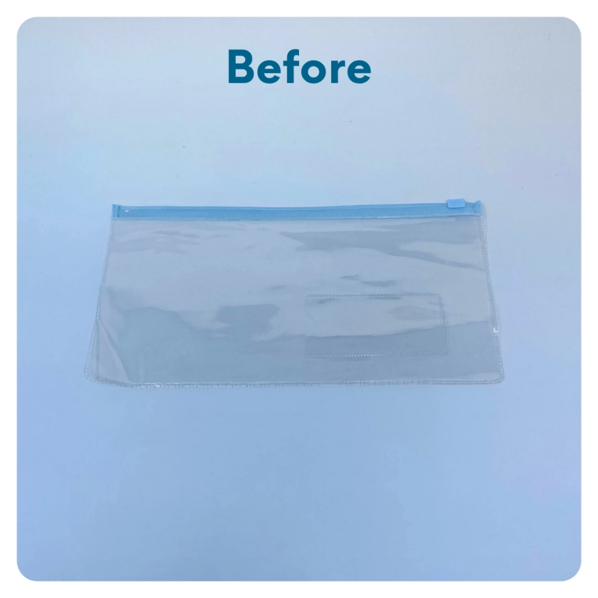
STEP 4 OF 9
Decorate the Clear Zipper Pouch
Use the permanent markers to decorate the plastic pouch. Tip: Be creative and use other supplies (no glitter) you may have on hand to make it colorful.

Slide 7
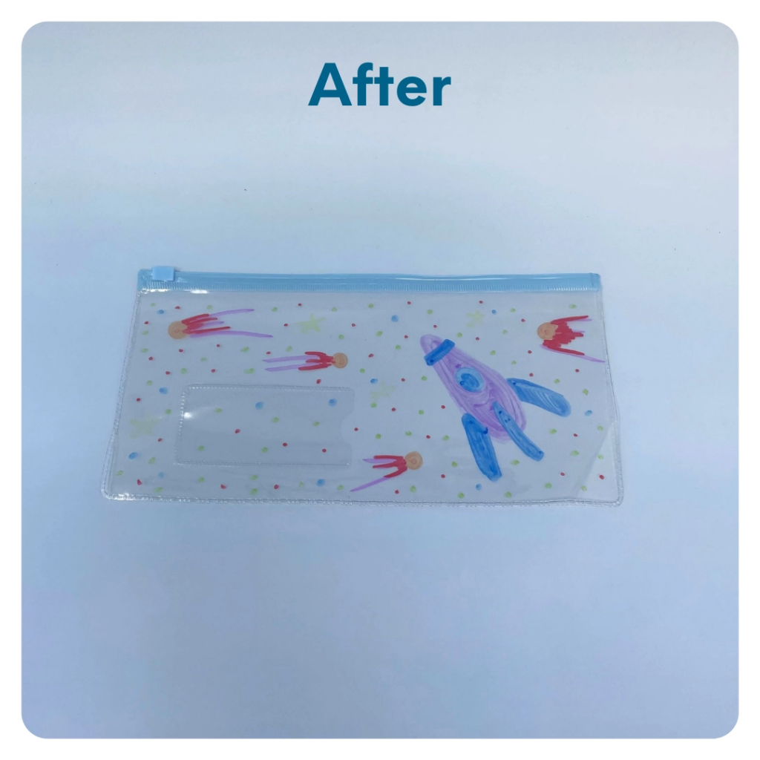
STEP 4 OF 9
Decorate the Clear Zipper Pouch (continued)

Slide 8

STEP 5 OF 9
Write a Note to the Recipient and Decorate the Envelope
Write a card and decorate the envelope using the enclosed materials. Express your encouragement and include a hopeful message.
Please ensure your message is age-appropriate and avoids references to religion or politics.

Slide 9

STEP 5 OF 9
Write a Note to the Recipient and Decorate the Envelope (continued)

Slide 10
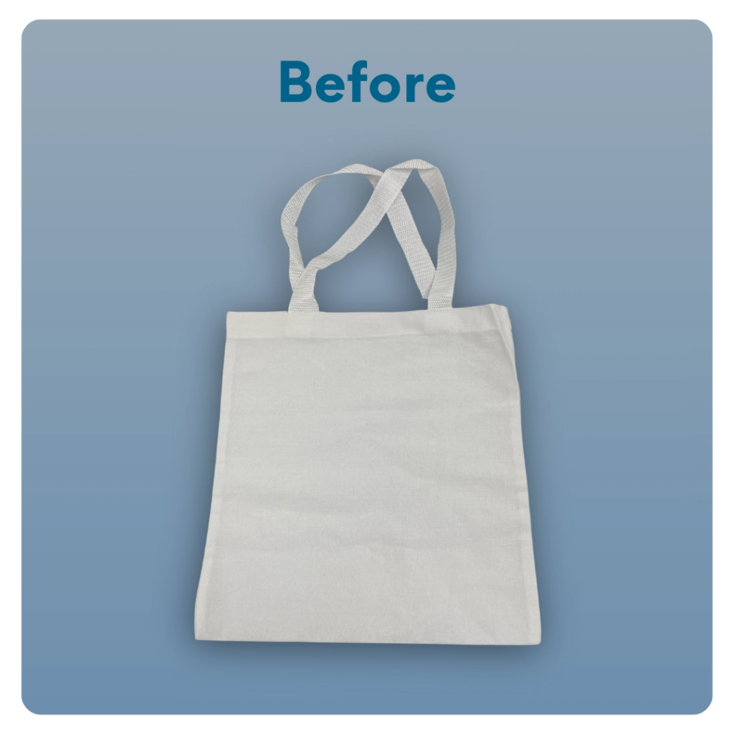
STEP 6 OF 9
Decorate The Small Canvas Tote
Decorate the canvas tote to make it fun and colorful! Tip: place a piece of paper in the tote before decorating. This will prevent the marker from bleeding through the tote.

Slide 11
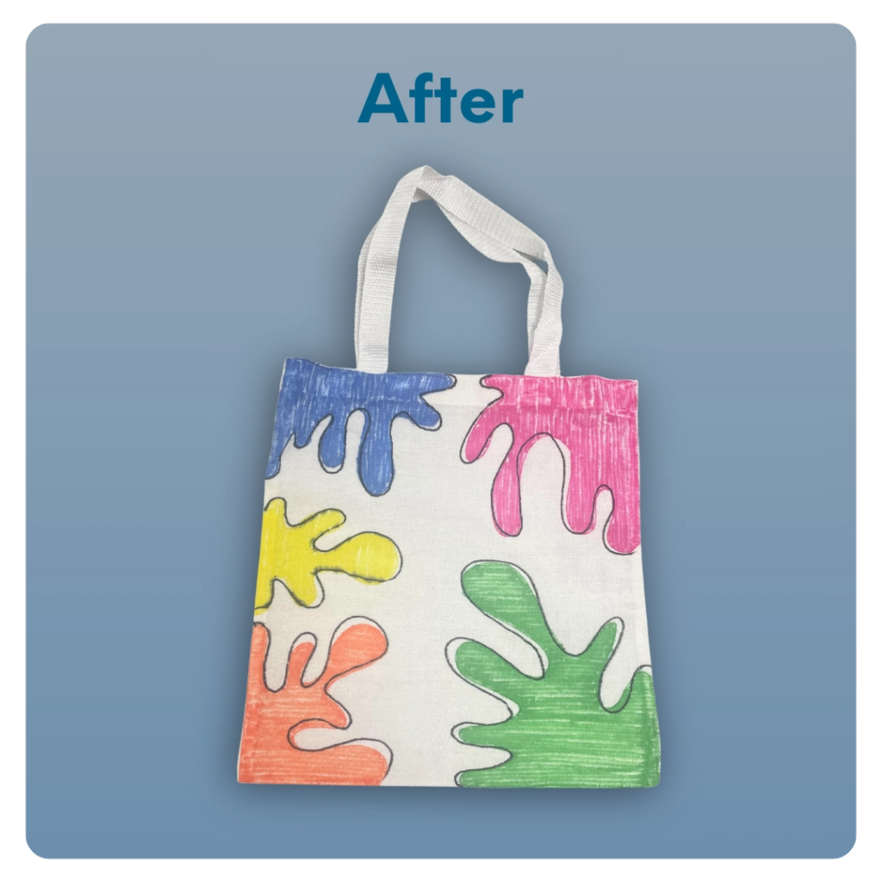
STEP 6 OF 9
Decorate The Small Canvas Tote (continued)

Slide 12
STEP 7 OF 9
Pack the Children's Hospital Sensory Bag
Pack all of the materials into the decorated plastic bag and put it back into the original box.
• Please only include items that are UNOPENED and UNUSED
• Add any optional items you would like.
Optional Items to Add:
• Toys
• Coloring Books
• Games
• Coloring pencils, crayons, or pens
Items not to include:
• Perishable items
• Sharp objects
• Nut food products
• Religious or political items

Slide 13
STEP 8 OF 9
Register My Kit (Optional)
Register your kit. To register and track your kits, you must visit the online instructions. Registering your kit is optional.

Slide 14
STEP 9 OF 9
Thank You!
When you build a Kynd Kit, you create layers of impact for yourself and the community. We appreciate your time and your support of our mission.
Cheers,
The Project Helping team

