Slide 1

MAX
Children&#8217;s Hospital Support [Max]
13 STEPS

Slide 2
STEP 1 OF 13
About Project Helping
Kynd Kits are a program of Project Helping, a mental wellness nonprofit. Our mission is to make it ridiculously easy to volunteer because doing good is good for your mental wellness!
•
•
Kynd Hub
Build your kit & track its entire journey
Create a free account at Kynd Hub — see exactly where your kit goes after you build it.
Build Your Kit on Kynd Hub
•
•
The Kynd Kit Cycle
Kynd Kits Create Impact
Every kit you build sets off a chain of good — for you, for a nonprofit, and for the whole community.

Slide 3
STEP 1 OF 13
About Project Helping (continued)
1
You Volunteer
You volunteer, which benefits your mental health and wellbeing.
•
2
Help a Nonprofit
The kit you build is donated to a vetted nonprofit partner in need.
•
3
Fund Programming
Proceeds fund free, community-based mental health programming.
•
4
Sustain the Mission
Proceeds benefit Project Helping, a 501(c)(3) nonprofit.
projecthelping.org

Slide 4

STEP 2 OF 13
Tips for Building Your Kit
Helpful Tip for Building Your Kynd Kit
• Avoid politics and religion entirely.
• Use appropriate humor.
• Can't think of what to write, draw a picture!
• Use words of affirmation!
• Place a piece of paper in any canvas bag before drawing on the outside. This way, the marker will not bleed through the other side of the bag.
• Please keep your designs gender-neutral, inclusive, and age-appropriate.
Spanish Translation Options

Slide 5
STEP 3 OF 13
Children's Hospital Activity Kit [Max]
Before You Build
Each year in the U.S. there are an estimated 15,780 children between the ages of birth and 19 years of age who are diagnosed with cancer.
Approximately 1 in 285 children in the U.S. will be diagnosed with cancer before their 20th birthday and globally there are more than 300,000 children diagnosed with cancer each year.
The children and their families spend a great deal of time waiting for treatment, tests, and procedures. These bags help them pass the time while in the waiting room or hospital room.

Slide 6

STEP 4 OF 13
Write a Note to the Recipient and Decorate the Envelope
Write a card and decorate the envelope using the enclosed materials. Express your encouragement and include a hopeful message.
Please ensure your message is age-appropriate and avoids references to religion or politics.

Slide 7

STEP 4 OF 13
Write a Note to the Recipient and Decorate the Envelope (continued)

Slide 8
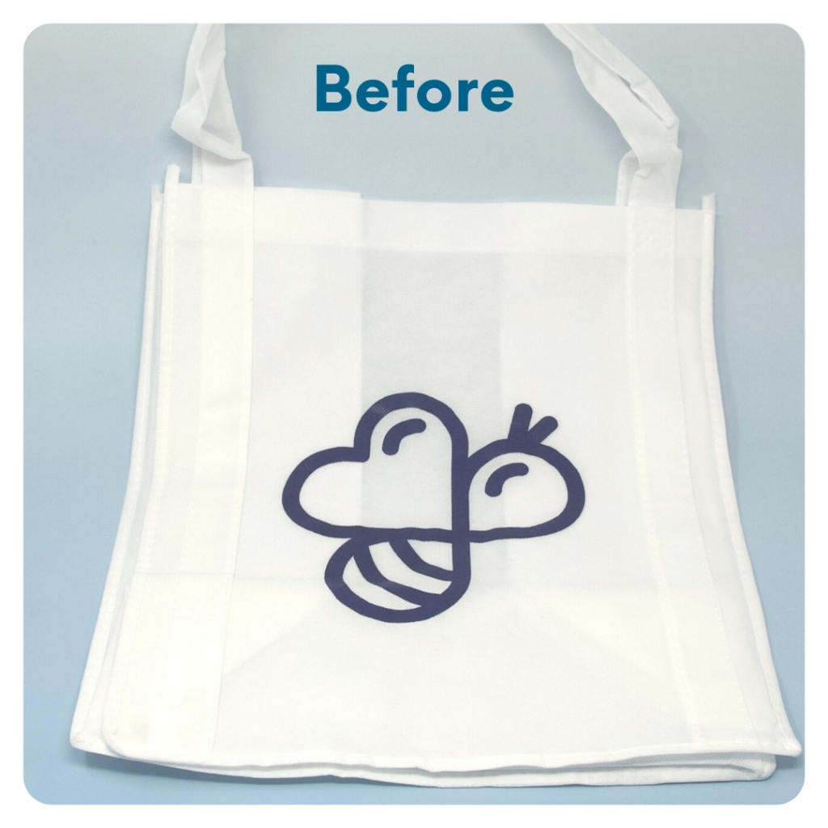
STEP 5 OF 13
DIY Tote Bag
Decorate the Canvas Tote
Decorate the canvas tote to make it fun and colorful! Tip: place a piece of paper in the tote before decorating. This will prevent the marker from bleeding through the tote.

Slide 9

STEP 5 OF 13
DIY Tote Bag (continued)

Slide 10
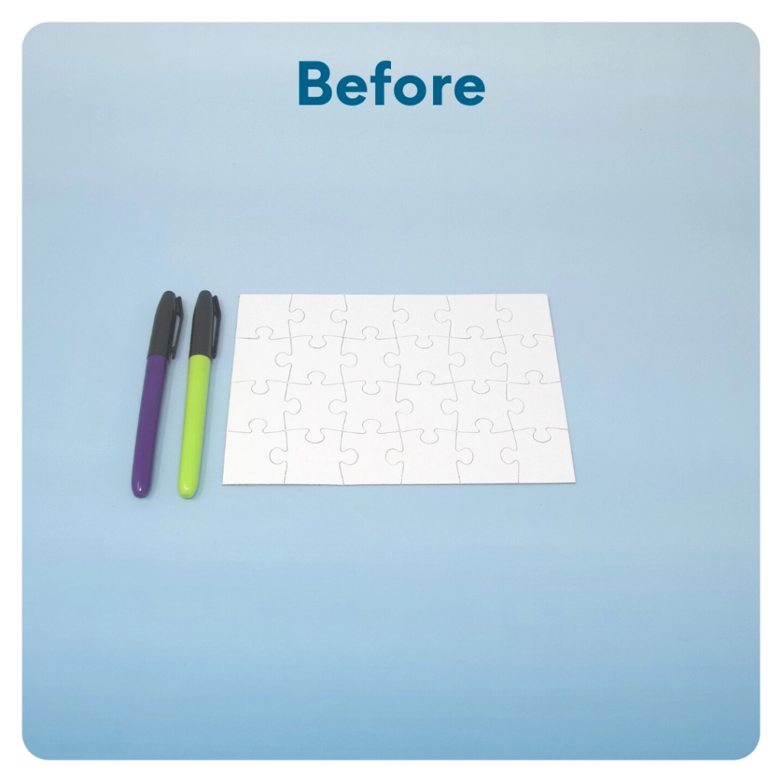
STEP 6 OF 13
DIY Jigsaw Puzzle
Start with the puzzle assembled. Decorate the whole puzzle, filling it with color or messaging from edge to edge. The small sorting envelope will hold the pieces of the completed puzzle. Decorate one side of the envelope with the same image or wording as the puzzle. Take the puzzle apart and put it in the envelope.

Slide 11
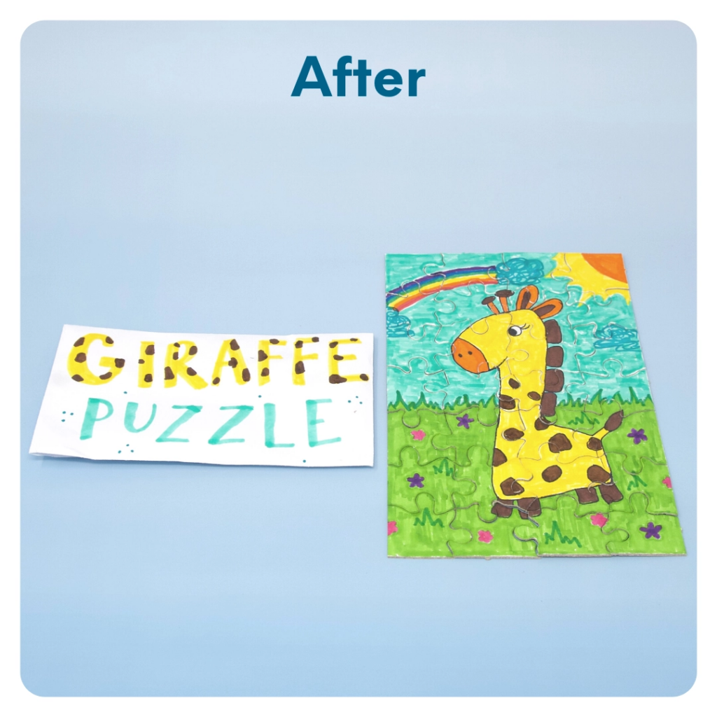
STEP 6 OF 13
DIY Jigsaw Puzzle (continued)

Slide 12

STEP 7 OF 13
Surprise Kyndness Notebook
Decorate the outside of the journal with a picture or uplifting message. Use random pages in the journal to write short, uplifting messages, draw small, colorful images, or create fun writing prompts for the recipient.

Slide 13

STEP 7 OF 13
Surprise Kyndness Notebook (continued)

Slide 14
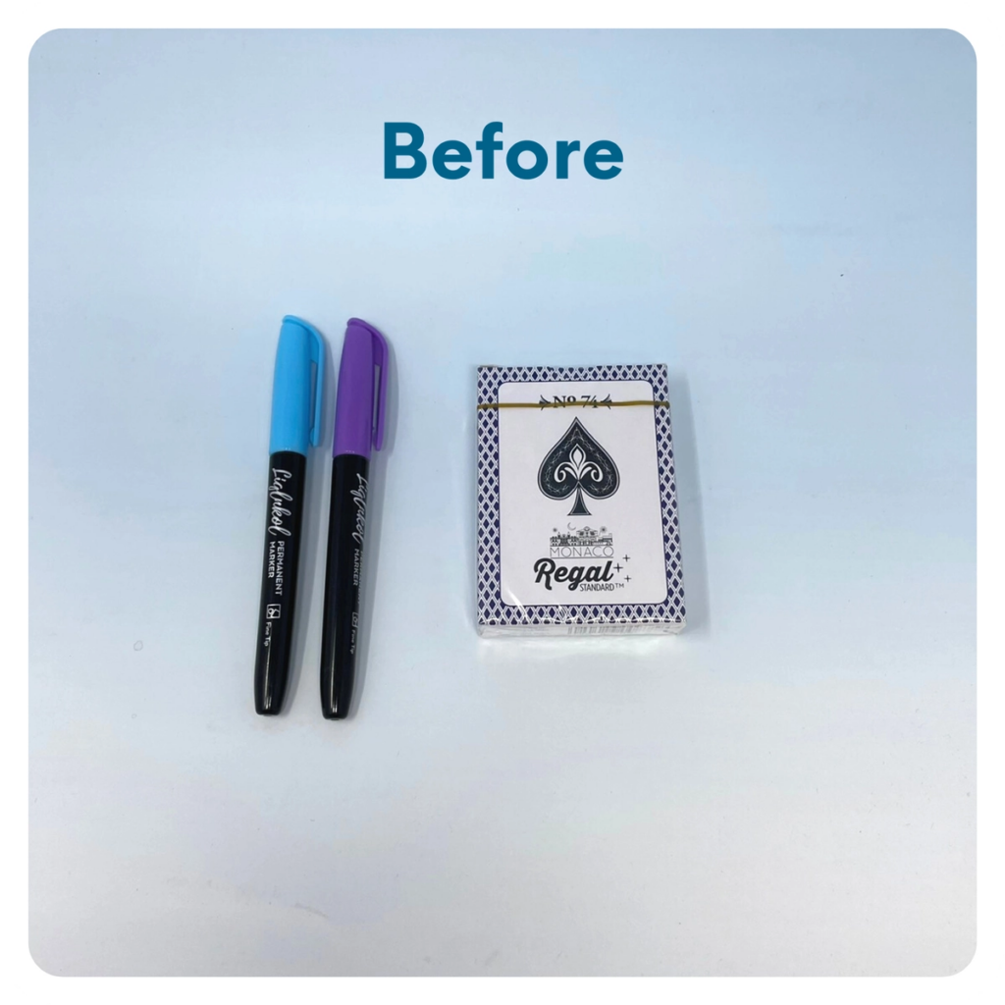
STEP 8 OF 13
Decorate the Playing Cards
Write encouraging messages, affirmations, jokes, or pictures on the faces of the playing cards for players to see when they are playing a card game.

Slide 15
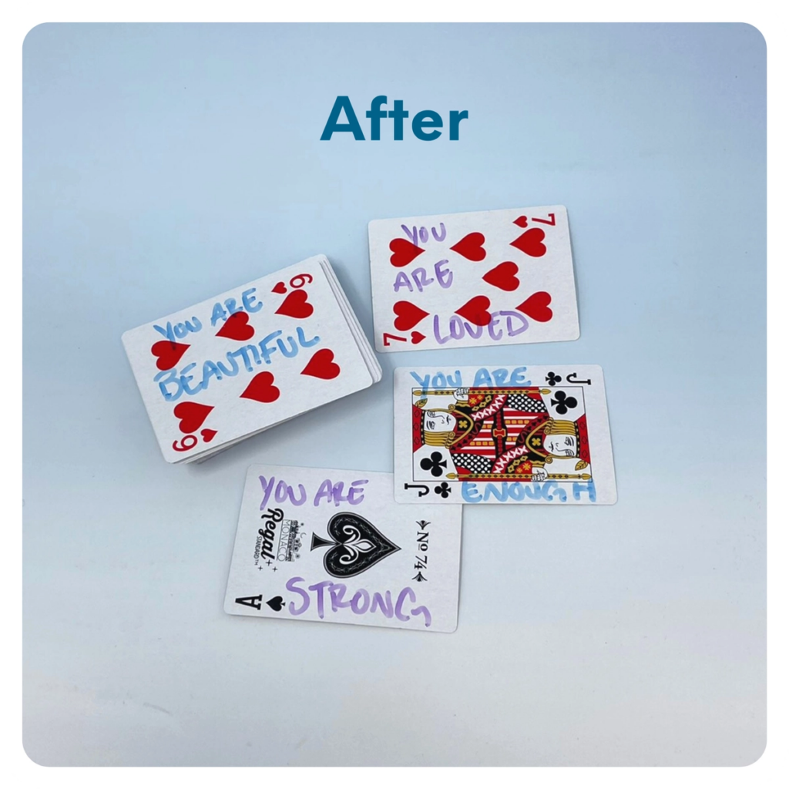
STEP 8 OF 13
Decorate the Playing Cards (continued)

Slide 16

STEP 9 OF 13
Decorate the Canvas Bag
Use the permanent markers to decorate the canvas bag.
Tip: Place a piece of paper in the bag before decorating to prevent the markers from bleeding through.

Slide 17

STEP 9 OF 13
Decorate the Canvas Bag (continued)

Slide 18
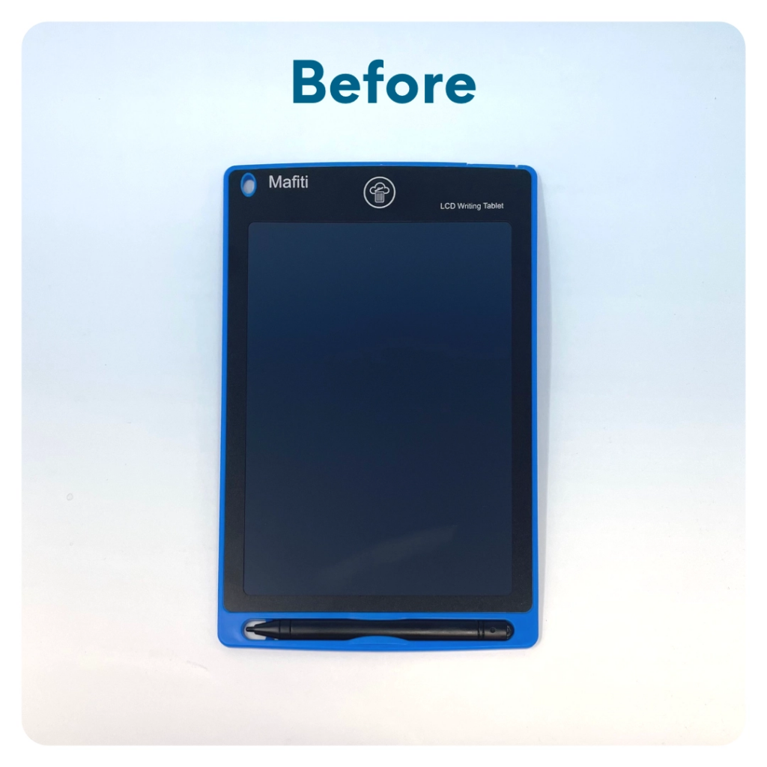
STEP 10 OF 13
LCD Writing Tablet
Decorate the white 4″ x 4″ sticker with an encouraging/inspiring message. Peel the sticker off and stick it to the back of the LCD tablet. This way, whenever the child is using their tablet, they can see your hopeful message on the back.

Slide 19
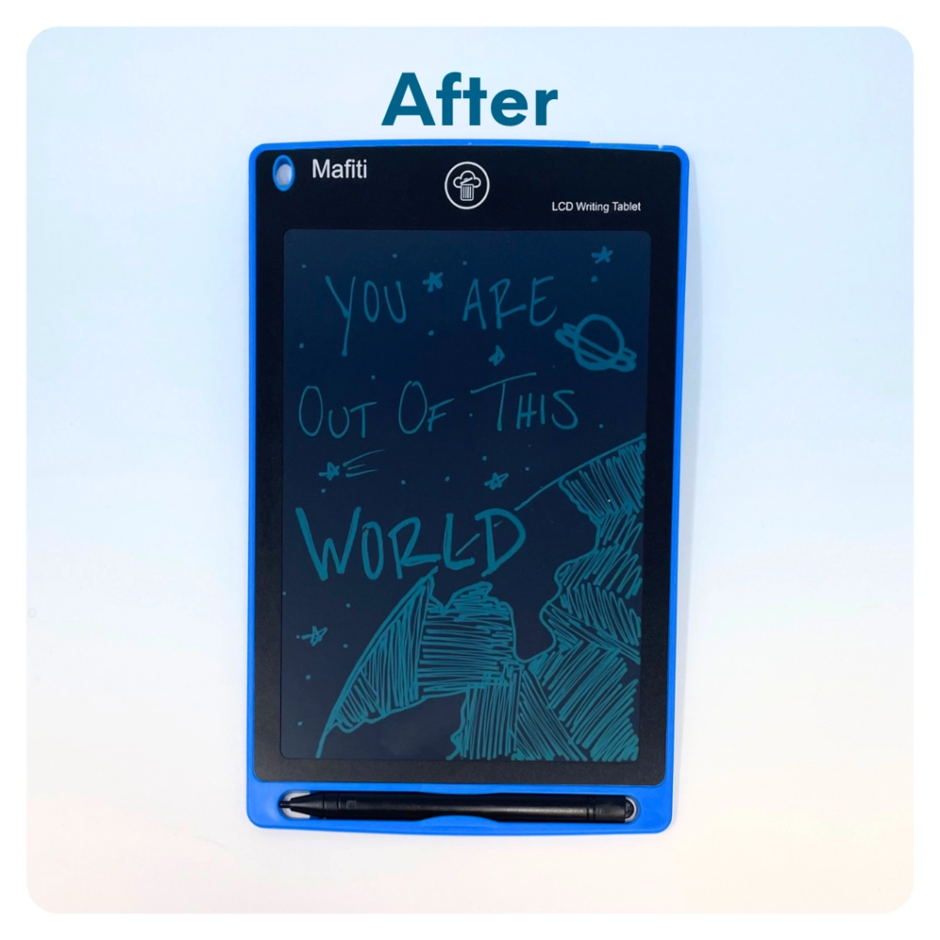
STEP 10 OF 13
LCD Writing Tablet (continued)
• You can also write an encouraging message on the front of the tablet using the tablet pen. After you write your message, turn the tablet over and lock the screen by flipping the switch to “lock”. When the child opens their activity kit, your message will still appear on the front of the tablet. If you choose to do this, include instructions somewhere on the 4” x 4” sticker on how to unlock the screen so the child can erase your message and start using it for their own creative projects.

Slide 20
STEP 11 OF 13
Pack The Children's Hospital Activity Kit [Max]
Pack all of the materials into the decorated tote bag and put it back in the original box.
• Please only include items that are UNOPENED and UNUSED
• Add any optional items you would like.
Optional Items to Add:
• Sudoku and crossword puzzles
• Paint and paintbrushes
• More markers, crayons, and colored pencils
• Journals for teens
• Teething rings/small baby toys
• Chapter books and cardboard baby books
• DVDs (rated G, PG, or PG13)
Items not to include:
• Perishable items
• Sharp objects
• Nut food products
• Religious or political items

Slide 21
STEP 12 OF 13
Register My Kit (Optional)
Register your kit. To register and track your kits, you must visit the online instructions. Registering your kit is optional.

Slide 22
STEP 13 OF 13
Thank You!
When you build a Kynd Kit, you create layers of impact for yourself and the community. We appreciate your time and your support of our mission.
Cheers,
The Project Helping team

