Slide 1
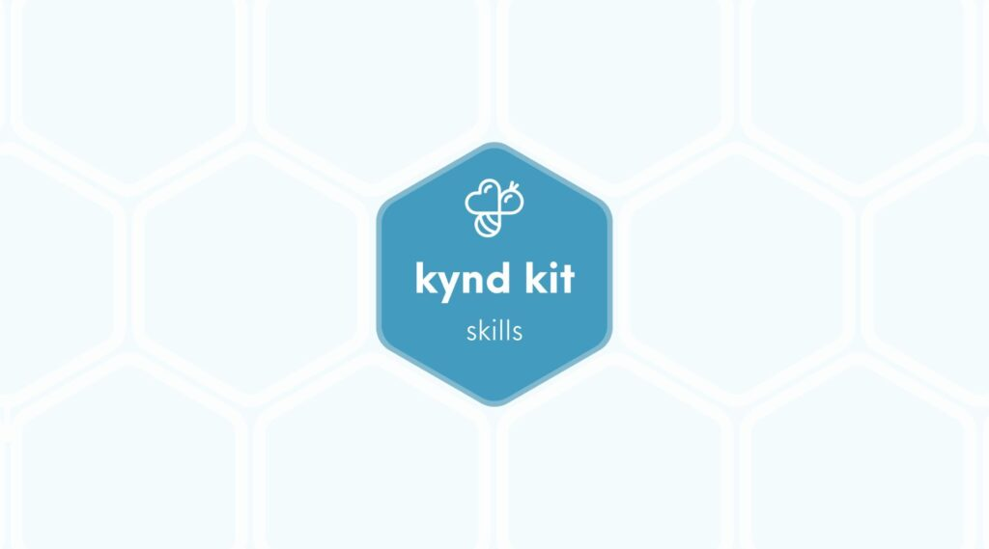
SKILLS
Crochet [Skills]
8 STEPS

Slide 2

STEP 1 OF 8
About Project Helping
Kynd Kits are a program of Project Helping, a mental wellness nonprofit. Our mission is to make it ridiculously easy to volunteer because doing good is good for your mental wellness!
Learn More at ProjectHelping.org
When You Build a Kynd Kit - The Cycle of Impact

Slide 3

STEP 2 OF 8
Tips for Building Your Kit
Helpful Tip for Building Your Kynd Kit
• Avoid politics and religion entirely.
• Use appropriate humor.
• Can't think of what to write, draw a picture!
• Use words of affirmation!
• Place a piece of paper in any canvas bag before drawing on the outside. This way, the marker will not bleed through the other side of the bag.
• Please keep your designs gender-neutral, inclusive, and age-appropriate.
Spanish Translation Options

Slide 4
STEP 3 OF 8
Skill: Crochet
Crochet a scarf for someone who is unhoused. The cold weather presents many challenges for someone experiencing homelessness, and the most basic needs can make a world of difference for them.
The Skills Kits were created for you, as the volunteer, to learn a new skill and use it to give back to your community. Learn how to crochet a basic scarf. You
can then use this new skill of crocheting to keep giving back to your own community by creating other scarfs or try something new like a hat!

Slide 5
STEP 4 OF 8
Crochet a scarf
Items you will need:
• Crochet hook
• Yarn
Let’s Get Started!
Tip: Watch the video all the way through before you start your scarf. Then grab your materials, follow along and begin!
Watch the video below to learn how to do a basic crochet knot. You will continue this basic crochet know until you have a 3 foot scarf. This will use 2-3 skeins of yarn to make a scarf. To change skeins, tie the ends of the skeins together and keep crocheting.

Slide 6
STEP 4 OF 8
Crochet a scarf (continued)
When you’re done, roll and tie your final product together with the ribbon. Write a note with the provided card and envelope. Keep using this skill to give back to your community and do good!

Slide 7

STEP 5 OF 8
Write a Note to the Recipient and Decorate the Envelope
Write a card and decorate the envelope using the enclosed materials. Express your encouragement and include a hopeful message.
Please ensure your message is age-appropriate and avoids references to religion or politics.

Slide 8

STEP 5 OF 8
Write a Note to the Recipient and Decorate the Envelope (continued)

Slide 9
STEP 6 OF 8
Crochet Kit - Delivery Instructions
This kit is designed to be distributed locally to an unhoused person. You can either bring it to a shelter or hand it out to someone you see who could benefit from a scarf to keep them warm.

Slide 10
STEP 7 OF 8
Register My Kit (Optional)
Register your kit. To register and track your kits, you must visit the online instructions. Registering your kit is optional.

Slide 11
STEP 8 OF 8
Thank You!
When you build a Kynd Kit, you create layers of impact for yourself and the community. We appreciate your time and your support of our mission.
Cheers,
The Project Helping team

