Slide 1
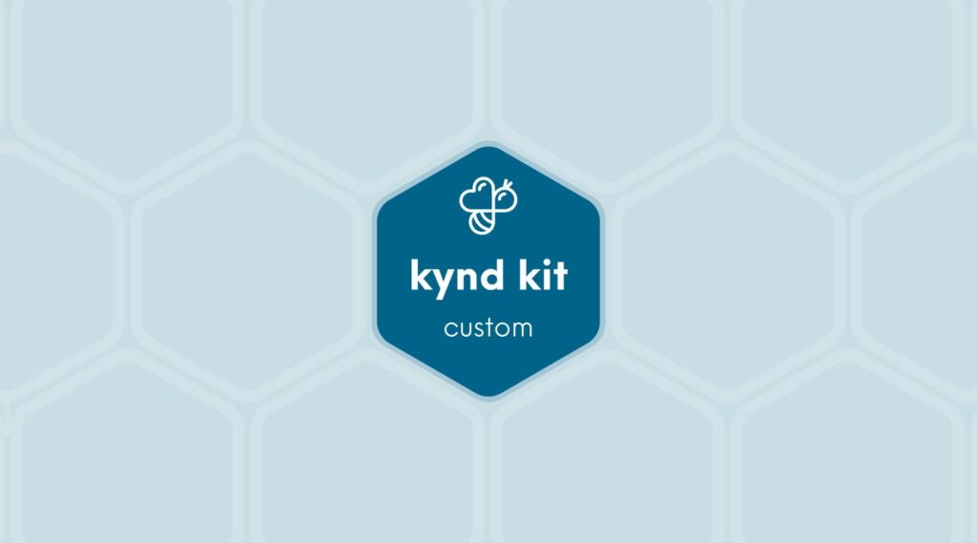
CLASSIC
Cyber Education &#8211; PaloAlto [Classic]
9 STEPS

Slide 2

STEP 1 OF 9
About Project Helping
Kynd Kits are a program of Project Helping, a mental wellness nonprofit. Our mission is to make it ridiculously easy to volunteer because doing good is good for your mental wellness!
Learn More at ProjectHelping.org
When You Build a Kynd Kit - The Cycle of Impact

Slide 3

STEP 2 OF 9
Tips for Building Your Kit
Helpful Tip for Building Your Kynd Kit
• Avoid politics and religion entirely.
• Use appropriate humor.
• Can't think of what to write, draw a picture!
• Use words of affirmation!
• Place a piece of paper in any canvas bag before drawing on the outside. This way, the marker will not bleed through the other side of the bag.
• Please keep your designs gender-neutral, inclusive, and age-appropriate.
Spanish Translation Options

Slide 4
STEP 3 OF 9
Cyber Education [Classic]
Before You Build
This Cyber Education Kit, created in partnership with Palo Alto Networks, helps inspire the next generation of digital defenders! The completed kits will be donated to young learners who are exploring how to stay safe, smart, and kind online. Through fun, hands-on activities, kids will learn the basics of cybersecurity—like protecting personal information, creating strong passwords, and building their own “digital force field.” Your work today helps empower future cybersecurity superheroes to protect our digital world!

Slide 5

STEP 4 OF 9
Decorate the Bag
Decorate the kraft bag(s). This is what the final kit is distributed in, so try to make this fun and colorful for the recipient to open.
Please note: we are currently transitioning from plastic ziplock bags to kraft bags. Some kits may still include the plastic bag for you to decorate while we complete this transition.

Slide 6



STEP 4 OF 9
Decorate the Bag (continued)

Slide 7

STEP 5 OF 9
Write a Note to the Recipient and Decorate the Envelope
Write a card and decorate the envelope using the enclosed materials. Express your encouragement and include a hopeful message.
Please ensure your message is age-appropriate and avoids references to religion or politics.

Slide 8

STEP 5 OF 9
Write a Note to the Recipient and Decorate the Envelope (continued)

Slide 9

STEP 6 OF 9
Decorate the Canvas Bag
Use the permanent markers to decorate the canvas bag.
Tip: Place a piece of paper in the bag before decorating to prevent the markers from bleeding through.

Slide 10

STEP 6 OF 9
Decorate the Canvas Bag (continued)

Slide 11
STEP 7 OF 9
Pack the Cyber Education Kit
Pack all the materials into the decorated plastic bag and put it back into the original box.
• Please only include items that are UNOPENED and UNUSED

Slide 12
STEP 8 OF 9
Register My Kit (Optional)
Register your kit. To register and track your kits, you must visit the online instructions. Registering your kit is optional.

Slide 13
STEP 9 OF 9
Thank You!
When you build a Kynd Kit, you create layers of impact for yourself and the community. We appreciate your time and your support of our mission.
Cheers,
The Project Helping team

