Slide 1

CLASSIC
Digital Literacy [Classic]
11 STEPS

Slide 2

STEP 1 OF 11
About Project Helping
Kynd Kits are a program of Project Helping, a mental wellness nonprofit. Our mission is to make it ridiculously easy to volunteer because doing good is good for your mental wellness!
Learn More at ProjectHelping.org
When You Build a Kynd Kit - The Cycle of Impact

Slide 3

STEP 2 OF 11
Tips for Building Your Kit
Helpful Tip for Building Your Kynd Kit
• Avoid politics and religion entirely.
• Use appropriate humor.
• Can't think of what to write, draw a picture!
• Use words of affirmation!
• Place a piece of paper in any canvas bag before drawing on the outside. This way, the marker will not bleed through the other side of the bag.
• Please keep your designs gender-neutral, inclusive, and age-appropriate.
Spanish Translation Options

Slide 4
STEP 3 OF 11
Digital Literacy [Classic]
Before You Build
About the Recipient

Slide 5
STEP 3 OF 11
Digital Literacy [Classic] (continued)
This kit, built in partnership with AT&T, is designed to help bridge the technology gap by giving someone the tools and confidence to navigate the digital world. Before you start building, take a moment to think about how the skill you use every day, online searching for information, spotting scams, creating documents, or connecting with others, can open doors for someone who may be new to technology. As you assemble this kit, imagine the recipient learning, exploring, and feeling empowered to use digital tools to connect, learn, and thrive. Your work today is helping them take that first step toward greater opportunity and independence.

Slide 6

STEP 4 OF 11
Decorate the Bag
Decorate the kraft bag(s). This is what the final kit is distributed in, so try to make this fun and colorful for the recipient to open.
Please note: we are currently transitioning from plastic ziplock bags to kraft bags. Some kits may still include the plastic bag for you to decorate while we complete this transition.

Slide 7



STEP 4 OF 11
Decorate the Bag (continued)

Slide 8

STEP 5 OF 11
Write a Note to the Recipient and Decorate the Envelope
Write a card and decorate the envelope using the enclosed materials. Express your encouragement and include a hopeful message.
Please ensure your message is age-appropriate and avoids references to religion or politics.

Slide 9

STEP 5 OF 11
Write a Note to the Recipient and Decorate the Envelope (continued)

Slide 10
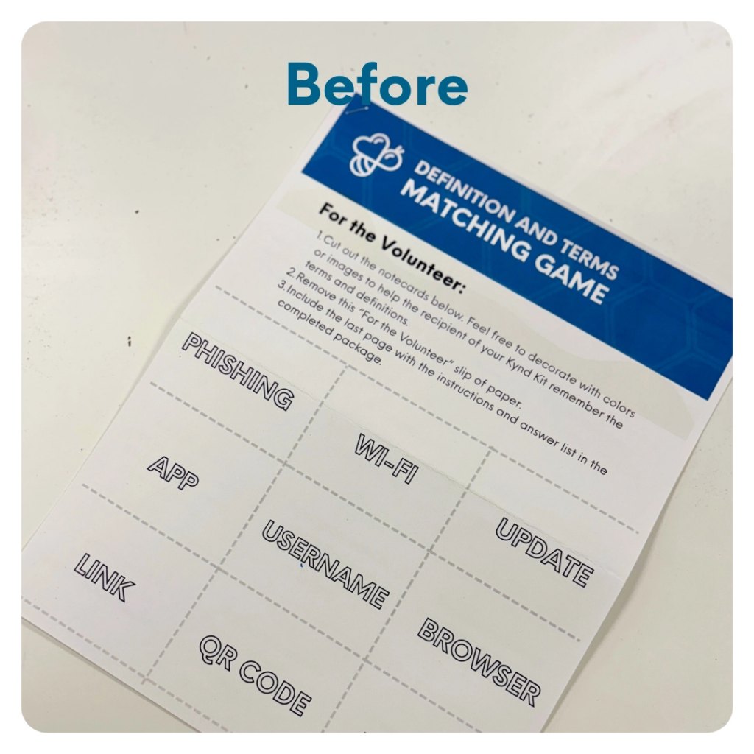
STEP 6 OF 11
Make Digital Literacy Flashcards
Color the flashcards to make them fun and colorful! Cut them out and add them to the decorated canvas bag. Don't forget to add the instruction sheet to the final completed kit.

Slide 11
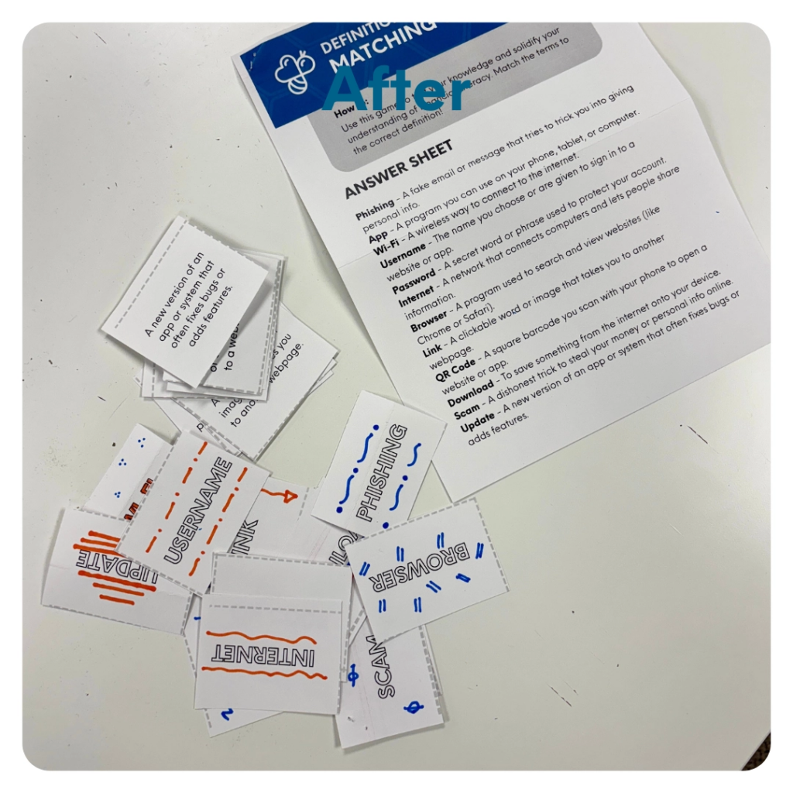
STEP 6 OF 11
Make Digital Literacy Flashcards (continued)

Slide 12

STEP 7 OF 11
Surprise Kyndness Notebook
Decorate the outside of the journal with a picture or uplifting message. Use random pages in the journal to write short, uplifting messages, draw small, colorful images, or create fun writing prompts for the recipient.

Slide 13

STEP 7 OF 11
Surprise Kyndness Notebook (continued)

Slide 14

STEP 8 OF 11
Decorate the Canvas Bag
Use the permanent markers to decorate the canvas bag.
Tip: Place a piece of paper in the bag before decorating to prevent the markers from bleeding through.

Slide 15

STEP 8 OF 11
Decorate the Canvas Bag (continued)

Slide 16
STEP 9 OF 11
Pack the Digital Literacy Kit
Pack all the materials and kit contents into the decorated plastic bag and put it back Into the original box.
• Please only include items that are UNOPENED and UNUSED
• Optional to add additional items
Optional items to add:
• USB flash drive
• Mouse pad
• Webcam cover
• Phone or tablet stand
Do not include:
• Perishable items
• Sharp objects
• Nut products
• Religious and/or political items

Slide 17
STEP 10 OF 11
Register My Kit (Optional)
Register your kit. To register and track your kits, you must visit the online instructions. Registering your kit is optional.

Slide 18
STEP 11 OF 11
Thank You!
When you build a Kynd Kit, you create layers of impact for yourself and the community. We appreciate your time and your support of our mission.
Cheers,
The Project Helping team

