Slide 1
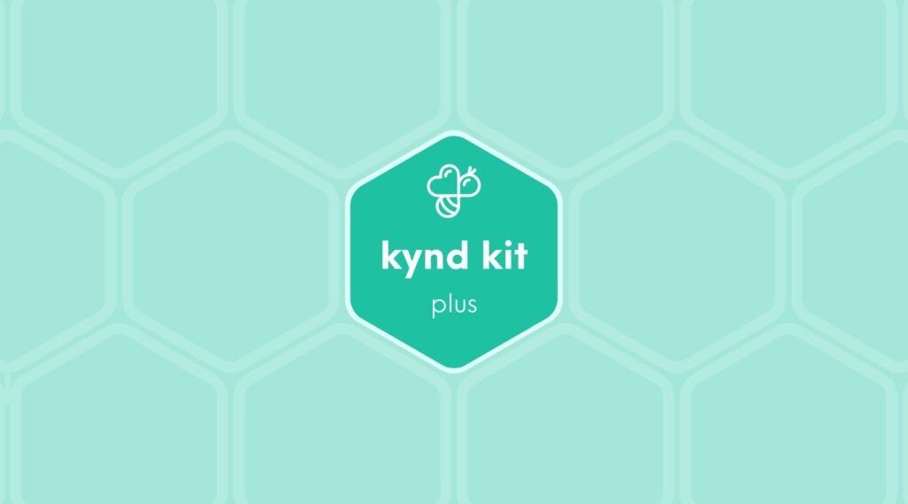
PLUS
Environmental Impact [Plus]
11 STEPS

Slide 2

STEP 1 OF 11
About Project Helping
Kynd Kits are a program of Project Helping, a mental wellness nonprofit. Our mission is to make it ridiculously easy to volunteer because doing good is good for your mental wellness!
Learn More at ProjectHelping.org
When You Build a Kynd Kit - The Cycle of Impact

Slide 3

STEP 2 OF 11
Tips for Building Your Kit
Helpful Tip for Building Your Kynd Kit
• Avoid politics and religion entirely.
• Use appropriate humor.
• Can't think of what to write, draw a picture!
• Use words of affirmation!
• Place a piece of paper in any canvas bag before drawing on the outside. This way, the marker will not bleed through the other side of the bag.
• Please keep your designs gender-neutral, inclusive, and age-appropriate.
Spanish Translation Options

Slide 4
STEP 3 OF 11
Environmental Impact [+]
Before You Build
Of the 40 million tons of plastic waste generated in the U.S. in 2021, only 5% to 6% — or about two million tons — was recycled. Every hour, 2.5 million plastic bottles are thrown away in the U.S., which take up to 450 years to degrade. Globally, 40% of the food produced is wasted. The food lost on farms alone could feed every undernourished person in the world four times over.

Slide 5
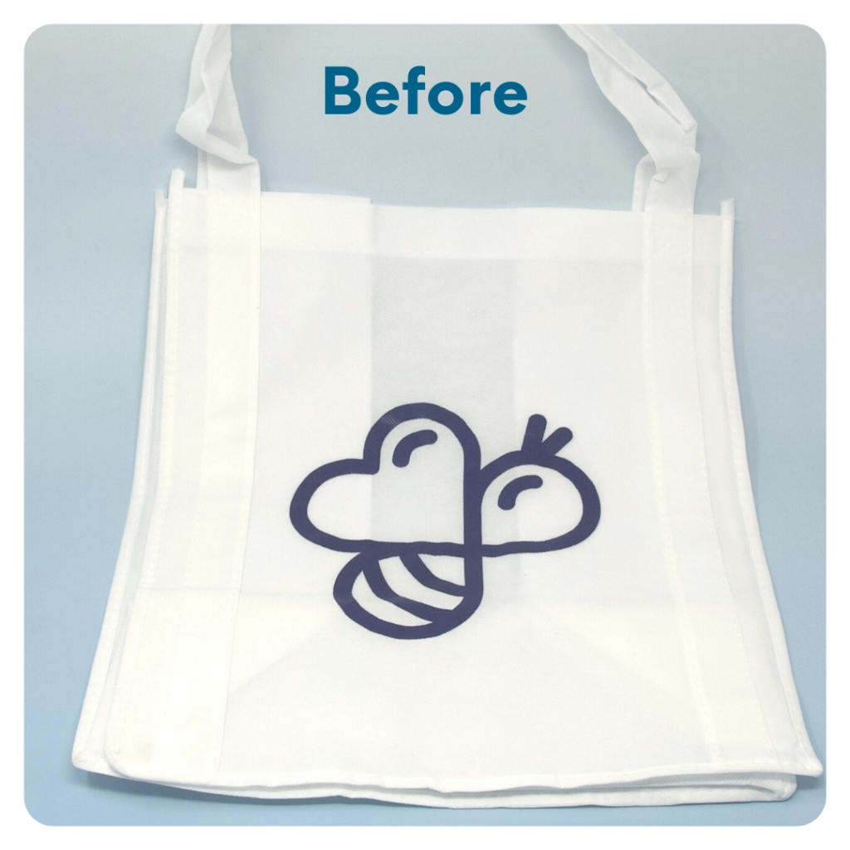
STEP 4 OF 11
DIY Tote Bag
Decorate the Canvas Tote
Decorate the canvas tote to make it fun and colorful! Tip: place a piece of paper in the tote before decorating. This will prevent the marker from bleeding through the tote.

Slide 6

STEP 4 OF 11
DIY Tote Bag (continued)

Slide 7
STEP 5 OF 11
DIY Wildflower Seed Bomb
• Find the following items:
• Wildflower seeds
• Paper
• Tear a few sheets of paper into small pieces.
• Slowly add water and mix slowly until the mixture becomes sticky like dough
• Add some of the wildflower seeds and roll them into a golf-ball-sized ball.
• Let the seed bomb dry out.
• Scatter them where you want them to grow (preferably on top of soil or compost), and let nature do the rest.
Tip: You should have enough supplies to create 2-3 seed bombs.

Slide 8
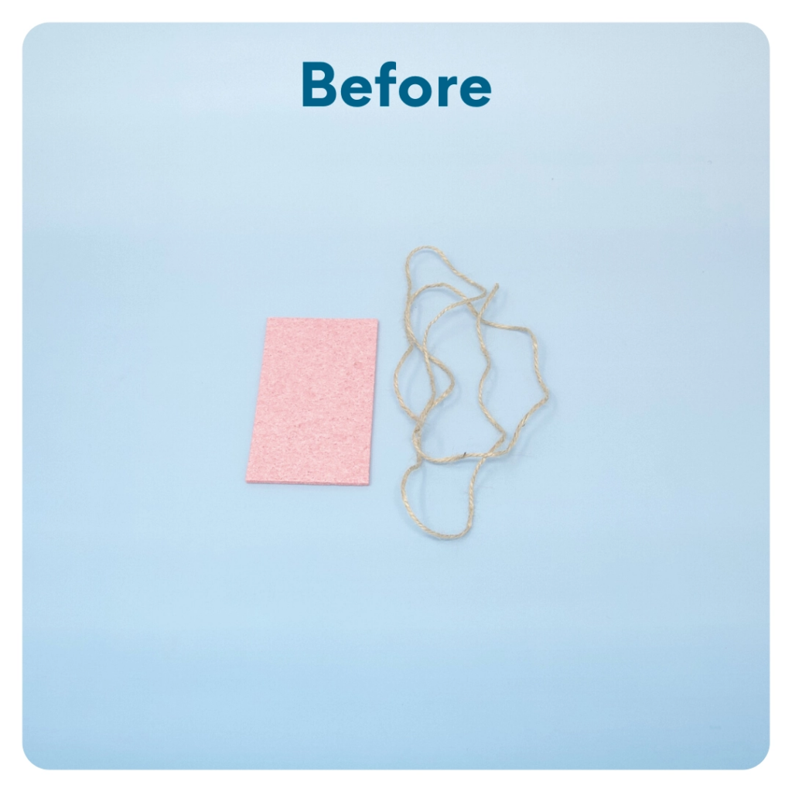
STEP 6 OF 11
DIY Butterfly Feeder
• Find the following items:
• Compressed Sponge (4.75×2.95 in.)
• Twine
• Sugar water
• Bring two cups of water to a boil.
• Stir in one cup of white sugar.
• Mix until the sugar is dissolved.
• Allow the mixture to cool completely.
• Soak the sponge in the homemade sugar water and allow it to expand completely.
• Wrap the twine around the sponge so that it cinches in the middle, and tie a knot. Be sure to leave some extra length of twine attached to hang the feeder from.
• Hang outside from a branch or awning.
• Check often and Re-soak with sugar water as needed.

Slide 9
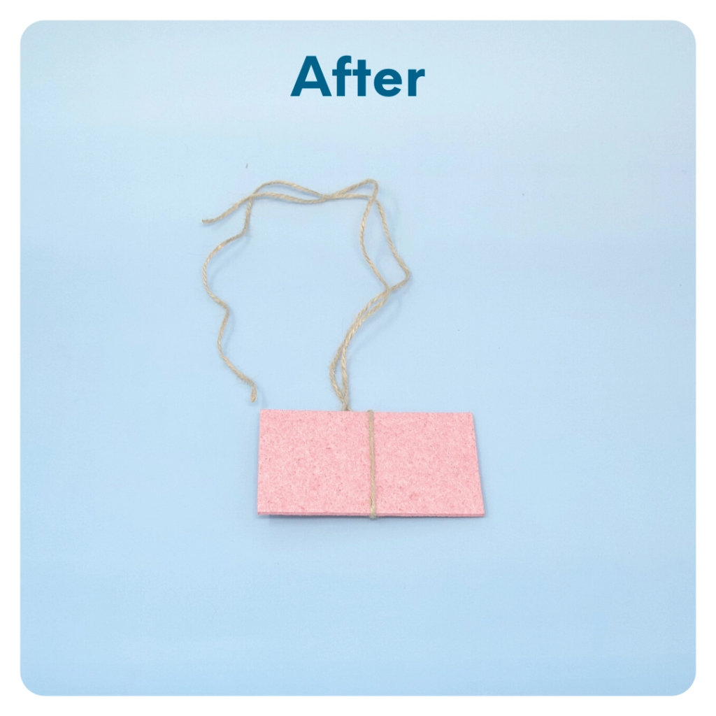
STEP 6 OF 11
DIY Butterfly Feeder (continued)

Slide 10
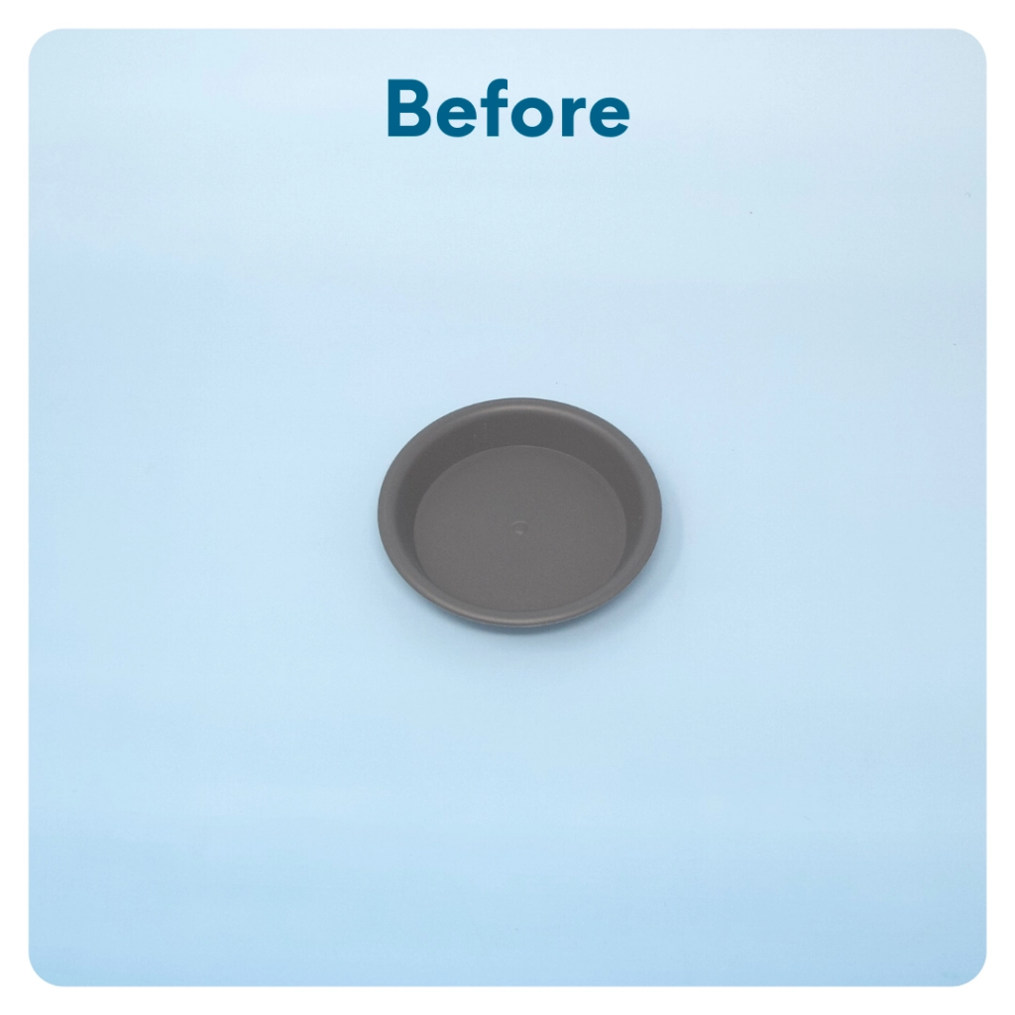
STEP 7 OF 11
Make a Bee Bath
A bee bath is a simple bee water feeder that you can add to your garden or outdoor space. It’s a way of attracting pollinating guests to your yard over and over again.
• Find the following items:
• Small reusable planter tray
• Rocks (go outside and find some larger rocks to put in your bee bath)
• Additional material (optional)
• Wash the tray and rocks to be sure they are free from any pesticides.

Slide 11
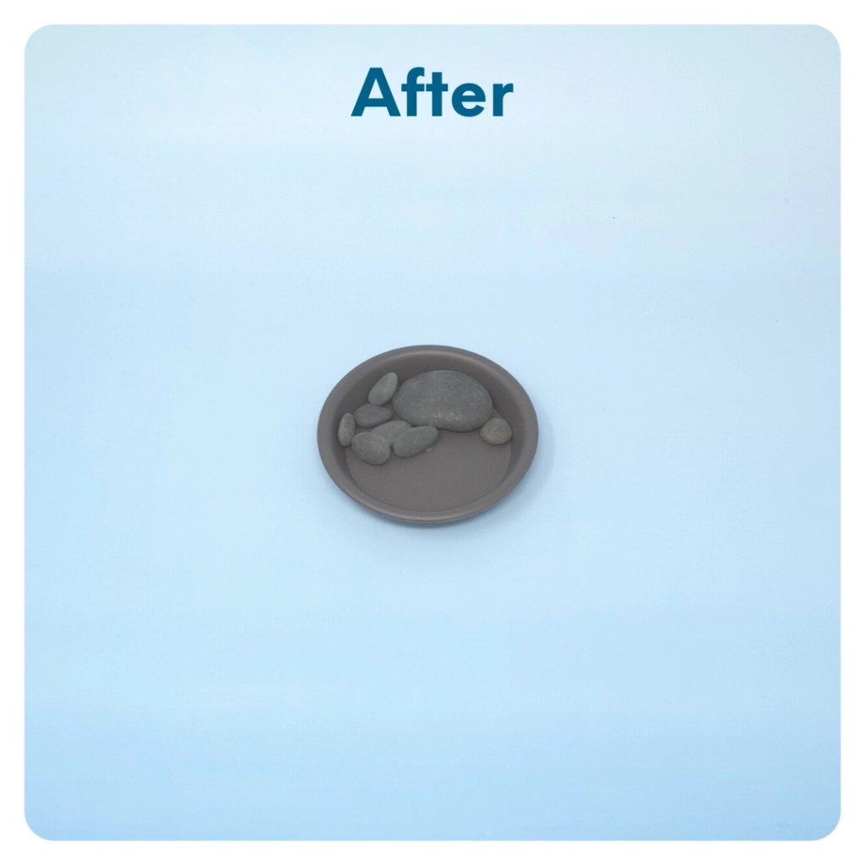
STEP 7 OF 11
Make a Bee Bath (continued)
• Place the included rocks into the tray. These will provide a place for the bees to land near the water. (Optional: Add additional material to the bee bath, such as sticks, sea shells, or additional stones).
• Later, fill the container with water and place it outside near plants or a garden. Refill it frequently to continuously attract bees to your space.

Slide 12
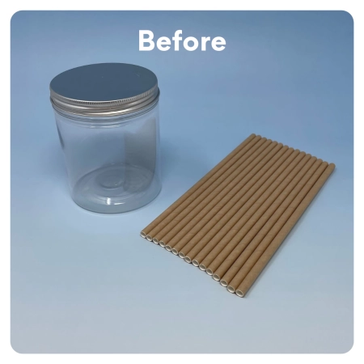
STEP 8 OF 11
DIY Bee House or Bird Feeder
You can use the items in this kit to make either a Bee House or a Bird Feeder.
Bee House
• Decorate the tin can using the paint pens.
• Cut the straws to fit inside the tin can. Use the loose leaf paper to make more straws by wrapping the paper around a pencil or pen for sizing. Fill the tin can with the paper straws and the paper rolls you made
• Tie the twine around the bee house and hang outside!
Bee House
Bird Feeder
• Decorate the tin can using the paint pens.

Slide 13
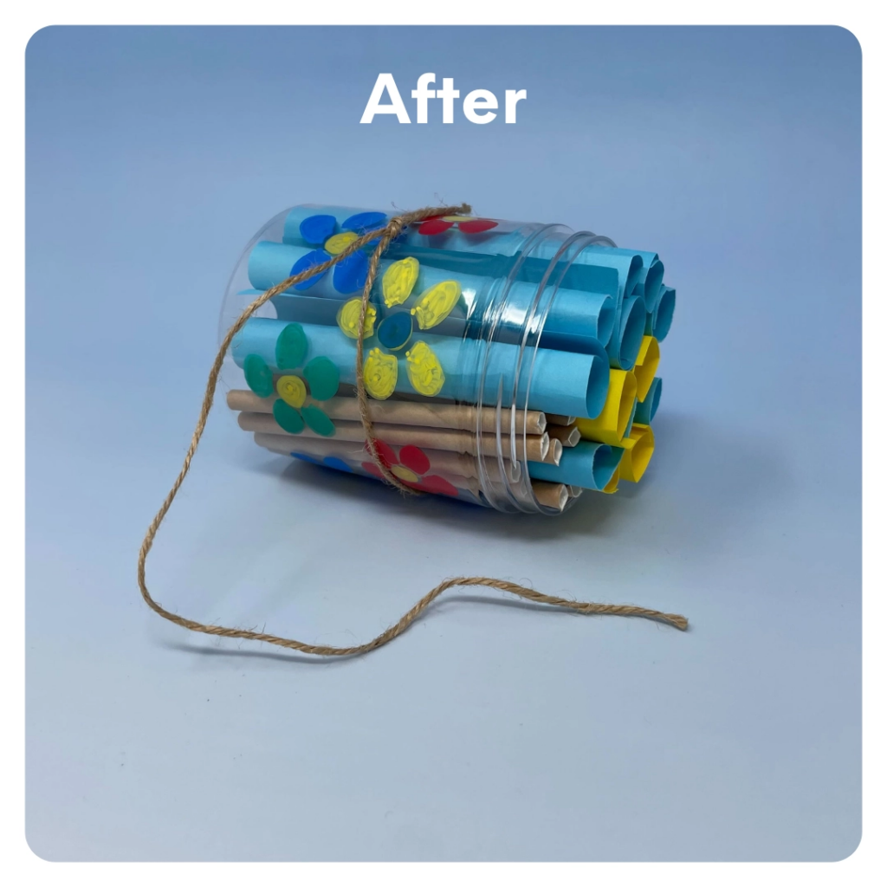
STEP 8 OF 11
DIY Bee House or Bird Feeder (continued)
• Glue a paper straw into the tin can, making sure enough of the straw is coming out of the can so birds can perch on it to eat.
• Tie the twine around the bird feeder, fill with bird seeds, and hang it outside!
Bird Feeder

Slide 14
STEP 9 OF 11
Pack the Environmental Impact [Plus] Kit
This kit is designed for you to keep and place the items you've made in the environment or use the included items to be more environmentally conscious.
Reusable Items to Prevent the Use of Additional Plastics
• Take this reusable straw with you when you are on the go and prevent the use of additional plastics in the environment.
• Use the reusable ziploc bags for your snack or leftovers
• Take the produce bags with you on your next grocery run to put your fresh fruits and vegetables in.

Slide 15
STEP 10 OF 11
Register My Kit (Optional)
Register your kit. To register and track your kits, you must visit the online instructions. Registering your kit is optional.

Slide 16
STEP 11 OF 11
Thank You!
When you build a Kynd Kit, you create layers of impact for yourself and the community. We appreciate your time and your support of our mission.
Cheers,
The Project Helping team

