Slide 1

CLASSIC
Financial Literacy [Classic]
12 STEPS

Slide 2

STEP 1 OF 12
About Project Helping
Kynd Kits are a program of Project Helping, a mental wellness nonprofit. Our mission is to make it ridiculously easy to volunteer because doing good is good for your mental wellness!
Learn More at ProjectHelping.org
When You Build a Kynd Kit - The Cycle of Impact

Slide 3

STEP 2 OF 12
Tips for Building Your Kit
Helpful Tip for Building Your Kynd Kit
• Avoid politics and religion entirely.
• Use appropriate humor.
• Can't think of what to write, draw a picture!
• Use words of affirmation!
• Place a piece of paper in any canvas bag before drawing on the outside. This way, the marker will not bleed through the other side of the bag.
• Please keep your designs gender-neutral, inclusive, and age-appropriate.
Spanish Translation Options

Slide 4
STEP 3 OF 12
Financial Literacy [Classic]
Before You Build
About the Recipient
Young adults in the U.S. today are facing a perfect storm of personal and social pressures that can compromise their financial well-being: record lows in savings, record highs in student and consumer debt increasing living costs, and uncertain employment prospects.
Money Matters helps young people learn financial literacy, so they can make good financial choices as adults. Participants learn how to manage a checking account, create a budget, save and invest, start small businesses, and pay for college.

Slide 5
STEP 3 OF 12
Financial Literacy [Classic] (continued)
Use the contents of this Kynd Kit to build a financial literacy kit for teens at the Boys and Girls Club going through the Money Matters program. Building financial literacy and awareness early can help to create good financial habits for life. Teens who complete this program show improved financial management skills, including saving money and sticking to a budget.

Slide 6

STEP 4 OF 12
Decorate the Bag
Decorate the kraft bag(s). This is what the final kit is distributed in, so try to make this fun and colorful for the recipient to open.
Please note: we are currently transitioning from plastic ziplock bags to kraft bags. Some kits may still include the plastic bag for you to decorate while we complete this transition.

Slide 7



STEP 4 OF 12
Decorate the Bag (continued)

Slide 8

STEP 5 OF 12
Write a Note to the Recipient and Decorate the Envelope
Write a card and decorate the envelope using the enclosed materials. Express your encouragement and include a hopeful message.
Please ensure your message is age-appropriate and avoids references to religion or politics.

Slide 9

STEP 5 OF 12
Write a Note to the Recipient and Decorate the Envelope (continued)

Slide 10
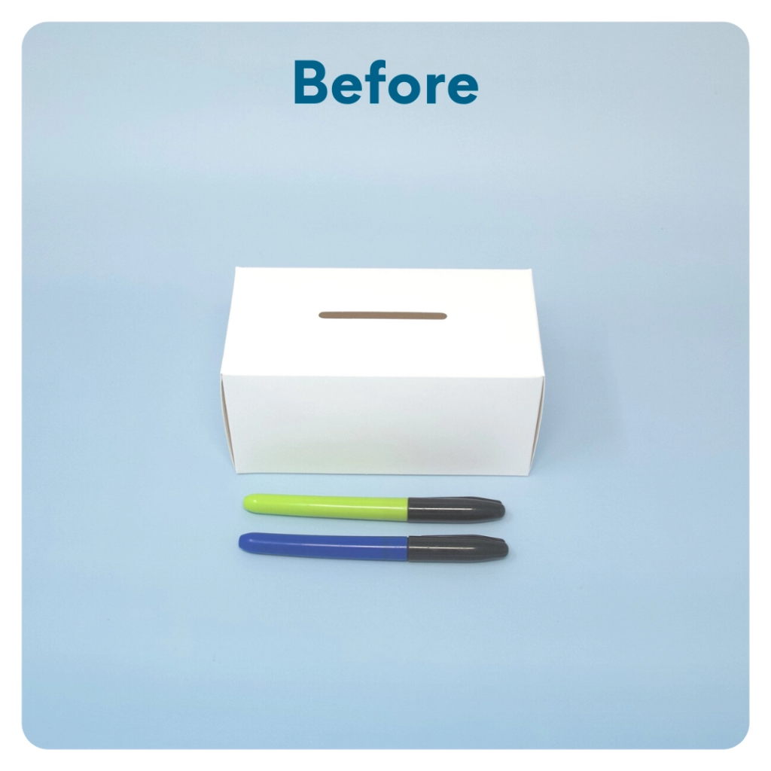
STEP 6 OF 12
DIY Piggy Bank
Customize the piggy bank. Consider adding a short financial literacy message about saving.
Tip: Build the piggy bank to decorate, then break it down to fit it in the final kit!

Slide 11
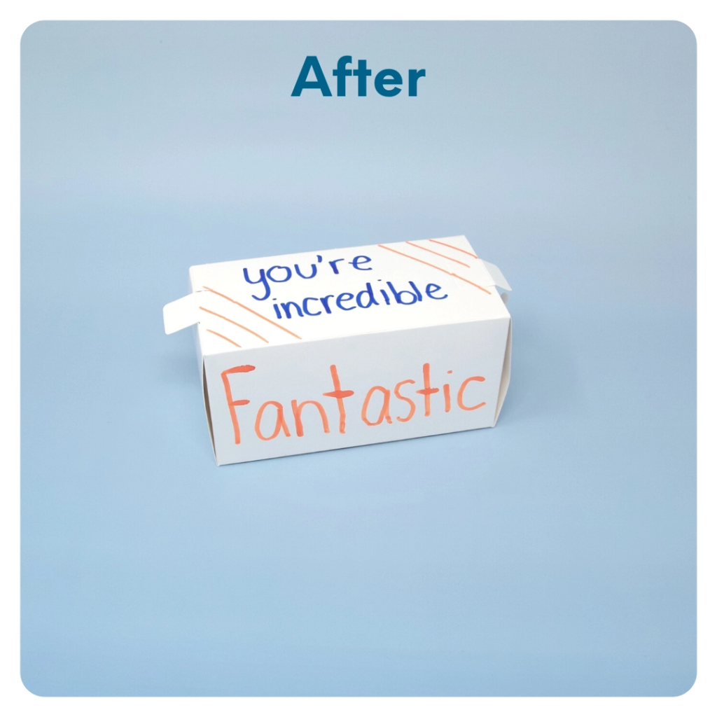
STEP 6 OF 12
DIY Piggy Bank (continued)

Slide 12
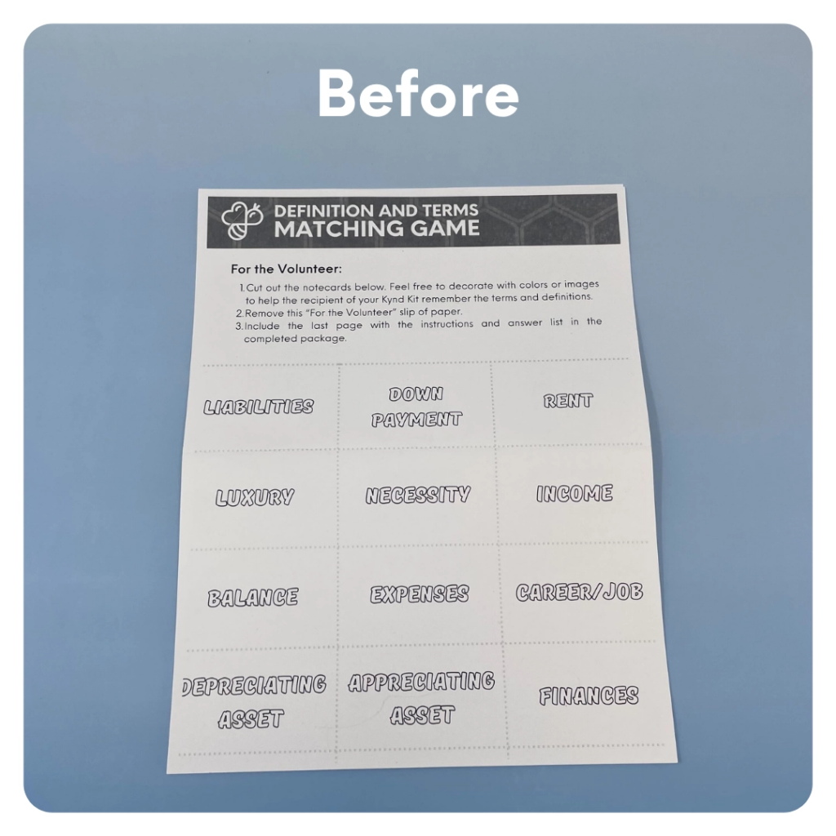
STEP 7 OF 12
Make Financial Literacy Flashcards
Color in the flashcards to make them fun and colorful! Cut them out and use the rubber band to secure them.
• We are currently transitioning this activity. If you have index cards, please create your own flashcards using the terms/definitions and index cards.

Slide 13
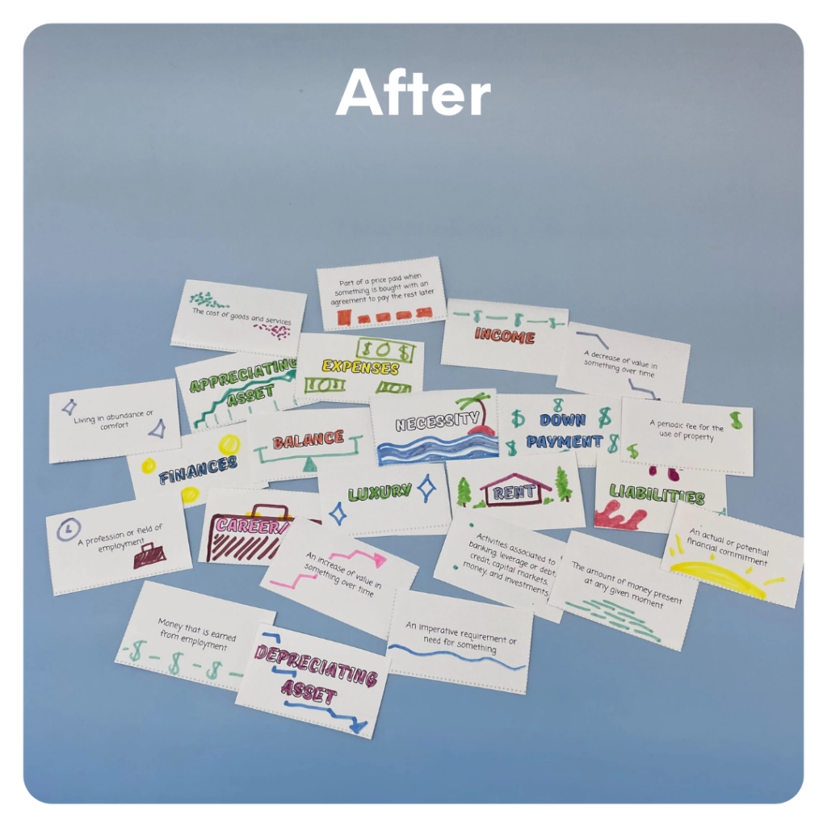
STEP 7 OF 12
Make Financial Literacy Flashcards (continued)

Slide 14
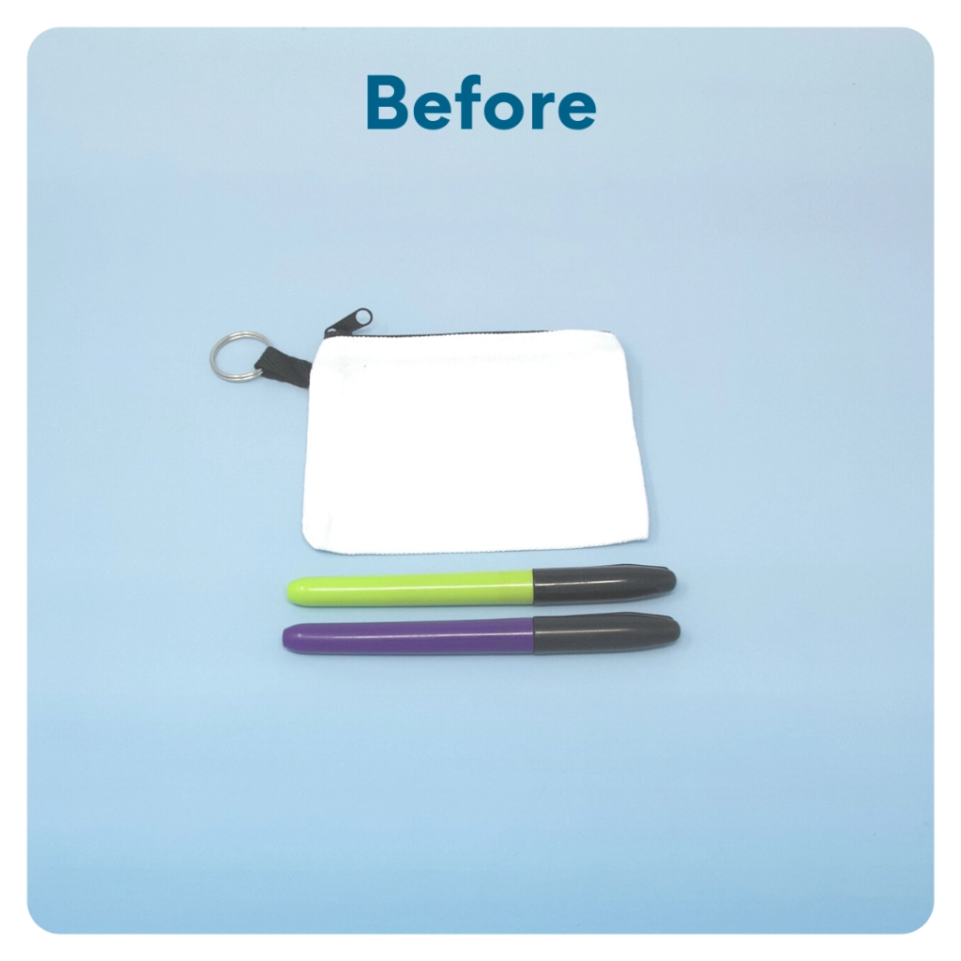
STEP 8 OF 12
DIY Coin Purse
Use the permanent markers to decorate the small coin purse. Use financial terms such as save, donate, spend, and invest.

Slide 15
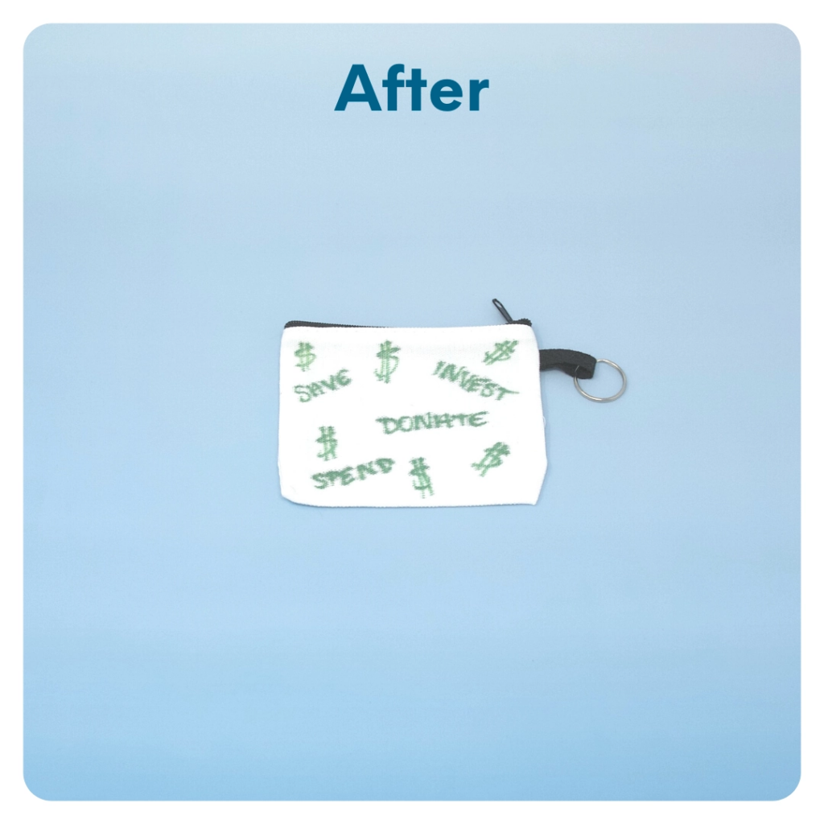
STEP 8 OF 12
DIY Coin Purse (continued)

Slide 16

STEP 9 OF 12
Surprise Kyndness Notebook
Decorate the outside of the journal with a picture or uplifting message. Use random pages in the journal to write short, uplifting messages, draw small, colorful images, or create fun writing prompts for the recipient.

Slide 17

STEP 9 OF 12
Surprise Kyndness Notebook (continued)

Slide 18
STEP 10 OF 12
Pack The Financial Literacy Kit
Pack all of the materials into the decorated plastic bag and put it back into the original box.
Please only include items that are UNOPENED and UNUSED.
• Add any optional items you would like.
Optional items to add:
• Financial activity books
• Calculator
• Budget template
• Additional flashcards
• Fidget toys
Items not to include:
• Perishable items
• Sharp objects
• Nut food products
• Religious or political items

Slide 19
STEP 11 OF 12
Register My Kit (Optional)
Register your kit. To register and track your kits, you must visit the online instructions. Registering your kit is optional.

Slide 20
STEP 12 OF 12
Thank You!
When you build a Kynd Kit, you create layers of impact for yourself and the community. We appreciate your time and your support of our mission.
Cheers,
The Project Helping team

