Slide 1
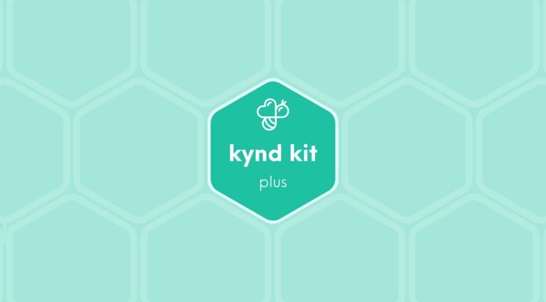
PLUS
Financial Literacy [Plus]
13 STEPS

Slide 2

STEP 1 OF 13
About Project Helping
Kynd Kits are a program of Project Helping, a mental wellness nonprofit. Our mission is to make it ridiculously easy to volunteer because doing good is good for your mental wellness!
Learn More at ProjectHelping.org
When You Build a Kynd Kit - The Cycle of Impact

Slide 3

STEP 2 OF 13
Tips for Building Your Kit
Helpful Tip for Building Your Kynd Kit
• Avoid politics and religion entirely.
• Use appropriate humor.
• Can't think of what to write, draw a picture!
• Use words of affirmation!
• Place a piece of paper in any canvas bag before drawing on the outside. This way, the marker will not bleed through the other side of the bag.
• Please keep your designs gender-neutral, inclusive, and age-appropriate.
Spanish Translation Options

Slide 4
STEP 3 OF 13
Financial Literacy [+]
Before You Build
Young adults in the U.S. today are facing a perfect storm of personal and social pressures that can compromise their financial well-being: record lows in savings, record highs in student and consumer debt, increasing living costs, and uncertain employment prospects. Money Matters helps young people learn financial literacy so they can make good financial choices as adults. Participants learn how to manage a checking account, create a budget, save and invest, start small businesses, and pay for college.

Slide 5
STEP 3 OF 13
Financial Literacy [+] (continued)
Use the contents of this kit to build a financial literacy kit for teens at the Boys and Girls Club going through the Money Matters program. Building financial literacy and awareness early can help to create good financial habits for life. Teens who complete this program show improved financial management skills, including saving money and sticking to a budget.

Slide 6

STEP 4 OF 13
Write a Note to the Recipient and Decorate the Envelope
Write a card and decorate the envelope using the enclosed materials. Express your encouragement and include a hopeful message.
Please ensure your message is age-appropriate and avoids references to religion or politics.

Slide 7

STEP 4 OF 13
Write a Note to the Recipient and Decorate the Envelope (continued)

Slide 8
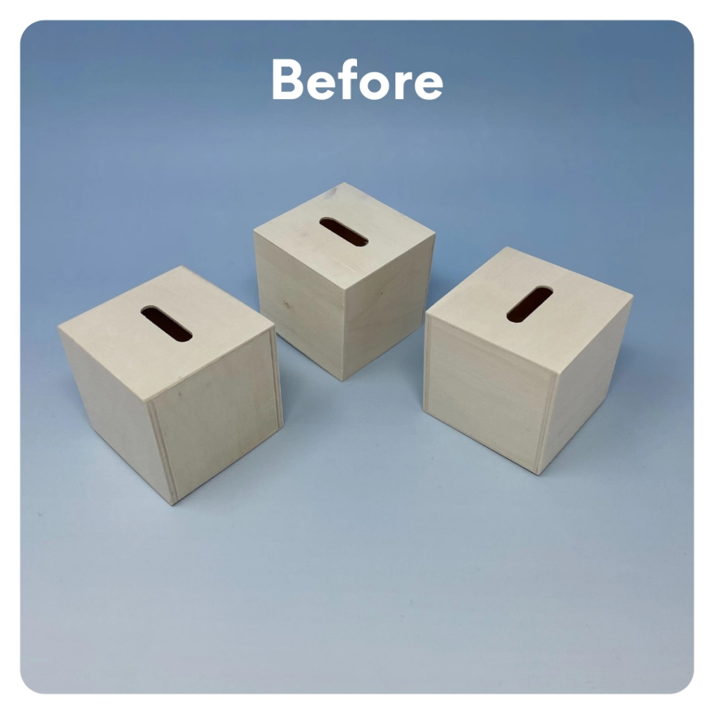
STEP 5 OF 13
Decorate the Piggy Bank
Use the included materials, along with any materials you have, to customize the piggy banks. Make one piggy bank for each of the following pillars: Save, Spend, and Donate.

Slide 9
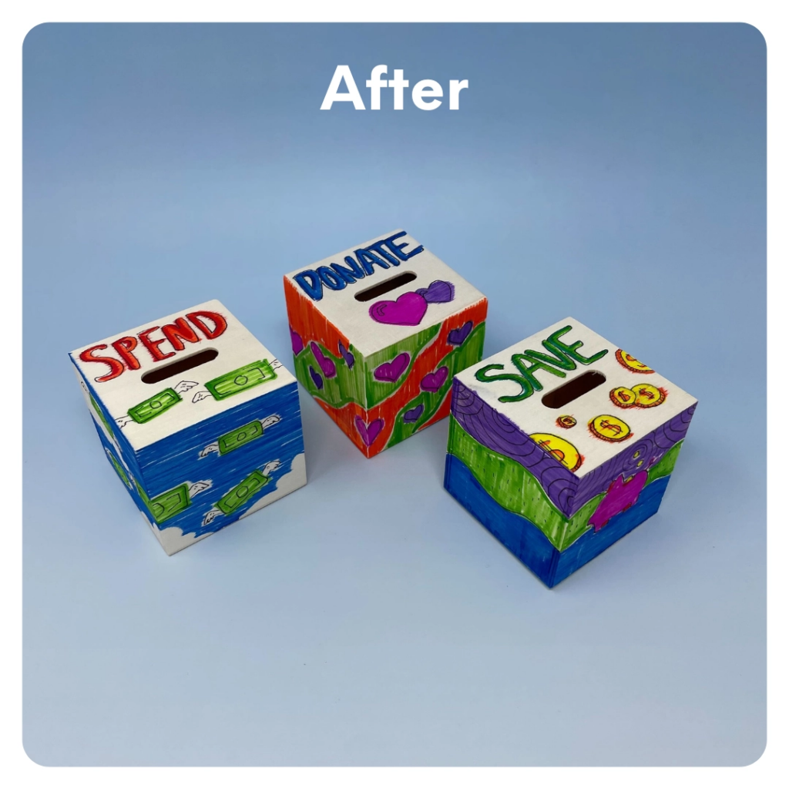
STEP 5 OF 13
Decorate the Piggy Bank (continued)

Slide 10
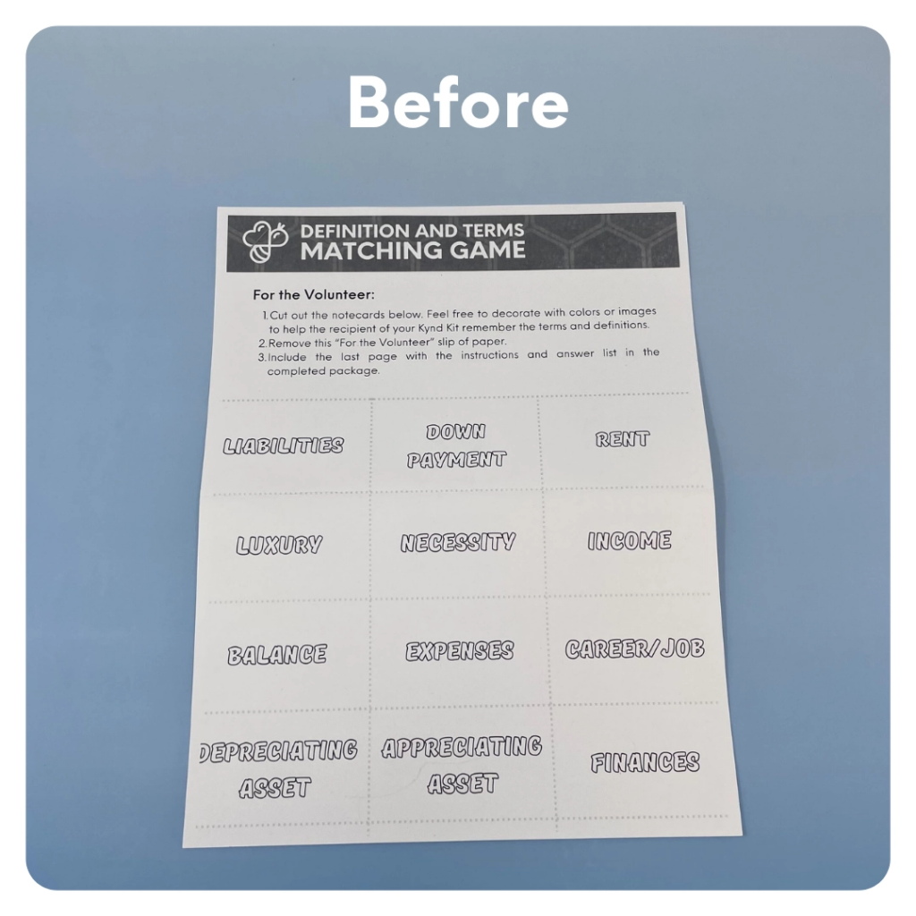
STEP 6 OF 13
Make Financial Literacy Flashcards
Color in the flashcards to make them fun and colorful! Cut them out and use the rubber band to secure them.
• We are currently transitioning this activity. If you have index cards, please create your own flashcards using the terms/definitions and index cards.

Slide 11
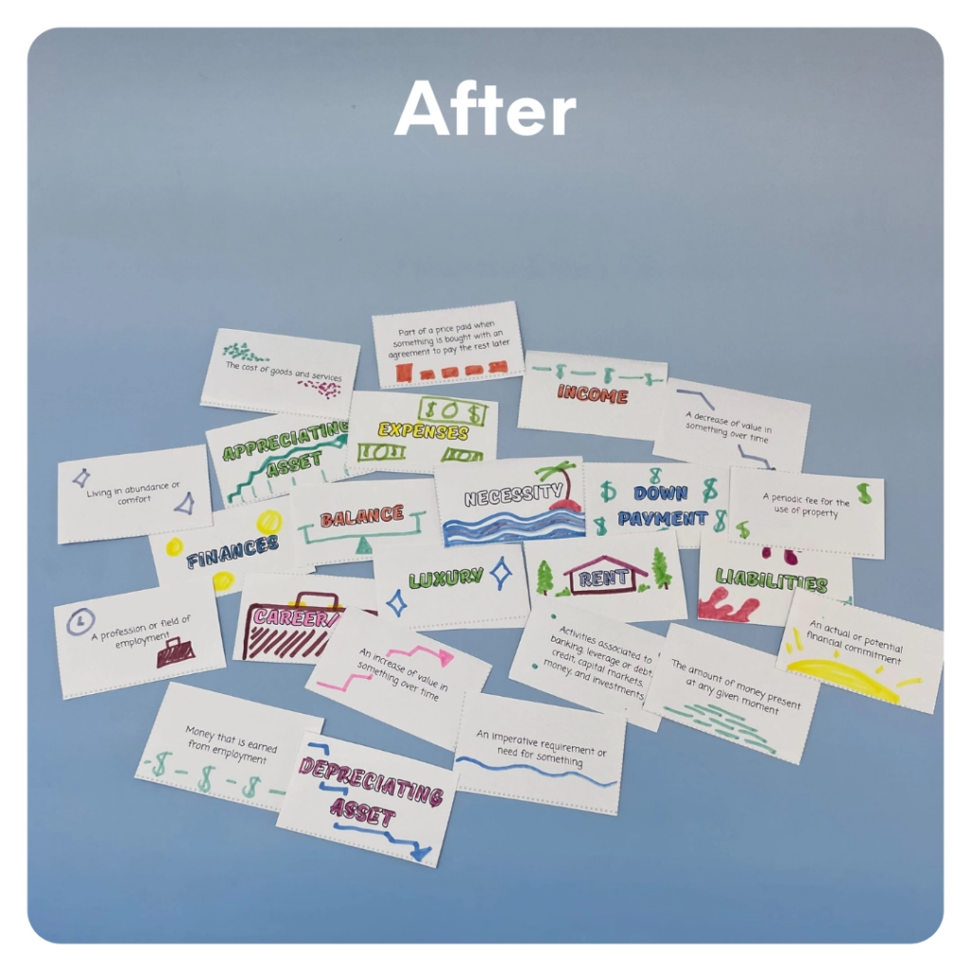
STEP 6 OF 13
Make Financial Literacy Flashcards (continued)

Slide 12
STEP 7 OF 13
Financial Literacy Workbook
This workbook is designed for the recipient to engage in games and complete exercises that will enhance their financial literacy. The smarties in this kit are used for one of the games in the workbook, so please ensure they stay in the kit.
(If you are completing this kit with your children, please feel free to grab a piece of paper and do these exercises with them. Just make sure to leave the workbook blank so the recipient can complete it.)

Slide 13
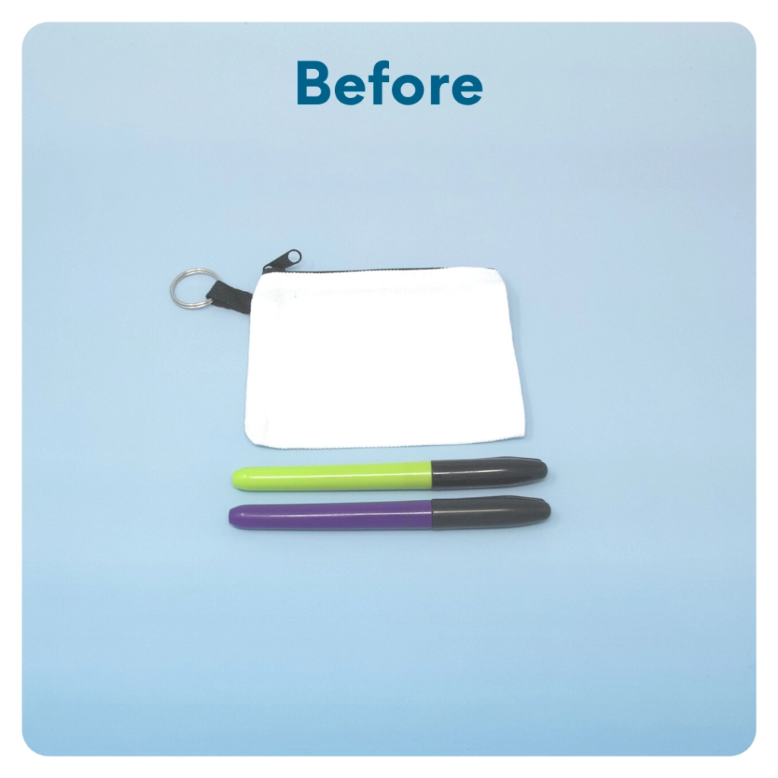
STEP 8 OF 13
DIY Coin Purse
Use the permanent markers to decorate the small coin purse. Use financial terms such as save, donate, spend, and invest.

Slide 14
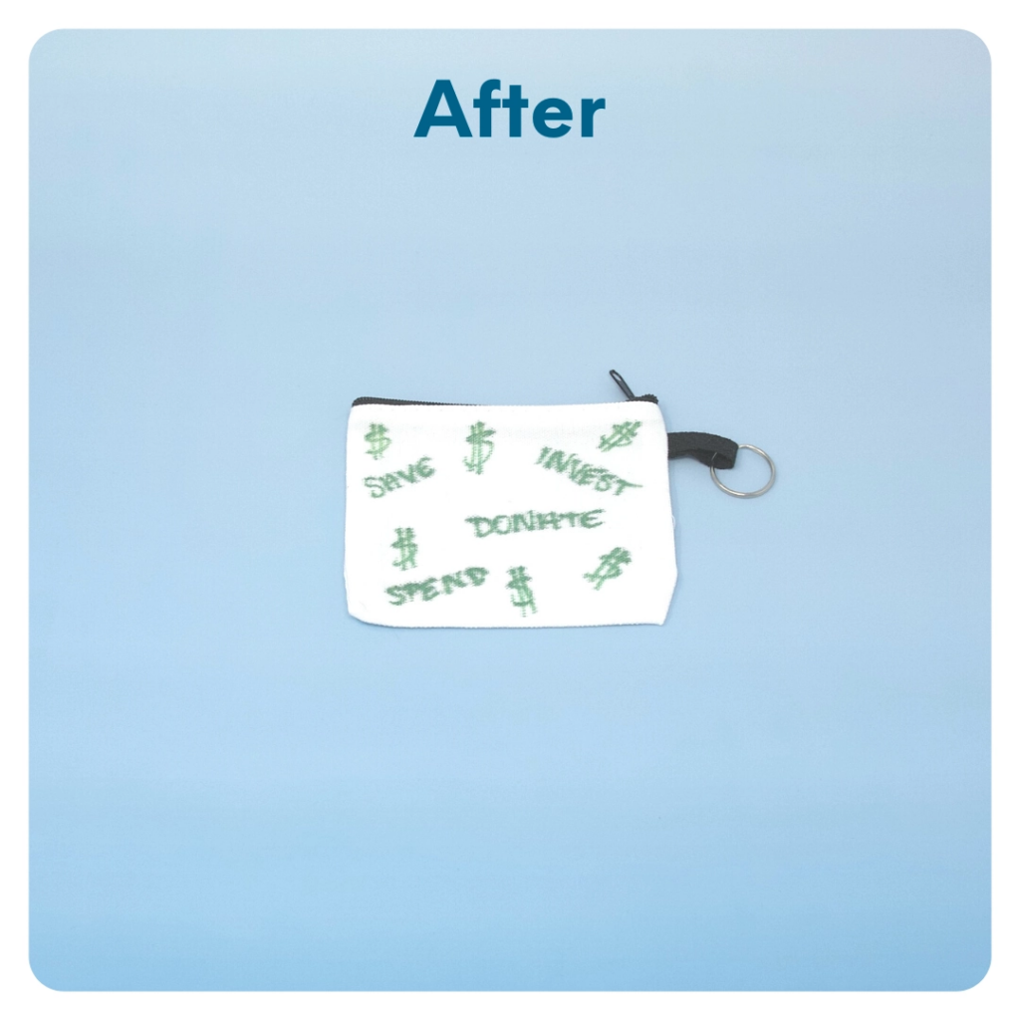
STEP 8 OF 13
DIY Coin Purse (continued)

Slide 15

STEP 9 OF 13
Surprise Kyndness Notebook
Decorate the outside of the journal with a picture or uplifting message. Use random pages in the journal to write short, uplifting messages, draw small, colorful images, or create fun writing prompts for the recipient.

Slide 16

STEP 9 OF 13
Surprise Kyndness Notebook (continued)

Slide 17
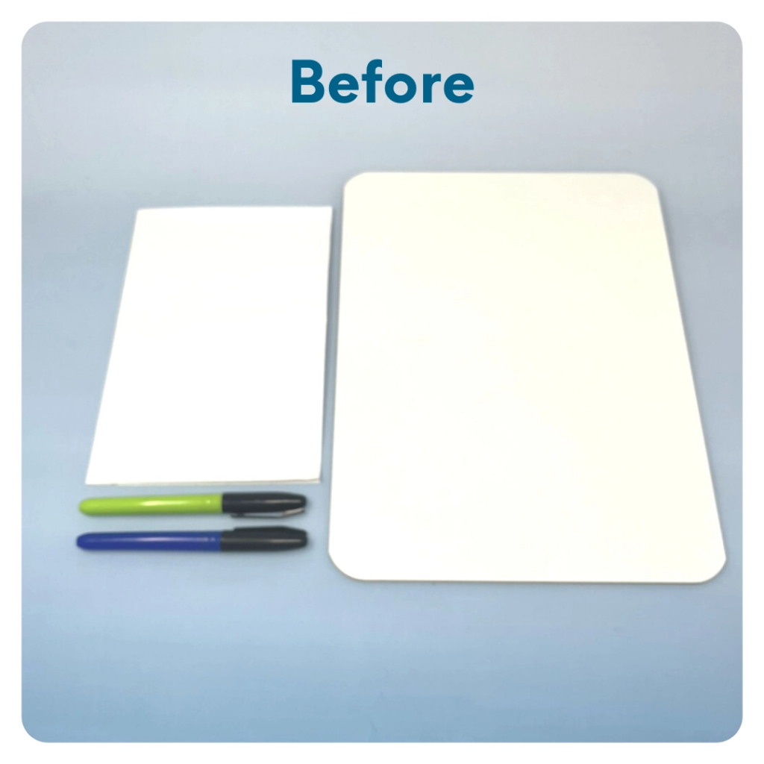
STEP 10 OF 13
Mini White Board
Stick the white 5 x 8 stickers to the back of the whiteboard. Use the crayons, colored pencils, or other writing materials to decorate the stickers with an uplifting message or picture for the recipient to see while using the board.

Slide 18
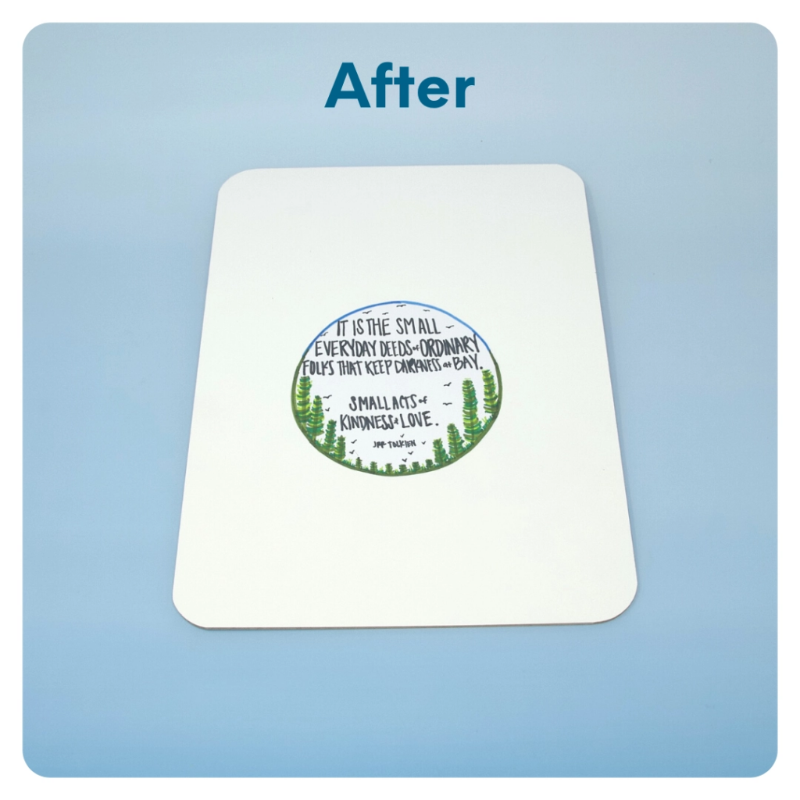
STEP 10 OF 13
Mini White Board (continued)

Slide 19
STEP 11 OF 13
Pack the Financial Literacy [Plus] Kit
Pack all of the materials into the original box.
• Please only include items that are UNOPENED and UNUSED
• Add any optional items you would like.
Optional Items to Add
• Financial activity books
• Calculator
• Budget template
• Additional flashcards
• Fidget toys
Items not to include:
• Perishable items
• Sharp objects
• Nut food products
• Religious or political items

Slide 20
STEP 12 OF 13
Register My Kit (Optional)
Register your kit. To register and track your kits, you must visit the online instructions. Registering your kit is optional.

Slide 21
STEP 13 OF 13
Thank You!
When you build a Kynd Kit, you create layers of impact for yourself and the community. We appreciate your time and your support of our mission.
Cheers,
The Project Helping team

