Slide 1

MAX
Food Insecurity Support [Max]
12 STEPS

Slide 2

STEP 1 OF 12
About Project Helping
Kynd Kits are a program of Project Helping, a mental wellness nonprofit. Our mission is to make it ridiculously easy to volunteer because doing good is good for your mental wellness!
Learn More at ProjectHelping.org
When You Build a Kynd Kit - The Cycle of Impact

Slide 3

STEP 2 OF 12
Tips for Building Your Kit
Helpful Tip for Building Your Kynd Kit
• Avoid politics and religion entirely.
• Use appropriate humor.
• Can't think of what to write, draw a picture!
• Use words of affirmation!
• Place a piece of paper in any canvas bag before drawing on the outside. This way, the marker will not bleed through the other side of the bag.
• Please keep your designs gender-neutral, inclusive, and age-appropriate.
Spanish Translation Options

Slide 4
STEP 3 OF 12
Food Insecurity Support [Max]
Before You Build
This kit was built with Conscious Alliance who partners with bands, artists, and fans to host food drives at concerts and music festivals across the country. From this they distribute healthy food to communities by partnering with schools, pantries, and other organizations working in the hearts of neighborhoods with an emphasis on remote rural areas including Native American reservations.

Slide 5
STEP 3 OF 12
Food Insecurity Support [Max] (continued)
Food insecurity is the condition of not having access to sufficient food, or food of an adequate quality, to meet one's basic needs. Unfortunately, many people in America struggle to meet their basic needs, which increases their risk of food insecurity. For example, lay-offs at work, unexpected car maintenance, or an accident can suddenly force a family to choose between buying food and paying bills. More than 34 million people, including 9 million children experience food insecurity in the United States.

Slide 6

STEP 4 OF 12
Write a Note to the Recipient and Decorate the Envelope
Write a card and decorate the envelope using the enclosed materials. Express your encouragement and include a hopeful message.
Please ensure your message is age-appropriate and avoids references to religion or politics.

Slide 7

STEP 4 OF 12
Write a Note to the Recipient and Decorate the Envelope (continued)

Slide 8
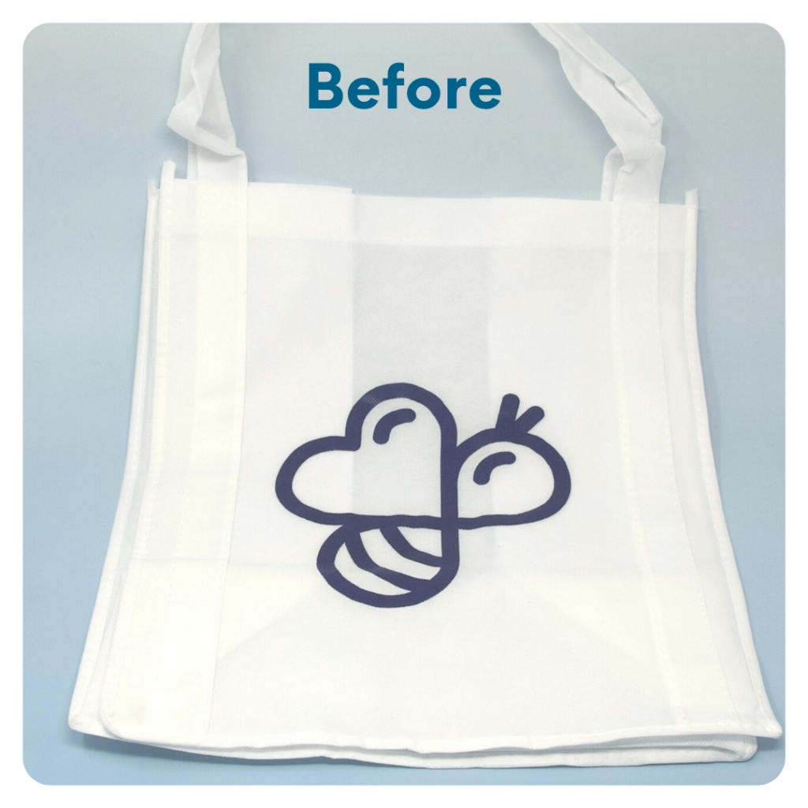
STEP 5 OF 12
DIY Tote Bag
Decorate the Canvas Tote
Decorate the canvas tote to make it fun and colorful! Tip: place a piece of paper in the tote before decorating. This will prevent the marker from bleeding through the tote.

Slide 9

STEP 5 OF 12
DIY Tote Bag (continued)

Slide 10
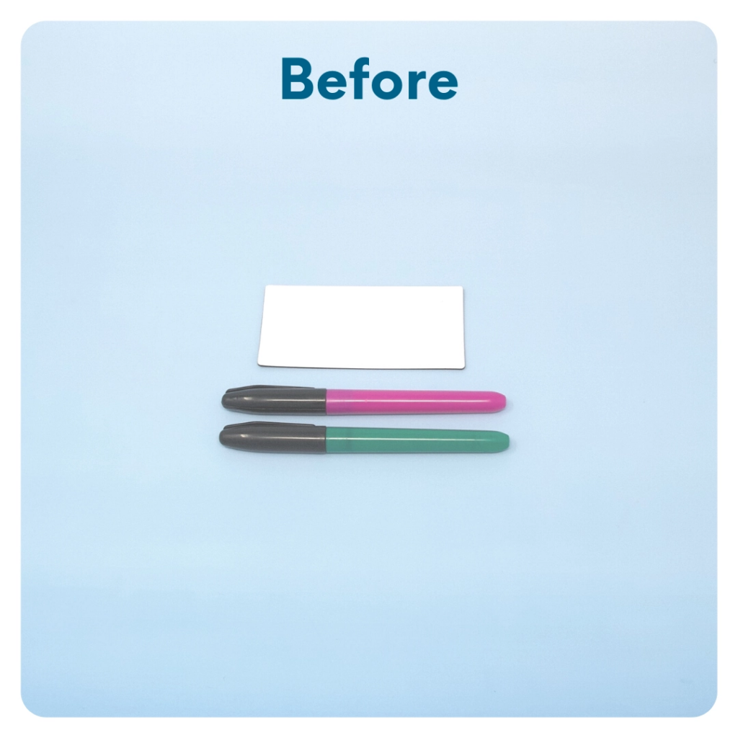
STEP 6 OF 12
DIY Magnets
You will either have magnets or cardstock squares with magnet dots in your kit. Decorate them with pictures, I am statements, encouraging quotes, jokes, etc. If you have magnet dots, stick them to the back of each cardstock square to make a fun magnet.

Slide 11
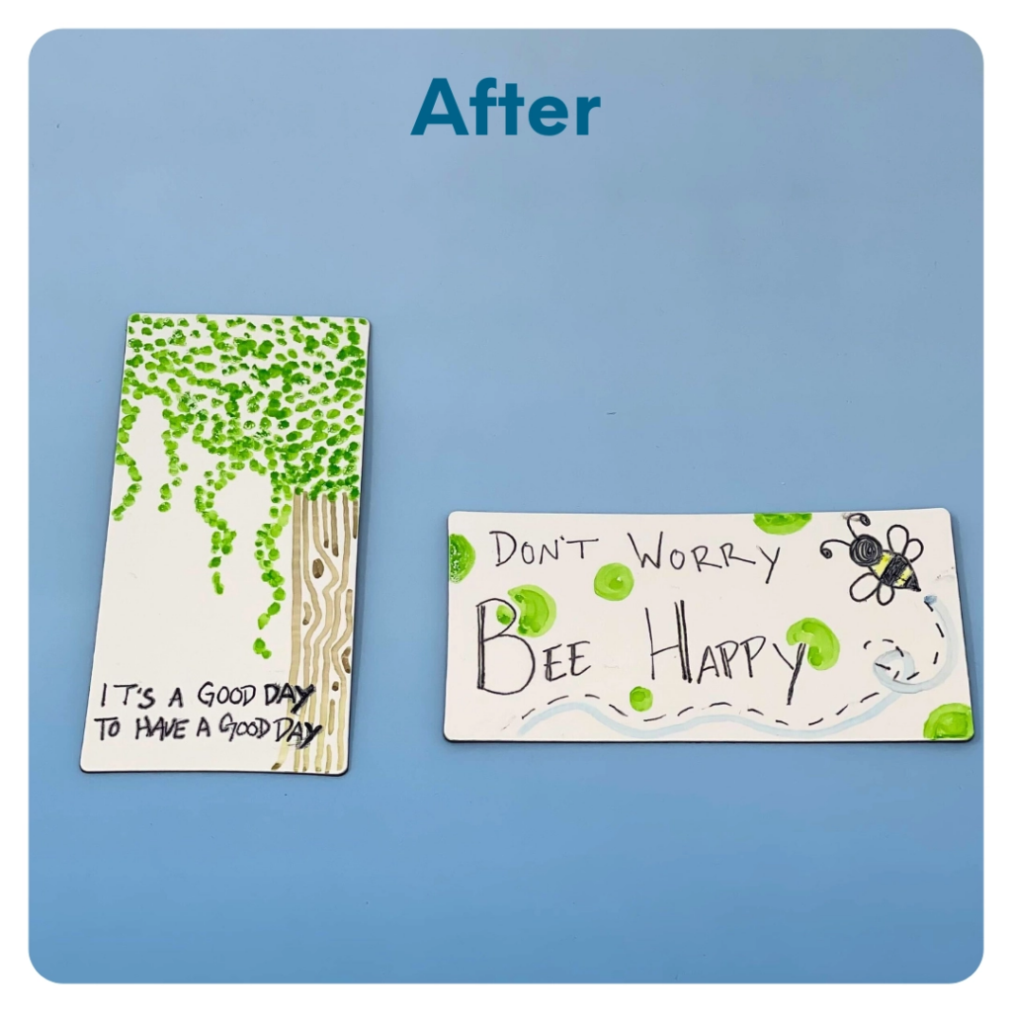
STEP 6 OF 12
DIY Magnets (continued)

Slide 12
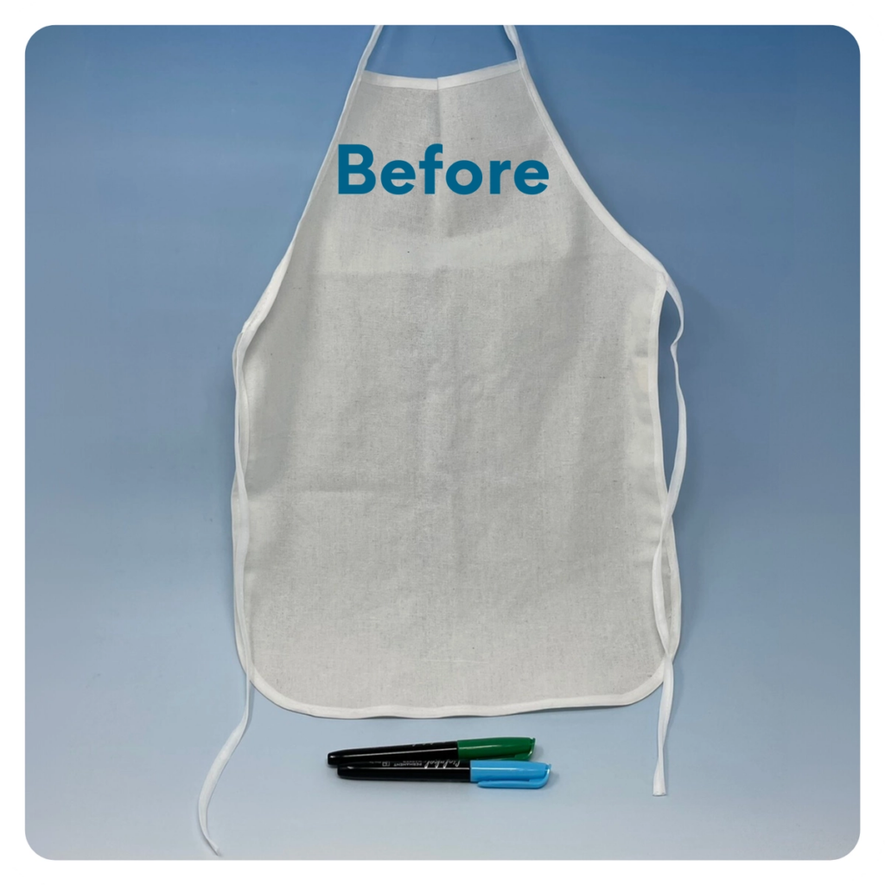
STEP 7 OF 12
DIY Apron
Create a fun and colorful apron using the permanent markers included in the kit.

Slide 13
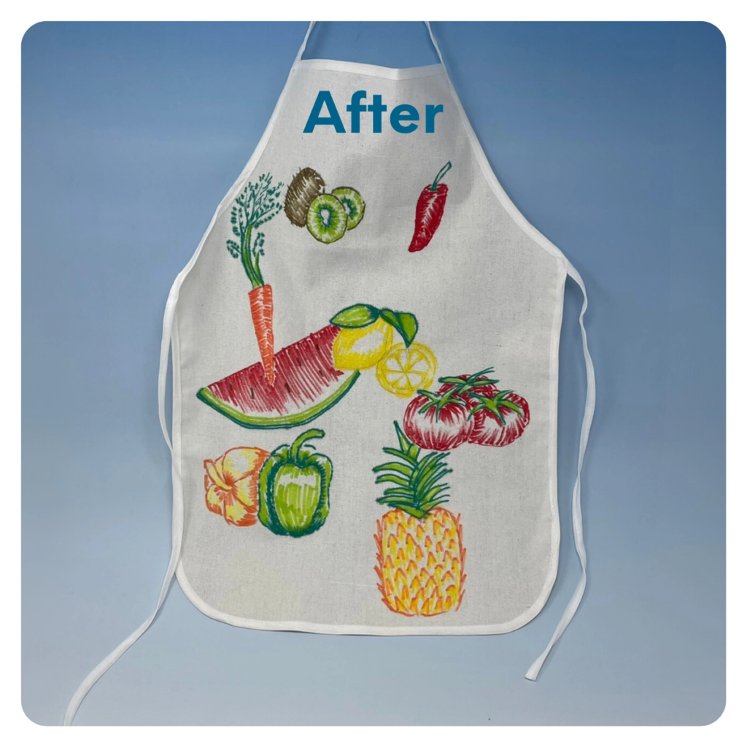
STEP 7 OF 12
DIY Apron (continued)

Slide 14
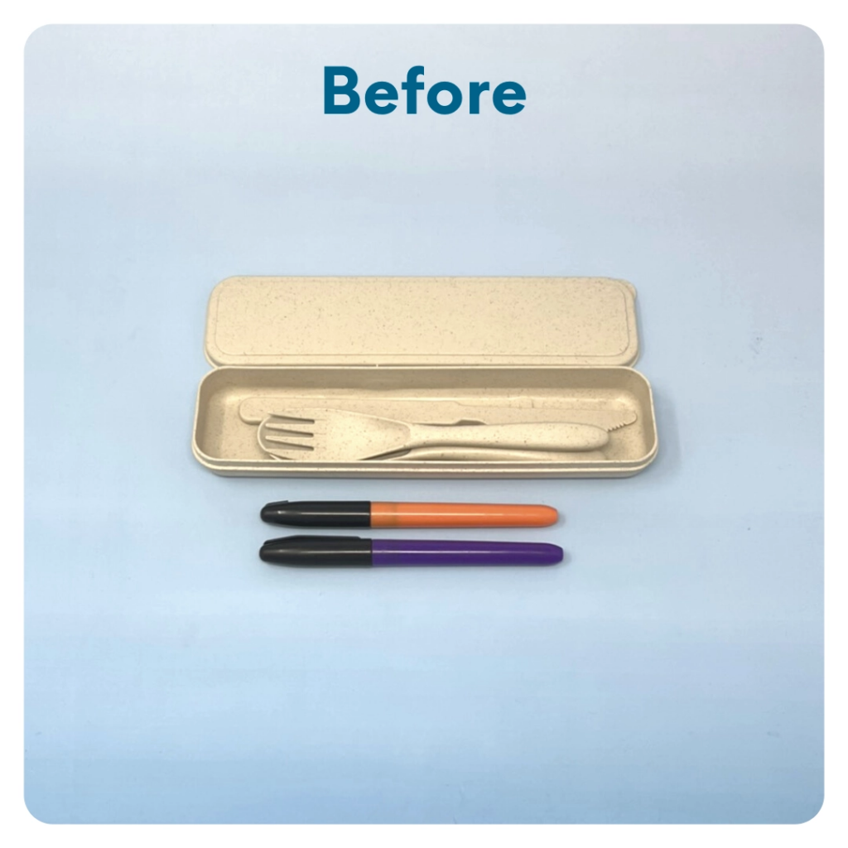
STEP 8 OF 12
Decorate the Utensil Holder
Use the permanent markers to decorate the utensil holder with a picture, quote, or words of affirmation.

Slide 15
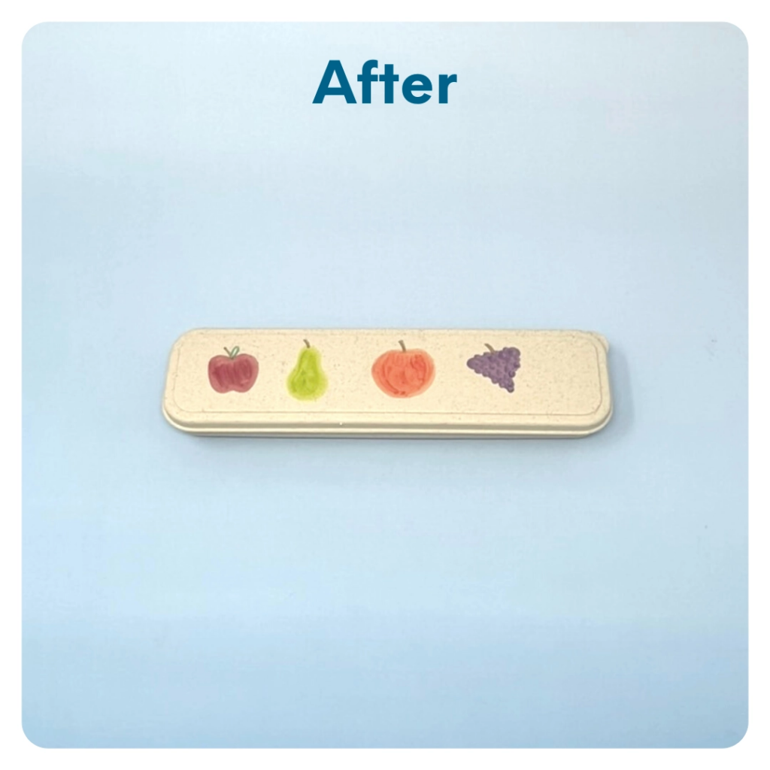
STEP 8 OF 12
Decorate the Utensil Holder (continued)

Slide 16
STEP 9 OF 12
Nonperishable Food
Go Through Your Pantry and Additional Nonperishable Food!
• Pasta
• Rice
• Oats -Beans
• Spices
• Canned soup
• Canned vegetables/fruit
• Broth
• Nuts
• Granola Bars
• Tuna/chicken pouches
• Raisins
• Nut butter
• Powdered milk
• Sugar/flour

Slide 17
STEP 10 OF 12
Pack The Food Insecurity Support Kit
Pack all of the materials into the decorated tote bag and put it back into the original box.
• Please only include items that are UNOPENED and UNUSED
• Add any optional items you would like.
Optional Items to Add:
• Additional nonperishable foods
• Journal
• Fidget toys
• Activity/coloring books
Items not to include:
• Perishable items
• Sharp objects
• Religious or political items

Slide 18
STEP 11 OF 12
Register My Kit (Optional)
Register your kit. To register and track your kits, you must visit the online instructions. Registering your kit is optional.

Slide 19
STEP 12 OF 12
Thank You!
When you build a Kynd Kit, you create layers of impact for yourself and the community. We appreciate your time and your support of our mission.
Cheers,
The Project Helping team

