Slide 1

PLUS
Foster Youth Activity Kit [Plus]
12 STEPS

Slide 2

STEP 1 OF 12
About Project Helping
Kynd Kits are a program of Project Helping, a mental wellness nonprofit. Our mission is to make it ridiculously easy to volunteer because doing good is good for your mental wellness!
Learn More at ProjectHelping.org
When You Build a Kynd Kit - The Cycle of Impact

Slide 3

STEP 2 OF 12
Tips for Building Your Kit
Helpful Tip for Building Your Kynd Kit
• Avoid politics and religion entirely.
• Use appropriate humor.
• Can't think of what to write, draw a picture!
• Use words of affirmation!
• Place a piece of paper in any canvas bag before drawing on the outside. This way, the marker will not bleed through the other side of the bag.
• Please keep your designs gender-neutral, inclusive, and age-appropriate.
Spanish Translation Options

Slide 4
STEP 3 OF 12
Foster Youth Activity Bag [+]
Before You Build
Fos­ter care is meant to pro­vide safe, tempo­rary liv­ing arrange­ments and support ser­vices for chil­dren who have been removed from their fam­i­lies due to mal­treat­ment, lack of safe­ty or inadequate care. In 2021, 203,770 chil­dren under 18 entered fos­ter care in the Unit­ed States, a rate of 3 per 1,000. Kids ages 1 to 5 make up the largest share (29%) of chil­dren enter­ing care.

Slide 5
STEP 3 OF 12
Foster Youth Activity Bag [+] (continued)
These kits will be gifted to children involved with Advocates for Children at CASA. CASA stands for Court Appointed Special Advocates. These community volunteers, or CASAs, are trained to advocate on behalf of children who are involved in the child welfare system as a result of abuse or neglect. Most of these kids are in out-of-home placements such as foster care, group homes, or kinship care.
Create a fun and interactive activity kit for CASA volunteers to take to the children as they wait for their court hearing, visit with their parents in a supervised setting, or to just have some fun with their CASA volunteer.

Slide 6

STEP 4 OF 12
Write a Note to the Recipient and Decorate the Envelope
Write a card and decorate the envelope using the enclosed materials. Express your encouragement and include a hopeful message.
Please ensure your message is age-appropriate and avoids references to religion or politics.

Slide 7

STEP 4 OF 12
Write a Note to the Recipient and Decorate the Envelope (continued)

Slide 8
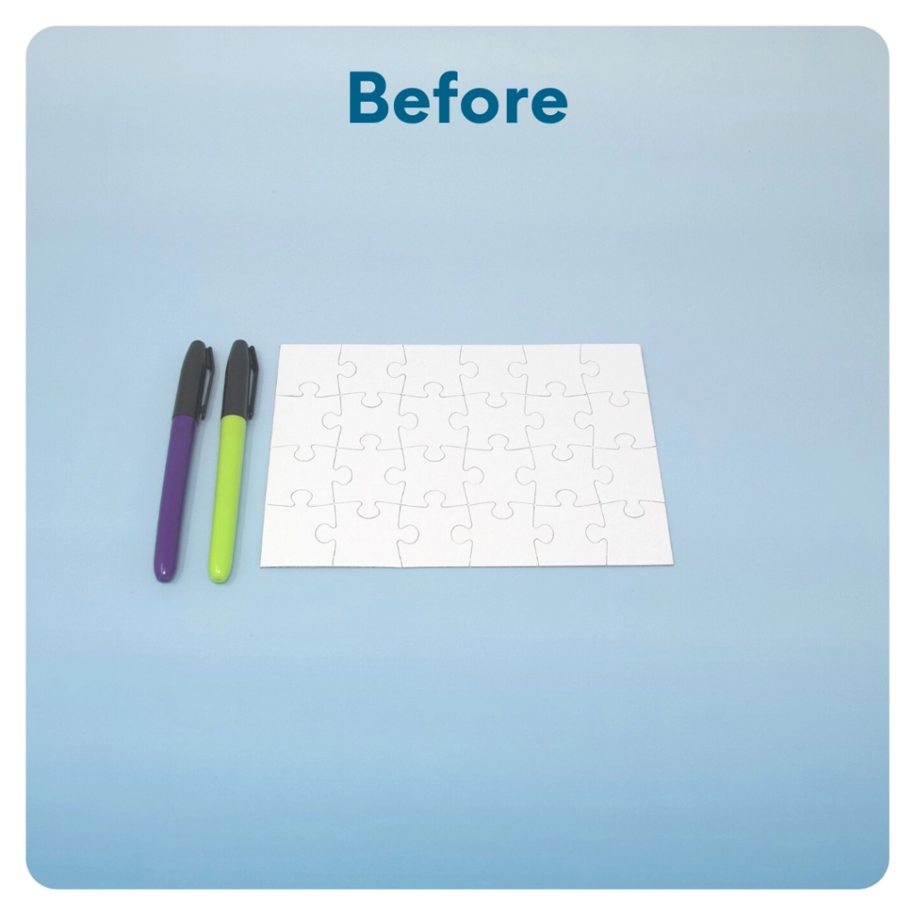
STEP 5 OF 12
DIY Jigsaw Puzzle
Start with the puzzle assembled. Decorate the whole puzzle, filling it with color or messaging from edge to edge. The small sorting envelope will hold the pieces of the completed puzzle. Decorate one side of the envelope with the same image or wording as the puzzle. Take the puzzle apart and put it in the envelope.

Slide 9
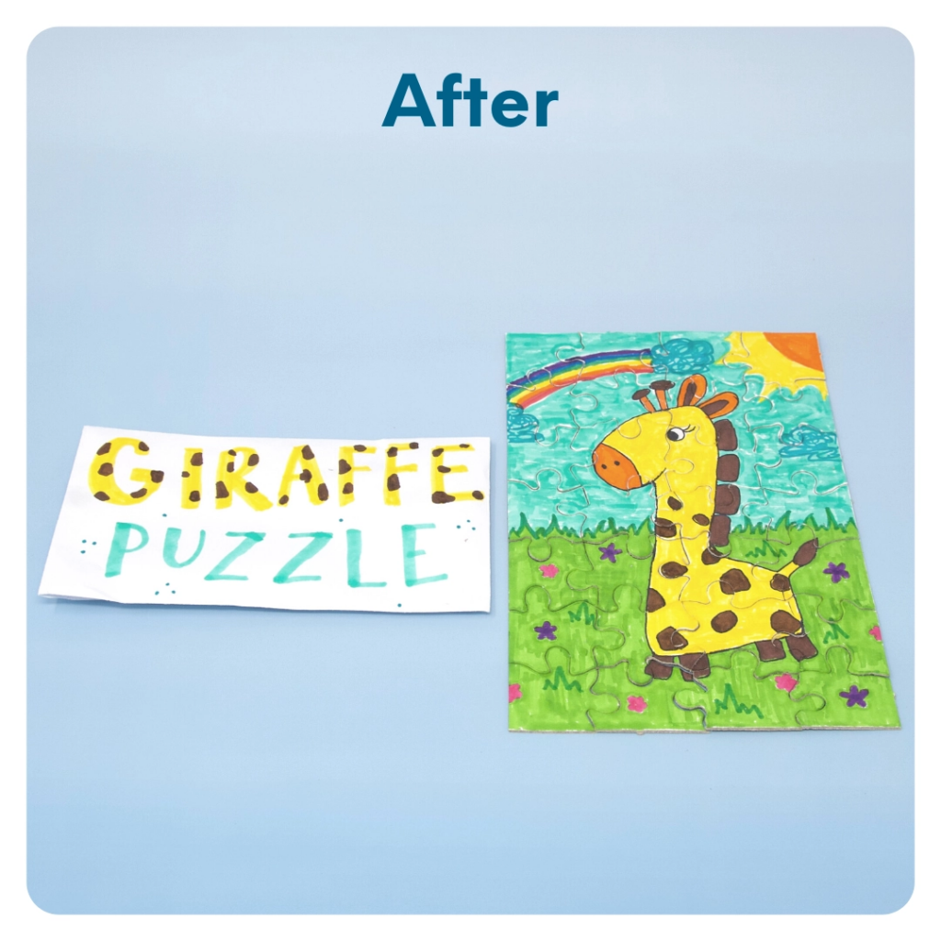
STEP 5 OF 12
DIY Jigsaw Puzzle (continued)

Slide 10
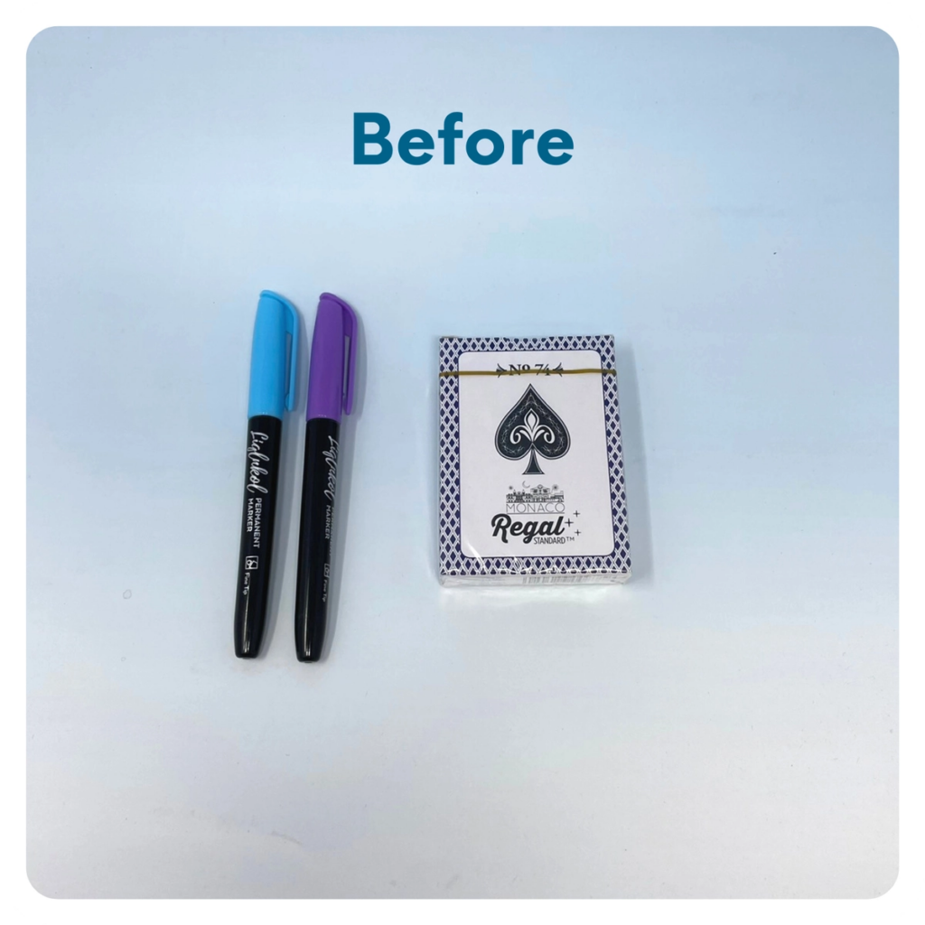
STEP 6 OF 12
Decorate the Playing Cards
Write encouraging messages, affirmations, jokes, or pictures on the faces of the playing cards for players to see when they are playing a card game.

Slide 11
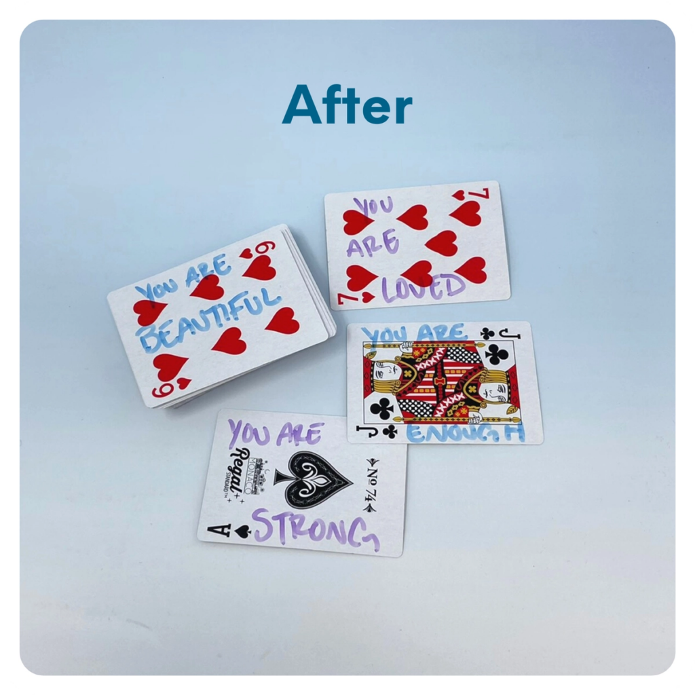
STEP 6 OF 12
Decorate the Playing Cards (continued)

Slide 12
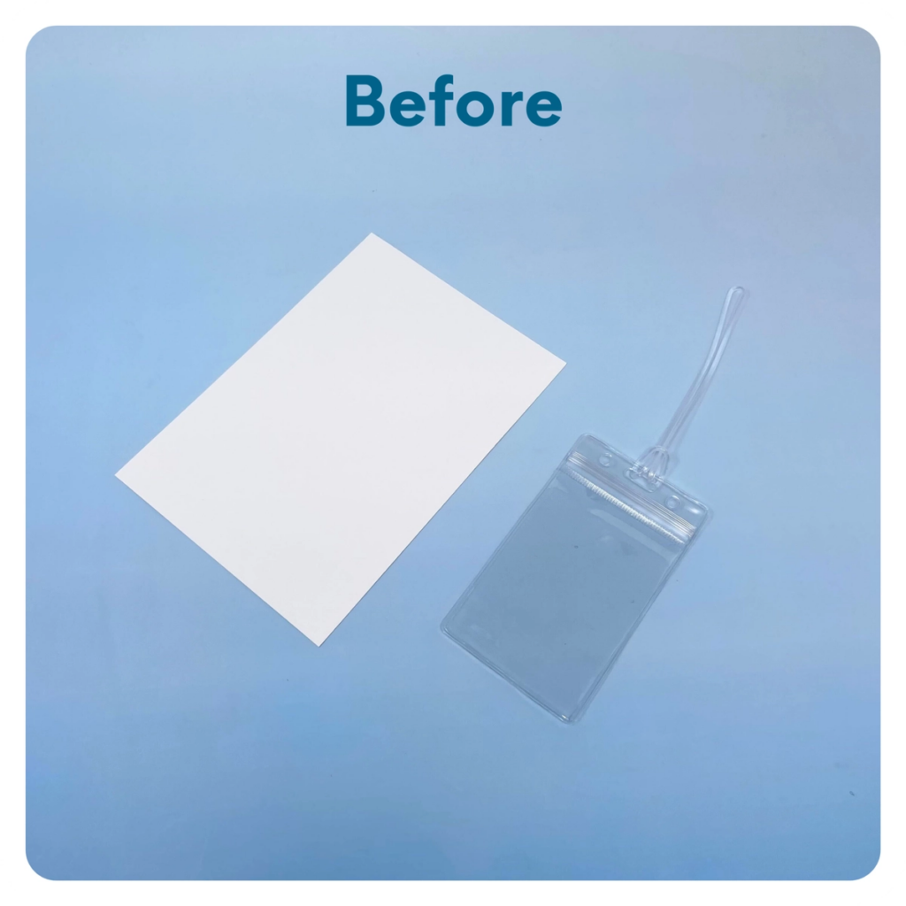
STEP 7 OF 12
Luggage Tag
Cut one of the blank cards to fit the luggage tag. Write an encouraging message, put it inside the luggage tag, and attach it to the outside of the backpack.

Slide 13
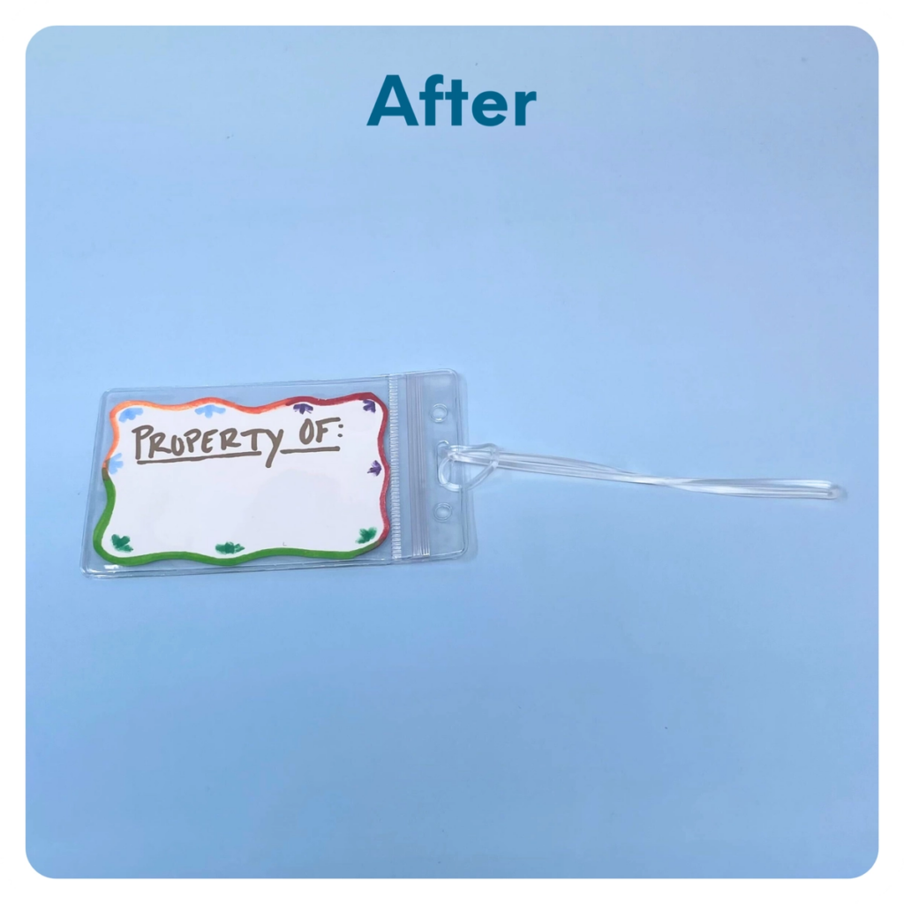
STEP 7 OF 12
Luggage Tag (continued)

Slide 14

STEP 8 OF 12
Affirmation Notebook
DIY Affirmations
Find the mini affirmation notebook in your kit. Decorate the front cover with drawings, stickers, or a positive message. Then, open it up and write 3–6 affirmations inside—more if you'd like! These can be encouraging words, self-love reminders, or anything that lifts the spirit.
Do you still have affirmation cards in your kit? If your kit includes affirmation cards instead of a notebook, go ahead and write a special affirmation on each card.

Slide 15


STEP 8 OF 12
Affirmation Notebook (continued)

Slide 16

STEP 9 OF 12
Decorate the Canvas Bag
Use the permanent markers to decorate the canvas bag.
Tip: Place a piece of paper in the bag before decorating to prevent the markers from bleeding through.

Slide 17

STEP 9 OF 12
Decorate the Canvas Bag (continued)

Slide 18
STEP 10 OF 12
Pack the Foster Youth Activity Bag [Plus]
Pack all of the materials into the backpack and put it back into the original box.
• Please only include items that are UNOPENED and UNUSED
• Add any optional items you would like.
Optional Items to Add:
• Games
• Crafts
• Fidget Items
• Journals
• More markers, crayons, colored pencils, etc.
• Small Stuffed Animal
Items not to include:
• Perishable items
• Sharp objects
• Nut food products
• Religious or political item

Slide 19
STEP 11 OF 12
Register My Kit (Optional)
Register your kit. To register and track your kits, you must visit the online instructions. Registering your kit is optional.

Slide 20
STEP 12 OF 12
Thank You!
When you build a Kynd Kit, you create layers of impact for yourself and the community. We appreciate your time and your support of our mission.
Cheers,
The Project Helping team

