Slide 1

PLUS
Grief Support [Plus]
10 STEPS

Slide 2

STEP 1 OF 10
About Project Helping
Kynd Kits are a program of Project Helping, a mental wellness nonprofit. Our mission is to make it ridiculously easy to volunteer because doing good is good for your mental wellness!
Learn More at ProjectHelping.org
When You Build a Kynd Kit - The Cycle of Impact

Slide 3

STEP 2 OF 10
Tips for Building Your Kit
Helpful Tip for Building Your Kynd Kit
• Avoid politics and religion entirely.
• Use appropriate humor.
• Can't think of what to write, draw a picture!
• Use words of affirmation!
• Place a piece of paper in any canvas bag before drawing on the outside. This way, the marker will not bleed through the other side of the bag.
• Please keep your designs gender-neutral, inclusive, and age-appropriate.
Spanish Translation Options

Slide 4

STEP 3 OF 10
Write a Note to the Recipient and Decorate the Envelope
Write a card and decorate the envelope using the enclosed materials. Express your encouragement and include a hopeful message.
Please ensure your message is age-appropriate and avoids references to religion or politics.

Slide 5

STEP 3 OF 10
Write a Note to the Recipient and Decorate the Envelope (continued)

Slide 6
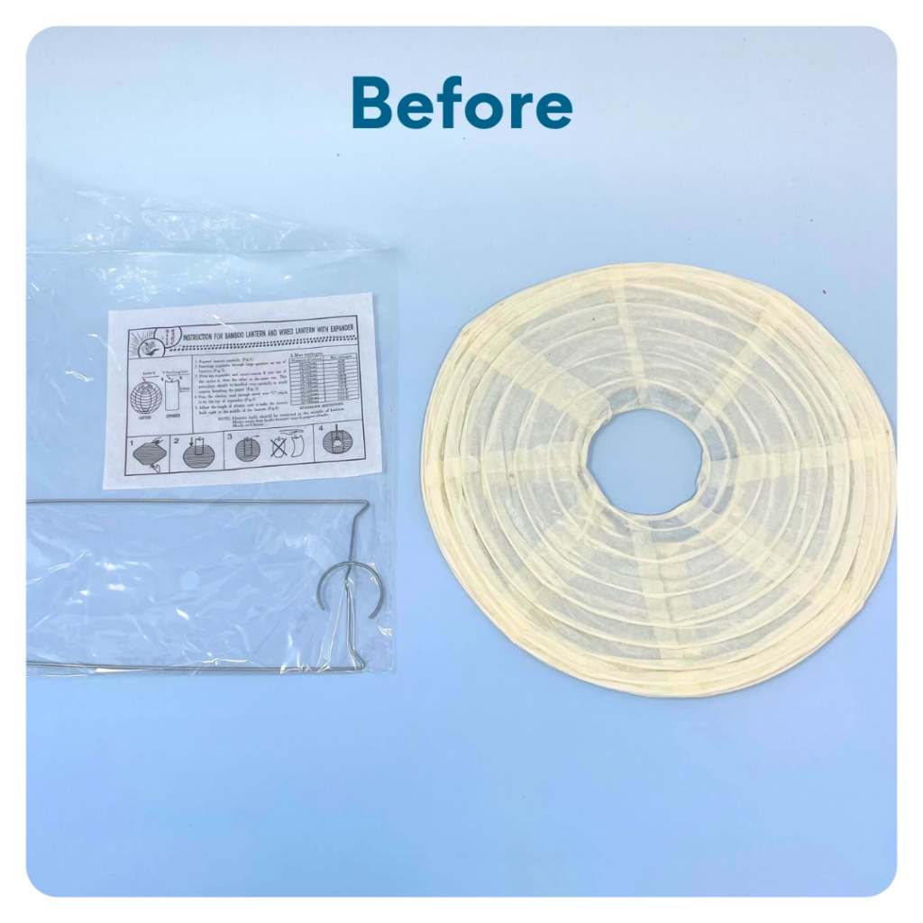
STEP 4 OF 10
Paper Lantern
Decorate the paper lantern. Slide the metal frame into the lantern, the hook side facing upwards. Balance the two metal rings on the bottom of the frame to hold the lantern in place. Screw off the bottom of the light. Remove the plastic ring and re-screw the bottom of the light together. Do not screw too tightly to make the light stay on. Hook the end of the light to the top of the metal frame of the lantern.

Slide 7
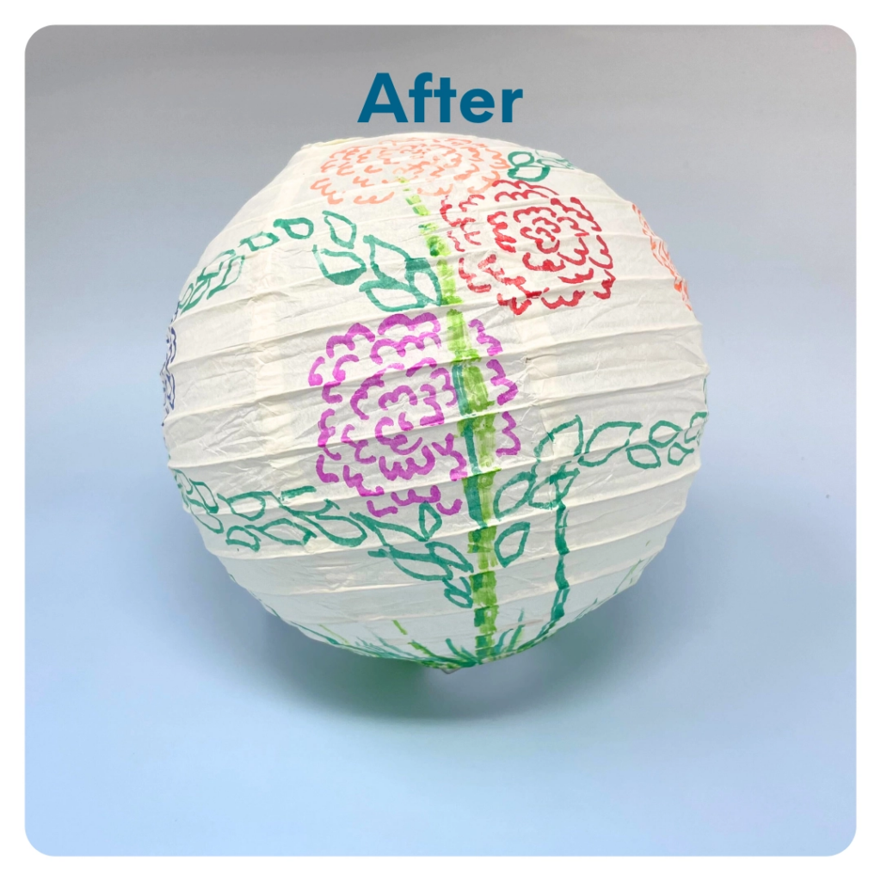
STEP 4 OF 10
Paper Lantern (continued)

Slide 8
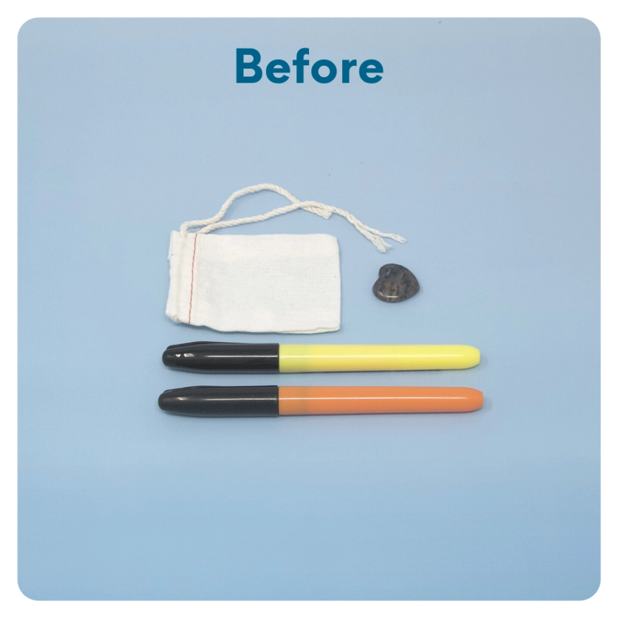
STEP 5 OF 10
Worry Stone
Worry stones are smooth, polished rocks used for relaxation or anxiety relief to help one feel grounded. The stone is meant to be kept in one’s pocket. The physical act of massaging a worry stone for several minutes is proven to provide therapeutic & psychological benefits that help soothe your nervous system, reduce stress and anxiety, and help clear your mind so you can focus and think clearly.
On one side of the drawstring bag write an inspirational or calming word. Examples: hope, love, grow, breathe, dream, courage, wonder.

Slide 9
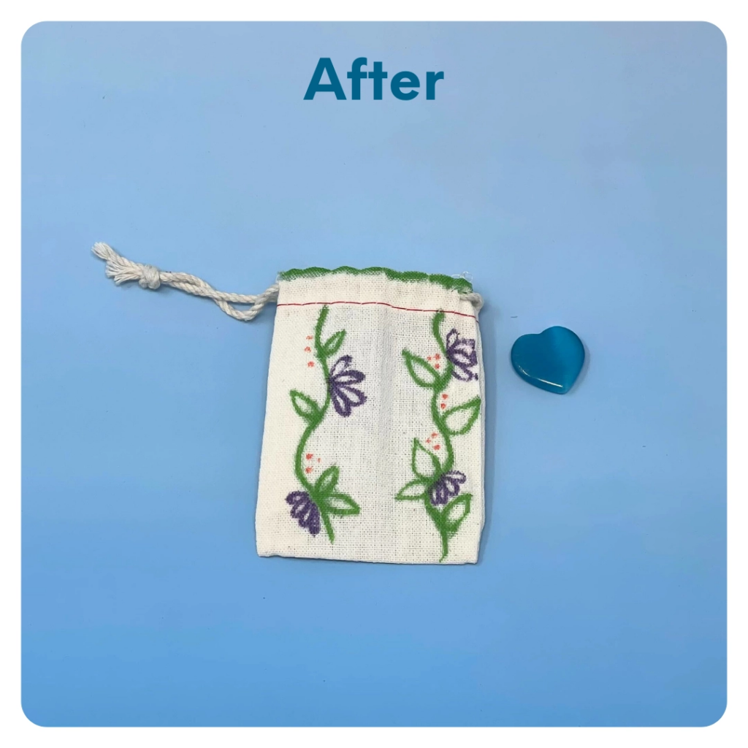
STEP 5 OF 10
Worry Stone (continued)
Tip: Place a piece of paper or cardboard in the bag before decorating to prevent the marker from bleeding through.

Slide 10
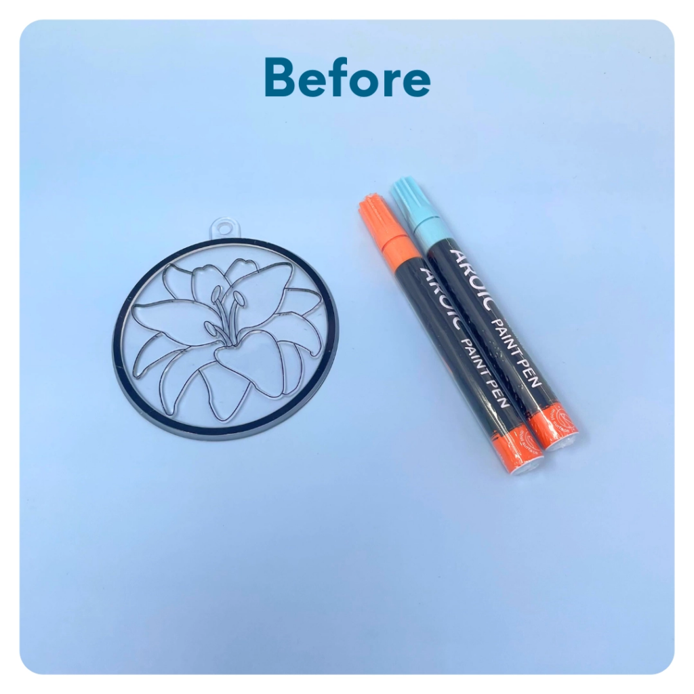
STEP 6 OF 10
Sun Catcher
Use paint pens to decorate the ridged side of the clear suncatcher.

Slide 11
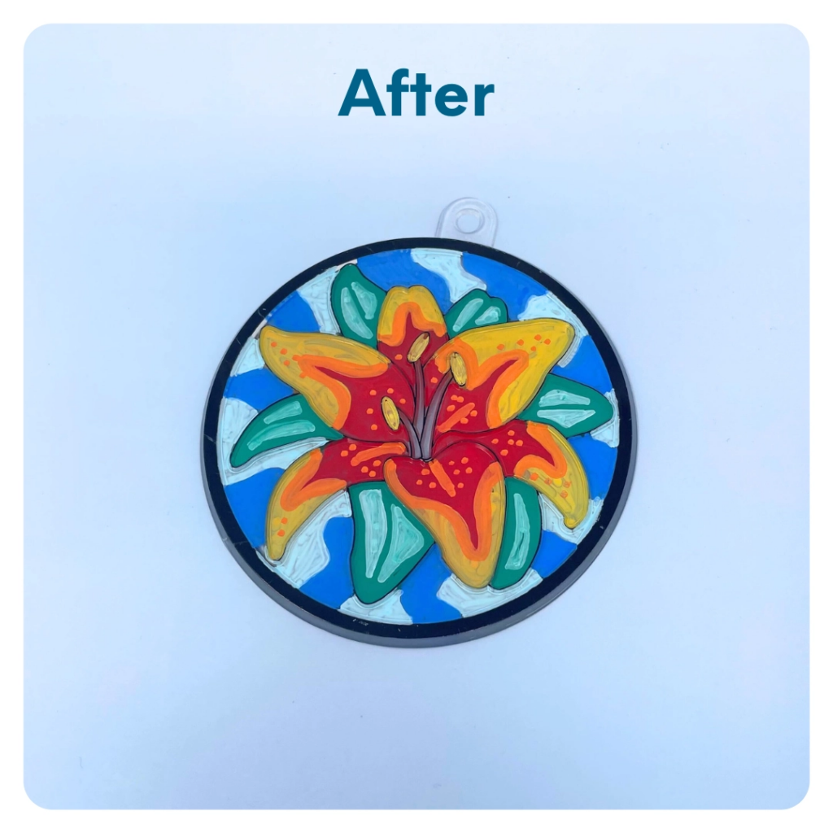
STEP 6 OF 10
Sun Catcher (continued)

Slide 12

STEP 7 OF 10
Affirmation Notebook
DIY Affirmations
Find the mini affirmation notebook in your kit. Decorate the front cover with drawings, stickers, or a positive message. Then, open it up and write 3–6 affirmations inside—more if you'd like! These can be encouraging words, self-love reminders, or anything that lifts the spirit.
Do you still have affirmation cards in your kit? If your kit includes affirmation cards instead of a notebook, go ahead and write a special affirmation on each card.

Slide 13


STEP 7 OF 10
Affirmation Notebook (continued)

Slide 14
STEP 8 OF 10
Pack the Grief Support [Plus] Kit
Pack all of the materials into the original box. Feel free to decorate the box to make it like a gift for someone to open.
• Please only include items that are UNOPENED and UNUSED
• Add any optional items you would like.
Optional Items to Add:
• Journals
• Photo books
• Self care items
• Stuffed animal
• Gifts cards
Items not to include:
• Perishable items
• Sharp objects
• Nut food products
• Religious or political items

Slide 15
STEP 9 OF 10
Register My Kit (Optional)
Register your kit. To register and track your kits, you must visit the online instructions. Registering your kit is optional.

Slide 16
STEP 10 OF 10
Thank You!
When you build a Kynd Kit, you create layers of impact for yourself and the community. We appreciate your time and your support of our mission.
Cheers,
The Project Helping team

