Slide 1

CLASSIC
Heat Relief for the Unhoused [Classic]
11 STEPS

Slide 2

STEP 1 OF 11
About Project Helping
Kynd Kits are a program of Project Helping, a mental wellness nonprofit. Our mission is to make it ridiculously easy to volunteer because doing good is good for your mental wellness!
Learn More at ProjectHelping.org
When You Build a Kynd Kit - The Cycle of Impact

Slide 3

STEP 2 OF 11
Tips for Building Your Kit
Helpful Tip for Building Your Kynd Kit
• Avoid politics and religion entirely.
• Use appropriate humor.
• Can't think of what to write, draw a picture!
• Use words of affirmation!
• Place a piece of paper in any canvas bag before drawing on the outside. This way, the marker will not bleed through the other side of the bag.
• Please keep your designs gender-neutral, inclusive, and age-appropriate.
Spanish Translation Options

Slide 4
STEP 3 OF 11
Seasonal Kit
This is a seasonal kit, and kit contents may vary based on the time of year, the needs of the community, and feedback from our recipient organizations.

Slide 5
STEP 4 OF 11
Heat Relief for the Unhoused [Classic]
Before You Build
About the Recipient
There are an estimated 582,462 people in the United States experiencing homelessness on a given night, according to the most recent national point-in-time estimate. This represents a rate of approximately 18 people experiencing homelessness per 10,000 people in the general population.
By making a heat relief kit you can impact someone with a meaningful, thoughtful action.

Slide 6
STEP 4 OF 11
Heat Relief for the Unhoused [Classic] (continued)
For people experiencing homelessness, the warm weather presents many challenges. This Kynd Kit is designed to build heat relief kits to hand out when you see someone who could use it. The most basic needs can make a world of difference to those experiencing homelessness.

Slide 7

STEP 5 OF 11
Decorate the Bag
Decorate the kraft bag(s). This is what the final kit is distributed in, so try to make this fun and colorful for the recipient to open.
Please note: we are currently transitioning from plastic ziplock bags to kraft bags. Some kits may still include the plastic bag for you to decorate while we complete this transition.

Slide 8



STEP 5 OF 11
Decorate the Bag (continued)

Slide 9

STEP 6 OF 11
Write a Note to the Recipient and Decorate the Envelope
Write a card and decorate the envelope using the enclosed materials. Express your encouragement and include a hopeful message.
Please ensure your message is age-appropriate and avoids references to religion or politics.

Slide 10

STEP 6 OF 11
Write a Note to the Recipient and Decorate the Envelope (continued)

Slide 11
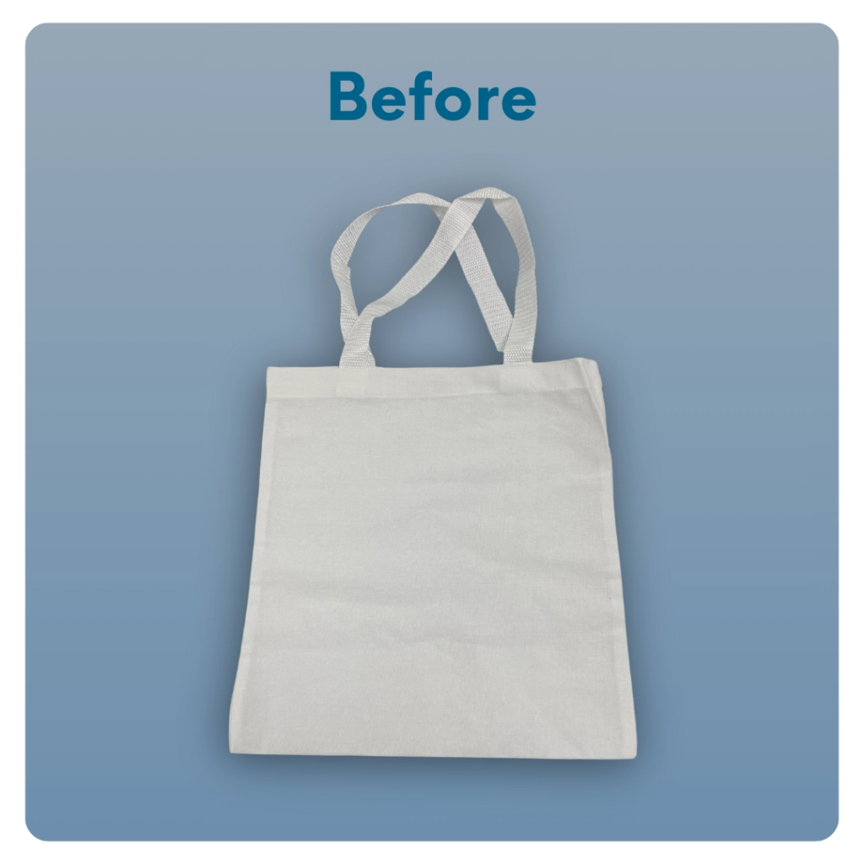
STEP 7 OF 11
Decorate The Small Canvas Tote
Decorate the canvas tote to make it fun and colorful! Tip: place a piece of paper in the tote before decorating. This will prevent the marker from bleeding through the tote.

Slide 12
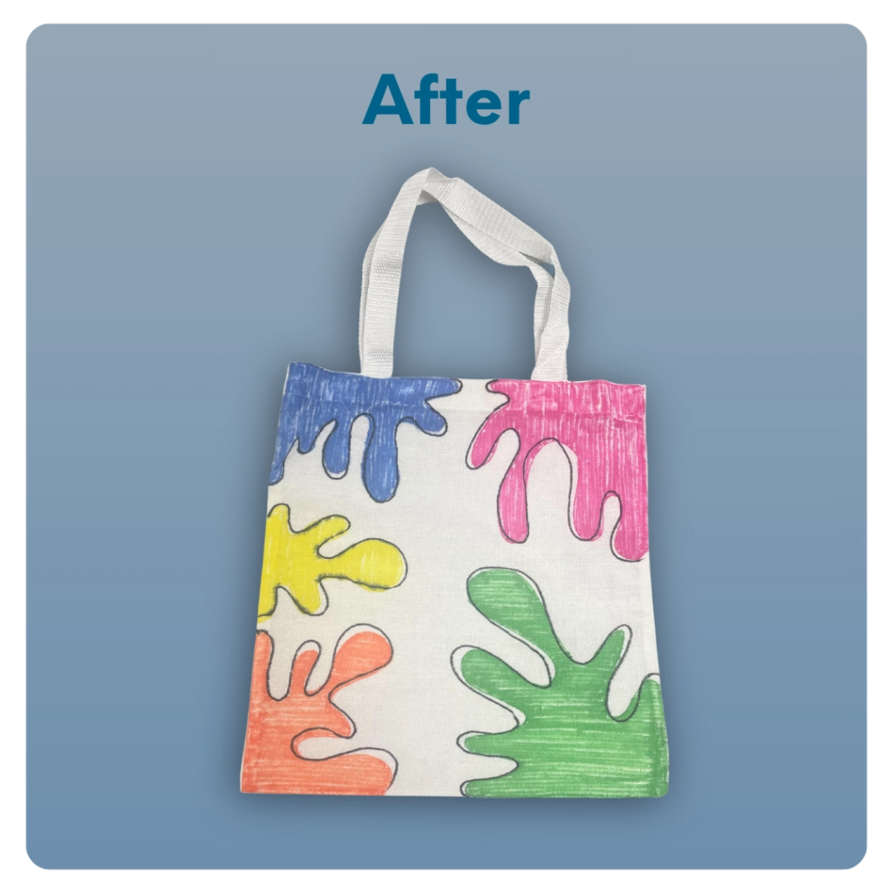
STEP 7 OF 11
Decorate The Small Canvas Tote (continued)

Slide 13
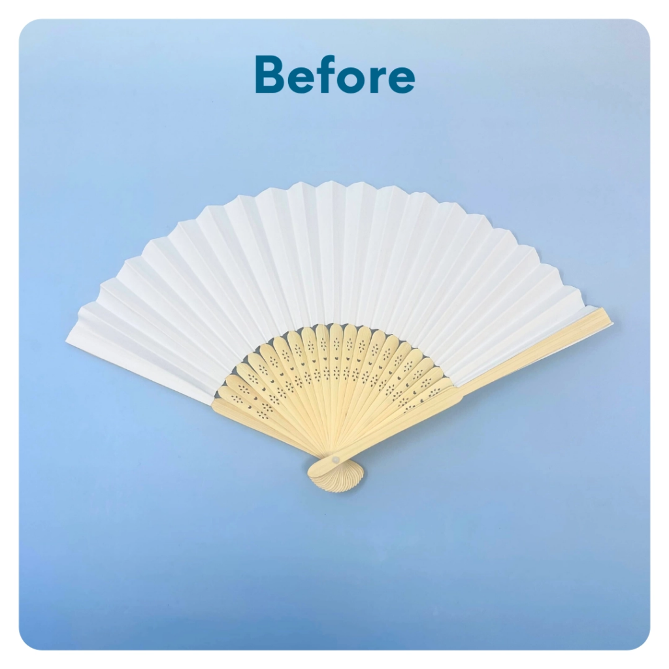
STEP 8 OF 11
Decorate the Fan
Decorate the fan with an inspiring message or decoration. Make it cheerful and colorful!

Slide 14
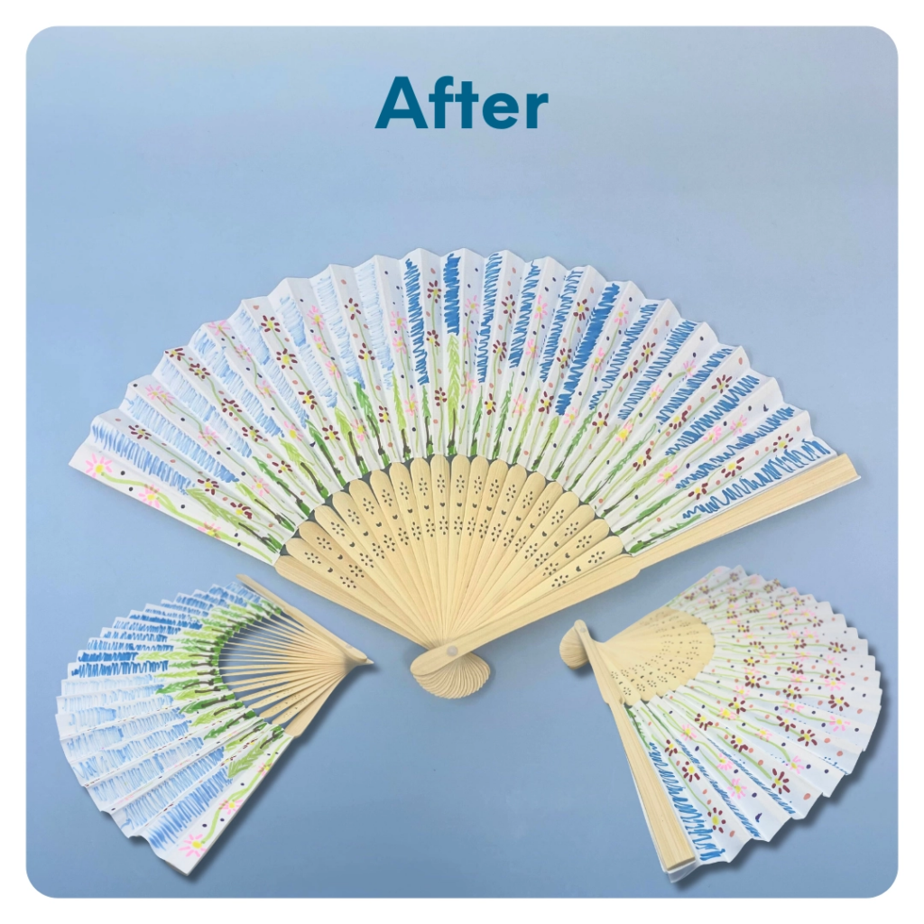
STEP 8 OF 11
Decorate the Fan (continued)

Slide 15
STEP 9 OF 11
Pack the Heat Relief Kit
Pack all of the materials into the decorated plastic bag and cosmetic bag.
• Please only include items that are UNOPENED and UNUSED
• Add any optional items you would like.
Optional Items to Add
• Socks
• Sanitary items
• Sunscreen
• Sunglasses
• Water bottle
• Protein-rich snacks
Items not to include:
• Perishable items
• Sharp objects
• Nut food products
• Religious or political items

Slide 16
STEP 10 OF 11
Register My Kit (Optional)
Register your kit. To register and track your kits, you must visit the online instructions. Registering your kit is optional.

Slide 17
STEP 11 OF 11
Thank You!
When you build a Kynd Kit, you create layers of impact for yourself and the community. We appreciate your time and your support of our mission.
Cheers,
The Project Helping team

