Slide 1
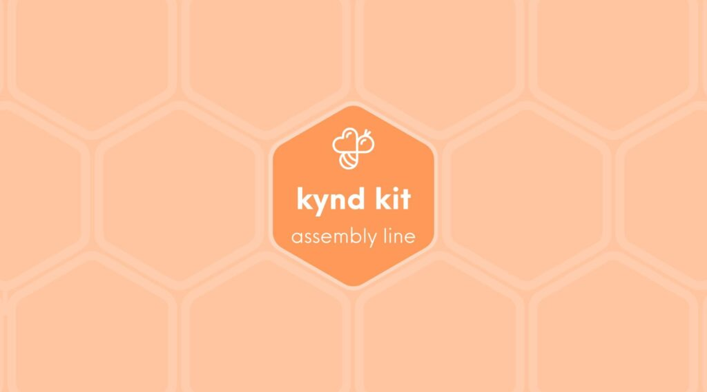
X/XL
Kynd Kit X/XL Facilitator Guide
7 STEPS

Slide 2

STEP 1 OF 7
About Project Helping
Kynd Kits are a program of Project Helping, a mental wellness nonprofit. Our mission is to make it ridiculously easy to volunteer because doing good is good for your mental wellness!
Learn More at ProjectHelping.org
When You Build a Kynd Kit - The Cycle of Impact

Slide 3
STEP 2 OF 7
About Kynd Kit X/XL
The Kynd Kit X was created to offer a meaningful and engaging volunteer experience. Open the box, lay out the materials, and set up your own mini assembly line—each kit you complete makes a direct impact on someone in need.

Slide 4
STEP 3 OF 7
Kynd Kit X/XL - Helpful Tips
• Set up tables to accommodate your group size.
• Consider providing additional decorating supplies.
• Arrange your assembly line using the instructions and checklist provided.
• Set up and label boxes where attendees can place their completed kits.
• Keep groups small enough so everyone has space at each table to spread out their materials.
• Set up a trash collection area or add a trash can to each station.
• Starting or ending the event with gratitude prompts helps engage participants in kyndness throughout the experience.

Slide 5
STEP 4 OF 7
Kynd Kit X/XL Welcome!
Welcome!
We're glad you're here! We hope you're as excited as we are to improve mental well-being and impact your community. We created these instructions to help reduce any stress that comes with facilitating an event. If you have any questions, please email us at info@projecthelping.org.
Before you start
• X kits are designed as assembly-line kits, where volunteers pack the contents and decorate the DIY items at a separate decorating station.
• Review the instructions for the kit(s) you'll be doing as a group. You can find them at how.kyndkit.com.

Slide 6
STEP 5 OF 7
Kynd Kit X/XL Before the Build
Kynd Kits are volunteer projects in a box. Each kit is designed to serve a unique cause or individual in need. Today we will be building the following kit(s): [Share the kit or kits you will be making]
Explain the kit or kits you will be completing today:
• Why were these kits chosen?
• Do they have a special meaning?
• Who will they benefit?
• Details about each kit can be found on the individual instruction pages.
• What items need to be decorated or personalized in the kit?

Slide 7
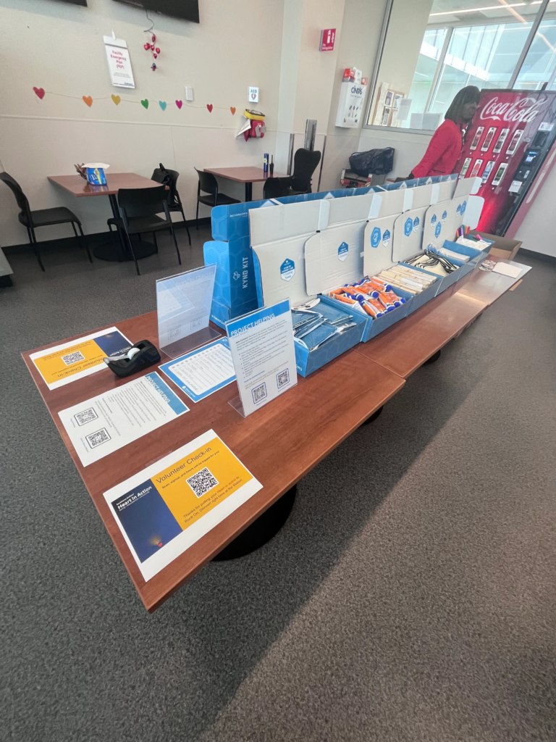
STEP 6 OF 7
Kynd Kit X/XL Setup
Set Up
• Set up an assembly line with each product on the checklist. This checklist is in the "open me first" box.
• The stickers on the inner lid of each box indicate how many of each item should go in each kit.
• You may have additional boxes with overstock—keep those nearby or under the tables to restock the blue boxes as needed.
• Set up your DIY decorating stations with pens, markers, scissors (if needed), and any additional decorating supplies.
🔽 Click the dropdown to see photo examples of the setup.
Setup Examples+

Slide 8
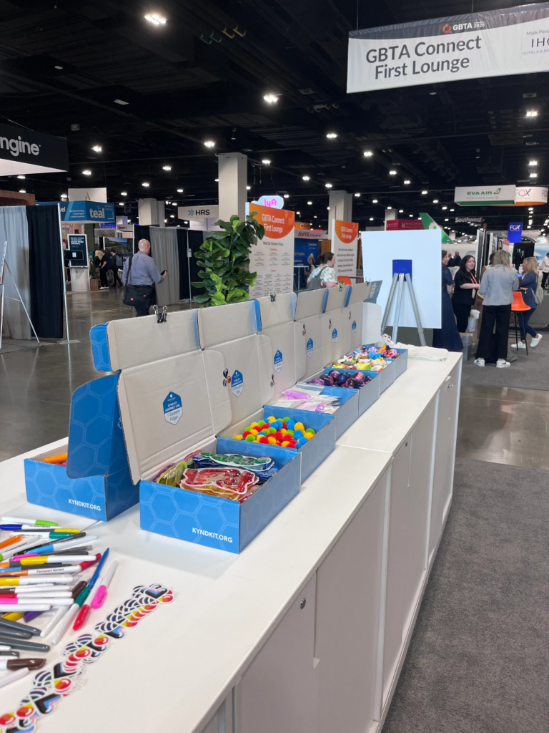
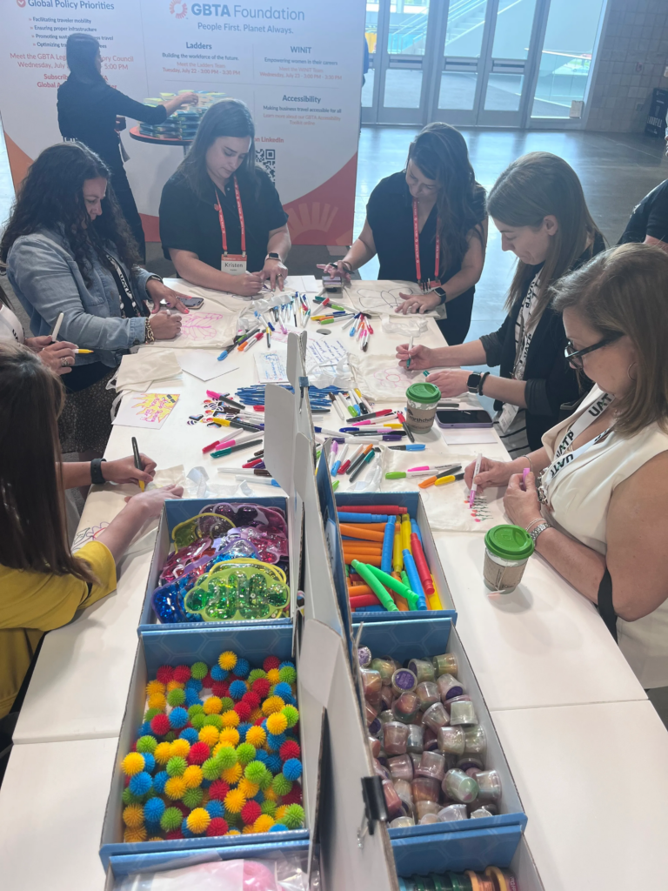
STEP 6 OF 7
Kynd Kit X/XL Setup (continued)

Slide 9
STEP 7 OF 7
Kynd Kit X/XL After the Build Is Complete
Pack Up and Kit Distribution
• Ensure all kit items have been added to the provided plastic bag, tote bag, or backpack and all DIY items have been completed.
• If kits are returning to Project Helping:
• Direct attendees where to leave the completed kits.
• Incomplete kits may also be sent back to Project Helping.
• If attendees are self-distributing kits:
• Let them know they are responsible for taking the kits with them and delivering them to someone in need.
• Encourage them to take a picture or post their delivery on social media.

Slide 10
STEP 7 OF 7
Kynd Kit X/XL After the Build Is Complete (continued)
• Please tag @projecthelping and use #projecthelping and #dogoodfeelgood so we can interact and share experiences with our community.

