Slide 1

CLASSIC
KYND SCHOOLS &#8211; Teen Mental Health
9 STEPS

Slide 2

STEP 1 OF 9
About Project Helping
Kynd Kits are a program of Project Helping, a mental wellness nonprofit. Our mission is to make it ridiculously easy to volunteer because doing good is good for your mental wellness!
Learn More at ProjectHelping.org
When You Build a Kynd Kit - The Cycle of Impact

Slide 3

STEP 2 OF 9
Tips for Building Your Kit
Helpful Tip for Building Your Kynd Kit
• Avoid politics and religion entirely.
• Use appropriate humor.
• Can't think of what to write, draw a picture!
• Use words of affirmation!
• Place a piece of paper in any canvas bag before drawing on the outside. This way, the marker will not bleed through the other side of the bag.
• Please keep your designs gender-neutral, inclusive, and age-appropriate.
Spanish Translation Options

Slide 4
STEP 3 OF 9
Kynd Schools Teen Mental Health
Thank you for participating in our Kynd Schools Program. In these boxes, you will find all the necessary supplies and instructions to complete your volunteer experience.
About your teen mental health kynd kit:
This kit is designed to support teen mental wellness. As you personalize the DIY items, think about tools and reminders that help you manage stress, anxiety, and tough moments.

Slide 5
STEP 3 OF 9
Kynd Schools Teen Mental Health (continued)
Once your kit is complete, you are encouraged to keep it for yourself and use it whenever you need a reminder to care for your mental health. You can also choose to give it to a friend or someone who might need support.
If you’d like to pass it along but aren’t sure who to give it to, return the kit to your counselor and it will be sent back to Project Helping to share with a teen in need.

Slide 6

STEP 4 OF 9
Decorate the Bag
Decorate the kraft bag(s). This is what the final kit is distributed in, so try to make this fun and colorful for the recipient to open.
Please note: we are currently transitioning from plastic ziplock bags to kraft bags. Some kits may still include the plastic bag for you to decorate while we complete this transition.

Slide 7



STEP 4 OF 9
Decorate the Bag (continued)

Slide 8

STEP 5 OF 9
Decorate the Canvas Bag
Use the permanent markers to decorate the canvas bag.
Tip: Place a piece of paper in the bag before decorating to prevent the markers from bleeding through.

Slide 9

STEP 5 OF 9
Decorate the Canvas Bag (continued)

Slide 10
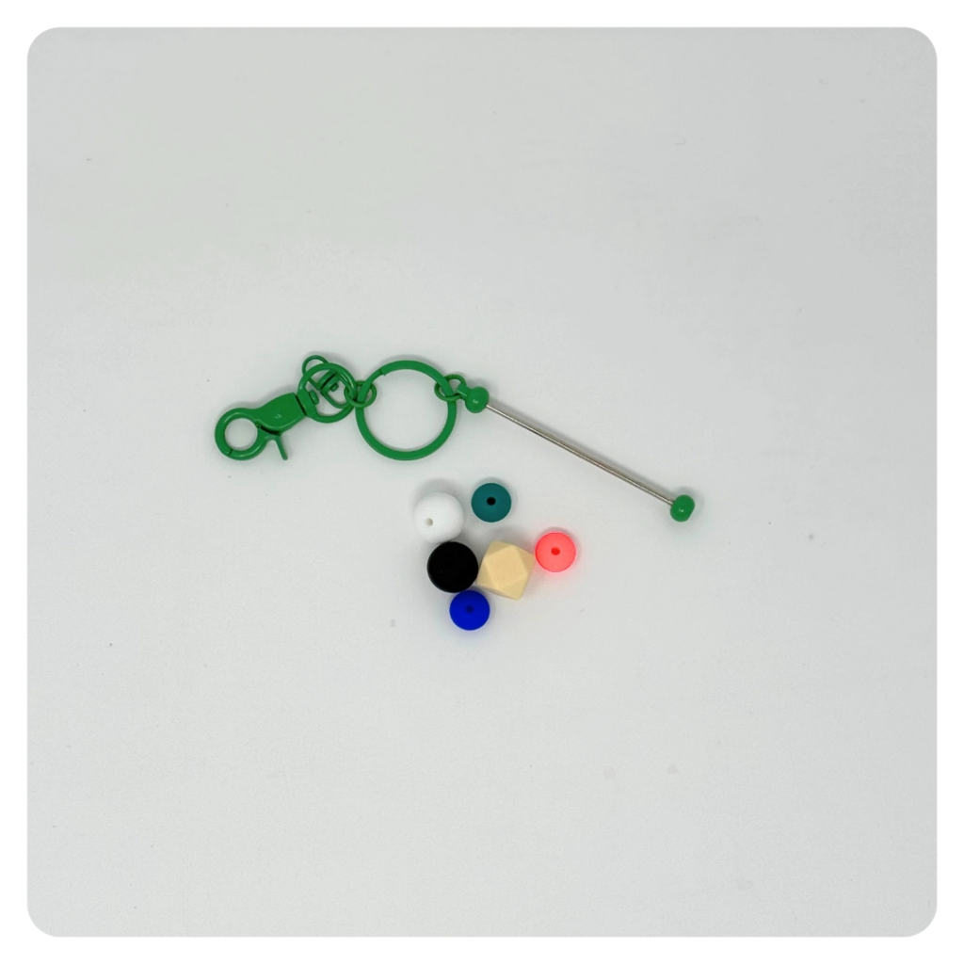
STEP 6 OF 9
Build a Fidget Keychain
Use the key chain and silicone beads to create a fidget key chain. This makes a fun, soothing tool for someone who could use a little calm and kyndness on the go.

Slide 11
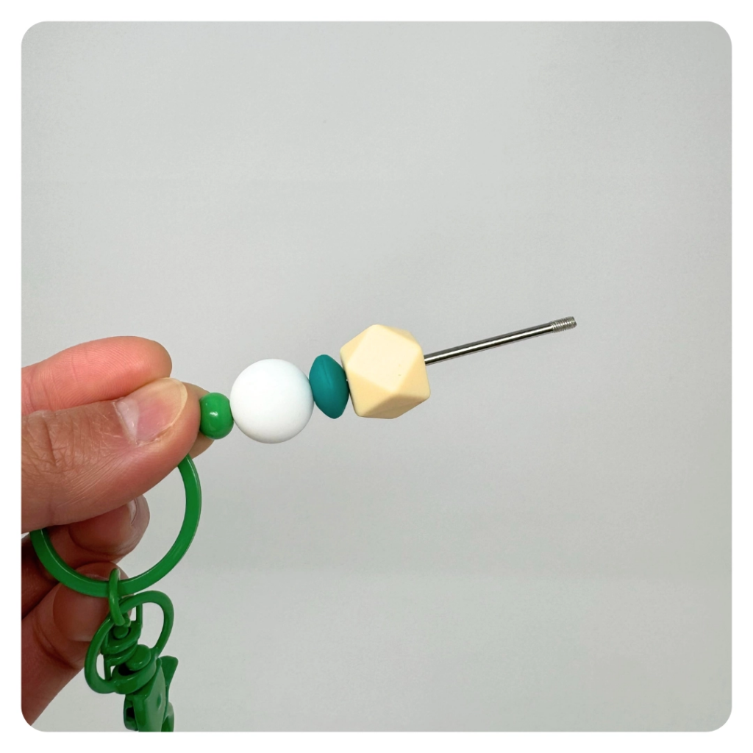
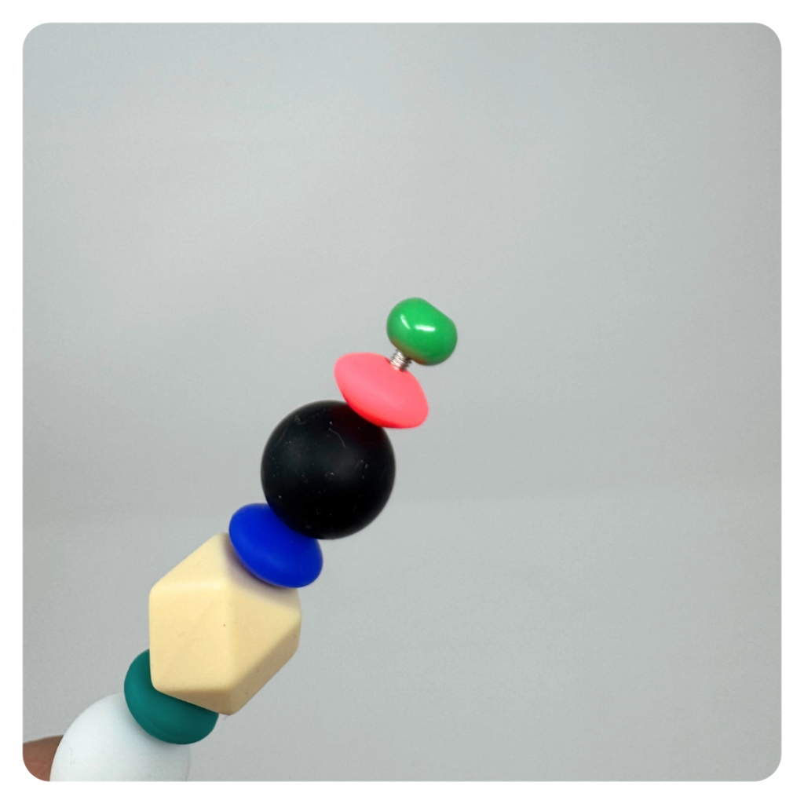
STEP 6 OF 9
Build a Fidget Keychain (continued)

Slide 12

STEP 7 OF 9
Write a Note to the Recipient and Decorate the Envelope
Write a card and decorate the envelope using the enclosed materials. Express your encouragement and include a hopeful message.
Please ensure your message is age-appropriate and avoids references to religion or politics.

Slide 13

STEP 7 OF 9
Write a Note to the Recipient and Decorate the Envelope (continued)

Slide 14
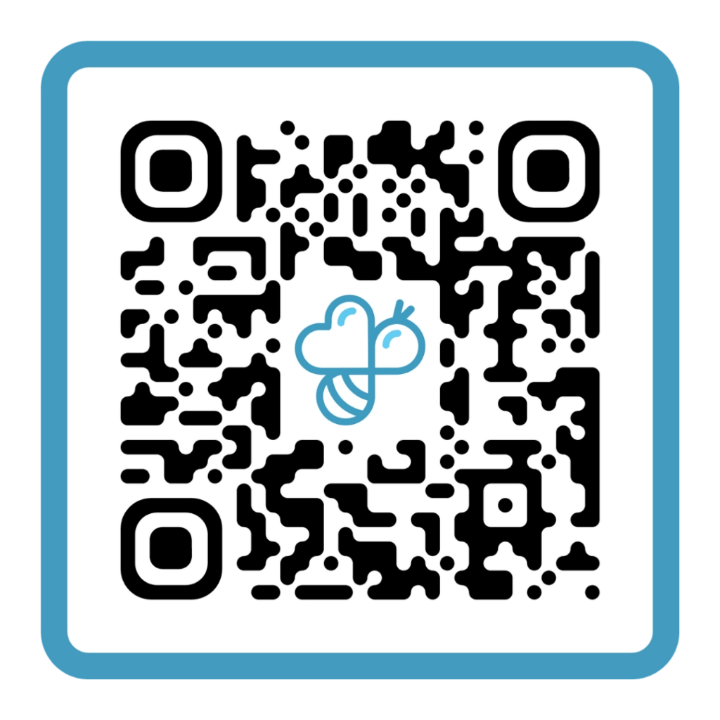
STEP 8 OF 9
Complete the survey
Follow the QR code to the online survey! We’d love your feedback.

Slide 15
STEP 9 OF 9
Thank You!
When you build a Kynd Kit, you create layers of impact for yourself and the community. We appreciate your time and your support of our mission.
Cheers,
The Project Helping team

