Slide 1

CLASSIC
LGBTQIA+ [Classic]
12 STEPS

Slide 2

STEP 1 OF 12
About Project Helping
Kynd Kits are a program of Project Helping, a mental wellness nonprofit. Our mission is to make it ridiculously easy to volunteer because doing good is good for your mental wellness!
Learn More at ProjectHelping.org
When You Build a Kynd Kit - The Cycle of Impact

Slide 3

STEP 2 OF 12
Tips for Building Your Kit
Helpful Tip for Building Your Kynd Kit
• Avoid politics and religion entirely.
• Use appropriate humor.
• Can't think of what to write, draw a picture!
• Use words of affirmation!
• Place a piece of paper in any canvas bag before drawing on the outside. This way, the marker will not bleed through the other side of the bag.
• Please keep your designs gender-neutral, inclusive, and age-appropriate.
Spanish Translation Options

Slide 4
STEP 3 OF 12
LGBTQIA+ Support [Classic]
Before You Build
About the Recipient
45% of LGBTQ youth seriously considered attempting suicide in the past year. LGBTQ youth are not inherently prone to suicide risk because of their sexual orientation or gender identity but rather placed at higher risk because of how they are mistreated and stigmatized in society

Slide 5
STEP 3 OF 12
LGBTQIA+ Support [Classic] (continued)
LGBTQ+ youth who live in a community that is accepting and supportive reported significantly lower rates of attempting suicide compared to those who do not. These kits provide an opportunity to deal with stress, anxiety, and other mental health related struggles with a variety of tools and coping skills. Completing this Kynd Kit helps provide this same support and sense of community while also providing accessible mental health resources for LGBTQ+ youth.

Slide 6

STEP 4 OF 12
Decorate the Bag
Decorate the kraft bag(s). This is what the final kit is distributed in, so try to make this fun and colorful for the recipient to open.
Please note: we are currently transitioning from plastic ziplock bags to kraft bags. Some kits may still include the plastic bag for you to decorate while we complete this transition.

Slide 7



STEP 4 OF 12
Decorate the Bag (continued)

Slide 8

STEP 5 OF 12
Write a Note to the Recipient and Decorate the Envelope
Write a card and decorate the envelope using the enclosed materials. Express your encouragement and include a hopeful message.
Please ensure your message is age-appropriate and avoids references to religion or politics.

Slide 9

STEP 5 OF 12
Write a Note to the Recipient and Decorate the Envelope (continued)

Slide 10
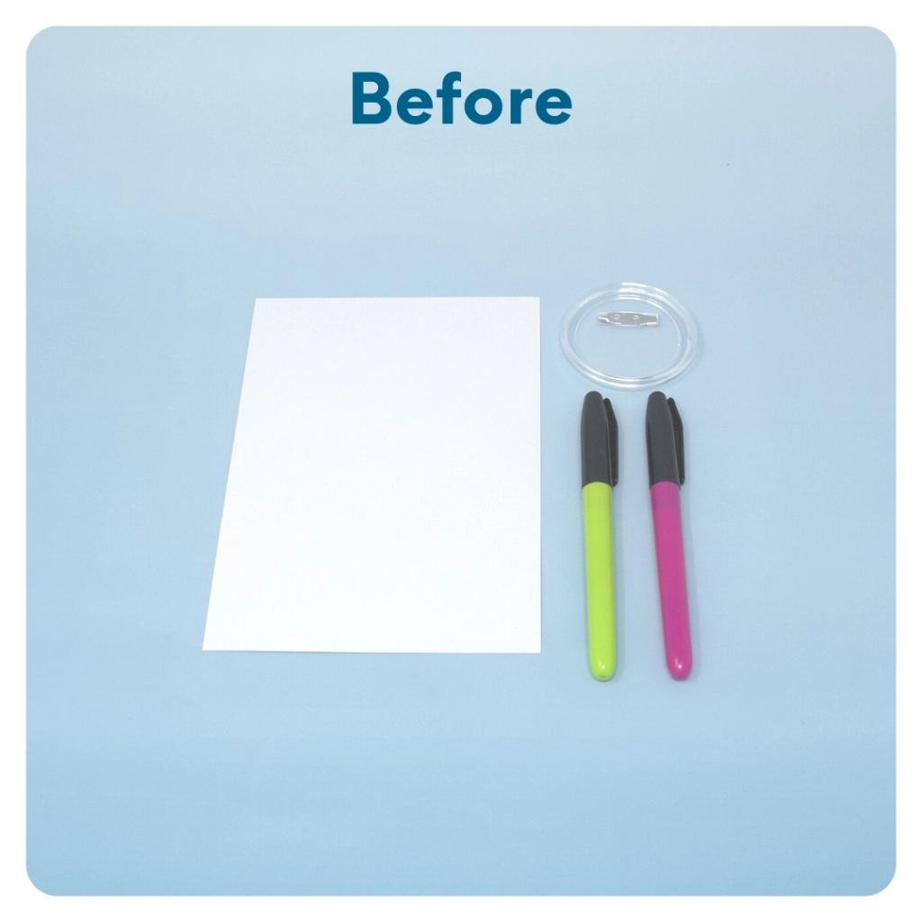
STEP 6 OF 12
Create a Pronoun Pin
Trace the shape and size of the pin onto the blank white card. Cut out and decorate a border on the piece of paper. Place the image inside of the pin and include in your final kit. This way the recipient can write their pronoun in the pin to wear around.

Slide 11
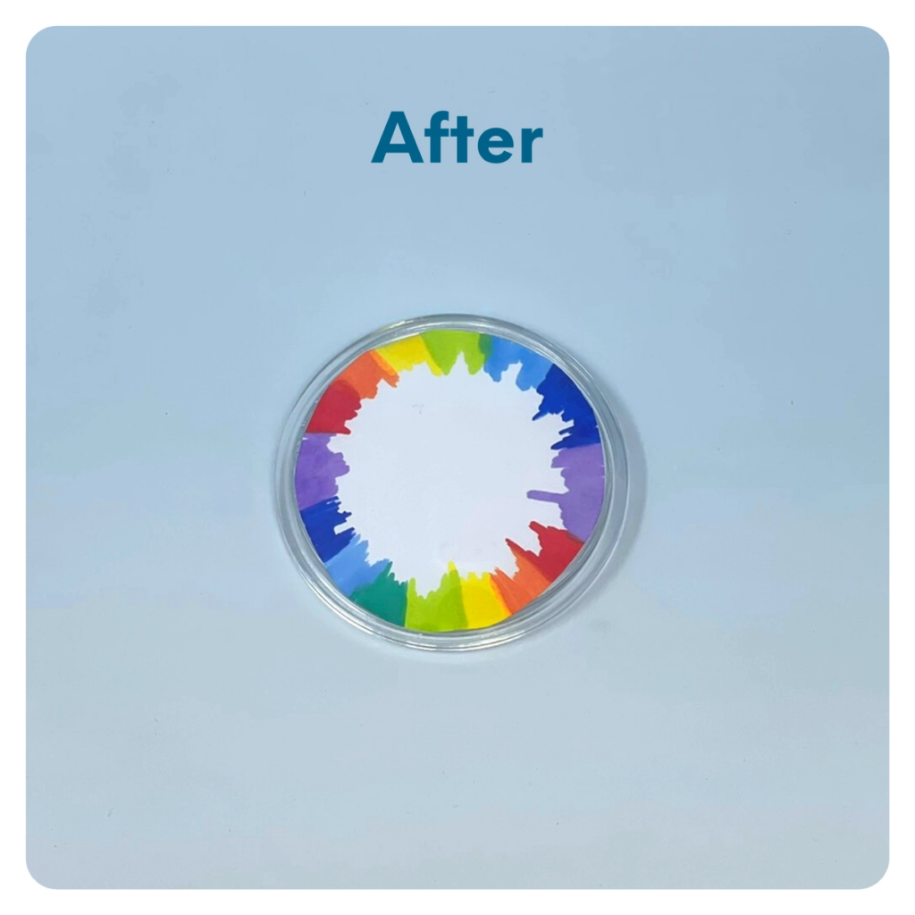
STEP 6 OF 12
Create a Pronoun Pin (continued)

Slide 12

STEP 7 OF 12
Surprise Kyndness Notebook
Decorate the outside of the journal with a picture or uplifting message. Use random pages in the journal to write short, uplifting messages, draw small, colorful images, or create fun writing prompts for the recipient.

Slide 13

STEP 7 OF 12
Surprise Kyndness Notebook (continued)

Slide 14

STEP 8 OF 12
Decorate the Canvas Bag
Use the permanent markers to decorate the canvas bag.
Tip: Place a piece of paper in the bag before decorating to prevent the markers from bleeding through.

Slide 15

STEP 8 OF 12
Decorate the Canvas Bag (continued)

Slide 16
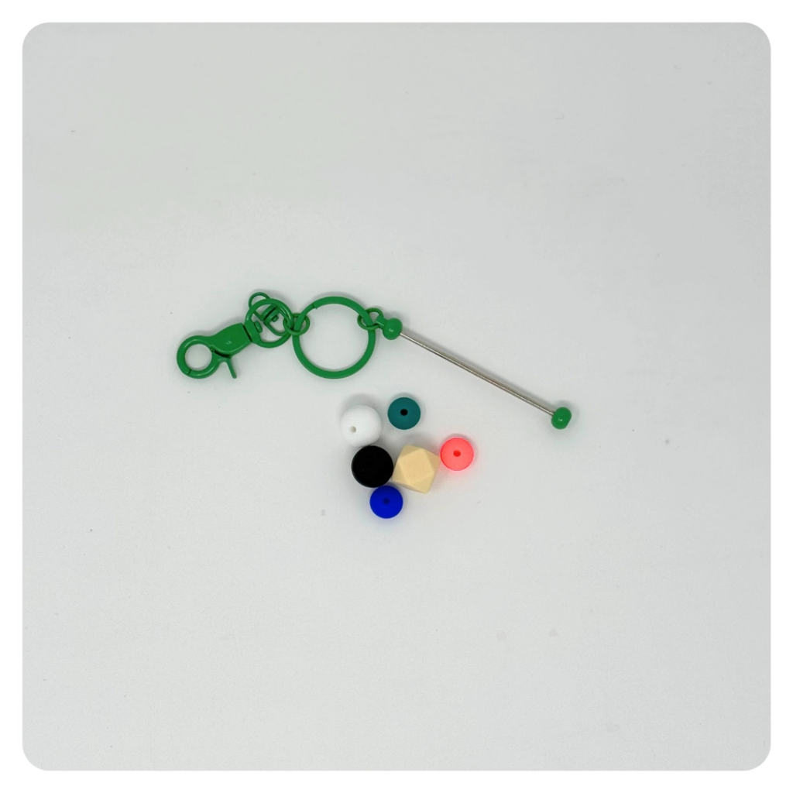
STEP 9 OF 12
Build a Fidget Keychain
Use the key chain and silicone beads to create a fidget key chain. This makes a fun, soothing tool for someone who could use a little calm and kyndness on the go.

Slide 17
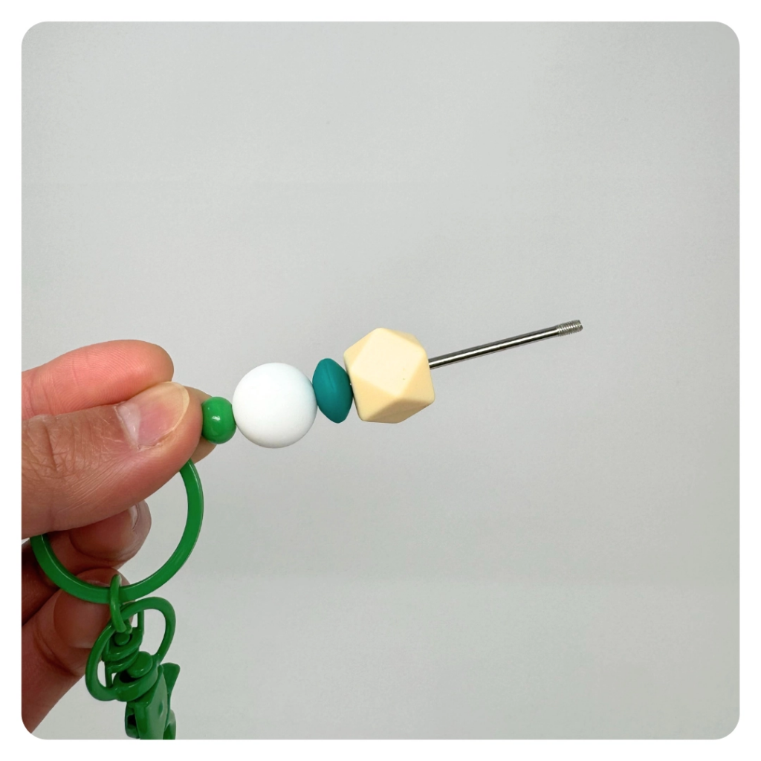
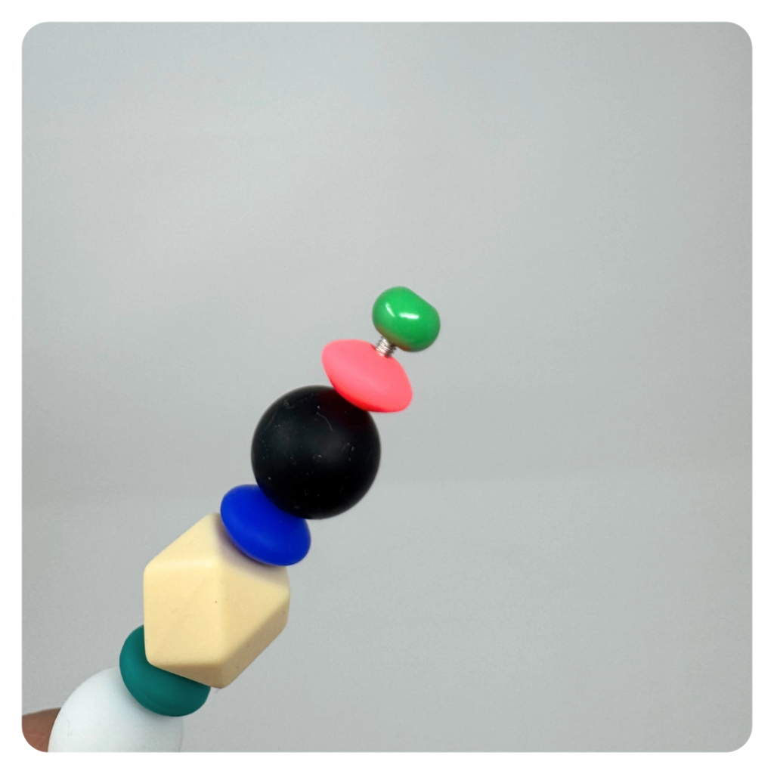
STEP 9 OF 12
Build a Fidget Keychain (continued)

Slide 18
STEP 10 OF 12
Pack the LGBTQIA+ Support Kit
Pack all of the materials into the decorated plastic bag and put it back into the original box.
• Please only include items that are UNOPENED and UNUSED
• Add any optional items you would like.
Optional Items to Add:
• Playing cards
• Journals
• Crafts
• Self-care items
• Protein-rich snacks
Items not to include:
• Perishable items
• Sharp objects
• Nut food products
• Religious or political items

Slide 19
STEP 11 OF 12
Register My Kit (Optional)
Register your kit. To register and track your kits, you must visit the online instructions. Registering your kit is optional.

Slide 20
STEP 12 OF 12
Thank You!
When you build a Kynd Kit, you create layers of impact for yourself and the community. We appreciate your time and your support of our mission.
Cheers,
The Project Helping team

