Slide 1
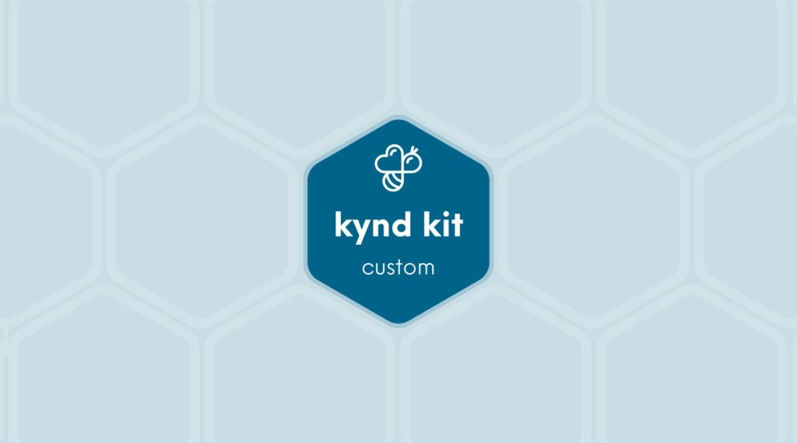
CUSTOM
Make-a-Wish TEEN United
10 STEPS

Slide 2

STEP 1 OF 10
About Project Helping
Kynd Kits are a program of Project Helping, a mental wellness nonprofit. Our mission is to make it ridiculously easy to volunteer because doing good is good for your mental wellness!
Learn More at ProjectHelping.org
When You Build a Kynd Kit - The Cycle of Impact

Slide 3

STEP 2 OF 10
Tips for Building Your Kit
Helpful Tip for Building Your Kynd Kit
• Avoid politics and religion entirely.
• Use appropriate humor.
• Can't think of what to write, draw a picture!
• Use words of affirmation!
• Place a piece of paper in any canvas bag before drawing on the outside. This way, the marker will not bleed through the other side of the bag.
• Please keep your designs gender-neutral, inclusive, and age-appropriate.
Spanish Translation Options

Slide 4
STEP 3 OF 10
Make-A-Wish® Travel Kit [+]
Before You Build
Make-A-Wish® exists to create life-changing wishes for children with critical illnesses. Make-A-Wish has collectively granted more than 585,000 wishes worldwide since 1980.
The wish-granting experience can help children build the strength and energy to fight a critical illness. The Wish Journey is often a pivotal experience during a wish kid's treatment and recovery. Many medical providers vastly agree that a wish is a necessary part of a child's treatment journey. That is why wishes matter. That is why we grant wishes.

Slide 5
STEP 3 OF 10
Make-A-Wish® Travel Kit [+] (continued)
These bags will be distributed to Make-A-Wish® kids to help encourage them and give them something to put a smile on their face while waiting for their wish to come true.

Slide 6

STEP 4 OF 10
Write a Note to the Recipient and Decorate the Envelope
Write a card and decorate the envelope using the enclosed materials. Express your encouragement and include a hopeful message.
Please ensure your message is age-appropriate and avoids references to religion or politics.

Slide 7

STEP 4 OF 10
Write a Note to the Recipient and Decorate the Envelope (continued)

Slide 8
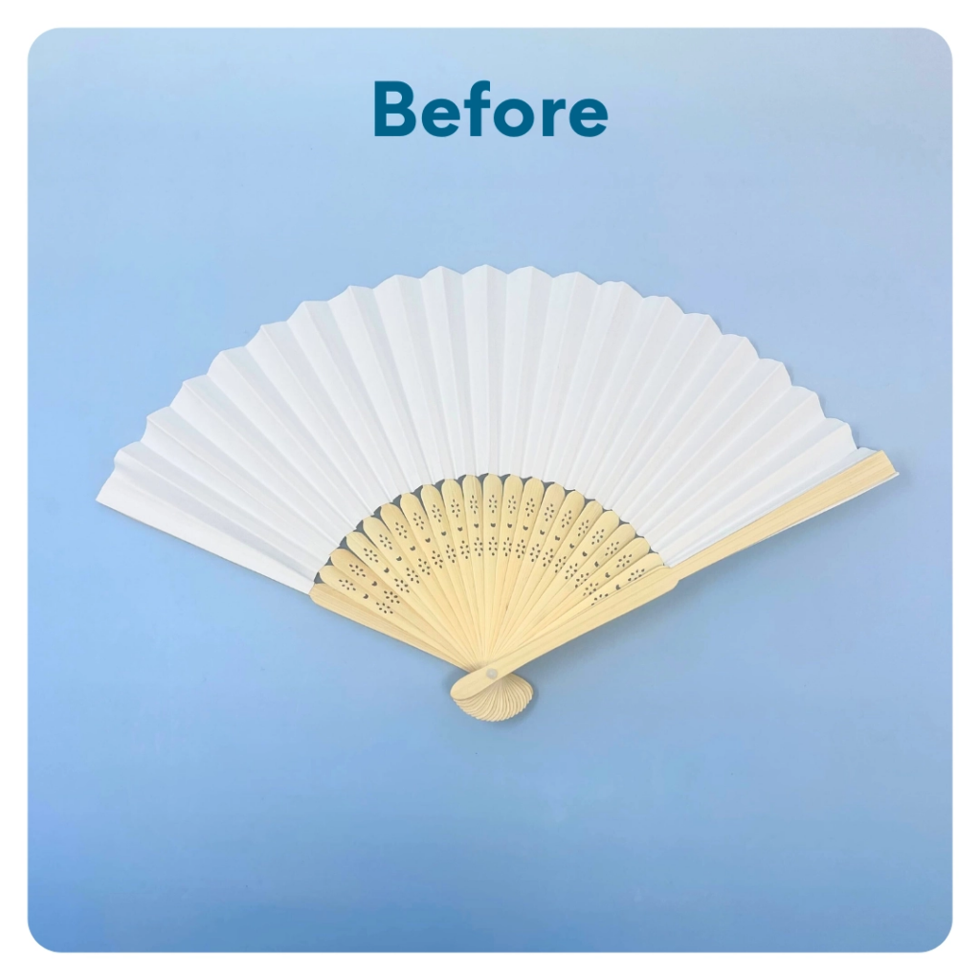
STEP 5 OF 10
Decorate the Fan
Decorate the fan with an inspiring message or decoration. Make it cheerful and colorful!

Slide 9
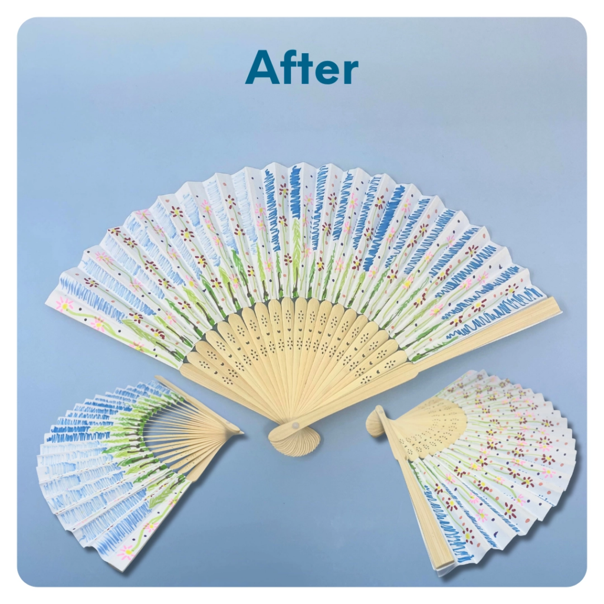
STEP 5 OF 10
Decorate the Fan (continued)

Slide 10
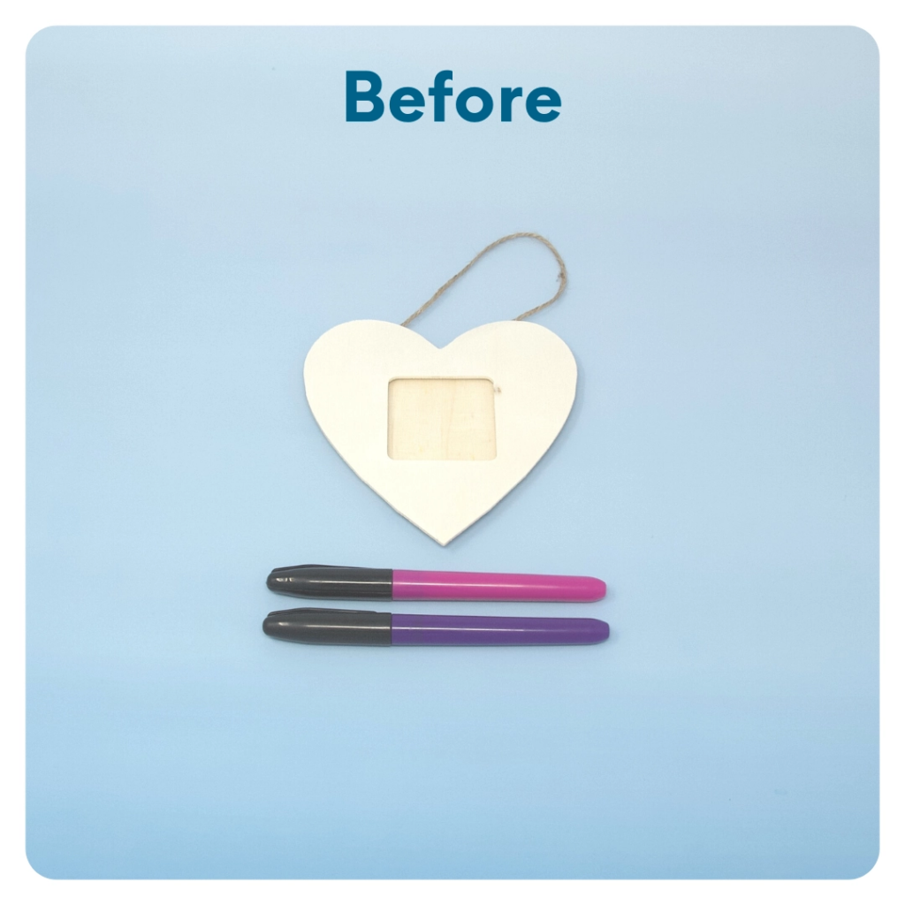
STEP 6 OF 10
DIY Picture Frame
Decorate the picture frame with pictures, shapes, encouraging words, quotes, etc.
(the size and shape of the DIY picture frame may vary)

Slide 11
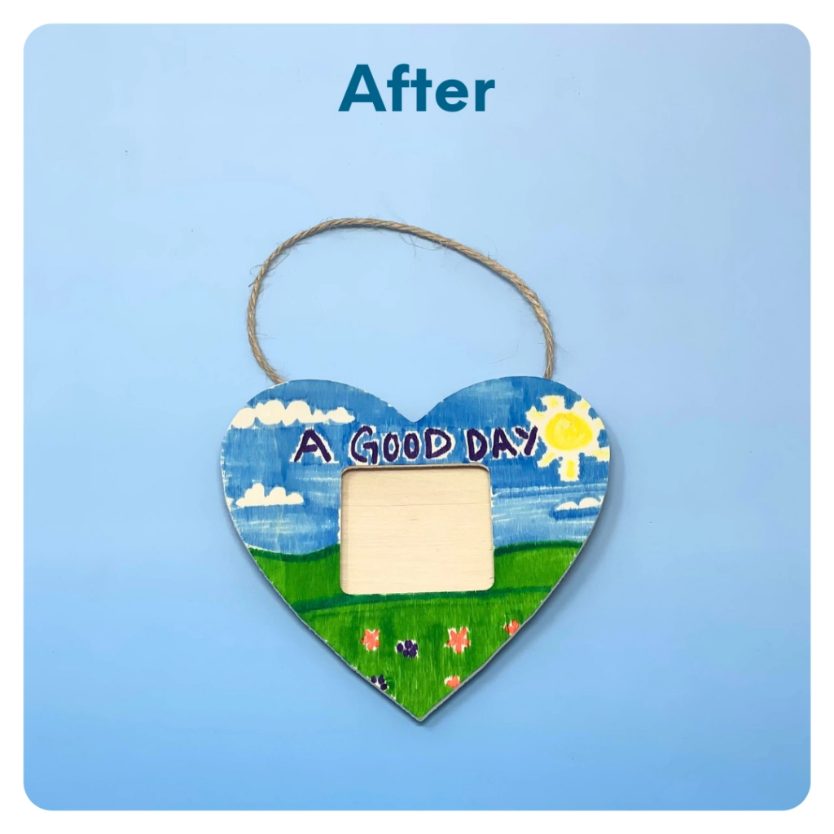
STEP 6 OF 10
DIY Picture Frame (continued)

Slide 12

STEP 7 OF 10
Decorate the Canvas Bag
Use the permanent markers to decorate the canvas bag.
Tip: Place a piece of paper in the bag before decorating to prevent the markers from bleeding through.

Slide 13

STEP 7 OF 10
Decorate the Canvas Bag (continued)

Slide 14
STEP 8 OF 10
Pack The Make-A-Wish® Travel Kit
Pack all of the materials into the United drawstring bag and put them into the original box.
• Please only include items that are UNOPENED and UNUSED
• Add any optional items you would like.
Optional Items to Add:
• Fidget toys
• Card games
• DVDs
• Activity books
• Coloring utensils
• Craft supplies
Items not to include:
• Perishable items
• Sharp objects
• Nut food products
• Religious or political items

Slide 15
STEP 9 OF 10
Register My Kit (Optional)
Register your kit. To register and track your kits, you must visit the online instructions. Registering your kit is optional.

Slide 16
STEP 10 OF 10
Thank You!
When you build a Kynd Kit, you create layers of impact for yourself and the community. We appreciate your time and your support of our mission.
Cheers,
The Project Helping team

