Slide 1
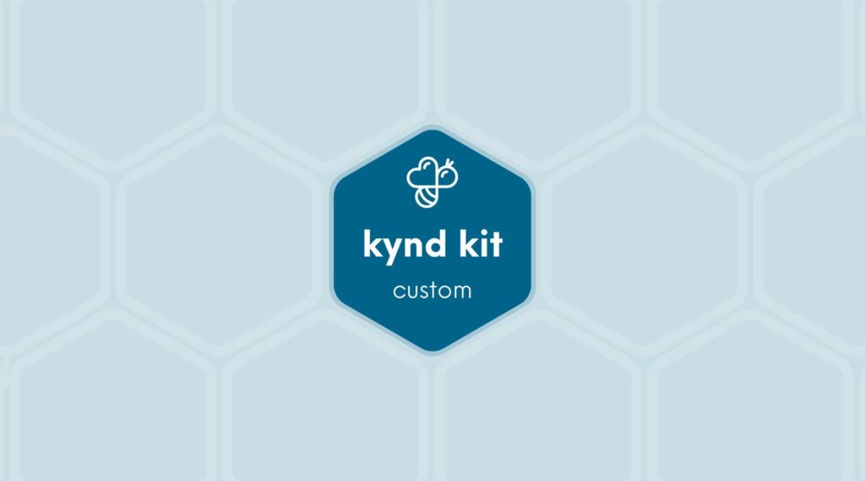
CUSTOM
Medtronic Co-Creator: Introduction to Robotics [+]
8 STEPS

Slide 2

STEP 1 OF 8
About Project Helping
Kynd Kits are a program of Project Helping, a mental wellness nonprofit. Our mission is to make it ridiculously easy to volunteer because doing good is good for your mental wellness!
Learn More at ProjectHelping.org
When You Build a Kynd Kit - The Cycle of Impact

Slide 3
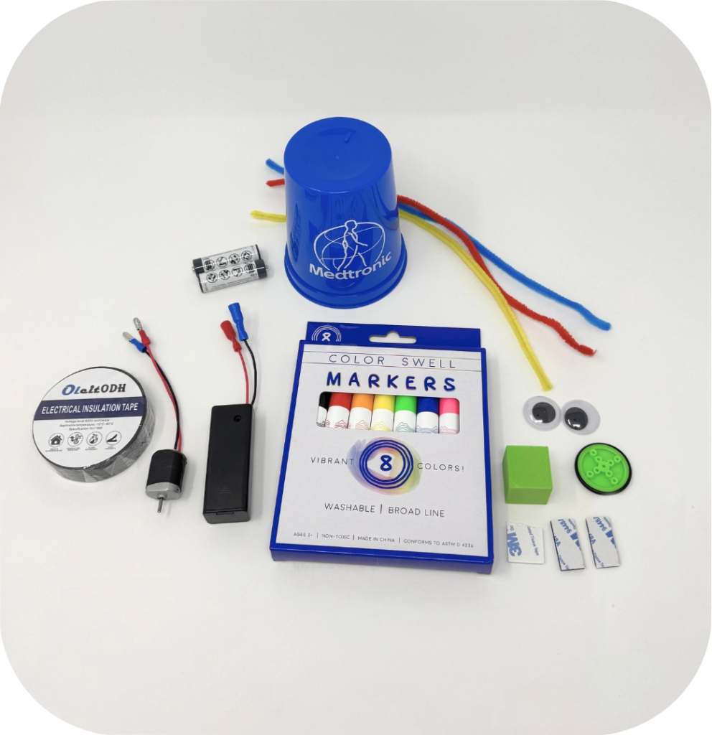
STEP 2 OF 8
Medtronic Co-Creator: Introduction to Robotics [+]
Before You Build
Begin your Co-Creator experience with the Introduction to Robotics Instruction Booklet. You will be instructed when it is time to return to this page.
Kit Contents:
Robot Parts
2 Motors
2 Battery Holders
2 AA Batteries
2 Plastic Cups
2 Wheels
2 Foam Blocks
6 Markers
Adhesives
1 Electric Tape
5 Adhesive Squares
1 Glue Bottle
Print Materials
1 Note to the Adult
1 Instruction Booklet
2 Robot Part Inventory
4 Field Journal Worksheets
Other Items
2 Safety Glasses
1 Robotic Pen
1 Sticker Sheet

Slide 4
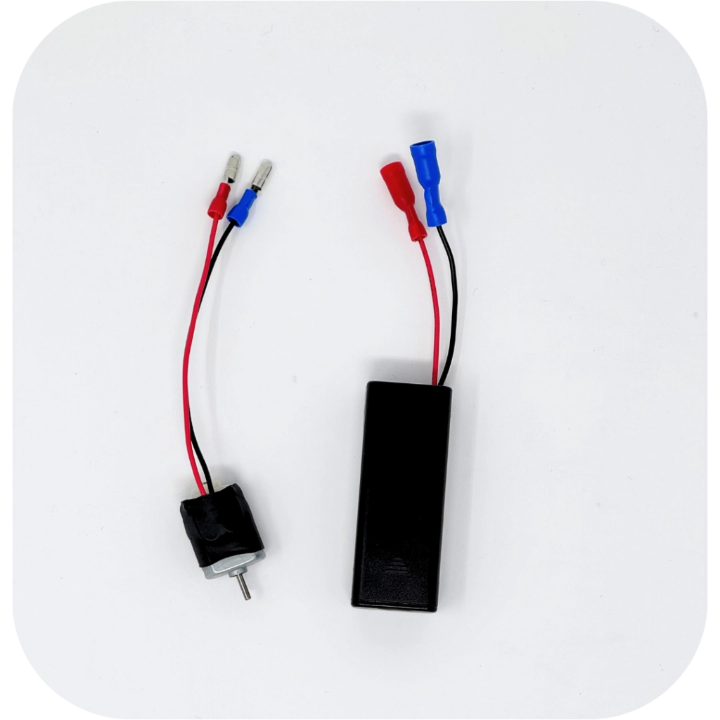
STEP 3 OF 8
Doodlebot Robot | Step 1
• Connect the motor to the battery holder, matching the wires (blue to blue and red to red).
• Place a AA battery in the battery holder.

Slide 5
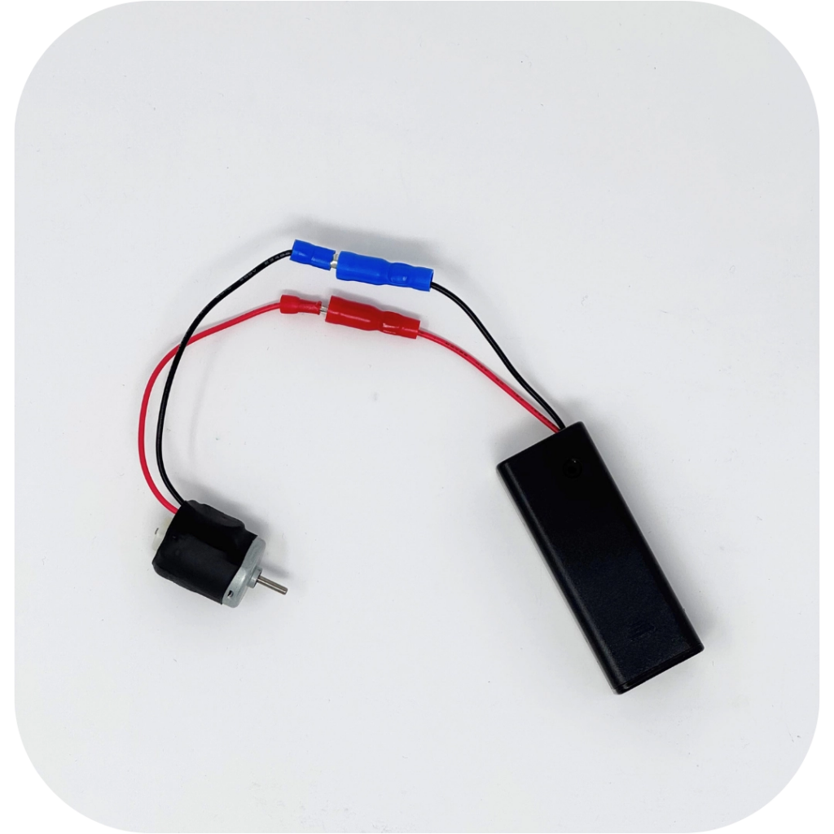
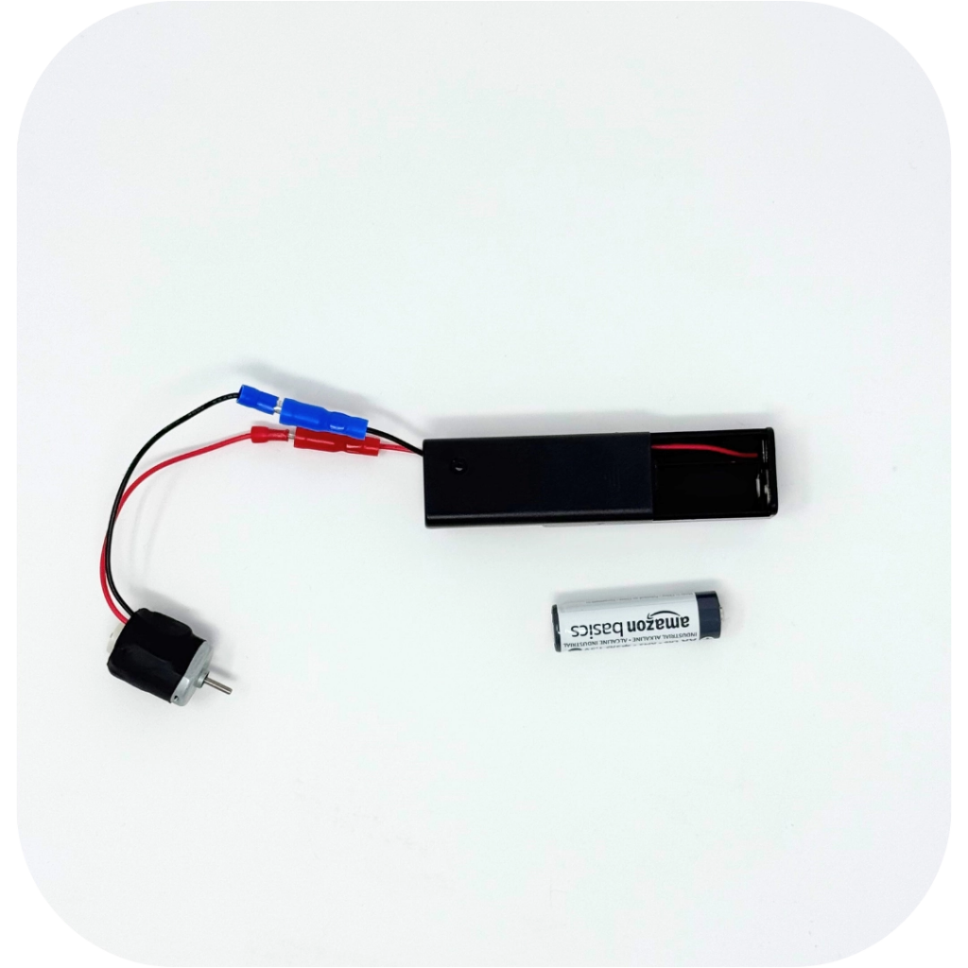
STEP 3 OF 8
Doodlebot Robot | Step 1 (continued)

Slide 6

STEP 4 OF 8
Doodlebot Robot | Step 2
• Check out the 2 options below
• Attach the battery holder and motor to your robot body (blue cup) using the foam adhesive squares. Press firmly for a stronger bond.
• Record your battery holder and motor design choice in your field journal.

Slide 7
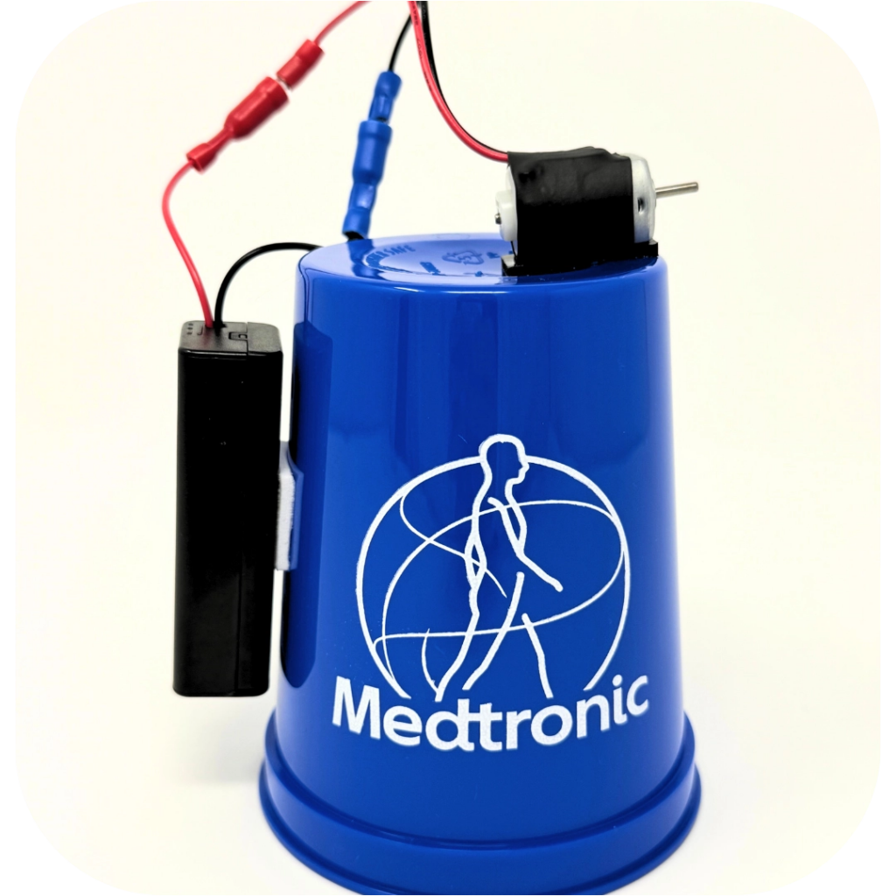
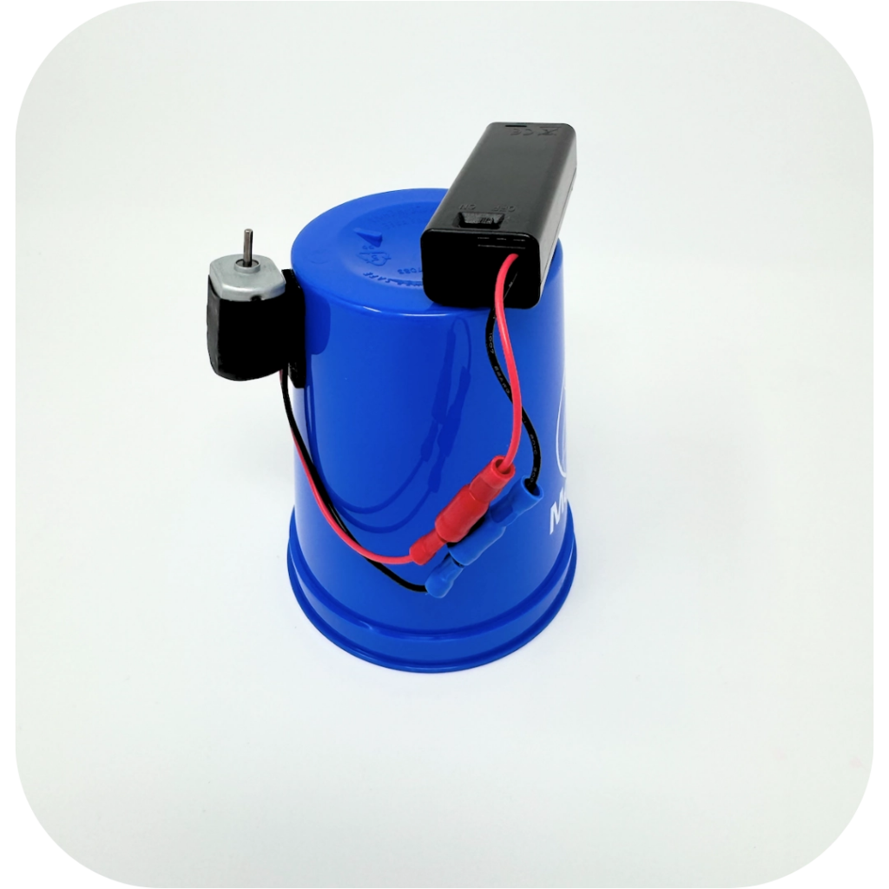
STEP 4 OF 8
Doodlebot Robot | Step 2 (continued)

Slide 8
STEP 5 OF 8
Doodlebot Robot | Step 3
• Fit the plastic wheel onto the motor shaft. Some holes fit tight and some fit loosely. Make sure you use a tight-fitting hole
• Use an adhesive square to attach the foam cube onto the wheel
• Record your wheel and foam cube design choice in your field journal

Slide 9
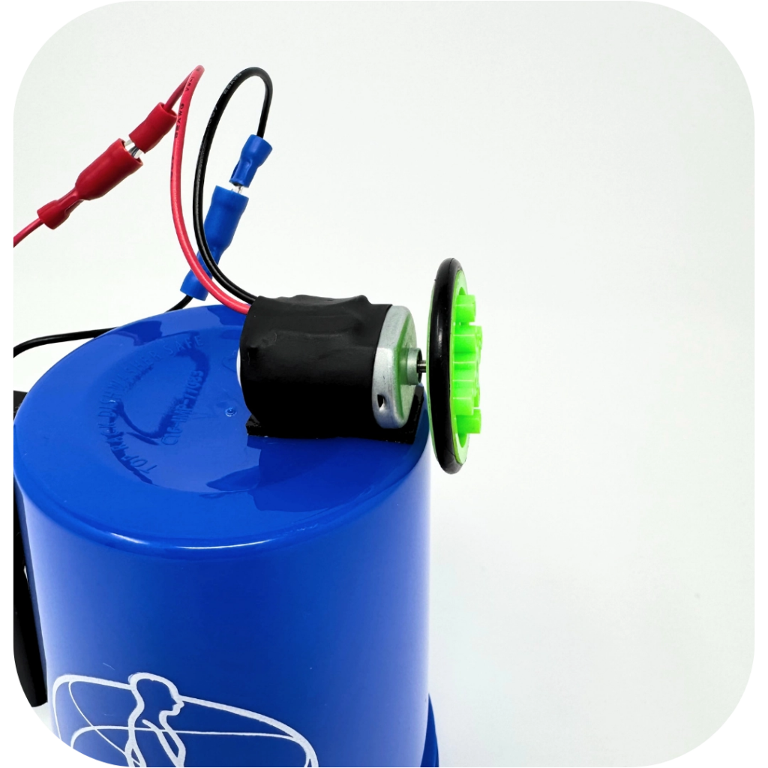
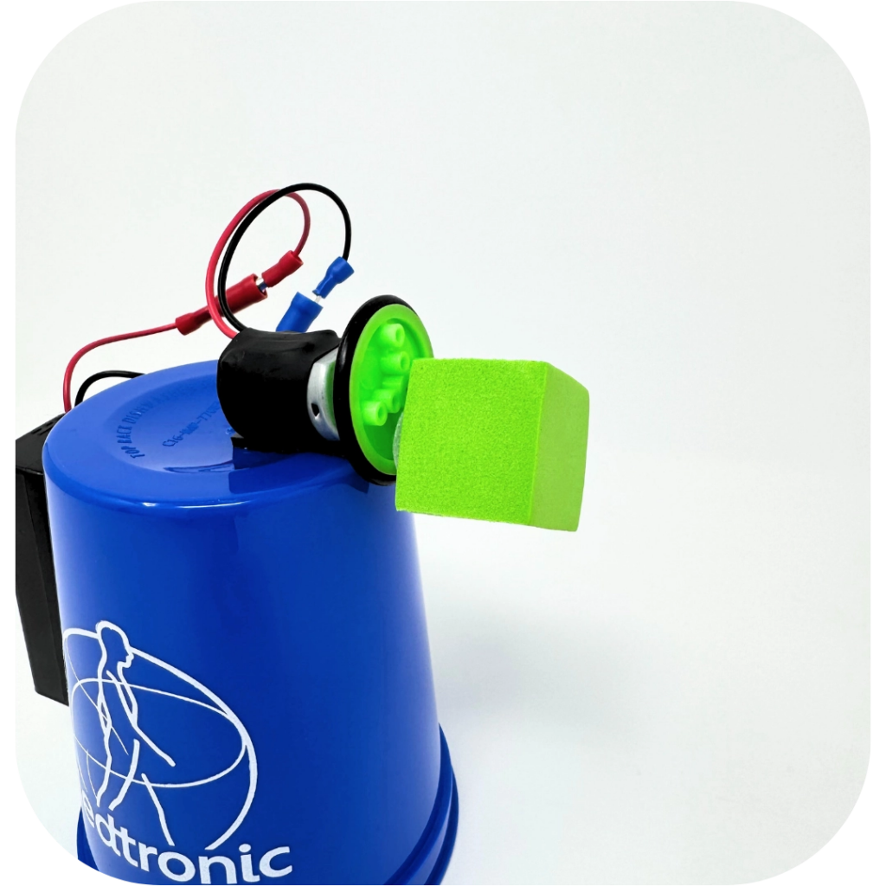
STEP 5 OF 8
Doodlebot Robot | Step 3 (continued)

Slide 10
STEP 6 OF 8
Doodlebot Robot | Step 4
• Add 3 markers as legs for your robot. Use two long pieces of tape per marker and make sure the felt tip will touch the paper when the caps are removed.
• Add googly eyes and pipe cleaners to give your robot some character.
• Record your marker design choice in your field journal

Slide 11
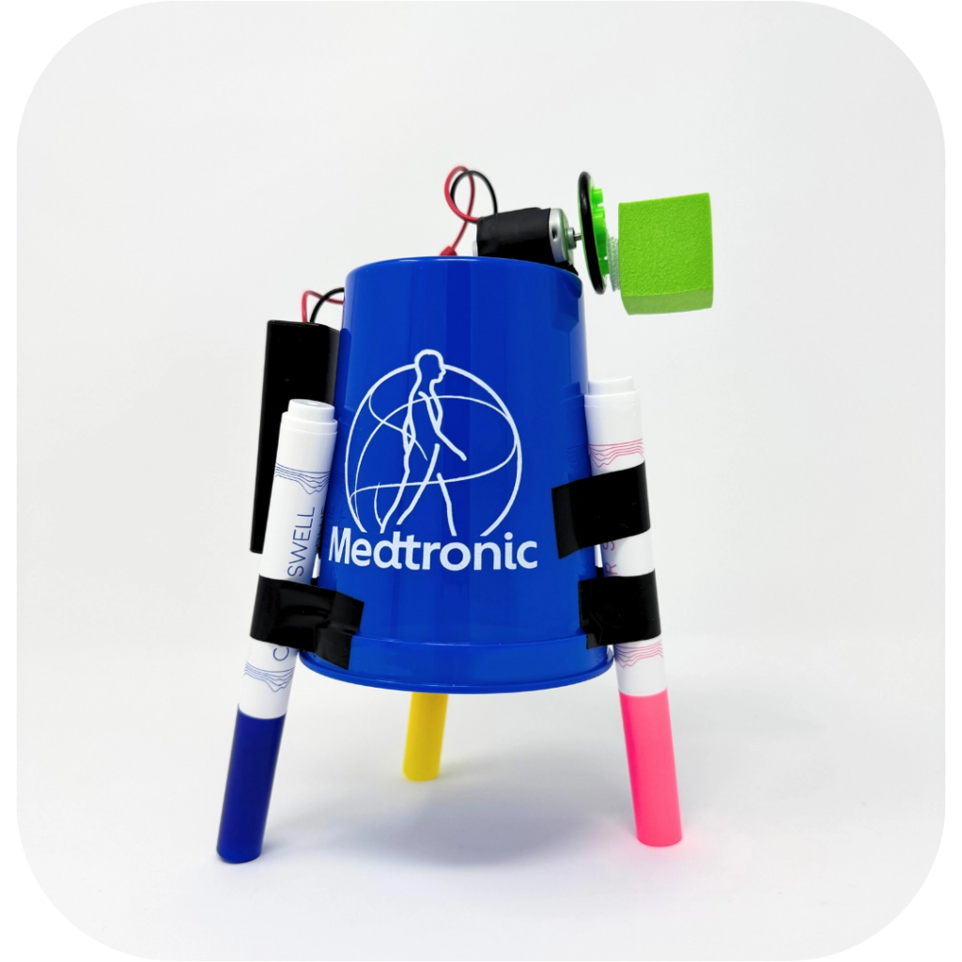
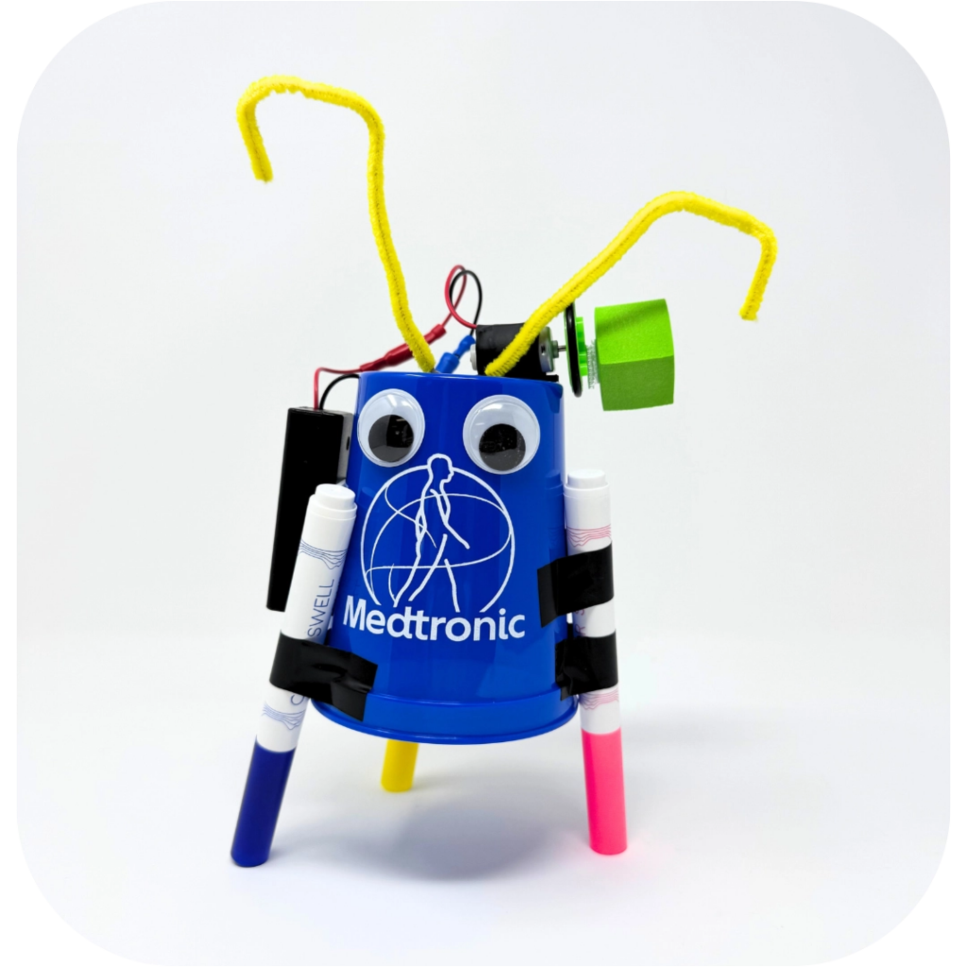
STEP 6 OF 8
Doodlebot Robot | Step 4 (continued)

Slide 12
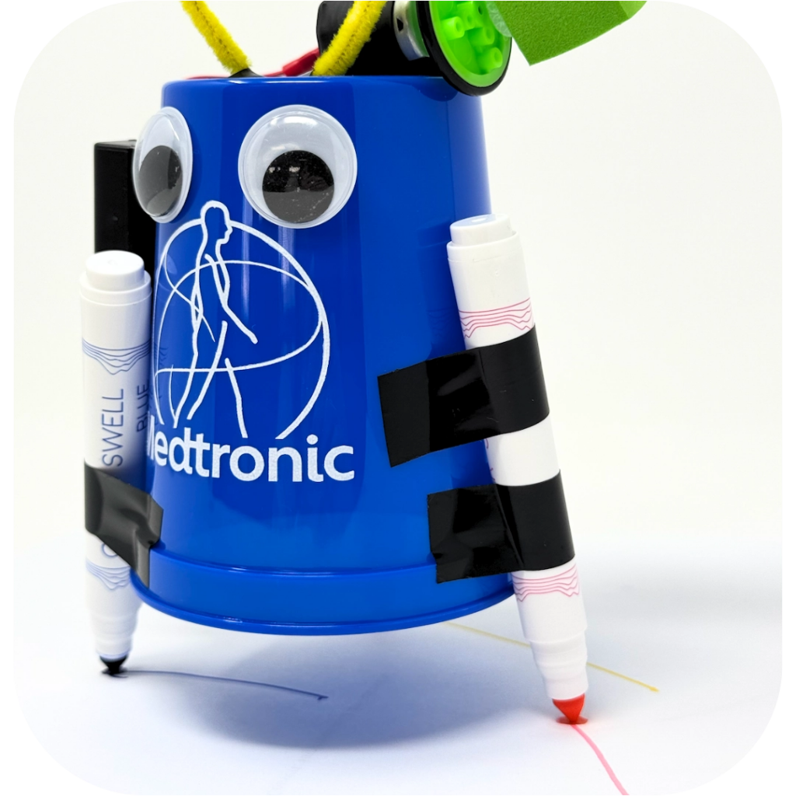
STEP 7 OF 8
Doodlebot Robot | Step 5
Time to test your robot!
Put on your safety glasses and turn to page 4 in your instruction booklet for the next steps.

Slide 13
STEP 8 OF 8
Thank You!
When you build a Kynd Kit, you create layers of impact for yourself and the community. We appreciate your time and your support of our mission.
Cheers,
The Project Helping team

