Slide 1

CLASSIC
Mens Mental Health Care [Classic]
12 STEPS

Slide 2

STEP 1 OF 12
About Project Helping
Kynd Kits are a program of Project Helping, a mental wellness nonprofit. Our mission is to make it ridiculously easy to volunteer because doing good is good for your mental wellness!
Learn More at ProjectHelping.org
When You Build a Kynd Kit - The Cycle of Impact

Slide 3

STEP 2 OF 12
Tips for Building Your Kit
Helpful Tip for Building Your Kynd Kit
• Avoid politics and religion entirely.
• Use appropriate humor.
• Can't think of what to write, draw a picture!
• Use words of affirmation!
• Place a piece of paper in any canvas bag before drawing on the outside. This way, the marker will not bleed through the other side of the bag.
• Please keep your designs gender-neutral, inclusive, and age-appropriate.
Spanish Translation Options

Slide 4
STEP 3 OF 12
Men’s Mental Health Care [Classic]
Before You Build
This kit was created in partnership with Angel Eyes, a nonprofit dedicated to providing compassionate grief support for parents who have experienced the loss of an infant or child. While mothers often receive the majority of care and attention during these heartbreaking moments, many dads silently shoulder their own grief—often with fewer outlets, fewer resources, and fewer opportunities to express what they’re carrying. This gap in support is real, and it matters.

Slide 5
STEP 3 OF 12
Men’s Mental Health Care [Classic] (continued)
The Men's Mental Health Kit was designed to help address that gap by offering dads meaningful tools, comfort items, and supportive resources during an incredibly difficult time. However, the mental health needs of men extend far beyond grief and child loss. Men across all ages, stages, and circumstances face unique barriers when seeking help—whether due to stigma, societal expectations, or lack of accessible resources.
This kit is built to meet those broader needs. Whether supporting someone navigating depression, anxiety, stress, life transitions, trauma, or simply needing a reminder that they’re not alone, the items in this kit provide encouragement, grounding, and connection.
By building this kit, you are helping to create a moment of care and support for men who may not often receive it—no matter what they’re going through.

Slide 6

STEP 4 OF 12
Decorate the Bag
Decorate the kraft bag(s). This is what the final kit is distributed in, so try to make this fun and colorful for the recipient to open.
Please note: we are currently transitioning from plastic ziplock bags to kraft bags. Some kits may still include the plastic bag for you to decorate while we complete this transition.

Slide 7



STEP 4 OF 12
Decorate the Bag (continued)

Slide 8

STEP 5 OF 12
Affirmation Notebook
DIY Affirmations
Find the mini affirmation notebook in your kit. Decorate the front cover with drawings, stickers, or a positive message. Then, open it up and write 3–6 affirmations inside—more if you'd like! These can be encouraging words, self-love reminders, or anything that lifts the spirit.
Do you still have affirmation cards in your kit? If your kit includes affirmation cards instead of a notebook, go ahead and write a special affirmation on each card.

Slide 9


STEP 5 OF 12
Affirmation Notebook (continued)

Slide 10

STEP 6 OF 12
Surprise Kyndness Notebook
Decorate the outside of the journal with a picture or uplifting message. Use random pages in the journal to write short, uplifting messages, draw small, colorful images, or create fun writing prompts for the recipient.

Slide 11

STEP 6 OF 12
Surprise Kyndness Notebook (continued)

Slide 12

STEP 7 OF 12
Write a Note to the Recipient and Decorate the Envelope
Write a card and decorate the envelope using the enclosed materials. Express your encouragement and include a hopeful message.
Please ensure your message is age-appropriate and avoids references to religion or politics.

Slide 13

STEP 7 OF 12
Write a Note to the Recipient and Decorate the Envelope (continued)

Slide 14
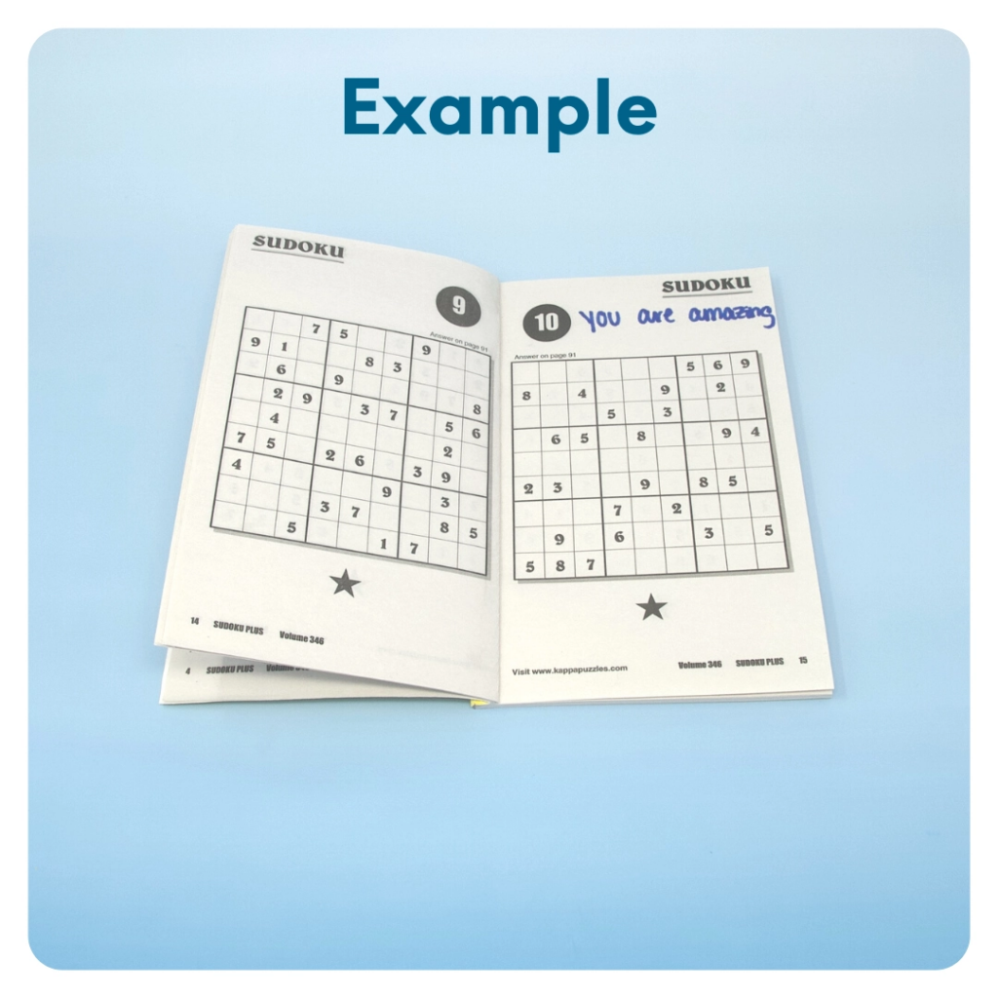
STEP 8 OF 12
Surprise Kyndness Puzzle Book
Go through the pages of the Sudoku or puzzle book and write uplifting messages, draw small, colorful images, or create fun writing prompts for the recipient.

Slide 15
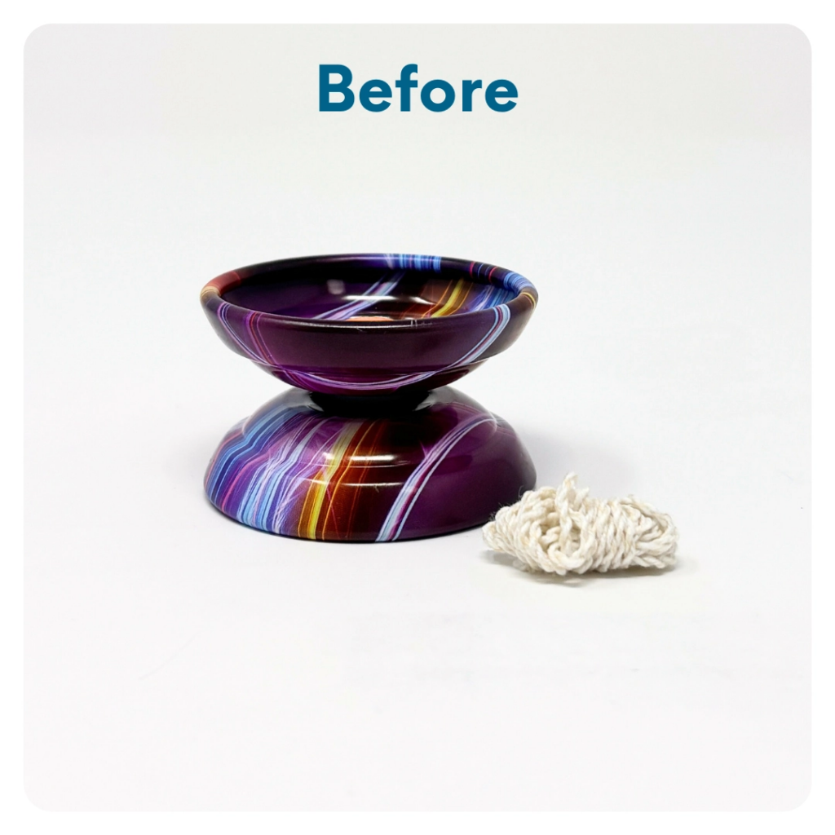
STEP 9 OF 12
DIY Yoyo
Step 1:
Find the string. One end already has a finger loop.
Step 2:
Find the other end of the string. Tie it securely around the middle of the yo-yo. Be sure to use a double knot.
Step 3:
Wrap the remaining string neatly around the middle of the yo-yo.
Step 4:
Test it out! Put your finger in the finger loop and try the yo-yo.
Step 5:
Assembly complete! Add the yo-yo to the completed contents of the kit.

Slide 16
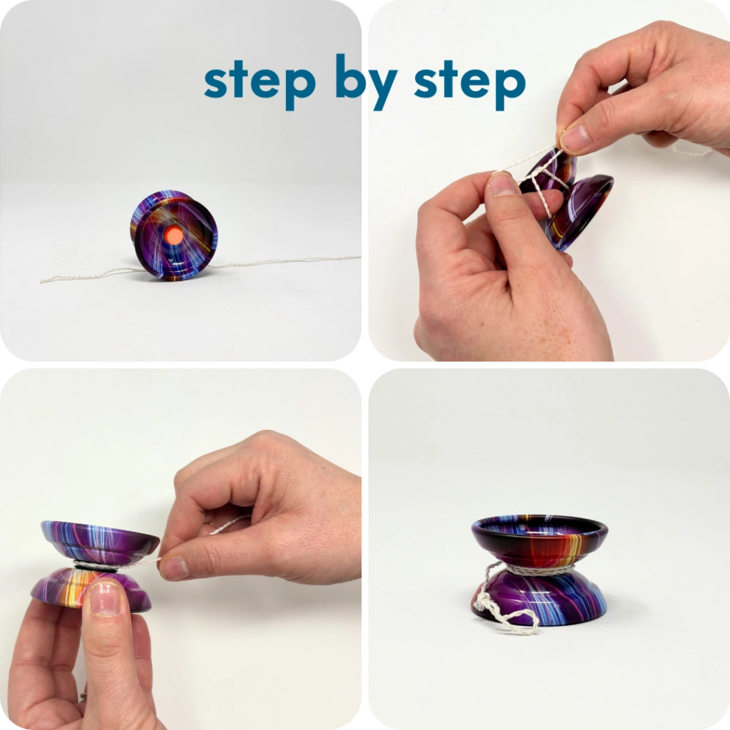
STEP 9 OF 12
DIY Yoyo (continued)

Slide 17
STEP 10 OF 12
Pack the Men’s Mental Health Kit [Classic]
Place all decorated items and additional kit contents into the decorated plastic bag.
• Pease only include any UNUSED and UNOPENED items
• Add any optional items you would like
Optional Items to Add:
• Self-care items
• Toiletries
• Socks
• High protein snack items
• Fidget items
Items not to include:
• Perishable items
• Sharp objects
• Nut food products
• Religious or political item

Slide 18
STEP 11 OF 12
Register My Kit (Optional)
Register your kit. To register and track your kits, you must visit the online instructions. Registering your kit is optional.

Slide 19
STEP 12 OF 12
Thank You!
When you build a Kynd Kit, you create layers of impact for yourself and the community. We appreciate your time and your support of our mission.
Cheers,
The Project Helping team

