Slide 1

PLUS
Mental Health Care [Plus]
13 STEPS

Slide 2

STEP 1 OF 13
About Project Helping
Kynd Kits are a program of Project Helping, a mental wellness nonprofit. Our mission is to make it ridiculously easy to volunteer because doing good is good for your mental wellness!
Learn More at ProjectHelping.org
When You Build a Kynd Kit - The Cycle of Impact

Slide 3

STEP 2 OF 13
Tips for Building Your Kit
Helpful Tip for Building Your Kynd Kit
• Avoid politics and religion entirely.
• Use appropriate humor.
• Can't think of what to write, draw a picture!
• Use words of affirmation!
• Place a piece of paper in any canvas bag before drawing on the outside. This way, the marker will not bleed through the other side of the bag.
• Please keep your designs gender-neutral, inclusive, and age-appropriate.
Spanish Translation Options

Slide 4
STEP 3 OF 13
Mental Health Care [+]
Before You Build
Millions of people in the U.S. are affected by mental illness each year. 1 in 5 U.S. adults lives with a mental illness. Suicide is the 12th leading cause of death overall in the U.S.
This Kynd Kit is designed to create a care package for yourself or someone you know experiencing mental health concerns. The Kynd Kit shows support for the individual’s mental health journey.
We all experience off days or personal crises, and it is important to be ready and not let these emotions overwhelm you.

Slide 5
STEP 3 OF 13
Mental Health Care [+] (continued)
This Kynd Kit equips you with calming tools and self-care products you can use when you feel anxious or nervous.

Slide 6

STEP 4 OF 13
Write a Note to the Recipient and Decorate the Envelope
Write a card and decorate the envelope using the enclosed materials. Express your encouragement and include a hopeful message.
Please ensure your message is age-appropriate and avoids references to religion or politics.

Slide 7

STEP 4 OF 13
Write a Note to the Recipient and Decorate the Envelope (continued)

Slide 8

STEP 5 OF 13
Decorate the Bag
Decorate the kraft bag(s). This is what the final kit is distributed in, so try to make this fun and colorful for the recipient to open.
Please note: we are currently transitioning from plastic ziplock bags to kraft bags. Some kits may still include the plastic bag for you to decorate while we complete this transition.

Slide 9



STEP 5 OF 13
Decorate the Bag (continued)

Slide 10

STEP 6 OF 13
Surprise Kyndness Notebook
Decorate the outside of the journal with a picture or uplifting message. Use random pages in the journal to write short, uplifting messages, draw small, colorful images, or create fun writing prompts for the recipient.

Slide 11

STEP 6 OF 13
Surprise Kyndness Notebook (continued)

Slide 12
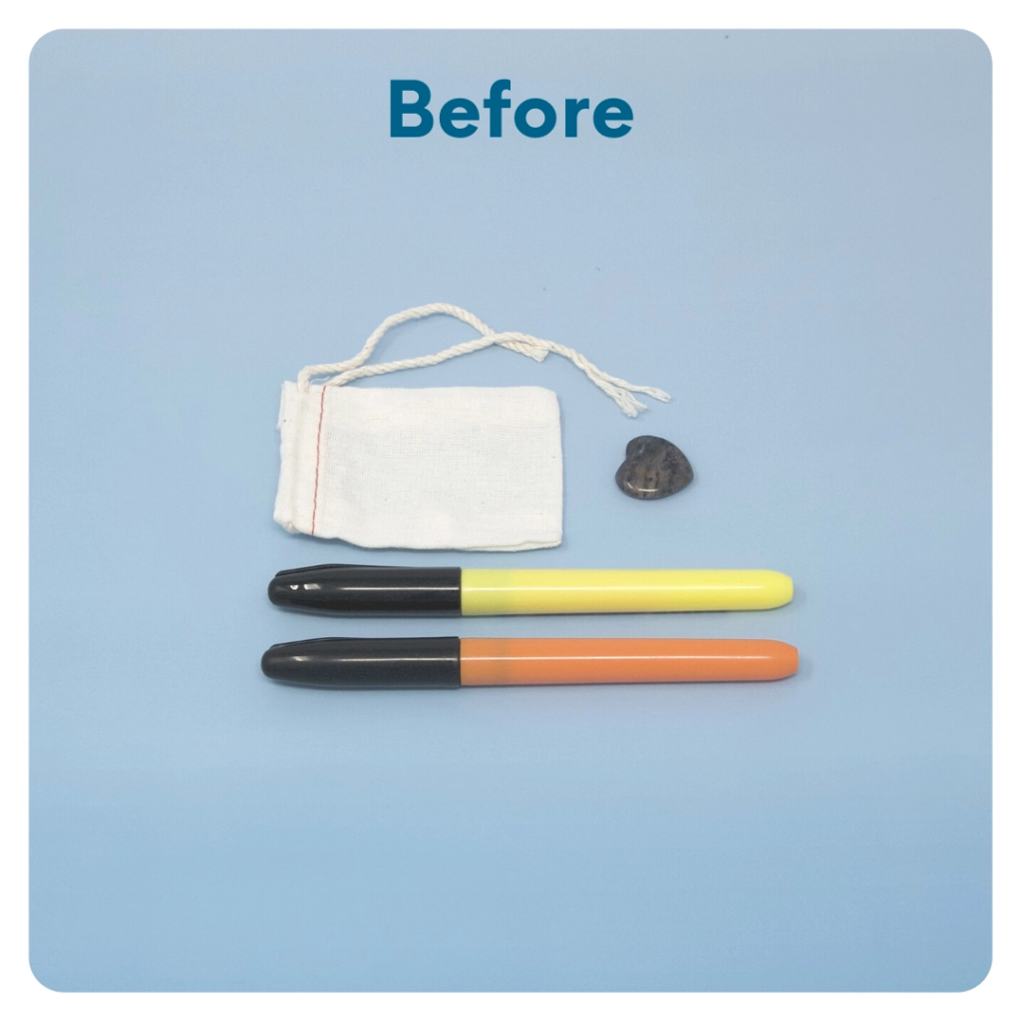
STEP 7 OF 13
Worry Stone
Worry stones are smooth, polished rocks used for relaxation or anxiety relief to help one feel grounded. The stone is meant to be kept in one’s pocket. The physical act of massaging a worry stone for several minutes is proven to provide therapeutic & psychological benefits that help soothe your nervous system, reduce stress and anxiety, and help clear your mind so you can focus and think clearly.
On one side of the drawstring bag write an inspirational or calming word. Examples: hope, love, grow, breathe, dream, courage, wonder.

Slide 13
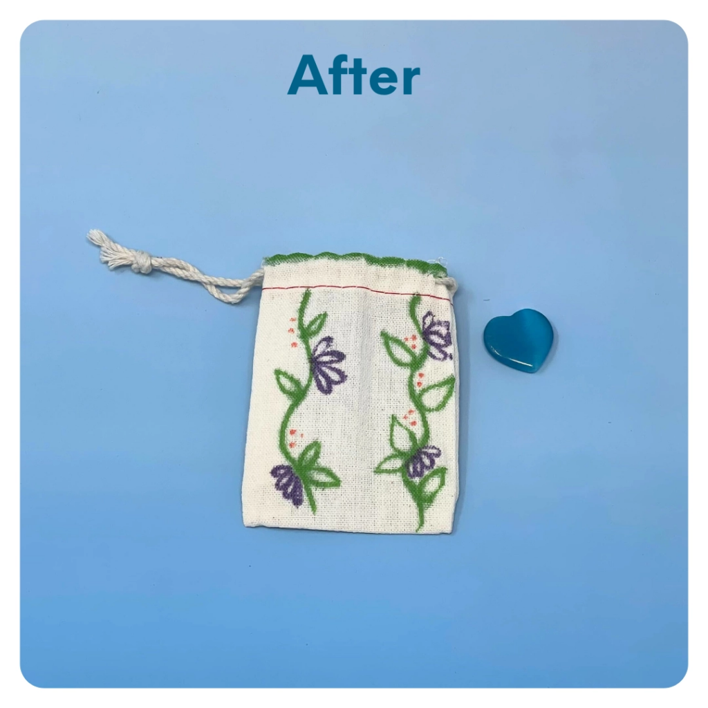
STEP 7 OF 13
Worry Stone (continued)
Tip: Place a piece of paper or cardboard in the bag before decorating to prevent the marker from bleeding through.

Slide 14

STEP 8 OF 13
Decorate the Canvas Bag
Use the permanent markers to decorate the canvas bag.
Tip: Place a piece of paper in the bag before decorating to prevent the markers from bleeding through.

Slide 15

STEP 8 OF 13
Decorate the Canvas Bag (continued)

Slide 16

STEP 9 OF 13
Affirmation Notebook
DIY Affirmations
Find the mini affirmation notebook in your kit. Decorate the front cover with drawings, stickers, or a positive message. Then, open it up and write 3–6 affirmations inside—more if you'd like! These can be encouraging words, self-love reminders, or anything that lifts the spirit.
Do you still have affirmation cards in your kit? If your kit includes affirmation cards instead of a notebook, go ahead and write a special affirmation on each card.

Slide 17


STEP 9 OF 13
Affirmation Notebook (continued)

Slide 18
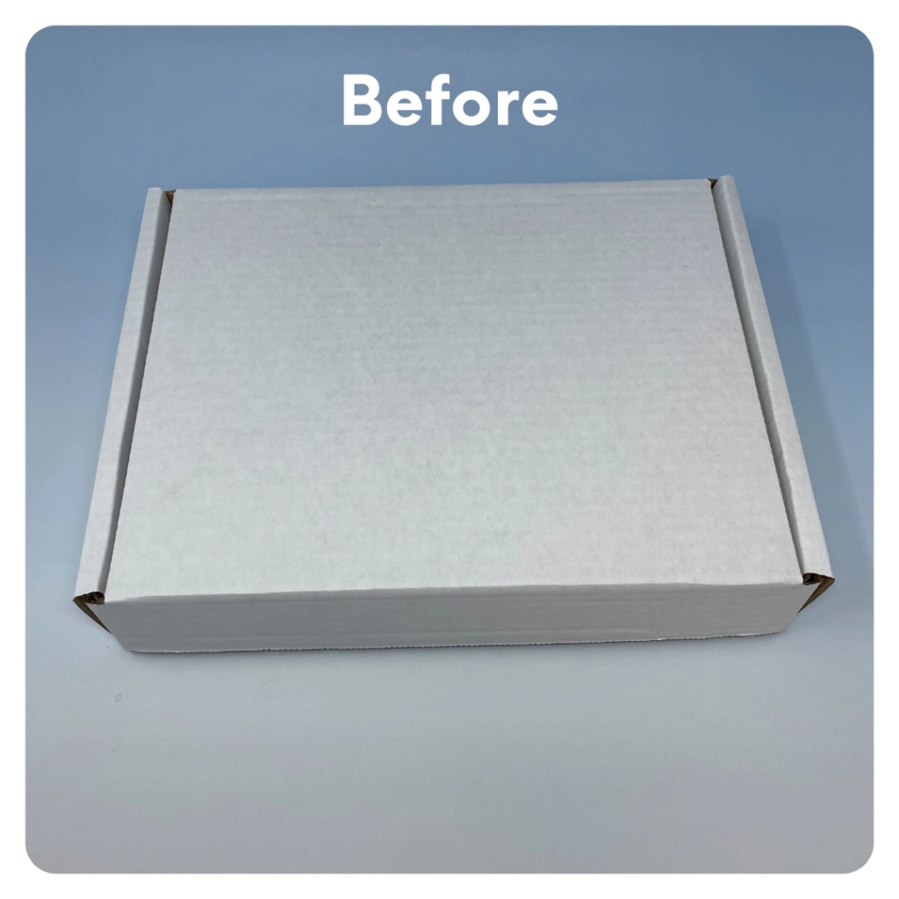
STEP 10 OF 13
Decorate Box (optional)
Decorate the outside of the box. Make it fun and colorful for the recipient.

Slide 19
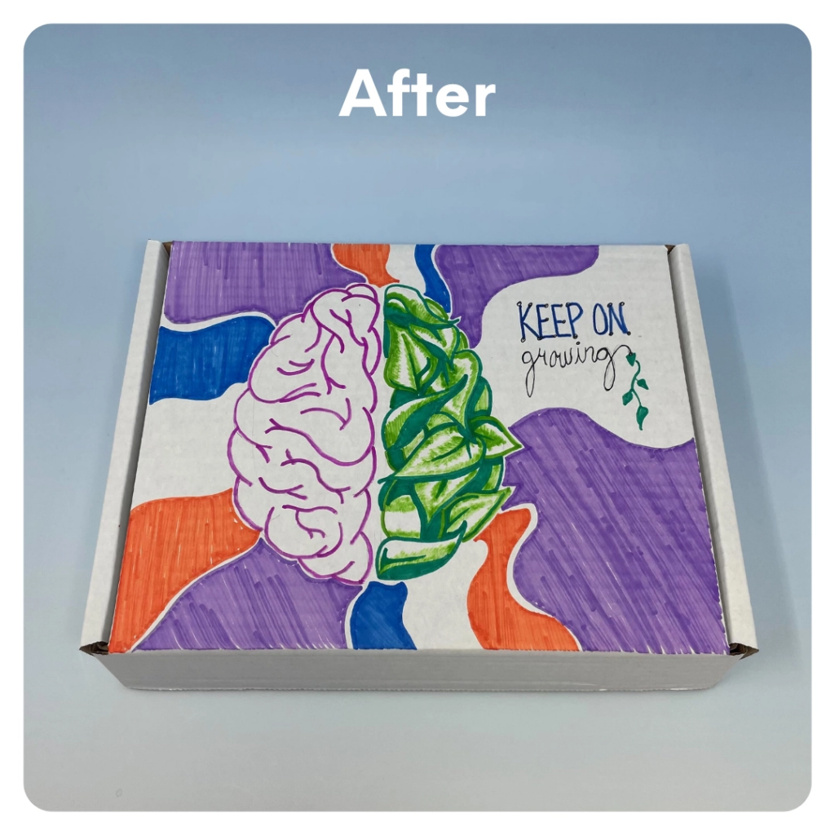
STEP 10 OF 13
Decorate Box (optional) (continued)

Slide 20
STEP 11 OF 13
Pack the Mental Health Care Kit [Plus]
Pack all of the materials into the kraft bag or into the original box.
• Please only include items that are UNOPENED and UNUSED
• Add any optional items you would like.
Optional Items to Add:
• Bath bombs
• Positive notes
• Self-care items
• Fidget toys
• Journals
Items not to include:
• Perishable items
• Sharp objects
• Nut food products
• Religious or political items

Slide 21
STEP 12 OF 13
Register My Kit (Optional)
Register your kit. To register and track your kits, you must visit the online instructions. Registering your kit is optional.

Slide 22
STEP 13 OF 13
Thank You!
When you build a Kynd Kit, you create layers of impact for yourself and the community. We appreciate your time and your support of our mission.
Cheers,
The Project Helping team

