Slide 1

PLUS
New Parent Support [Plus]
13 STEPS

Slide 2

STEP 1 OF 13
About Project Helping
Kynd Kits are a program of Project Helping, a mental wellness nonprofit. Our mission is to make it ridiculously easy to volunteer because doing good is good for your mental wellness!
Learn More at ProjectHelping.org
When You Build a Kynd Kit - The Cycle of Impact

Slide 3

STEP 2 OF 13
Tips for Building Your Kit
Helpful Tip for Building Your Kynd Kit
• Avoid politics and religion entirely.
• Use appropriate humor.
• Can't think of what to write, draw a picture!
• Use words of affirmation!
• Place a piece of paper in any canvas bag before drawing on the outside. This way, the marker will not bleed through the other side of the bag.
• Please keep your designs gender-neutral, inclusive, and age-appropriate.
Spanish Translation Options

Slide 4
STEP 3 OF 13
New Parent Support [+]
Before You Build
Postpartum depression is depression that occurs after having a baby. It occurs more commonly in adolescents, those who deliver premature infants, and those living in urban areas. 1 in 8 individuals suffer from postpartum depression, or mood and anxiety struggles during pregnancy or after delivery.

Slide 5
STEP 3 OF 13
New Parent Support [+] (continued)
The overall success rate for treating postpartum depression is 80%, making it essential for anyone who wants to heal. Create a care package for a new parent that includes mental health resources and self care items for them to take some time for themself and know they are supported by others.

Slide 6

STEP 4 OF 13
Write a Note to the Recipient and Decorate the Envelope
Write a card and decorate the envelope using the enclosed materials. Express your encouragement and include a hopeful message.
Please ensure your message is age-appropriate and avoids references to religion or politics.

Slide 7

STEP 4 OF 13
Write a Note to the Recipient and Decorate the Envelope (continued)

Slide 8
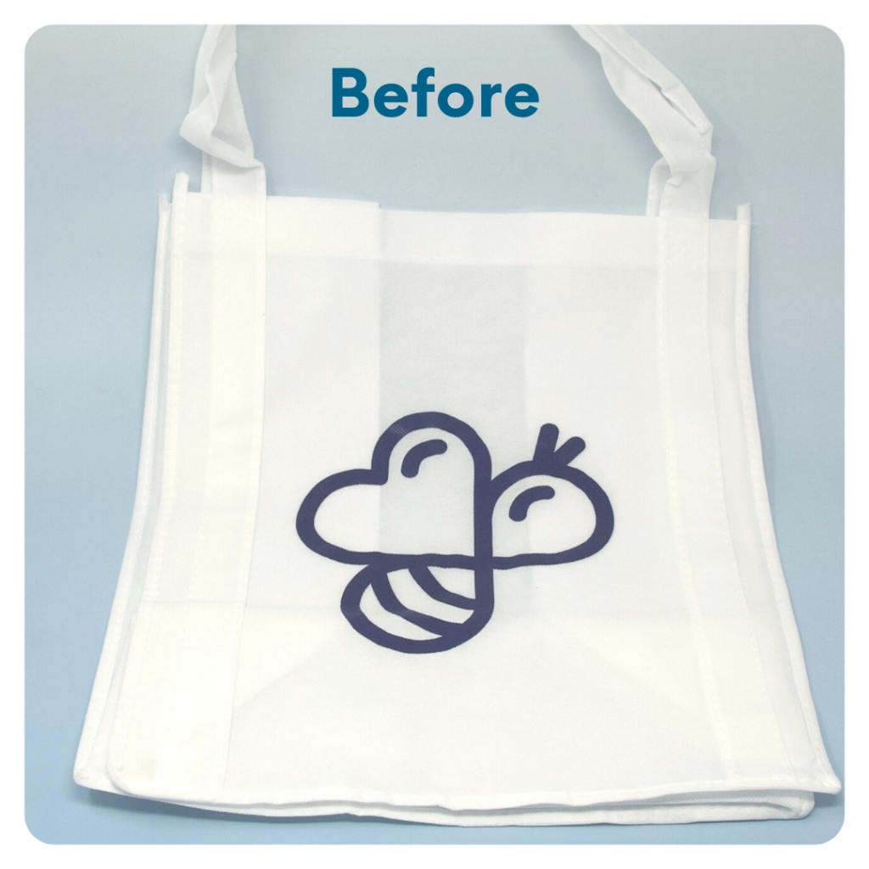
STEP 5 OF 13
DIY Tote Bag
Decorate the Canvas Tote
Decorate the canvas tote to make it fun and colorful! Tip: place a piece of paper in the tote before decorating. This will prevent the marker from bleeding through the tote.

Slide 9

STEP 5 OF 13
DIY Tote Bag (continued)

Slide 10

STEP 6 OF 13
Surprise Kyndness Notebook
Decorate the outside of the journal with a picture or uplifting message. Use random pages in the journal to write short, uplifting messages, draw small, colorful images, or create fun writing prompts for the recipient.

Slide 11

STEP 6 OF 13
Surprise Kyndness Notebook (continued)

Slide 12
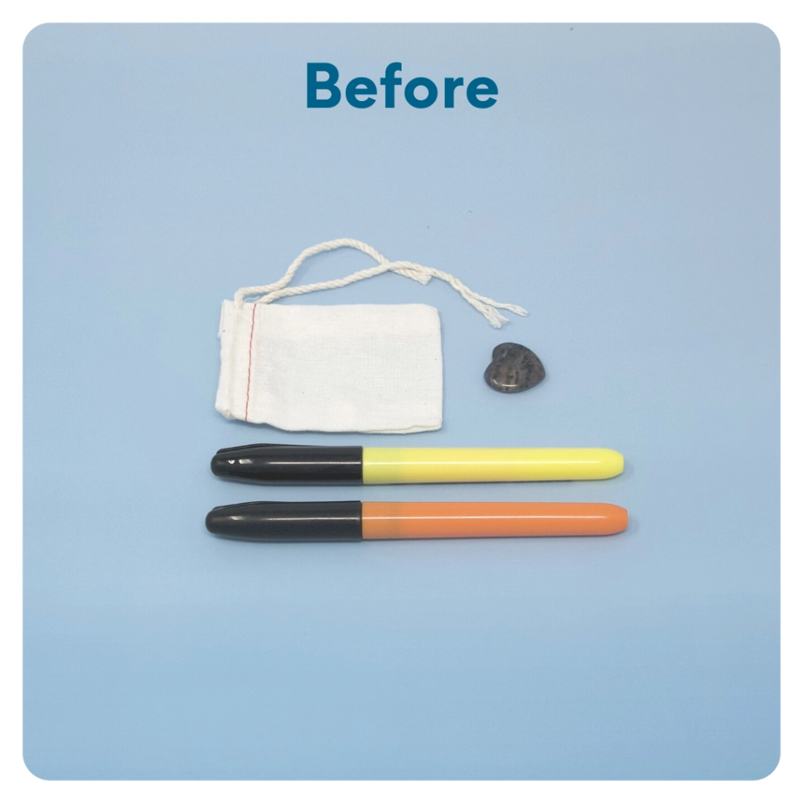
STEP 7 OF 13
Worry Stone
Worry stones are smooth, polished rocks used for relaxation or anxiety relief to help one feel grounded. The stone is meant to be kept in one’s pocket. The physical act of massaging a worry stone for several minutes is proven to provide therapeutic & psychological benefits that help soothe your nervous system, reduce stress and anxiety, and help clear your mind so you can focus and think clearly.
On one side of the drawstring bag write an inspirational or calming word. Examples: hope, love, grow, breathe, dream, courage, wonder.

Slide 13
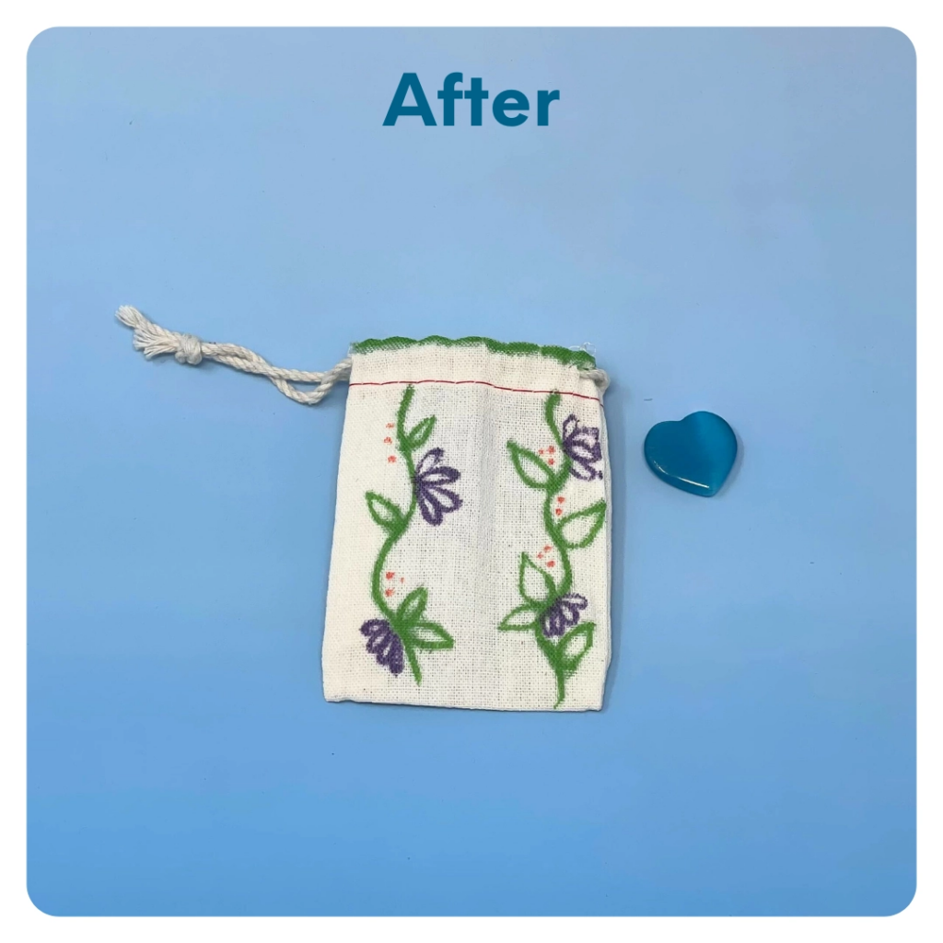
STEP 7 OF 13
Worry Stone (continued)
Tip: Place a piece of paper or cardboard in the bag before decorating to prevent the marker from bleeding through.

Slide 14

STEP 8 OF 13
Decorate the Canvas Bag
Use the permanent markers to decorate the canvas bag.
Tip: Place a piece of paper in the bag before decorating to prevent the markers from bleeding through.

Slide 15

STEP 8 OF 13
Decorate the Canvas Bag (continued)

Slide 16

STEP 9 OF 13
Affirmation Notebook
DIY Affirmations
Find the mini affirmation notebook in your kit. Decorate the front cover with drawings, stickers, or a positive message. Then, open it up and write 3–6 affirmations inside—more if you'd like! These can be encouraging words, self-love reminders, or anything that lifts the spirit.
Do you still have affirmation cards in your kit? If your kit includes affirmation cards instead of a notebook, go ahead and write a special affirmation on each card.

Slide 17


STEP 9 OF 13
Affirmation Notebook (continued)

Slide 18
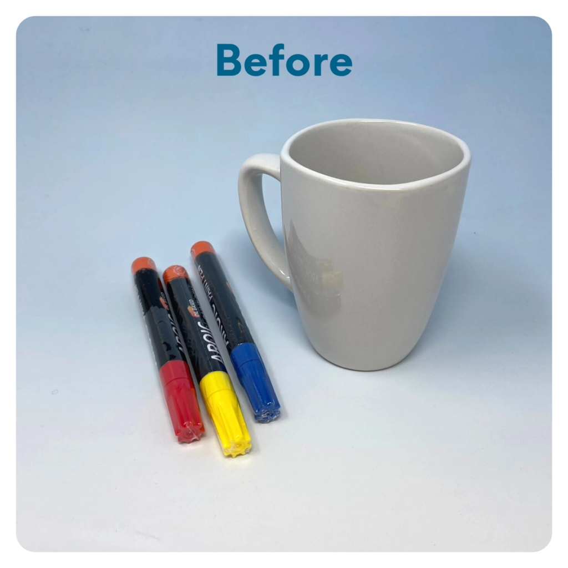
STEP 10 OF 13
Decorate the Coffee Mug
Using paint pens, decorate the mug. Write a message or draw something. Get creative! After you’re done decorating, place the mug in the oven before preheating. Then, preheat the oven to 350 degrees. Once preheated, set the timer for 30 min. Once the time is over, turn off your oven and let the mug cool off inside for an additional 30 min before taking it out.
WARNING: Mug may be hot. Use caution when removing!

Slide 19
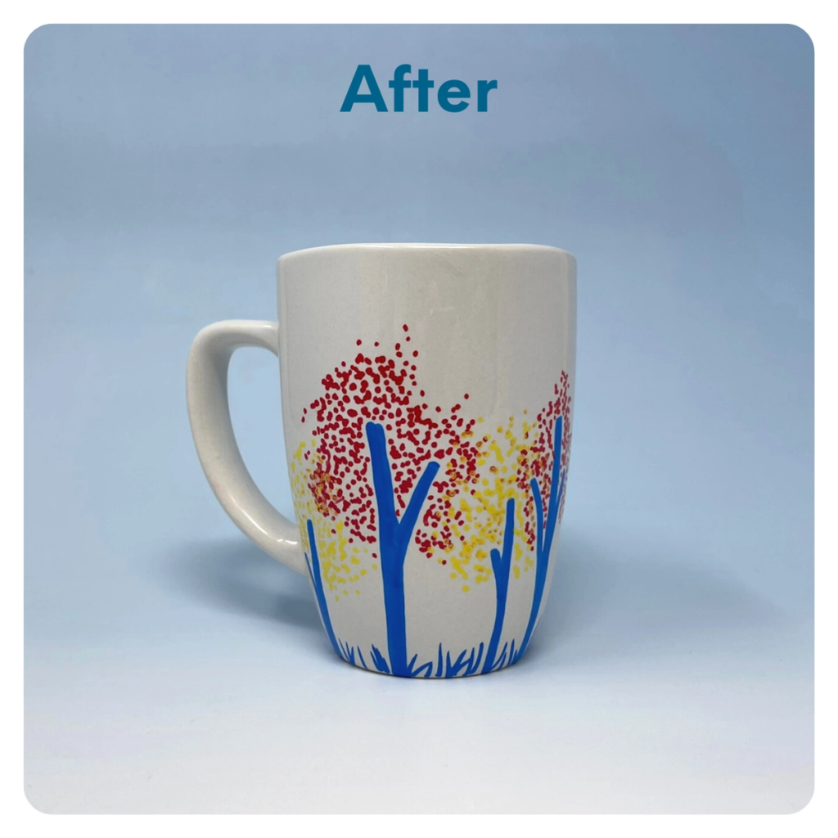
STEP 10 OF 13
Decorate the Coffee Mug (continued)

Slide 20
STEP 11 OF 13
Pack The New Parent Support [Plus]
Pack all of the materials into the decorated tote bag and put it back into the original box.
• Please only include items that are UNOPENED and UNUSED
• Add any optional items you would like.
• Please make sure to wrap your mug back up to prevent from breaking in shipping
Optional Items to Add:
• Self-care items
• Stress relief items
• Journals
• Coffee/snacks
Items not to include:
• Perishable items
• Sharp objects
• Nut food products
• Religious or political items

Slide 21
STEP 12 OF 13
Register My Kit (Optional)
Register your kit. To register and track your kits, you must visit the online instructions. Registering your kit is optional.

Slide 22
STEP 13 OF 13
Thank You!
When you build a Kynd Kit, you create layers of impact for yourself and the community. We appreciate your time and your support of our mission.
Cheers,
The Project Helping team

