Slide 1

CLASSIC
Pollinate Kit [Classic]
12 STEPS

Slide 2

STEP 1 OF 12
About Project Helping
Kynd Kits are a program of Project Helping, a mental wellness nonprofit. Our mission is to make it ridiculously easy to volunteer because doing good is good for your mental wellness!
Learn More at ProjectHelping.org
When You Build a Kynd Kit - The Cycle of Impact

Slide 3

STEP 2 OF 12
Tips for Building Your Kit
Helpful Tip for Building Your Kynd Kit
• Avoid politics and religion entirely.
• Use appropriate humor.
• Can't think of what to write, draw a picture!
• Use words of affirmation!
• Place a piece of paper in any canvas bag before drawing on the outside. This way, the marker will not bleed through the other side of the bag.
• Please keep your designs gender-neutral, inclusive, and age-appropriate.
Spanish Translation Options

Slide 4
STEP 3 OF 12
Pollinate Kit [Classic]
Before You Build
The Pollinate Kit benefits both the volunteer and recipients of kyndness. Those assembling the kit will enjoy creative expression and the joy of giving, while recipients will experience uplifting reminders that they are valued. It’s perfect for anyone wanting to buzz around their community, sharing connection and kyndness.

Slide 5
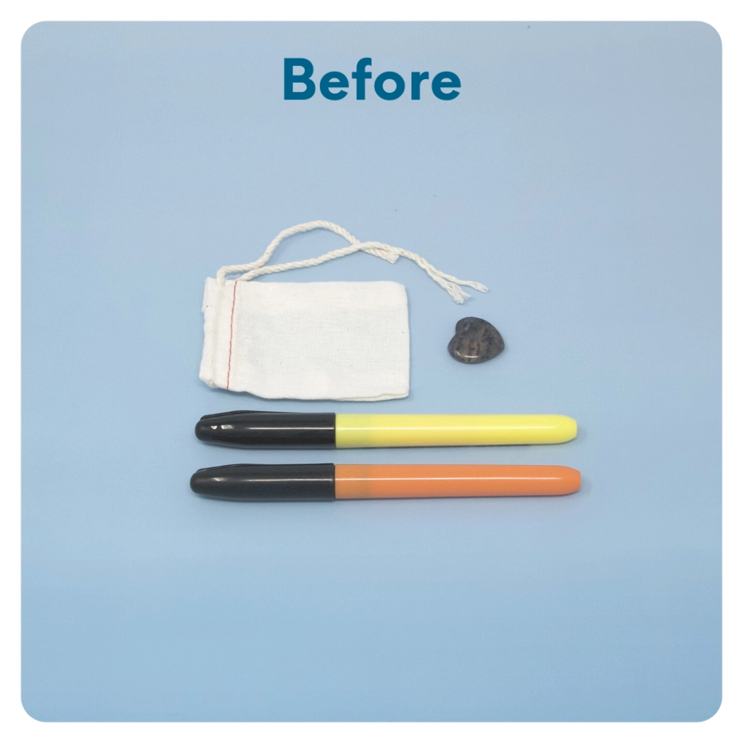
STEP 4 OF 12
Worry Stone
Worry stones are smooth, polished rocks used for relaxation or anxiety relief to help one feel grounded. The stone is meant to be kept in one’s pocket. The physical act of massaging a worry stone for several minutes is proven to provide therapeutic & psychological benefits that help soothe your nervous system, reduce stress and anxiety, and help clear your mind so you can focus and think clearly.
On one side of the drawstring bag write an inspirational or calming word. Examples: hope, love, grow, breathe, dream, courage, wonder.

Slide 6
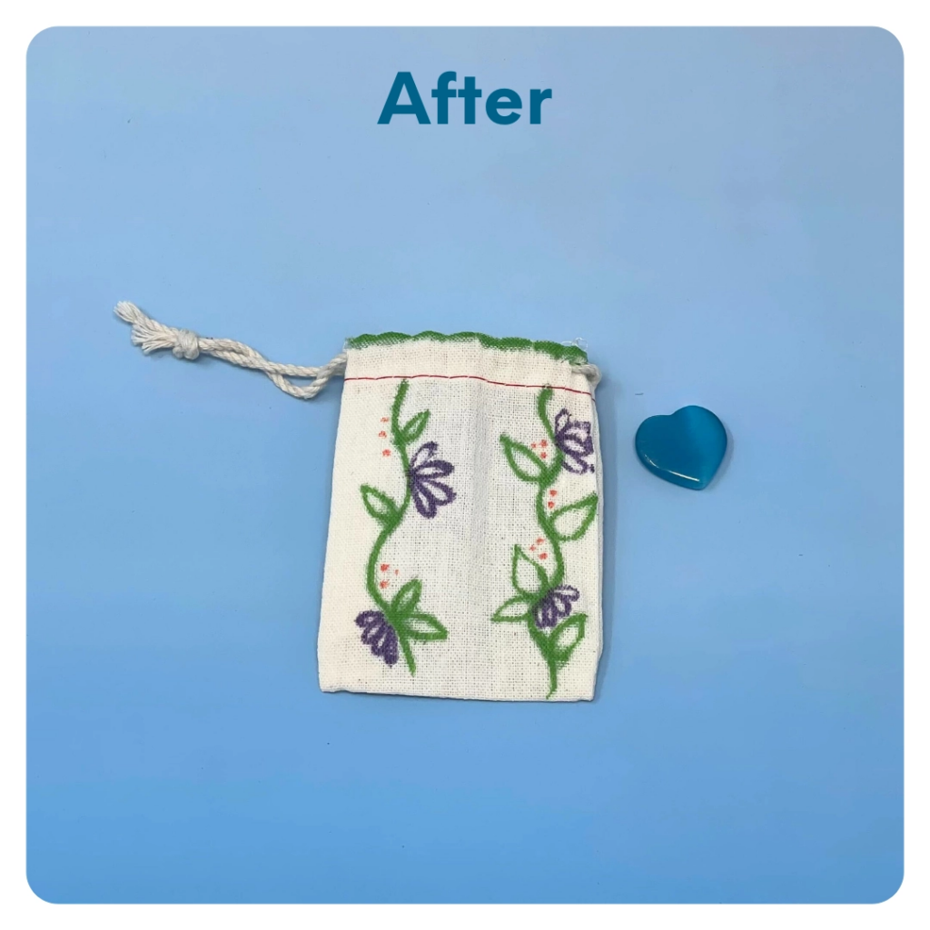
STEP 4 OF 12
Worry Stone (continued)
Tip: Place a piece of paper or cardboard in the bag before decorating to prevent the marker from bleeding through.

Slide 7
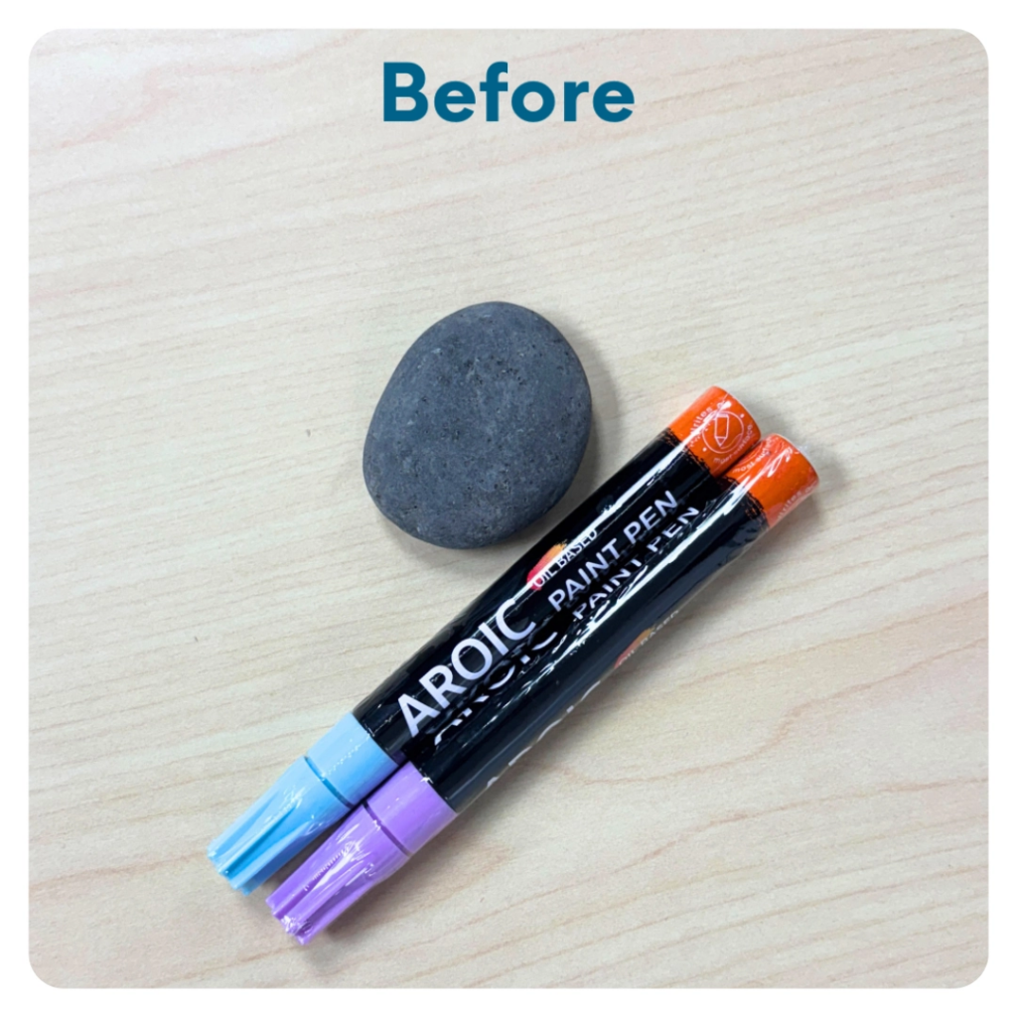
STEP 5 OF 12
Kyndness Rock
Use the paint pens to decorate your river rock with an uplifting message or design. Share it with someone who could use a smile, or leave it in a public place as a surprise reminder that kyndness is all around.

Slide 8
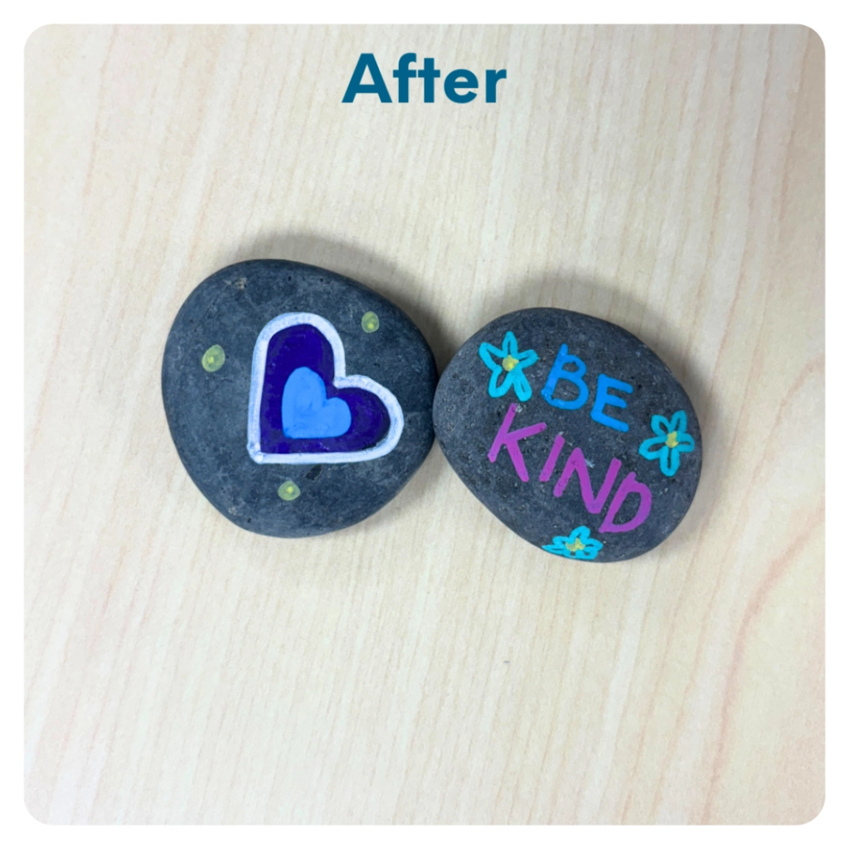
STEP 5 OF 12
Kyndness Rock (continued)

Slide 9
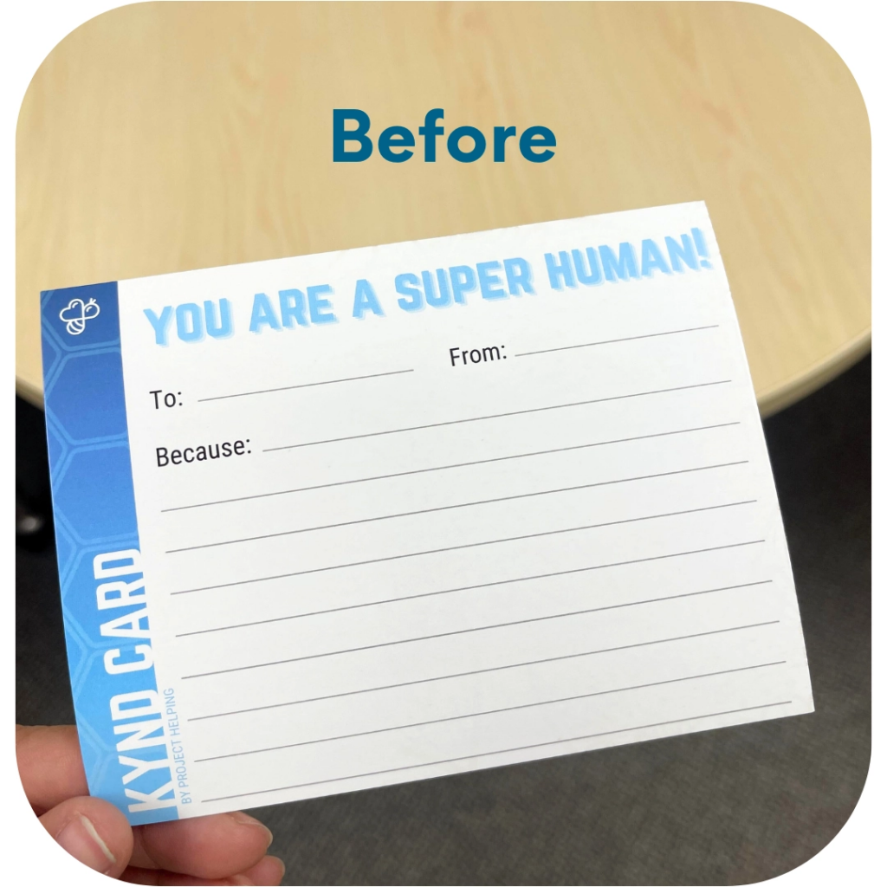
STEP 6 OF 12
Kyndness Card
Use the card to write a thoughtful note, an encouraging message, or a simple “thinking of you.” Share it with someone to brighten their day and spread a little extra kyndness.

Slide 10
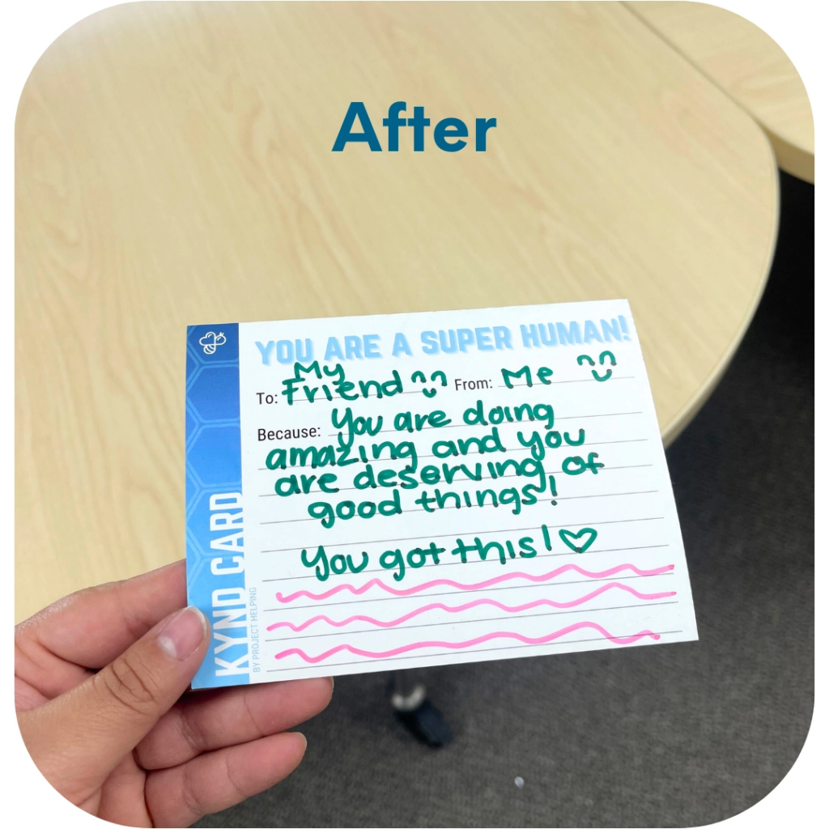
STEP 6 OF 12
Kyndness Card (continued)

Slide 11
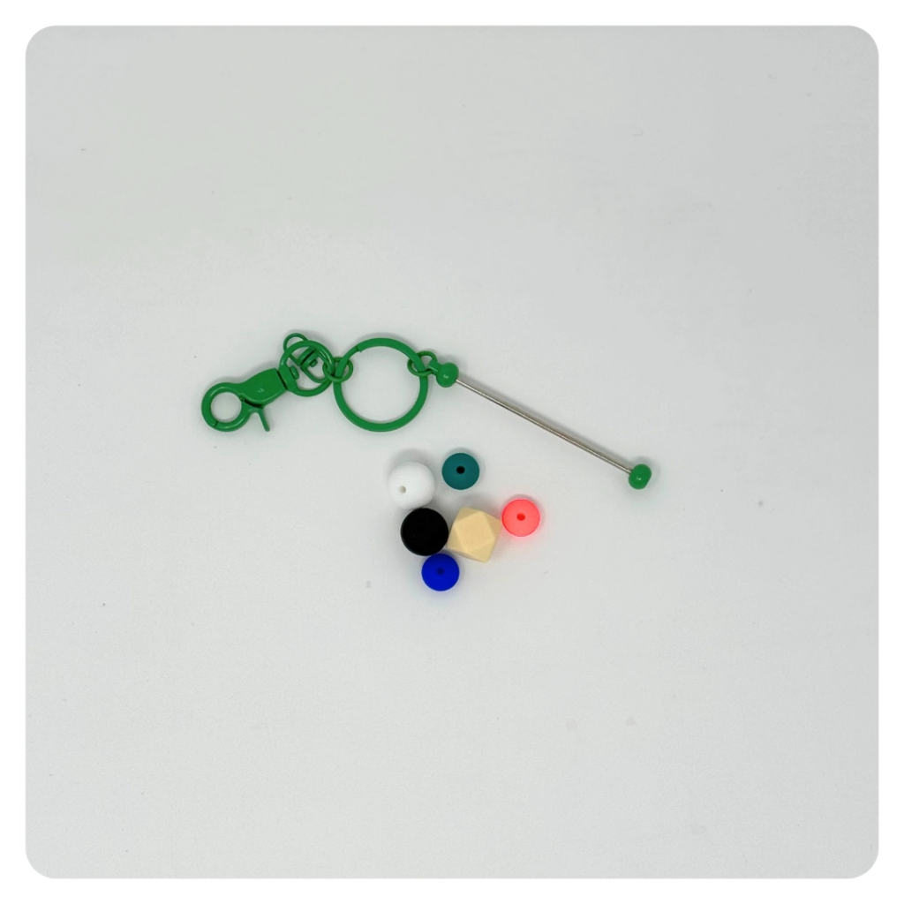
STEP 7 OF 12
Build a Fidget Keychain
Use the key chain and silicone beads to create a fidget key chain. This makes a fun, soothing tool for someone who could use a little calm and kyndness on the go.

Slide 12
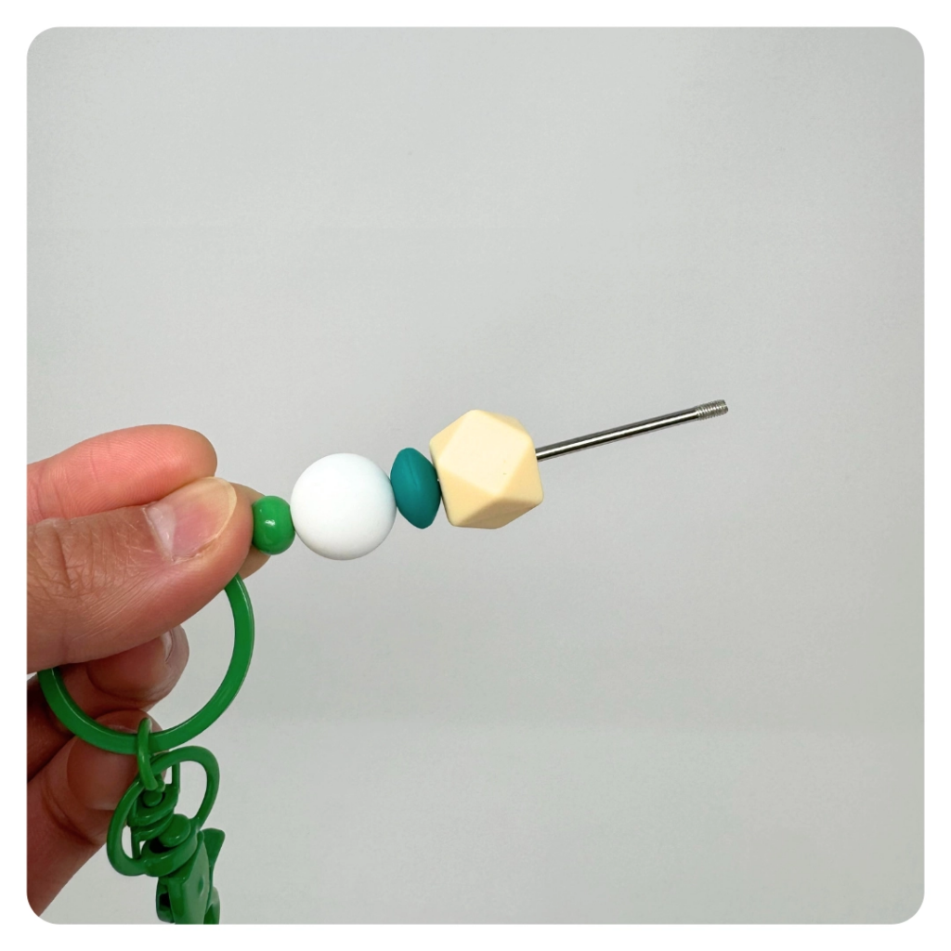
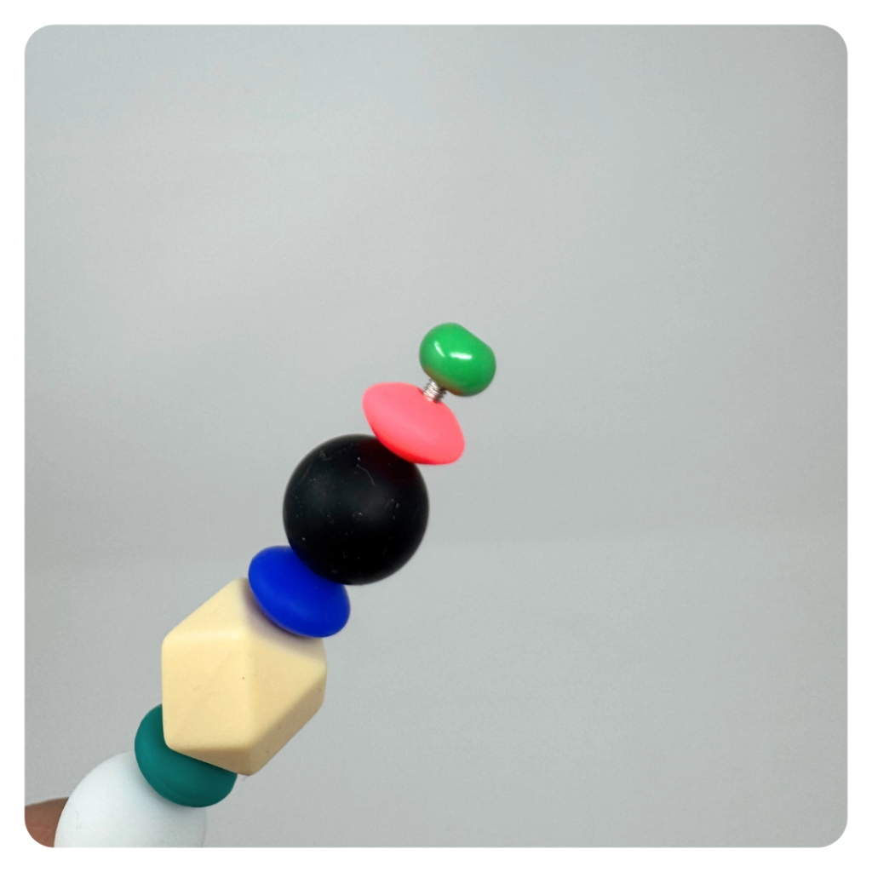
STEP 7 OF 12
Build a Fidget Keychain (continued)

Slide 13
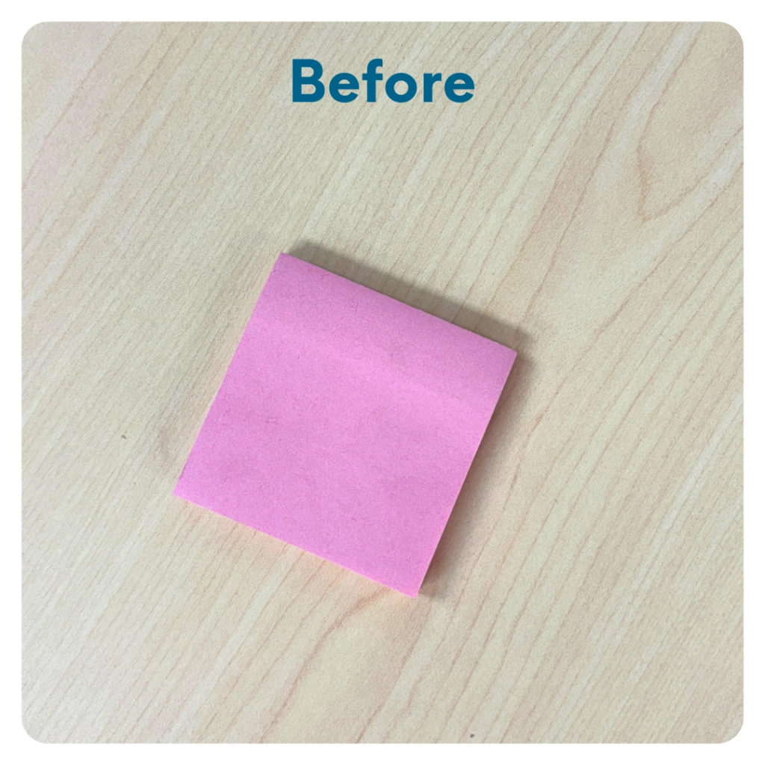
STEP 8 OF 12
Kyndness Notes
Use the sticky notes to write uplifting messages or affirmations. Leave them in unexpected places to brighten someone’s day, or stick them somewhere special as a reminder of your own worth and positivity.

Slide 14
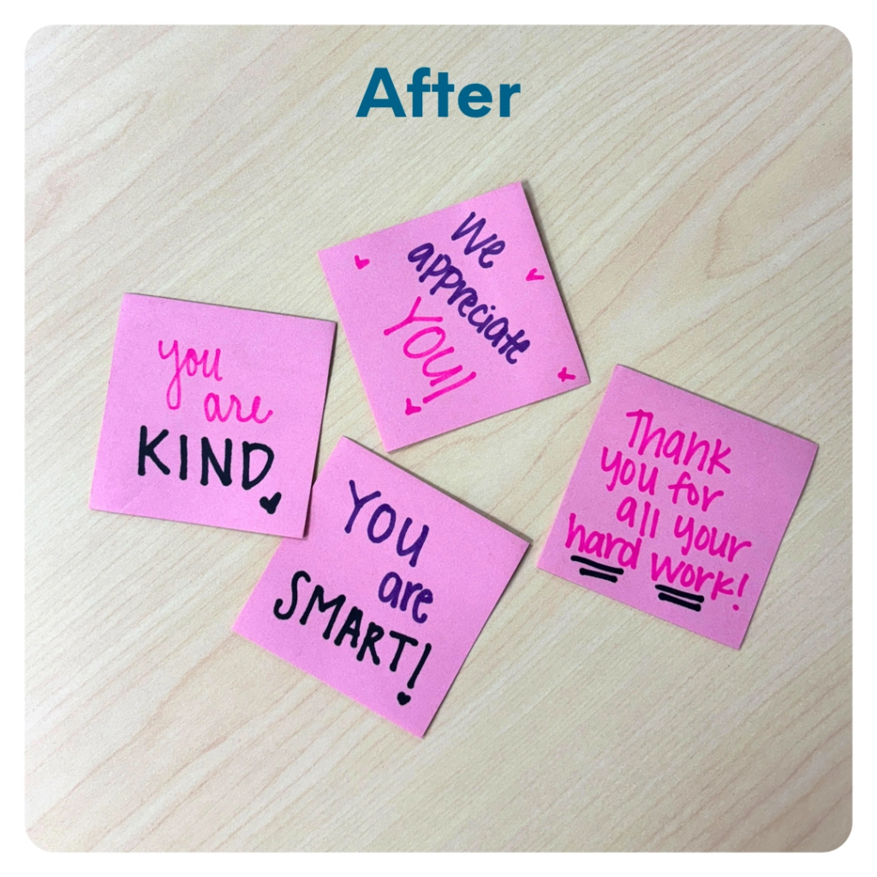
STEP 8 OF 12
Kyndness Notes (continued)

Slide 15
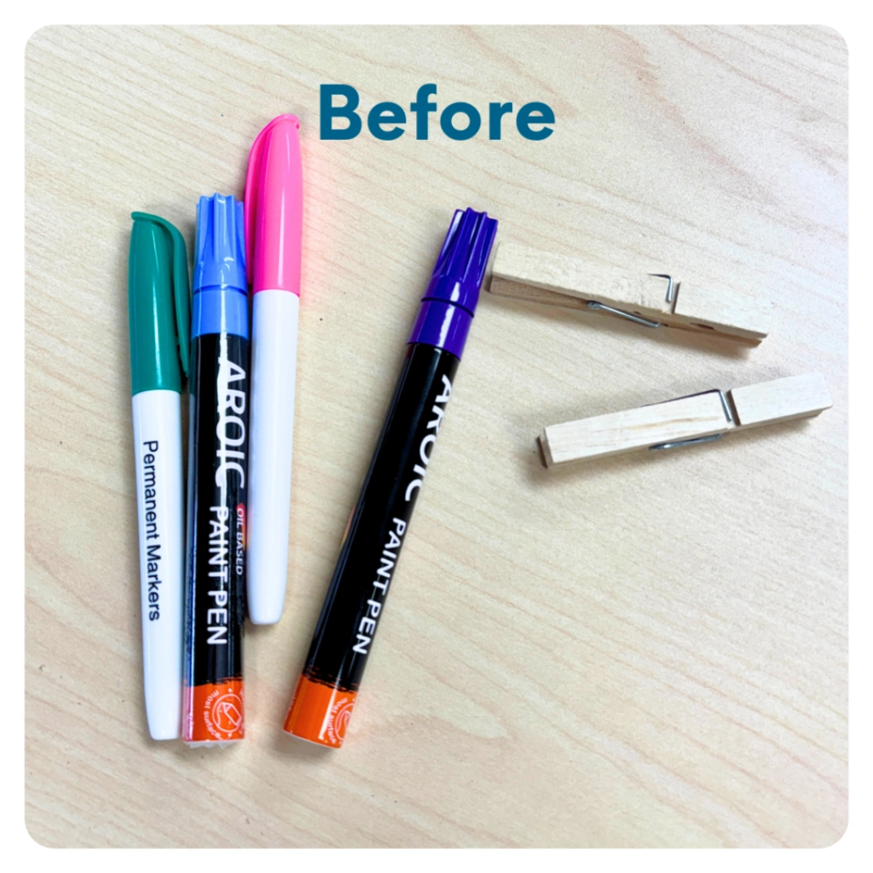
STEP 9 OF 12
Pin Kyndness
Write encouraging words on the clothespins and share them with others! Pin one to a friend, family member, or even a stranger to brighten their day with a little kindness.

Slide 16
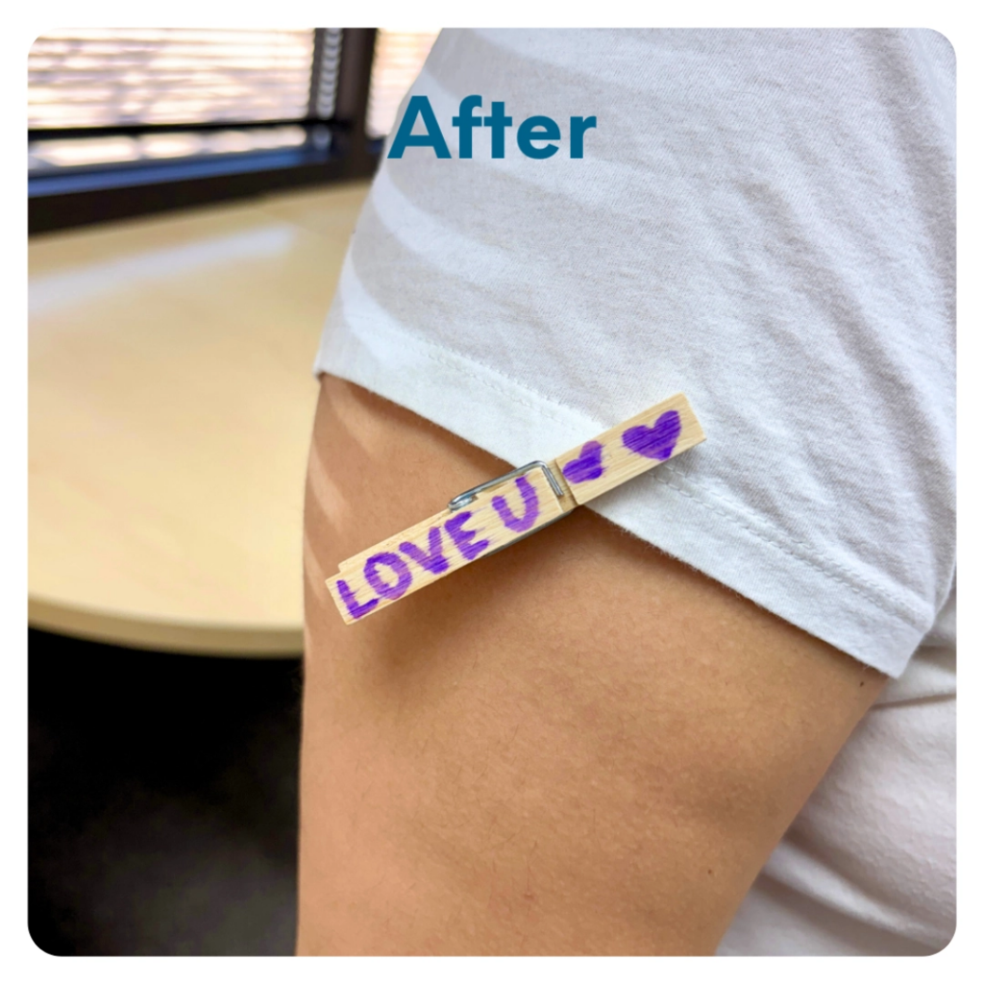
STEP 9 OF 12
Pin Kyndness (continued)

Slide 17
STEP 10 OF 12
Pack the Pollinate Kit
Additional Pollinate Items in Your Kit
Pocket Hug: A small reminder that someone cares–share it with someone who needs a little comfort. Inspirational Key Chain: Carry a positive message with you or gift it to someone who could use a boost. Playing Cards & Tea: Invite a friend over for a game night and share laughter over a warm cup of tea. Gratitude Journal: Reflect on the good in your life or gift it to someone to inspire their own gratitude journey.
Pollinate Cards: Use this card to encourage others to spread kyndness, keeping the ripple effect going.
Delivery Options

Slide 18
STEP 10 OF 12
Pack the Pollinate Kit (continued)
Your completed kit is meant to spread kyndness around you. Keep the kit and use it to brighten your day and the day of those around you.

Slide 19
STEP 11 OF 12
Register My Kit (Optional)
Register your kit. To register and track your kits, you must visit the online instructions. Registering your kit is optional.

Slide 20
STEP 12 OF 12
Thank You!
When you build a Kynd Kit, you create layers of impact for yourself and the community. We appreciate your time and your support of our mission.
Cheers,
The Project Helping team

