Slide 1
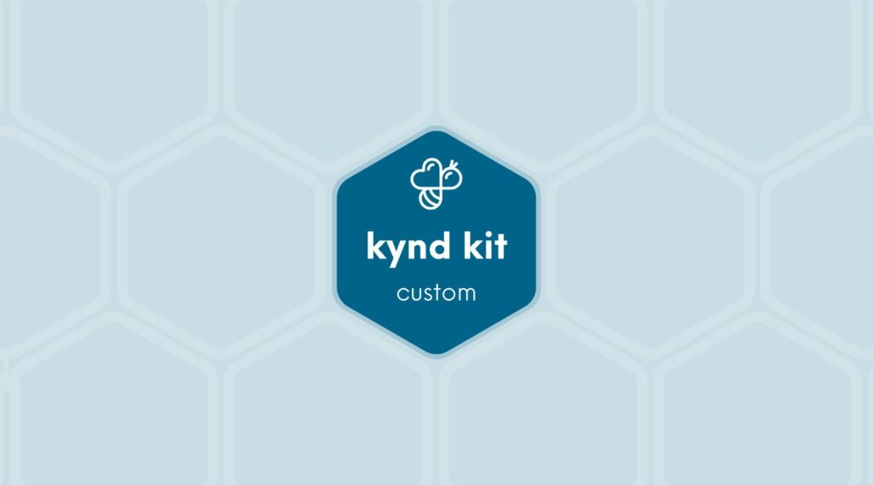
CUSTOM
Prudential &#8211; Welcome Home Kit [Custom]
6 STEPS

Slide 2
STEP 1 OF 6
About Project Helping
Kynd Kits are a program of Project Helping, a mental wellness nonprofit. Our mission is to make it ridiculously easy to volunteer because doing good is good for your mental wellness!
•
•
Kynd Hub
Build your kit & track its entire journey
Create a free account at Kynd Hub — see exactly where your kit goes after you build it.
Build Your Kit on Kynd Hub
•
•
The Kynd Kit Cycle
Kynd Kits Create Impact
Every kit you build sets off a chain of good — for you, for a nonprofit, and for the whole community.

Slide 3
STEP 1 OF 6
About Project Helping (continued)
1
You Volunteer
You volunteer, which benefits your mental health and wellbeing.
•
2
Help a Nonprofit
The kit you build is donated to a vetted nonprofit partner in need.
•
3
Fund Programming
Proceeds fund free, community-based mental health programming.
•
4
Sustain the Mission
Proceeds benefit Project Helping, a 501(c)(3) nonprofit.
projecthelping.org

Slide 4

STEP 2 OF 6
Tips for Building Your Kit
Helpful Tip for Building Your Kynd Kit
• Avoid politics and religion entirely.
• Use appropriate humor.
• Can't think of what to write, draw a picture!
• Use words of affirmation!
• Place a piece of paper in any canvas bag before drawing on the outside. This way, the marker will not bleed through the other side of the bag.
• Please keep your designs gender-neutral, inclusive, and age-appropriate.
Spanish Translation Options

Slide 5

STEP 3 OF 6
Write a Note to the Recipient and Decorate the Envelope
Write a card and decorate the envelope using the enclosed materials. Express your encouragement and include a hopeful message.
Please ensure your message is age-appropriate and avoids references to religion or politics.

Slide 6

STEP 3 OF 6
Write a Note to the Recipient and Decorate the Envelope (continued)

Slide 7
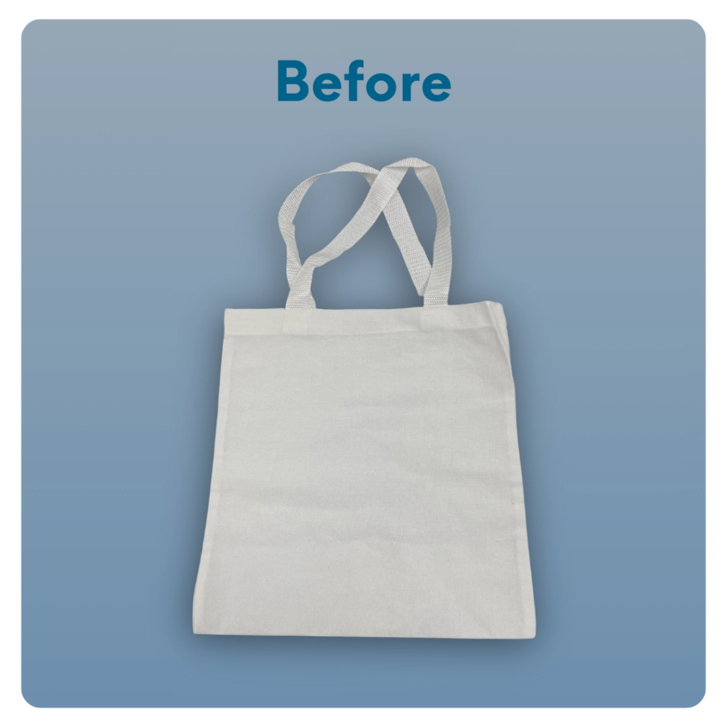
STEP 4 OF 6
Decorate The Small Canvas Tote
Decorate the canvas tote to make it fun and colorful! Tip: place a piece of paper in the tote before decorating. This will prevent the marker from bleeding through the tote.

Slide 8
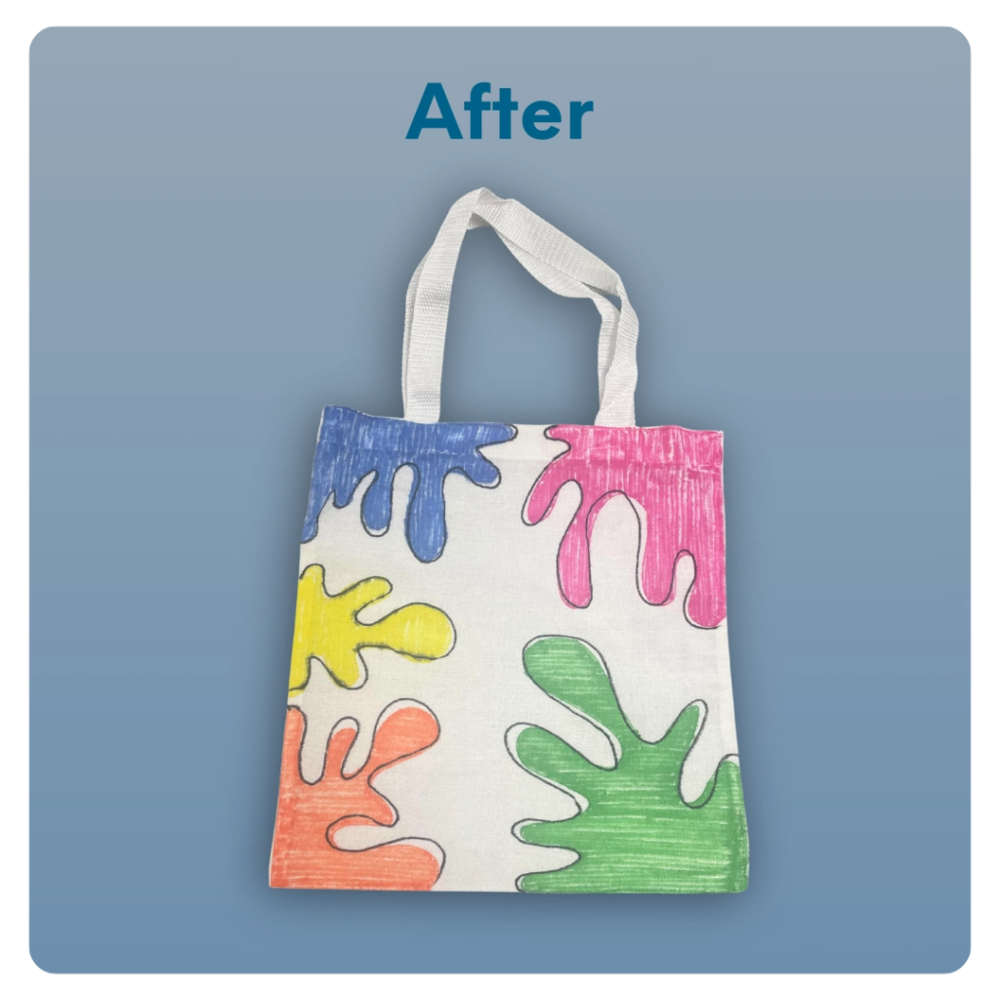
STEP 4 OF 6
Decorate The Small Canvas Tote (continued)

Slide 9
STEP 5 OF 6
Pack the Prudential Welcome Home Kit
Pack all of the materials into the tote bag.
• Please only include the items included in your kit. If there is an item that is damaged, do not pack it and discard it. Our team will replace the missing item during quality control.

Slide 10
STEP 5 OF 6
Pack the Prudential Welcome Home Kit (continued)
Your completed kit will support Bridges Outreach, a longtime nonprofit partner of Prudential focused on addressing housing insecurity in Newark, NJ, our headquarters city. Bridges works to end homelessness through street outreach and intensive case management, with a focus on health, housing, and independence. The organization builds relationships with individuals experiencing homelessness while addressing their most immediate needs.

Slide 11
STEP 6 OF 6
Thank You!
When you build a Kynd Kit, you create layers of impact for yourself and the community. We appreciate your time and your support of our mission.
Cheers,
The Project Helping team

