Slide 1
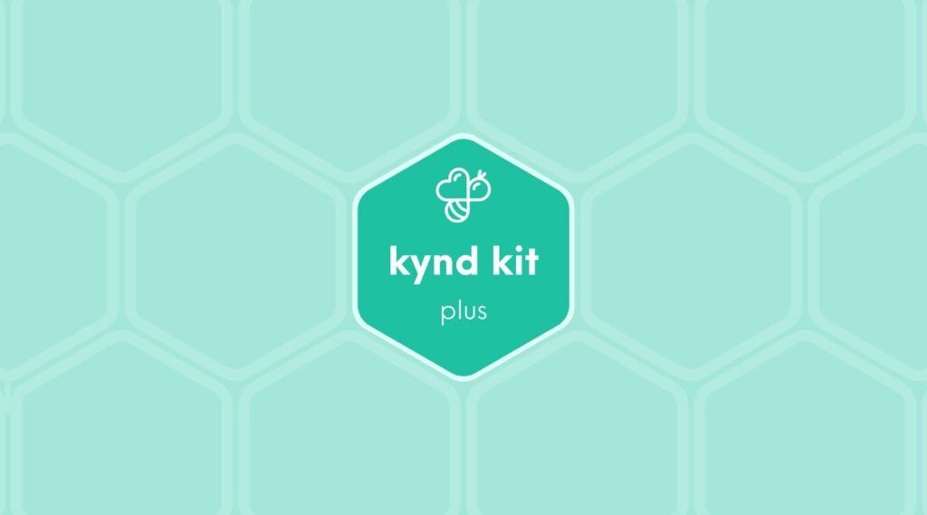
PLUS
Rescue Dog Care Package [Plus]
11 STEPS

Slide 2

STEP 1 OF 11
About Project Helping
Kynd Kits are a program of Project Helping, a mental wellness nonprofit. Our mission is to make it ridiculously easy to volunteer because doing good is good for your mental wellness!
Learn More at ProjectHelping.org
When You Build a Kynd Kit - The Cycle of Impact

Slide 3

STEP 2 OF 11
Tips for Building Your Kit
Helpful Tip for Building Your Kynd Kit
• Avoid politics and religion entirely.
• Use appropriate humor.
• Can't think of what to write, draw a picture!
• Use words of affirmation!
• Place a piece of paper in any canvas bag before drawing on the outside. This way, the marker will not bleed through the other side of the bag.
• Please keep your designs gender-neutral, inclusive, and age-appropriate.
Spanish Translation Options

Slide 4
STEP 3 OF 11
Rescue Dog [+]
Before You Build
Approximately 7.6 million animals enter U.S. animal shelters nationwide every year. These shelters are often overwhelmed and underfunded, reporting higher-than-ever rates of incoming lost or abandoned animals.

Slide 5
STEP 3 OF 11
Rescue Dog [+] (continued)
Animal shelters across the country operate under extremely tight budgets. This means that most of the donations they receive go towards food and other essentials, not toys. By completing this Kynd Kit, you’re providing shelter animals with opportunities for fun that they might not otherwise receive. And who knows — the toys might just allow these animals to show off their fun sides to a future adopter.

Slide 6
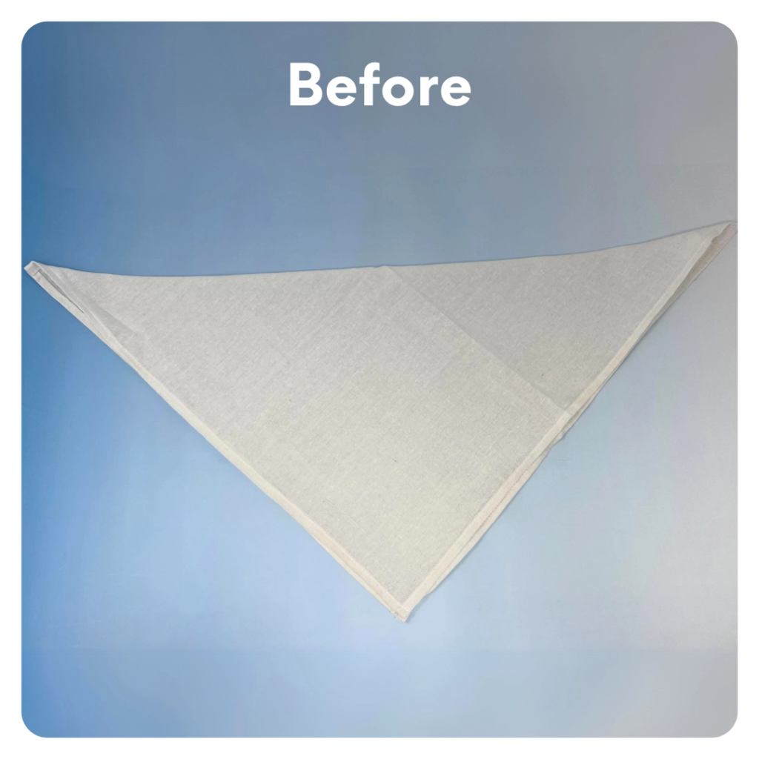
STEP 4 OF 11
DIY Bandana
Decorate a bandana for the shelter animal to wear when they are adopted.
Helpful Tips: Fold the bandana in half, corner to corner, to get an idea of what it will look like when it is worn by the shelter animal. Place a piece of paper or cardboard under the canvas to avoid the markers bleeding through.

Slide 7
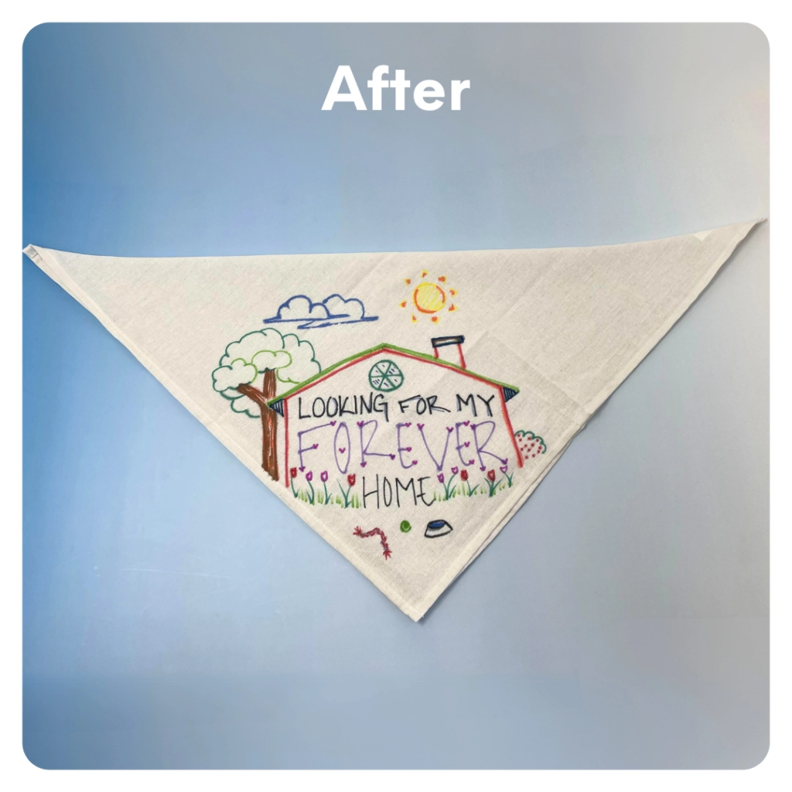
STEP 4 OF 11
DIY Bandana (continued)

Slide 8
STEP 5 OF 11
Create a Dog Bed

Slide 9
STEP 6 OF 11
Create a "Braided Tug Toy" for a Shelter Dog
Use the pre-cut fleece, scissors, and the following video to make a tug toy. Helpful tip: The tighter your knot, the longer the toy will last.

Slide 10
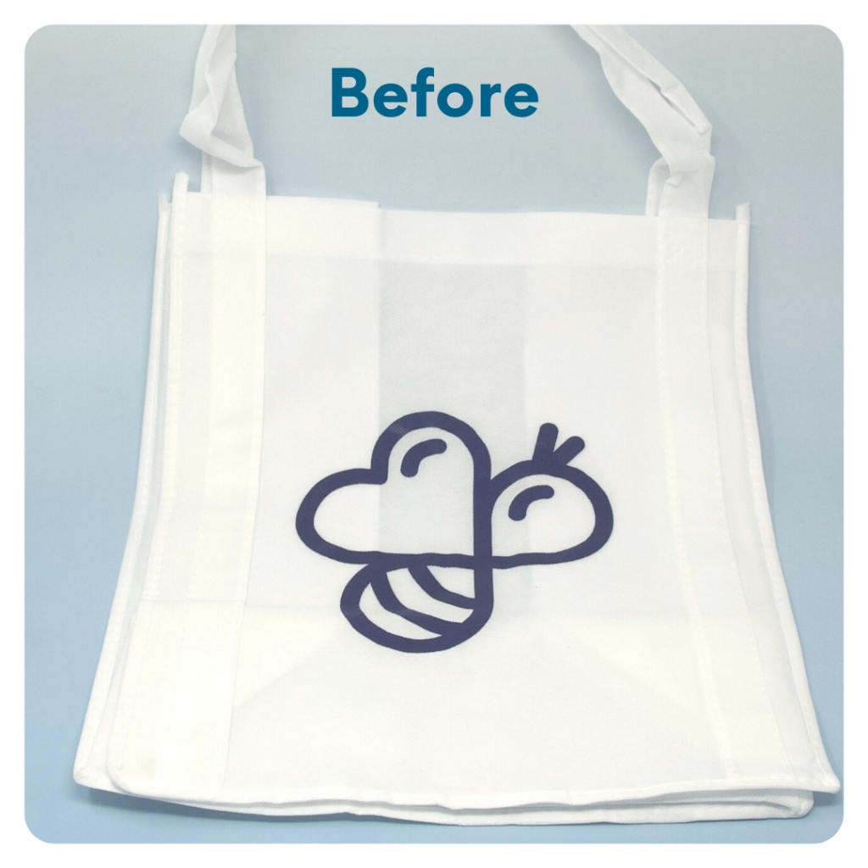
STEP 7 OF 11
DIY Tote Bag
Decorate the Canvas Tote
Decorate the canvas tote to make it fun and colorful! Tip: place a piece of paper in the tote before decorating. This will prevent the marker from bleeding through the tote.

Slide 11

STEP 7 OF 11
DIY Tote Bag (continued)

Slide 12
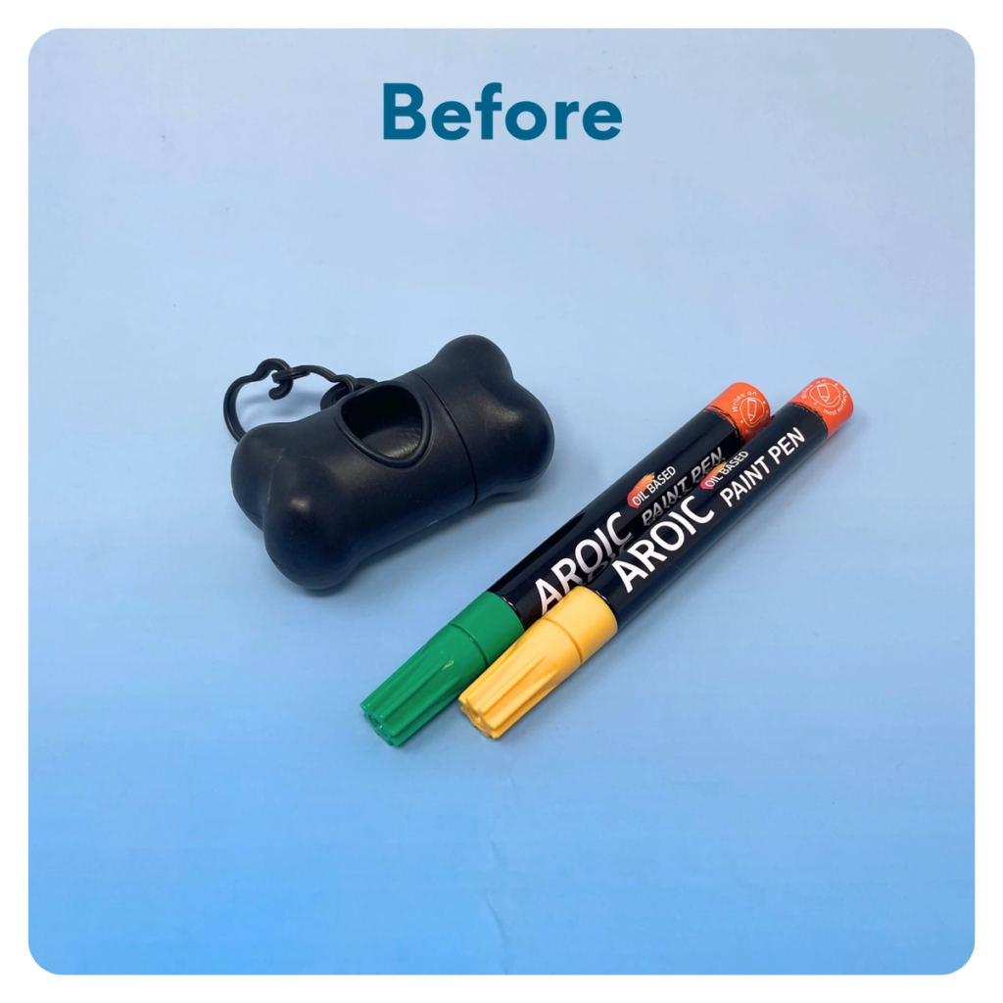
STEP 8 OF 11
Decorate the Doggy Bag Dispenser
Using the paint pen, decorate the doggy bag dispenser to make it fun and colorful!

Slide 13
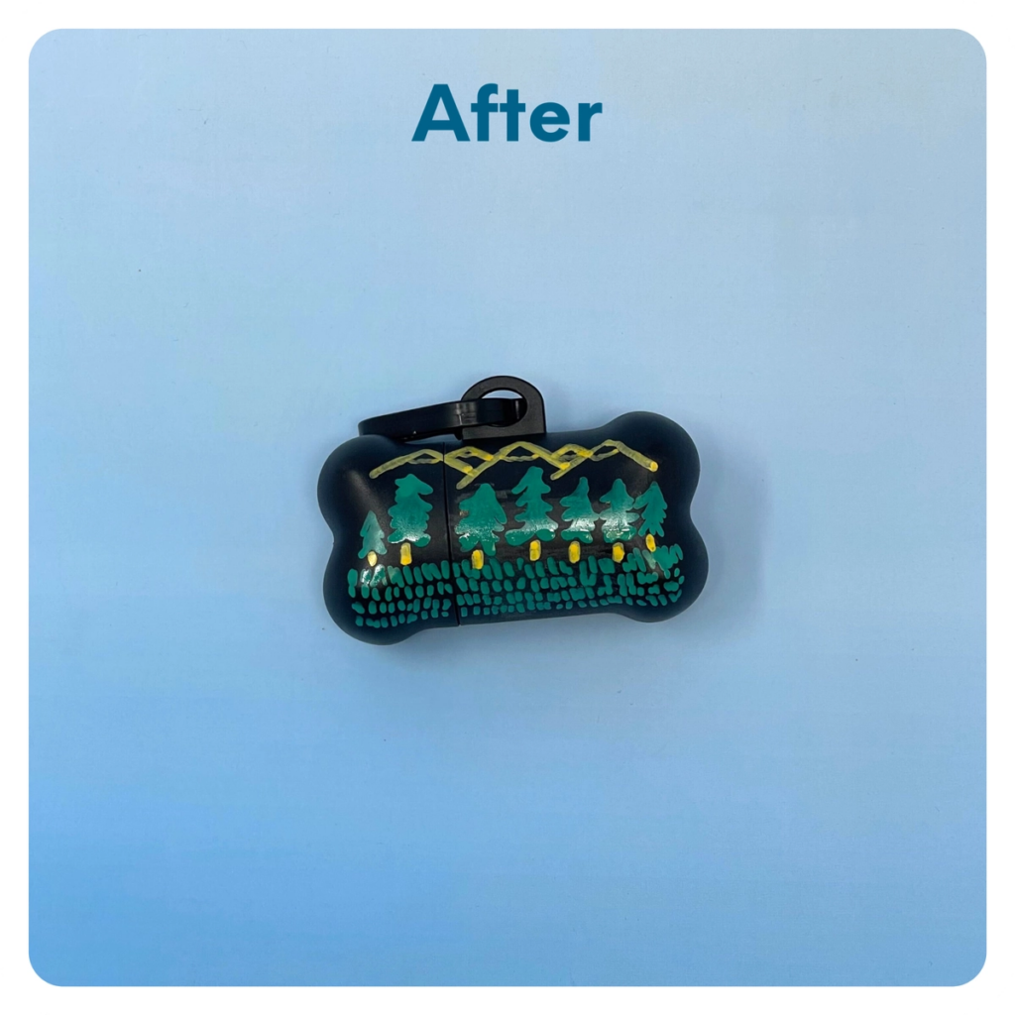
STEP 8 OF 11
Decorate the Doggy Bag Dispenser (continued)

Slide 14
STEP 9 OF 11
Pack the Rescue Dog [Plus] Kit
Pack all of the materials into the decorated tote bag and put it back into the original box.
• Please only include items that are UNOPENED and UNUSED
• Add any optional items you would like.
Optional Items to Add:
• Dog toys
• Dog treats
• Blankets/towels
• Collars/leashes
Items not to include:
• Perishable items
• Sharp objects

Slide 15
STEP 10 OF 11
Register My Kit (Optional)
Register your kit. To register and track your kits, you must visit the online instructions. Registering your kit is optional.

Slide 16
STEP 11 OF 11
Thank You!
When you build a Kynd Kit, you create layers of impact for yourself and the community. We appreciate your time and your support of our mission.
Cheers,
The Project Helping team

