Slide 1

CLASSIC
Senior Care Package [Classic]
11 STEPS

Slide 2

STEP 1 OF 11
About Project Helping
Kynd Kits are a program of Project Helping, a mental wellness nonprofit. Our mission is to make it ridiculously easy to volunteer because doing good is good for your mental wellness!
Learn More at ProjectHelping.org
When You Build a Kynd Kit - The Cycle of Impact

Slide 3

STEP 2 OF 11
Tips for Building Your Kit
Helpful Tip for Building Your Kynd Kit
• Avoid politics and religion entirely.
• Use appropriate humor.
• Can't think of what to write, draw a picture!
• Use words of affirmation!
• Place a piece of paper in any canvas bag before drawing on the outside. This way, the marker will not bleed through the other side of the bag.
• Please keep your designs gender-neutral, inclusive, and age-appropriate.
Spanish Translation Options

Slide 4
STEP 3 OF 11
Senior Care Package [Classic]
Before You Build
About the Recipient
Older adults are at increased risk for loneliness and social isolation because they are more likely to face factors such as living alone, the loss of family or friends, chronic illness, and hearing loss.
Nearly one-fourth of adults aged 65 and older are considered to be socially isolated, which can lead to an increased risk of dementia, heart disease, and increased risk of strokes.
These kits are designed for the volunteer to create a card and care package for a senior citizen living in assisted living or living alone.

Slide 5
STEP 3 OF 11
Senior Care Package [Classic] (continued)
Everyone loves to be surprised by an unexpected gift, especially senior citizens who are living alone or in assisted living. Even the smallest gifts can brighten their spirits and make them feel loved and remembered.

Slide 6

STEP 4 OF 11
Write a Note to the Recipient and Decorate the Envelope
Write a card and decorate the envelope using the enclosed materials. Express your encouragement and include a hopeful message.
Please ensure your message is age-appropriate and avoids references to religion or politics.

Slide 7

STEP 4 OF 11
Write a Note to the Recipient and Decorate the Envelope (continued)

Slide 8

STEP 5 OF 11
Decorate the Bag
Decorate the kraft bag(s). This is what the final kit is distributed in, so try to make this fun and colorful for the recipient to open.
Please note: we are currently transitioning from plastic ziplock bags to kraft bags. Some kits may still include the plastic bag for you to decorate while we complete this transition.

Slide 9



STEP 5 OF 11
Decorate the Bag (continued)

Slide 10
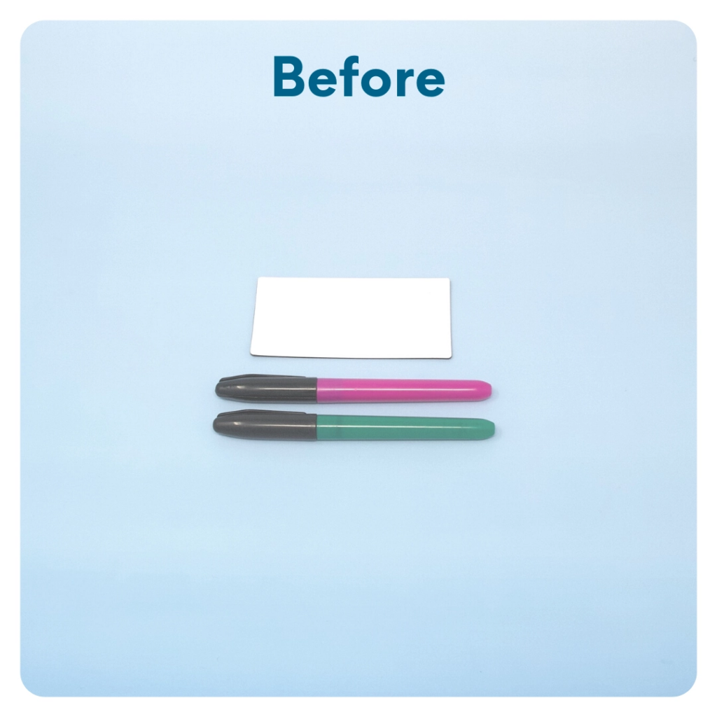
STEP 6 OF 11
DIY Magnets
You will either have magnets or cardstock squares with magnet dots in your kit. Decorate them with pictures, I am statements, encouraging quotes, jokes, etc. If you have magnet dots, stick them to the back of each cardstock square to make a fun magnet.

Slide 11
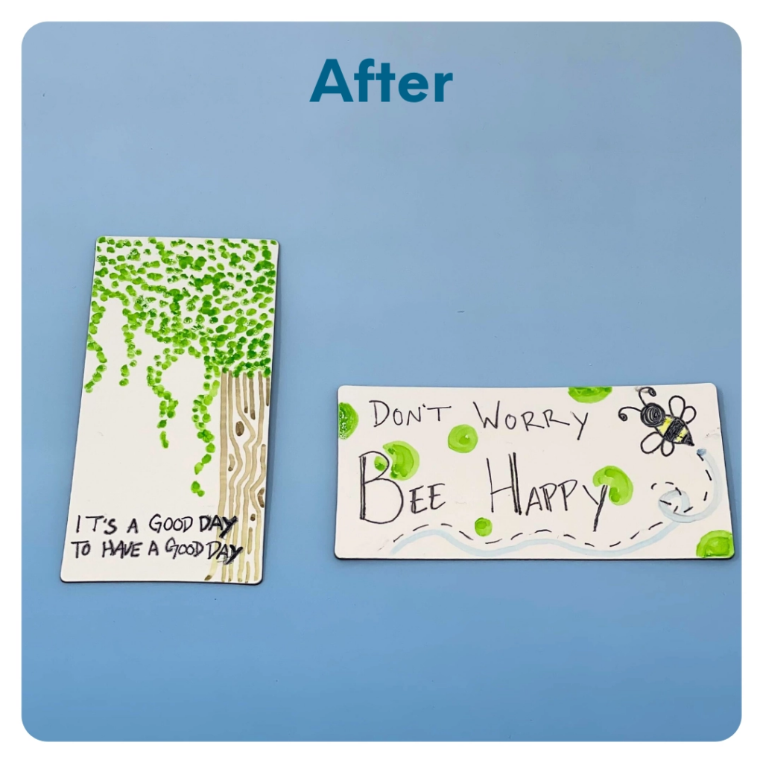
STEP 6 OF 11
DIY Magnets (continued)

Slide 12
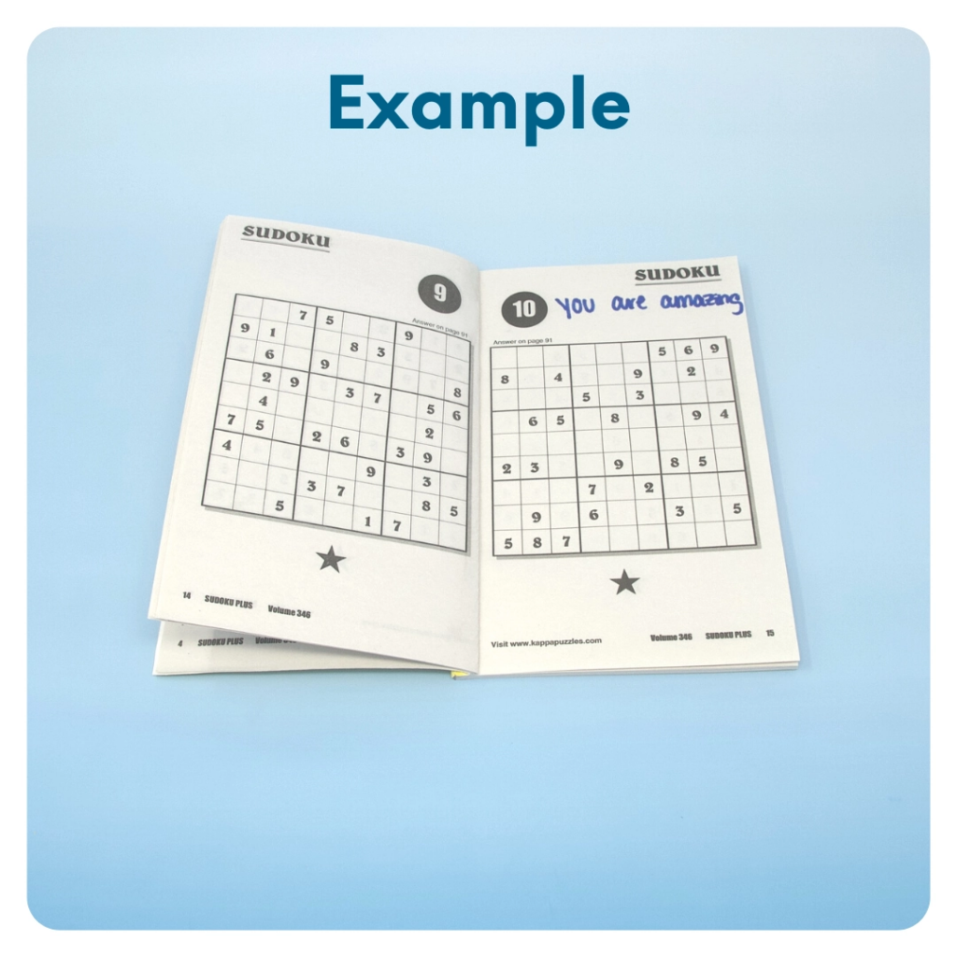
STEP 7 OF 11
Surprise Kyndness Puzzle Book
Go through the pages of the Sudoku or puzzle book and write uplifting messages, draw small, colorful images, or create fun writing prompts for the recipient.

Slide 13
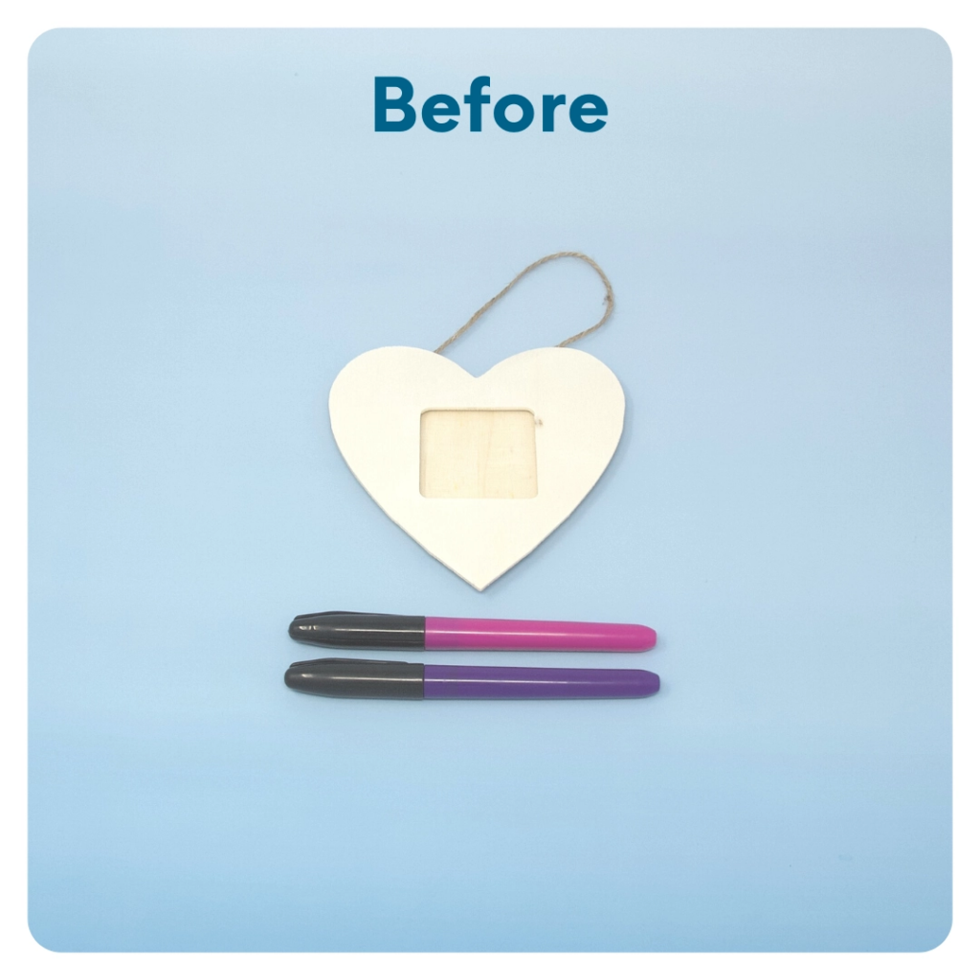
STEP 8 OF 11
DIY Picture Frame
Decorate the picture frame with pictures, shapes, encouraging words, quotes, etc.
(the size and shape of the DIY picture frame may vary)

Slide 14
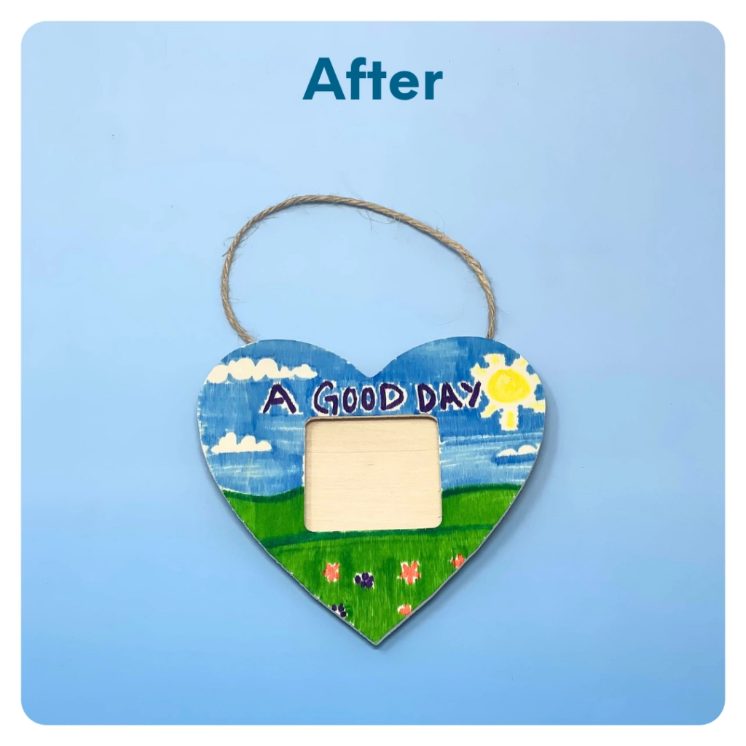
STEP 8 OF 11
DIY Picture Frame (continued)

Slide 15
STEP 9 OF 11
Pack the Senior Care Package
Pack all of the materials into the decorated plastic bag and put it back into the original box.
• Please only include items that are UNOPENED and UNUSED
• Add any optional items you would like.
Optional Items to Add:
• Post-it notes
• Games and activity books
• Toiletries
• Stamps
• Snacks
• Small, quick crafts
• Colored Pencils, crayons, or markers
• Other craft and art supplies
Items not to include:
• Perishable items
• Sharp objects
• Nut food products
• Religious or political items

Slide 16
STEP 10 OF 11
Register My Kit (Optional)
Register your kit. To register and track your kits, you must visit the online instructions. Registering your kit is optional.

Slide 17
STEP 11 OF 11
Thank You!
When you build a Kynd Kit, you create layers of impact for yourself and the community. We appreciate your time and your support of our mission.
Cheers,
The Project Helping team

