Slide 1

CLASSIC
Sensory Kit for Foster Youth [Classic]
10 STEPS

Slide 2

STEP 1 OF 10
About Project Helping
Kynd Kits are a program of Project Helping, a mental wellness nonprofit. Our mission is to make it ridiculously easy to volunteer because doing good is good for your mental wellness!
Learn More at ProjectHelping.org
When You Build a Kynd Kit - The Cycle of Impact

Slide 3

STEP 2 OF 10
Tips for Building Your Kit
Helpful Tip for Building Your Kynd Kit
• Avoid politics and religion entirely.
• Use appropriate humor.
• Can't think of what to write, draw a picture!
• Use words of affirmation!
• Place a piece of paper in any canvas bag before drawing on the outside. This way, the marker will not bleed through the other side of the bag.
• Please keep your designs gender-neutral, inclusive, and age-appropriate.
Spanish Translation Options

Slide 4
STEP 3 OF 10
Sensory Kit for Foster Youth [Classic]
Before You Build
About the Recipient
Fos­ter care is meant to pro­vide safe, tempo­rary liv­ing arrange­ments and support ser­vices for chil­dren who have been removed from their fam­i­lies due to mal­treat­ment, lack of safe­ty or inadequate care.
In 2021, 203,770 chil­dren under 18 entered fos­ter care in the Unit­ed States, a rate of 3 per 1,000. Kids ages 1 to 5 make up the largest share (29%) of chil­dren enter­ing care.

Slide 5
STEP 3 OF 10
Sensory Kit for Foster Youth [Classic] (continued)
These kits will be gifted to children involved with Advocates for Children at CASA. CASA stands for Court Appointed Special Advocates. These community volunteers, or CASAs, are trained to advocate on behalf of children who are involved in the child welfare system as a result of abuse or neglect. Most of these kids are in out-of-home placements such as foster care, group homes, or kinship care.

Slide 6

STEP 4 OF 10
Decorate the Bag
Decorate the kraft bag(s). This is what the final kit is distributed in, so try to make this fun and colorful for the recipient to open.
Please note: we are currently transitioning from plastic ziplock bags to kraft bags. Some kits may still include the plastic bag for you to decorate while we complete this transition.

Slide 7



STEP 4 OF 10
Decorate the Bag (continued)

Slide 8

STEP 5 OF 10
Write a Note to the Recipient and Decorate the Envelope
Write a card and decorate the envelope using the enclosed materials. Express your encouragement and include a hopeful message.
Please ensure your message is age-appropriate and avoids references to religion or politics.

Slide 9

STEP 5 OF 10
Write a Note to the Recipient and Decorate the Envelope (continued)

Slide 10
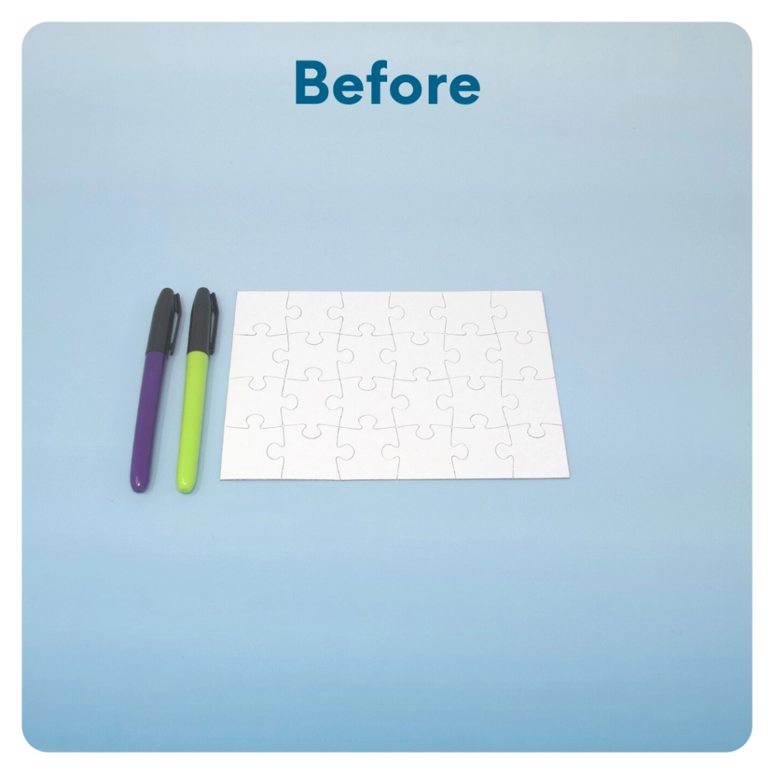
STEP 6 OF 10
DIY Jigsaw Puzzle
Start with the puzzle assembled. Decorate the whole puzzle, filling it with color or messaging from edge to edge. The small sorting envelope will hold the pieces of the completed puzzle. Decorate one side of the envelope with the same image or wording as the puzzle. Take the puzzle apart and put it in the envelope.

Slide 11
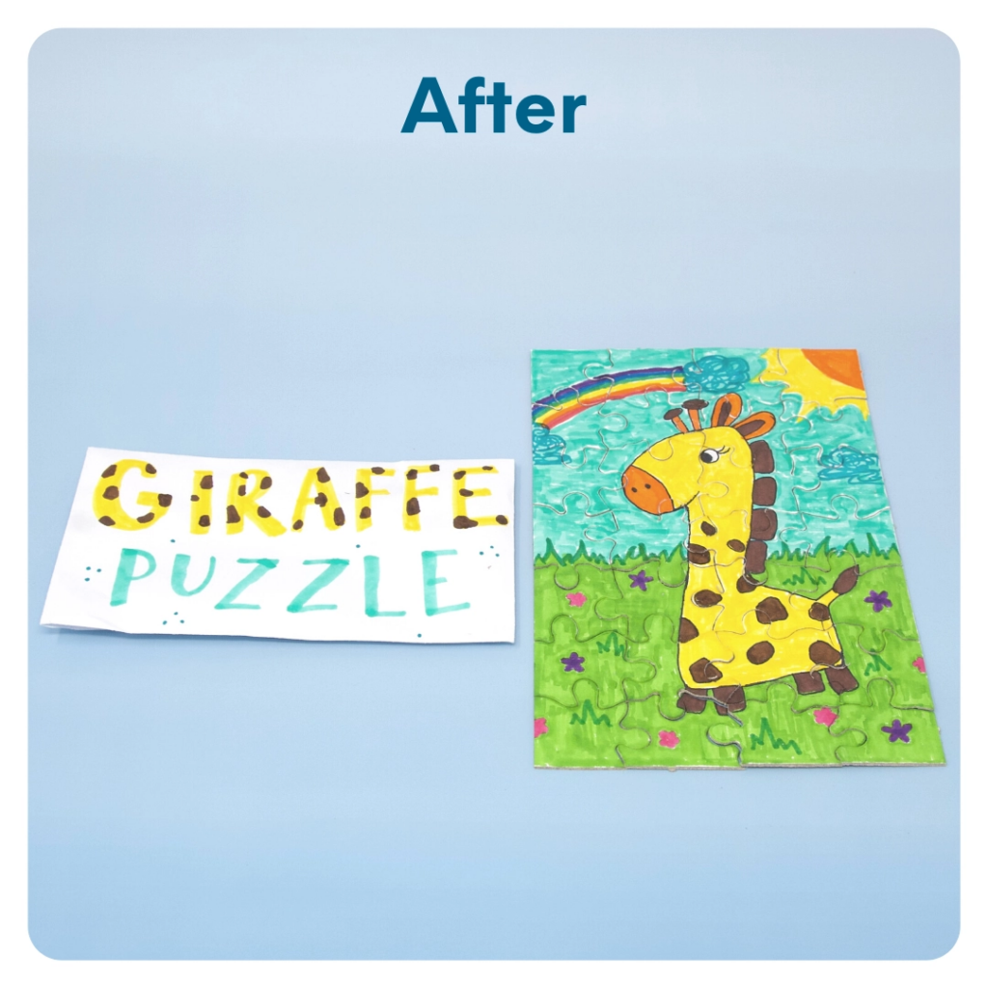
STEP 6 OF 10
DIY Jigsaw Puzzle (continued)

Slide 12

STEP 7 OF 10
Surprise Kyndness Notebook
Decorate the outside of the journal with a picture or uplifting message. Use random pages in the journal to write short, uplifting messages, draw small, colorful images, or create fun writing prompts for the recipient.

Slide 13

STEP 7 OF 10
Surprise Kyndness Notebook (continued)

Slide 14
STEP 8 OF 10
Pack the Sensory Kit
Pack all of the materials into the plastic bag that you decorated.
• Please only include items that are UNOPENED and UNUSED
• Add any optional items you would like.
Optional Items to Add:
• Playing cards
• Stickers
• Journals
• Coloring/writing utensils
• Other craft and art supplies
Items not to include:
• Perishable items
• Sharp objects
• Nut food products
• Religious or political items

Slide 15
STEP 9 OF 10
Register My Kit (Optional)
Register your kit. To register and track your kits, you must visit the online instructions. Registering your kit is optional.

Slide 16
STEP 10 OF 10
Thank You!
When you build a Kynd Kit, you create layers of impact for yourself and the community. We appreciate your time and your support of our mission.
Cheers,
The Project Helping team

