Slide 1
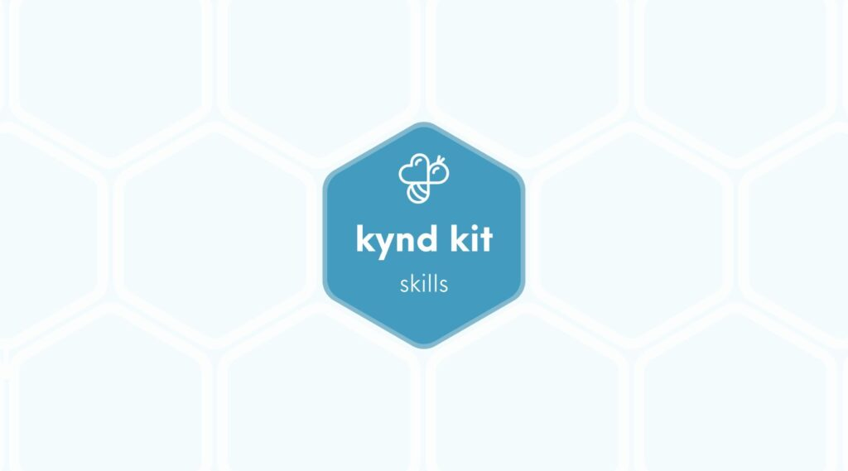
SKILLS
Sewing [Skills]
7 STEPS

Slide 2

STEP 1 OF 7
About Project Helping
Kynd Kits are a program of Project Helping, a mental wellness nonprofit. Our mission is to make it ridiculously easy to volunteer because doing good is good for your mental wellness!
Learn More at ProjectHelping.org
When You Build a Kynd Kit - The Cycle of Impact

Slide 3

STEP 2 OF 7
Tips for Building Your Kit
Helpful Tip for Building Your Kynd Kit
• Avoid politics and religion entirely.
• Use appropriate humor.
• Can't think of what to write, draw a picture!
• Use words of affirmation!
• Place a piece of paper in any canvas bag before drawing on the outside. This way, the marker will not bleed through the other side of the bag.
• Please keep your designs gender-neutral, inclusive, and age-appropriate.
Spanish Translation Options

Slide 4
STEP 3 OF 7
Skill: Sewing
Before You Build
Sew a stuffed animal for a child who is in need of a big hug. This can help provide love, a sense of security, warmth and comfort to a child that is unhoused, in the hospital, or in the foster system.
The Skills Kits were created for you, as the volunteer, to learn a new skill and use it to give back to your community. Learn how to sew a stuffed animal to give to a child in need. You can then use this new skill of sewing to keep giving back to your own community by creating other toys or items!

Slide 5
STEP 4 OF 7
Sew a Stuffed Animals
Items you will need:
• Needle
• Thread
• Stuffing
• 2 pairs of fuzzy socks
• 2 beads
• Felt sheet
• Thicker thread
Follow along to the video below to learn how to sew a stuffed animal. There are enough materials in the kit to make two stuffed animals. Keep using this skill to give back to your community and do good!

Slide 6
STEP 5 OF 7
Sewing Kit - Delivery Instructions
This kit is designed to be distributed locally to a child you know who could use a big hug. Here are some ideas on where to distribute:
• Children’s Hospital (call before dropping off)
• Homeless shelter
• CASA (foster youth)
• Boys and Girls Club
• Food pantry (bring any canned goods in addition!)
• Local nonprofit organization that serves kiddos

Slide 7
STEP 6 OF 7
Register My Kit (Optional)
Register your kit. To register and track your kits, you must visit the online instructions. Registering your kit is optional.

Slide 8
STEP 7 OF 7
Thank You!
When you build a Kynd Kit, you create layers of impact for yourself and the community. We appreciate your time and your support of our mission.
Cheers,
The Project Helping team

