Slide 1

CLASSIC
Sight Words for First Graders [Classic]
12 STEPS

Slide 2

STEP 1 OF 12
About Project Helping
Kynd Kits are a program of Project Helping, a mental wellness nonprofit. Our mission is to make it ridiculously easy to volunteer because doing good is good for your mental wellness!
Learn More at ProjectHelping.org
When You Build a Kynd Kit - The Cycle of Impact

Slide 3

STEP 2 OF 12
Tips for Building Your Kit
Helpful Tip for Building Your Kynd Kit
• Avoid politics and religion entirely.
• Use appropriate humor.
• Can't think of what to write, draw a picture!
• Use words of affirmation!
• Place a piece of paper in any canvas bag before drawing on the outside. This way, the marker will not bleed through the other side of the bag.
• Please keep your designs gender-neutral, inclusive, and age-appropriate.
Spanish Translation Options

Slide 4
STEP 3 OF 12
Sight Words for First Graders [Classic]
Before You Build
Since the pandemic, the percentage of 1st graders on track in reading by midyear fell from:
• 51 percent to 37 percent of Black students
• 54 percent to 42 percent of Hispanic students
• and from 65 percent to 58 percent of white students.
More than 1 in 3 of children who started school in the pandemic need "intensive" reading help. This kit will be delivered to under-resourced elementary schools literacy organizations around the country.

Slide 5
STEP 3 OF 12
Sight Words for First Graders [Classic] (continued)
Create bright, fun, sight word flashcards for first-grade students who are behind on their reading level. A first-grader has a small reading gap, and reaching them early is proven to be the most effective way to improve their reading. First-grade classes can use these Kynd Kits to help their literacy performance.

Slide 6

STEP 4 OF 12
Decorate the Bag
Decorate the kraft bag(s). This is what the final kit is distributed in, so try to make this fun and colorful for the recipient to open.
Please note: we are currently transitioning from plastic ziplock bags to kraft bags. Some kits may still include the plastic bag for you to decorate while we complete this transition.

Slide 7



STEP 4 OF 12
Decorate the Bag (continued)

Slide 8

STEP 5 OF 12
Write a Note to the Recipient and Decorate the Envelope
Write a card and decorate the envelope using the enclosed materials. Express your encouragement and include a hopeful message.
Please ensure your message is age-appropriate and avoids references to religion or politics.

Slide 9

STEP 5 OF 12
Write a Note to the Recipient and Decorate the Envelope (continued)

Slide 10

STEP 6 OF 12
Surprise Kyndness Notebook
Decorate the outside of the journal with a picture or uplifting message. Use random pages in the journal to write short, uplifting messages, draw small, colorful images, or create fun writing prompts for the recipient.

Slide 11

STEP 6 OF 12
Surprise Kyndness Notebook (continued)

Slide 12

STEP 7 OF 12
Decorate the Canvas Bag
Use the permanent markers to decorate the canvas bag.
Tip: Place a piece of paper in the bag before decorating to prevent the markers from bleeding through.

Slide 13

STEP 7 OF 12
Decorate the Canvas Bag (continued)

Slide 14
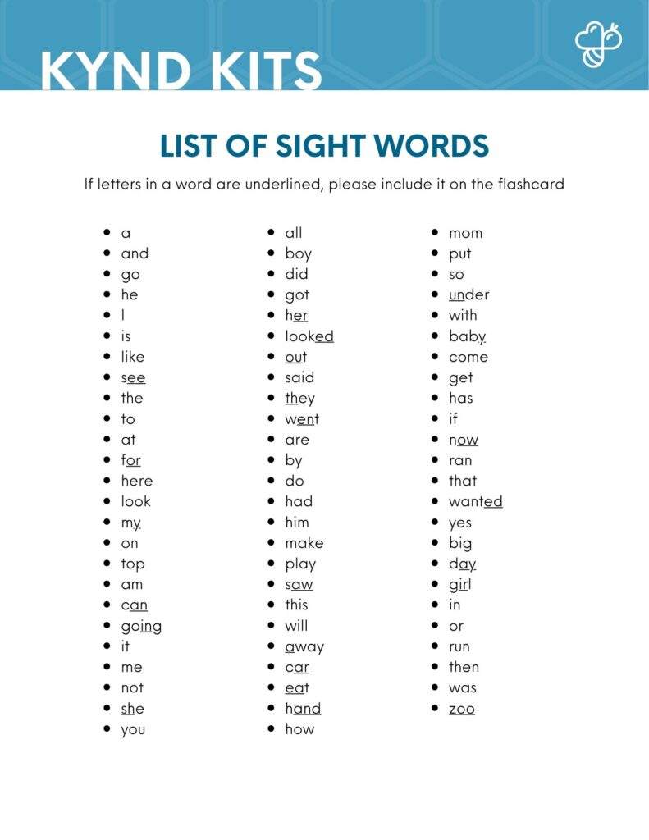
STEP 8 OF 12
Make Sight Word Flashcards
Write one sight word per index card provided. Use large, legible letters. Decorate the cards with colors, pictures, or stickers that represent the word on the card! Tips: Make sure the words are legible, do not use cursive, do not use any words not provided on the list, and underline portions of words on the flashcards if they are underlined on the sight words list.
The list of sight words is included in your kit. If you would like a digital list, you can find it in the dropdown below.
Digital Copy of Sightwords List

Slide 15
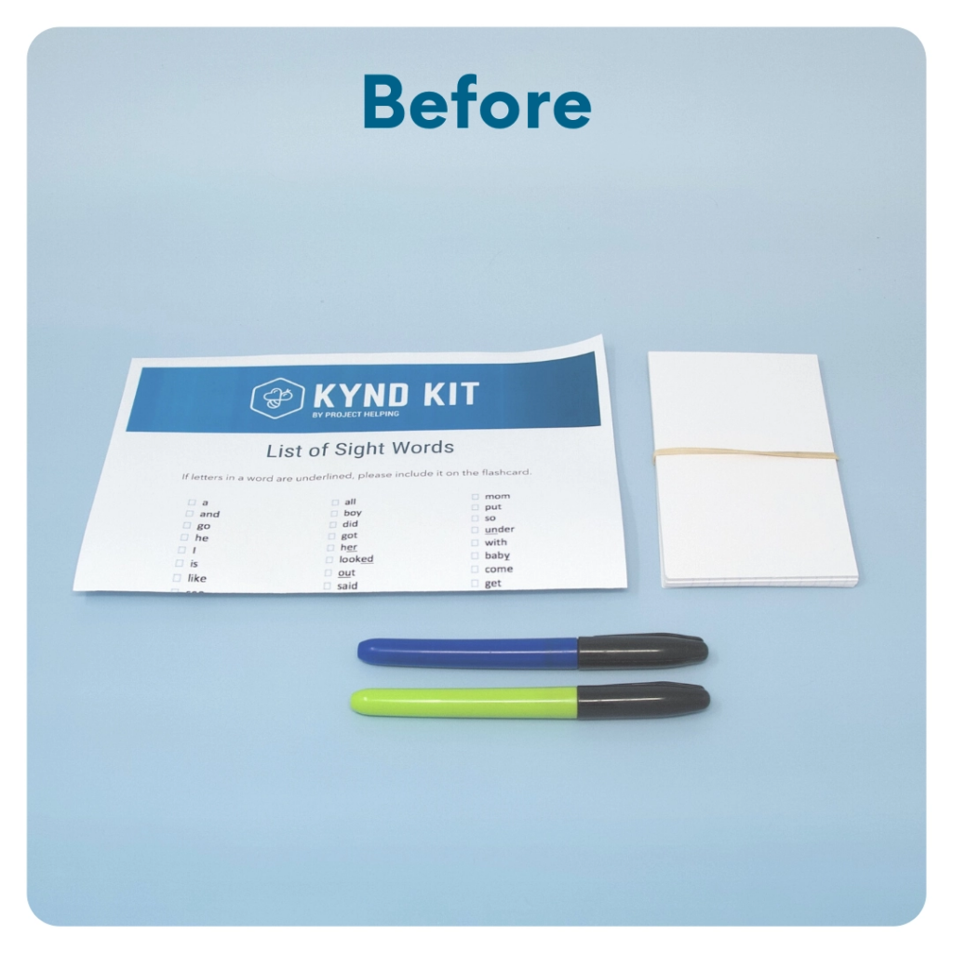
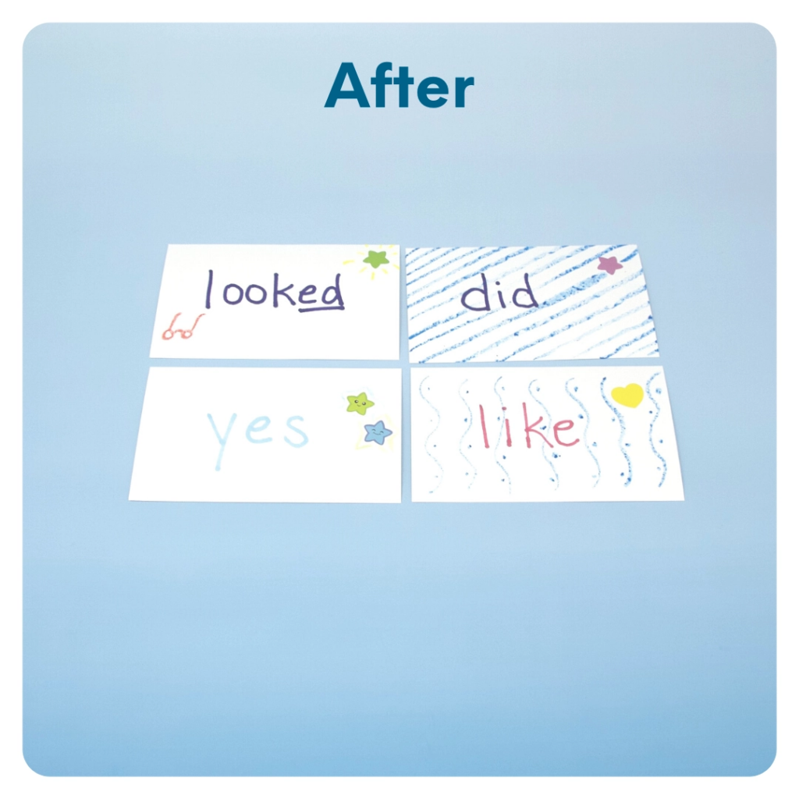
STEP 8 OF 12
Make Sight Word Flashcards (continued)

Slide 16
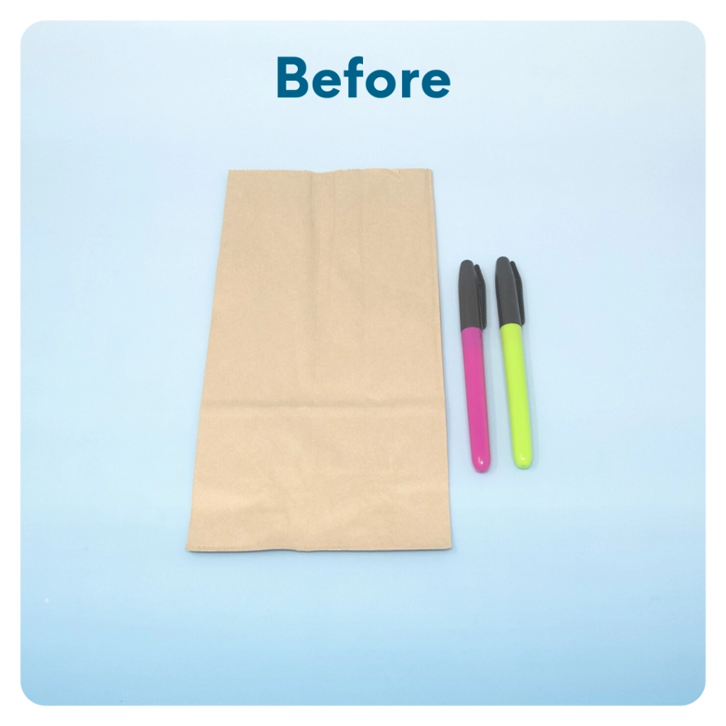
STEP 9 OF 12
Sight Word Game - Feed the Monster
You will be making a monster out of the bag for the child to play the “feed the monster” game while practicing their sight words. Each time the child gets a sight word correct, they can feed the monster the corresponding flashcard.

Slide 17
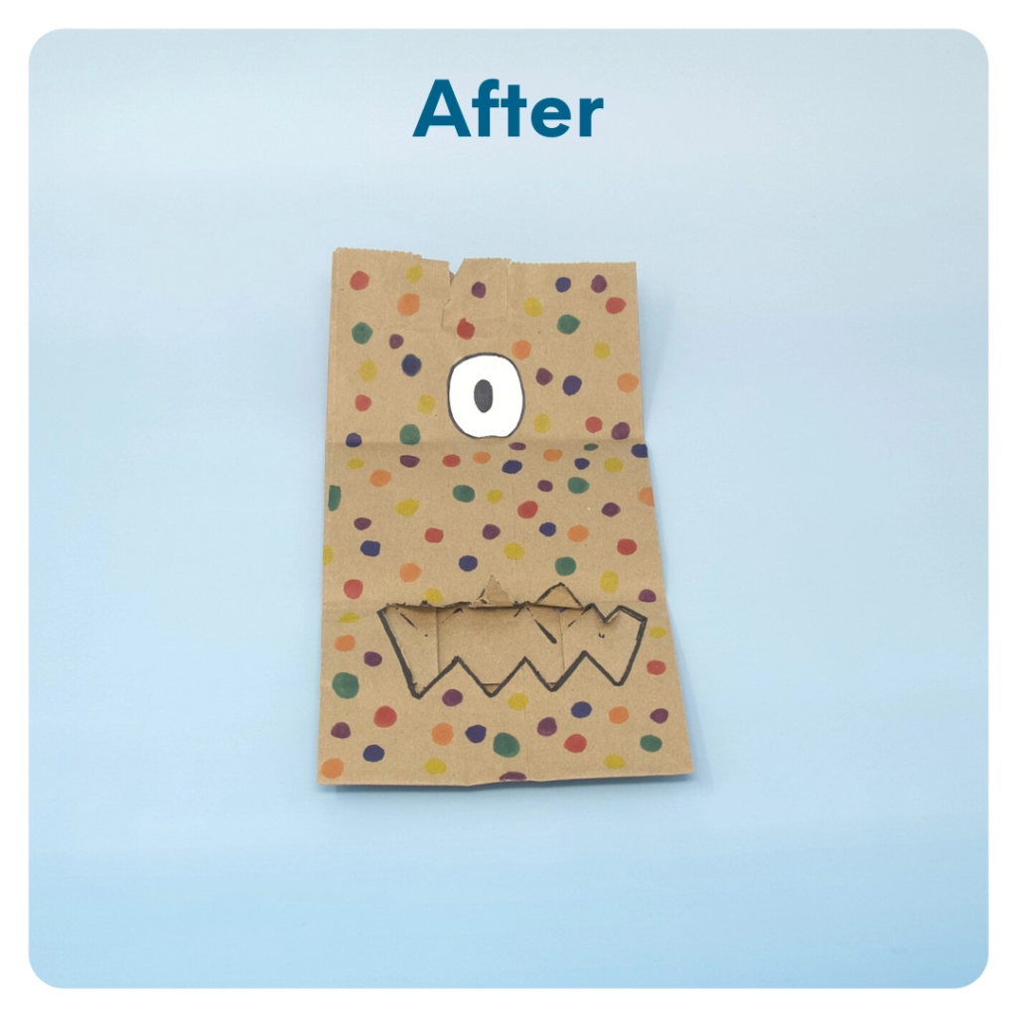
STEP 9 OF 12
Sight Word Game - Feed the Monster (continued)
Open the brown paper bag. Use a pair of scissors to cut a fun-shaped mouth in one side of the bag (make sure it’s large enough for an index card to fit through so the monster can “eat”). Use the included markers to decorate the bag like an animal or monster. On the back of the bag, write instructions so the child knows how to play the “feed the monster” game. Ex. “Every time you get a sight word correct, you can feed the monster by putting the card in the bag through the monster’s mouth.”

Slide 18
STEP 10 OF 12
Pack the Sight Words Kit
Pack all of the materials into the decorated plastic bag and put it back into the original box.
• Please only include items that are UNOPENED and UNUSED
• Add any optional items you would like.
Optional Items to Add:
• Fidget toys
• Stickers
• Journals
• Coloring/writing utensils
• Other craft and art supplies
Items not to include:
• Perishable items
• Sharp objects
• Nut food products
• Religious or political items

Slide 19
STEP 11 OF 12
Register My Kit (Optional)
Register your kit. To register and track your kits, you must visit the online instructions. Registering your kit is optional.

Slide 20
STEP 12 OF 12
Thank You!
When you build a Kynd Kit, you create layers of impact for yourself and the community. We appreciate your time and your support of our mission.
Cheers,
The Project Helping team

