Slide 1
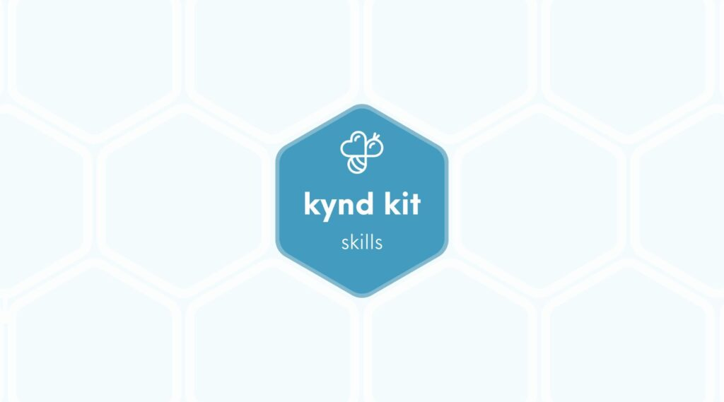
SKILLS
Solar [Skills]
18 STEPS

Slide 2

STEP 1 OF 18
About Project Helping
Kynd Kits are a program of Project Helping, a mental wellness nonprofit. Our mission is to make it ridiculously easy to volunteer because doing good is good for your mental wellness!
Learn More at ProjectHelping.org
When You Build a Kynd Kit - The Cycle of Impact

Slide 3

STEP 2 OF 18
Tips for Building Your Kit
Helpful Tip for Building Your Kynd Kit
• Avoid politics and religion entirely.
• Use appropriate humor.
• Can't think of what to write, draw a picture!
• Use words of affirmation!
• Place a piece of paper in any canvas bag before drawing on the outside. This way, the marker will not bleed through the other side of the bag.
• Please keep your designs gender-neutral, inclusive, and age-appropriate.
Spanish Translation Options

Slide 4
STEP 3 OF 18
Skill: Solar
Before You Build
Build a solar-powered charger for someone experiencing homelessness. The majority of unhoused individuals have access to electronics, but they often lack access to power. This way, they can charge their electronics from anywhere.
The Skills Kits were created for you, as the volunteer, to learn a new skill and use it to give back to your community. Learn how to wire a solar-powered charger. You can then utilize this new skill to continue giving back to your community by developing other sustainable power sources.

Slide 5
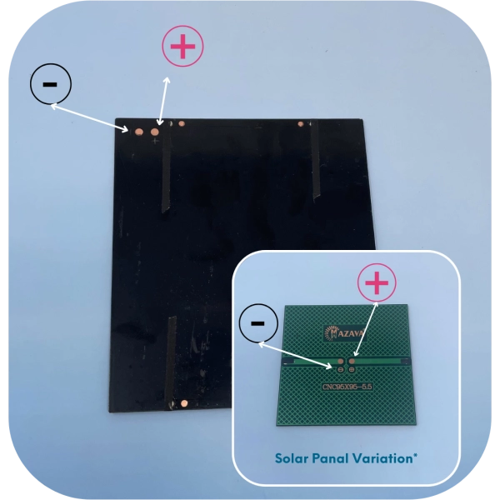
STEP 4 OF 18
Solar Panels | Step 1
Prepare the Solar Panel
• Find the following items:
• Solar Panel
• Find the positive and negative connections
We use several different panel types, and yours may look different than the image below.
• Turn the solar panel over so you can see the connection points. Arrange the panel so the wording is upright.
• The left terminal is positive (+) and the right terminal is negative (-).
Remove the clear protective covering from the front of the solar panel (if needed)

Slide 6
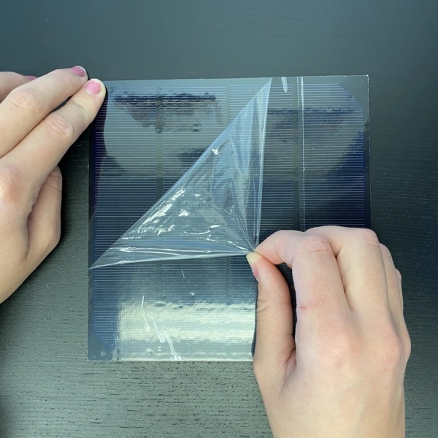
STEP 4 OF 18
Solar Panels | Step 1 (continued)

Slide 7
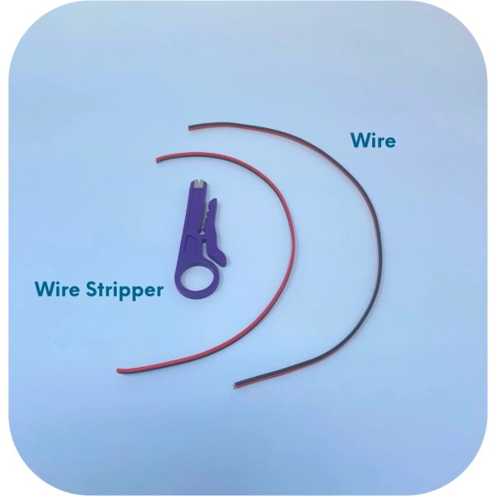
STEP 5 OF 18
Solar Panels | Step 2
Prepare the Wires
• Find the following items:
• Red and Black Wire
• Wire stripper
Tip: If you don’t have a wire stripper, you can easily use scissors. Make a small cut around the silicon without cutting through the wire, and use your hand to pull off the plastic
• Split the wire into 2 pieces. Strip the outer coating off of the wires down approximately 2″.
• Do NOT cut into the black and red wires.
• Do this to both sides of the wire.
• You can split the wires fully into 2 pieces, or leave them slightly connected

Slide 8
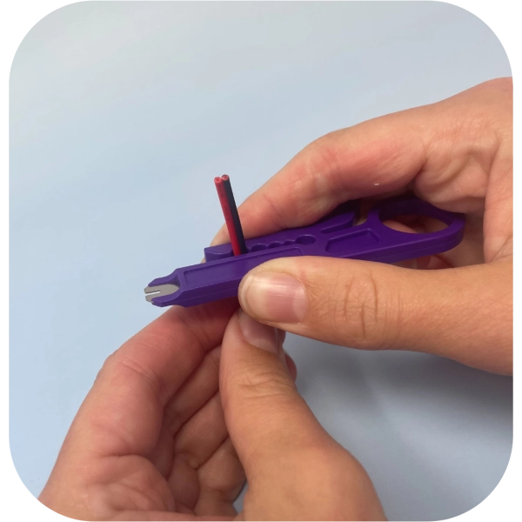
STEP 5 OF 18
Solar Panels | Step 2 (continued)
• There is enough wire. If you mess up, cut the wire entirely and try again!

Slide 9
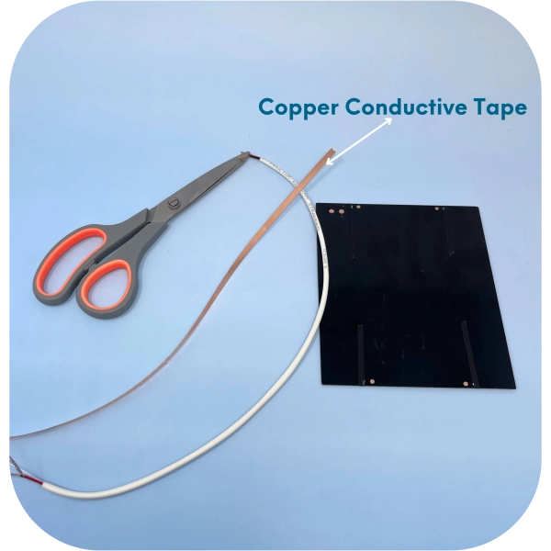
STEP 6 OF 18
Solar Panels | Step 3
Prepare the Conductive Tape
• Find the following items:
• Conductive Tape
• Scissors
• Locate the long strip of copper conductive tape.
• Cut two strips of conductive tape approximately 1″ long.

Slide 10
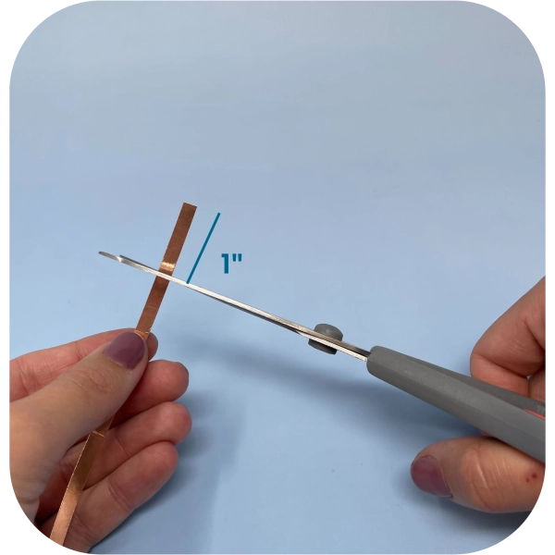
STEP 6 OF 18
Solar Panels | Step 3 (continued)

Slide 11
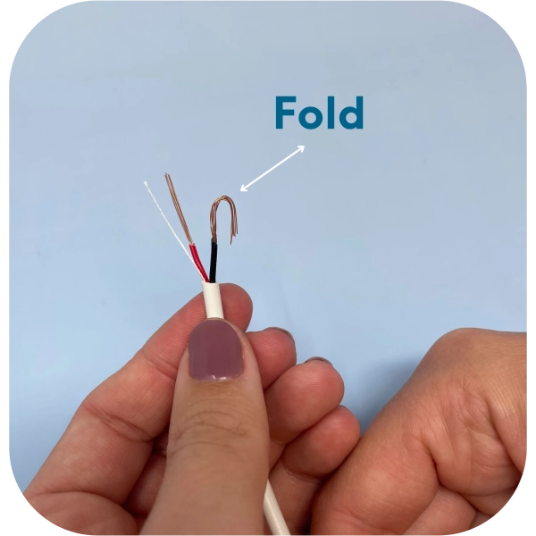
STEP 7 OF 18
Solar Panels | Step 4
Attach the Wires to the Solar Panel
• Find the following items:
• Solar panel
• Wire (stripped)
• Two strips of copper conductive tape
• How to:
• To Know: Red wire is positive (+), black wire is (-)
• Using the copper tape, tape the red wire to the positive (+).
• Tape the black wire to the negative (-).
Tip: Fold the wire to make a small loop, so more of the wire is touching the solar panel, for better surface connectivity. Do this to both wires.

Slide 12
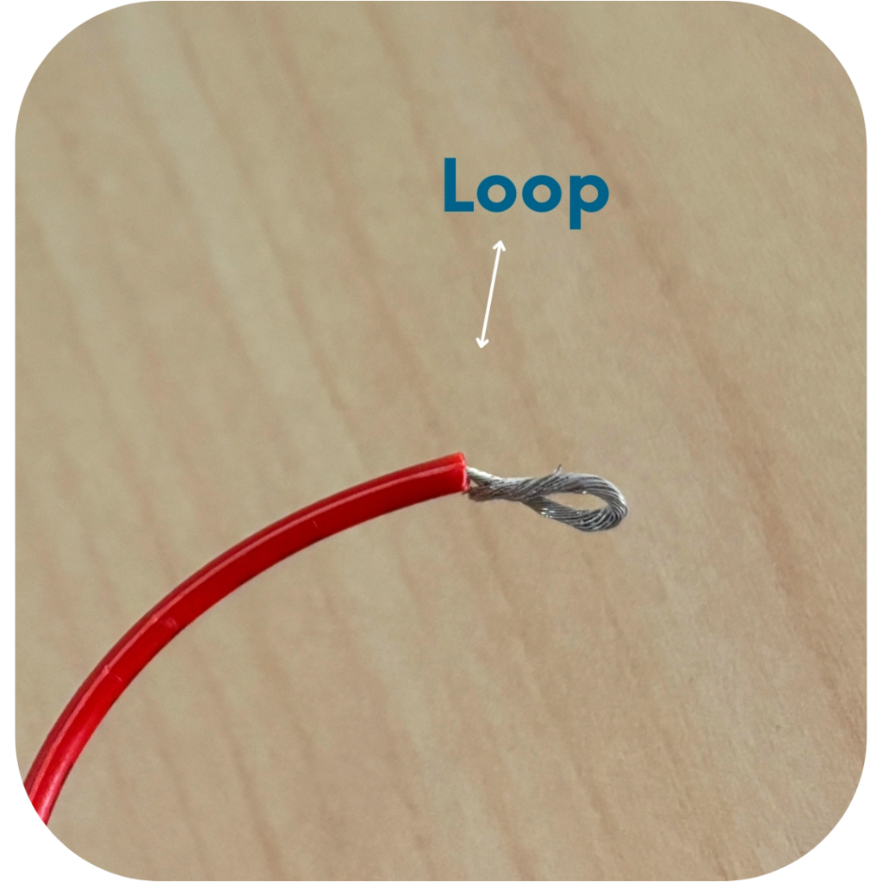
STEP 7 OF 18
Solar Panels | Step 4 (continued)

Slide 13
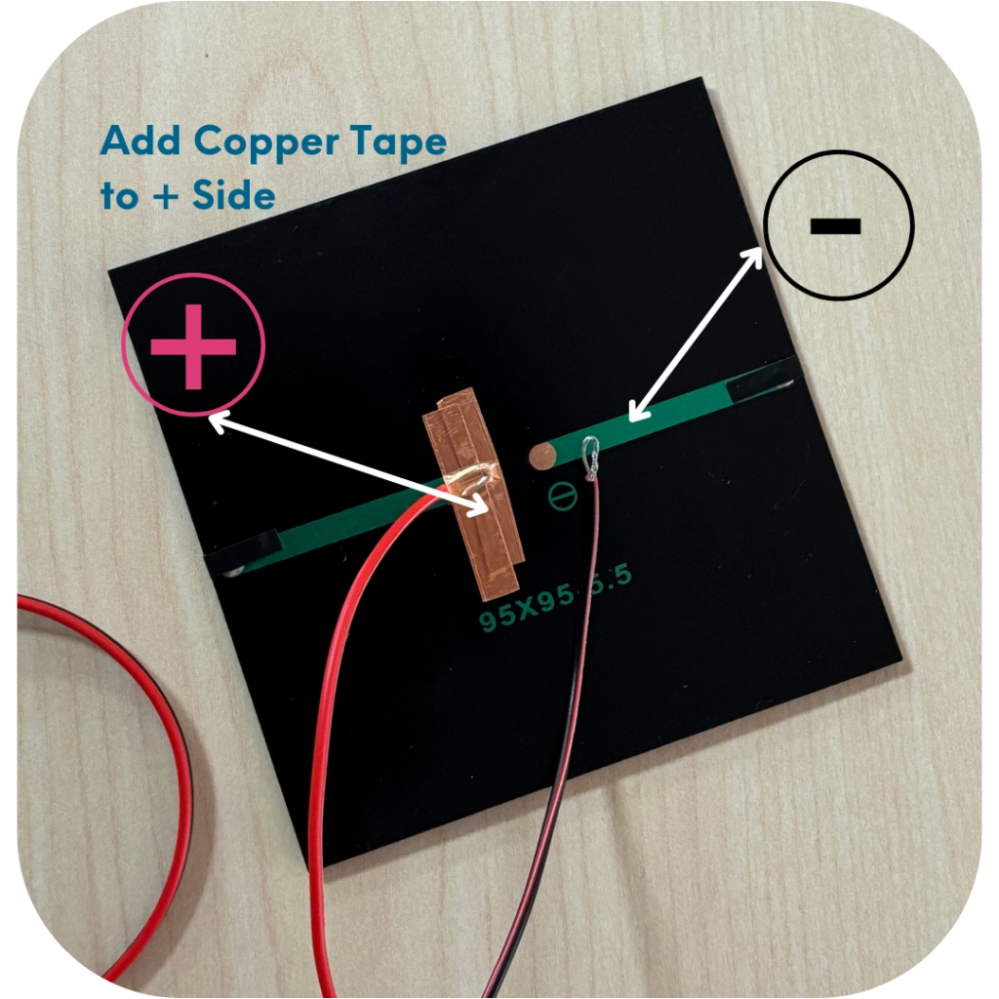
STEP 8 OF 18
Solar Panels | Step 5
Adding the Copper Tape
Press firmly on the tape to hold the wires down securely.
Tip: Do one side fully before moving on to the next.
Wires must firmly and securely touch the surface of the +/- points!! You can use several pieces of tape to improve it. The stronger the connection between panel and wires, the more stable the circuit.
BE SURE THE COPPER TAPE STRIPS AND WIRES DO NOT TOUCH

Slide 14
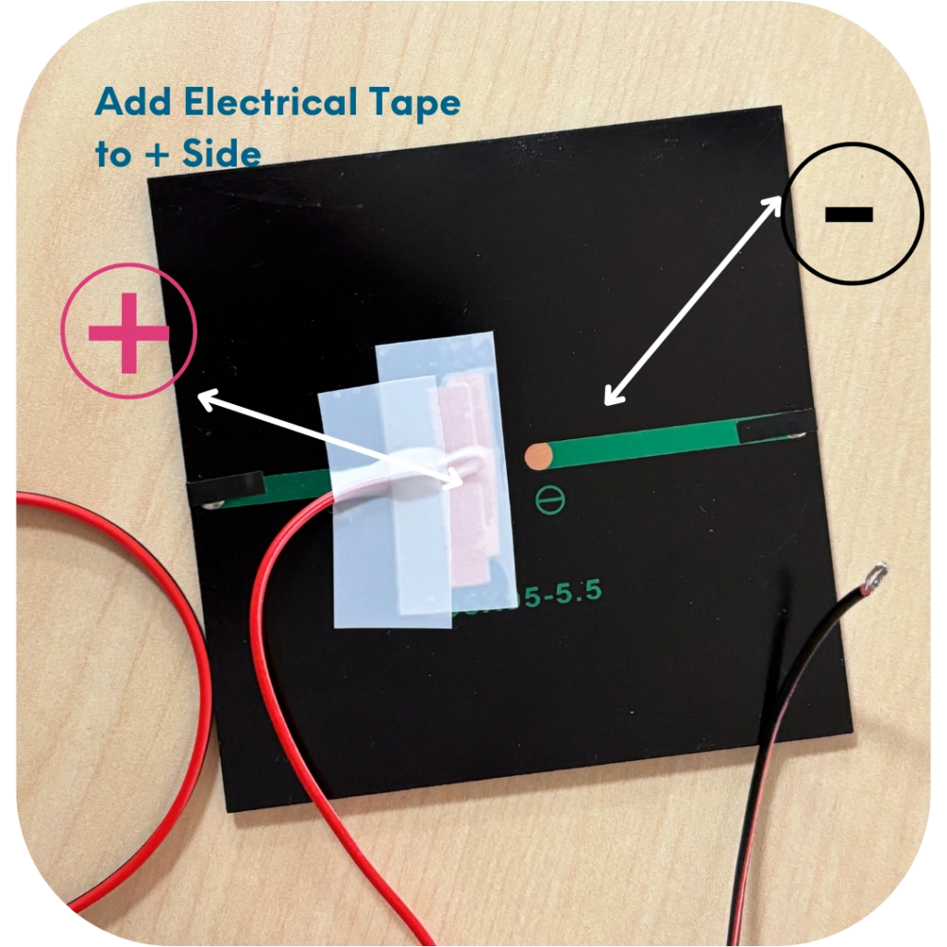
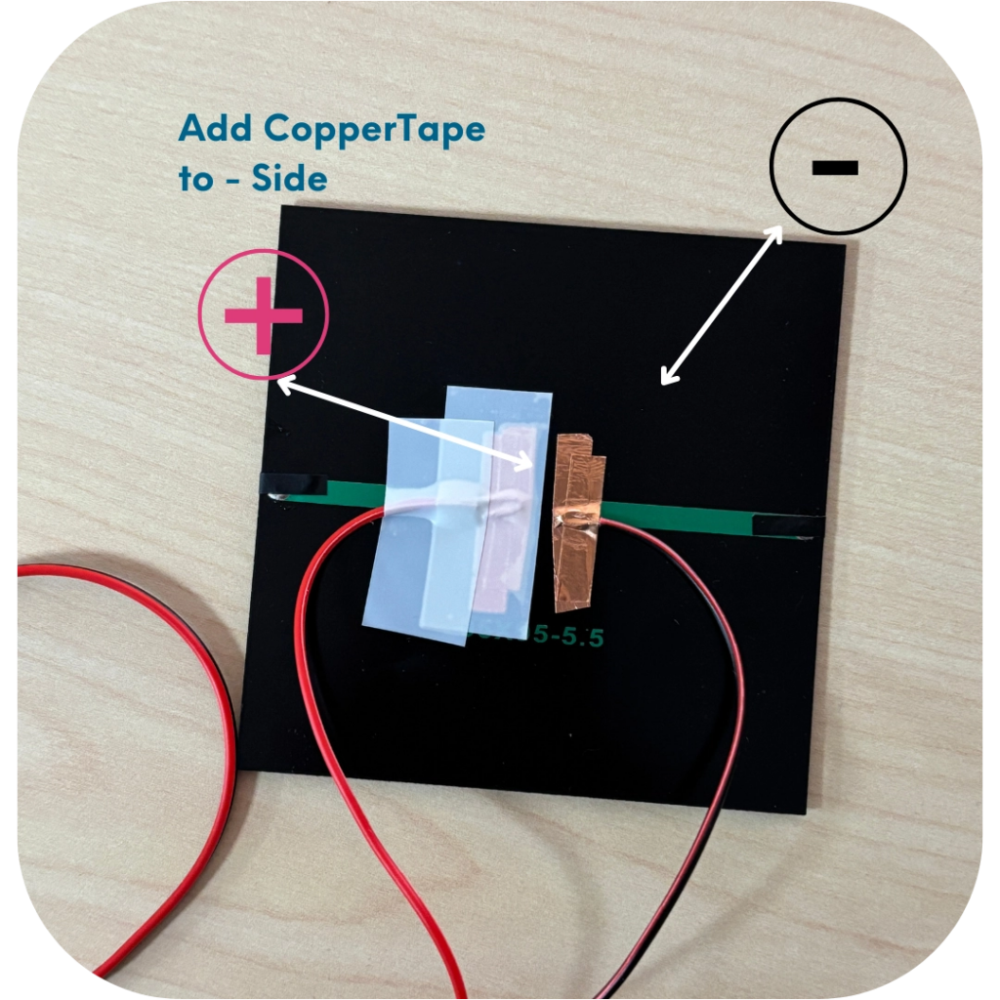
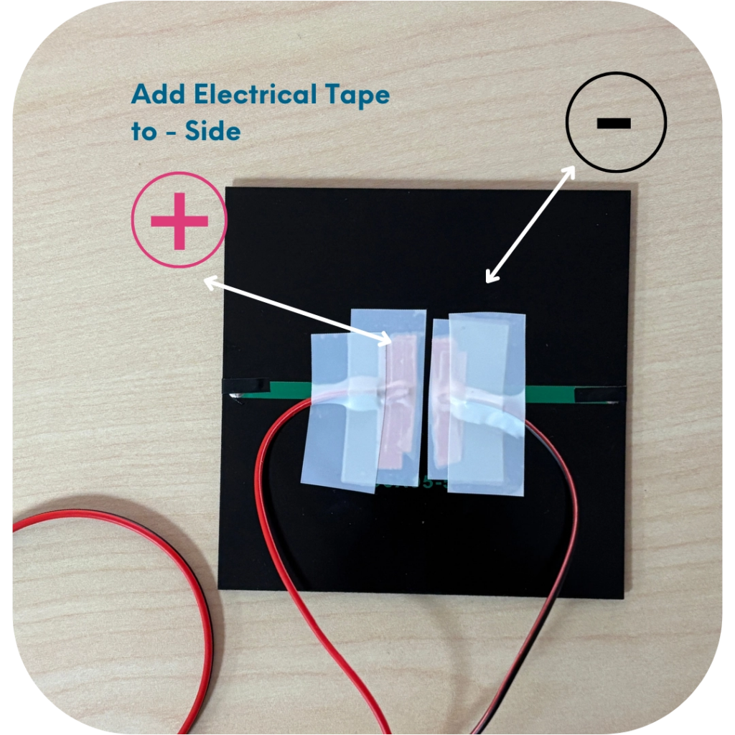
STEP 8 OF 18
Solar Panels | Step 5 (continued)

Slide 15
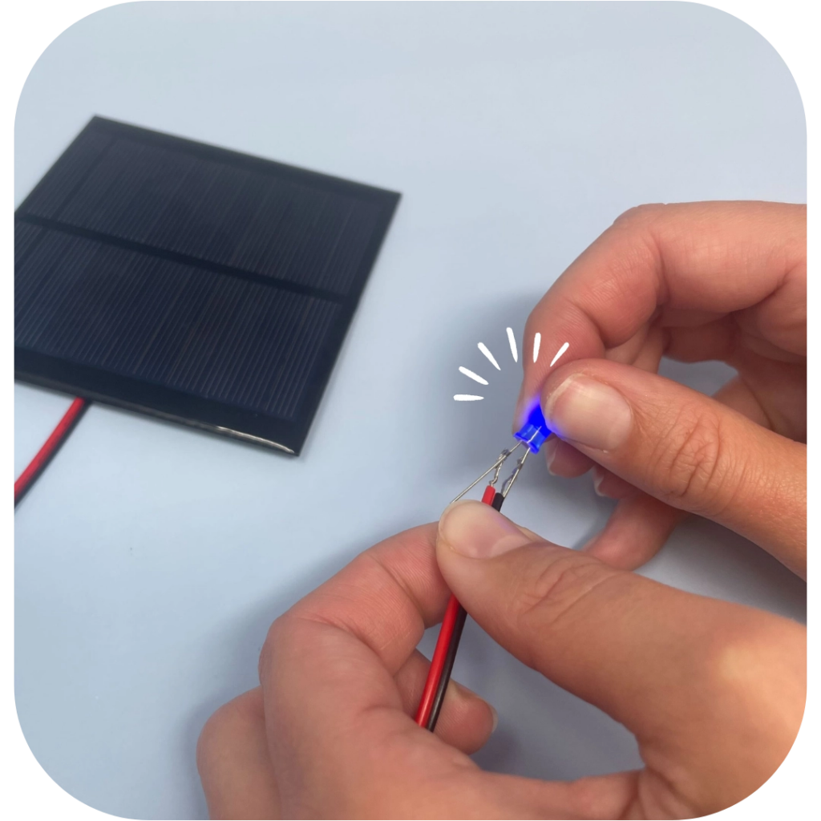
STEP 9 OF 18
Solar Panels | Step 6
Test the Connection
• Turn the solar panel over and expose it to a STRONG and DIRECT light source such as a lamp.
• Take a diode (pictured below) – hold the long pin to red wire & short pin to black wire.
• The diode will light up if the connection is stable and the circuit is correct.

Slide 16
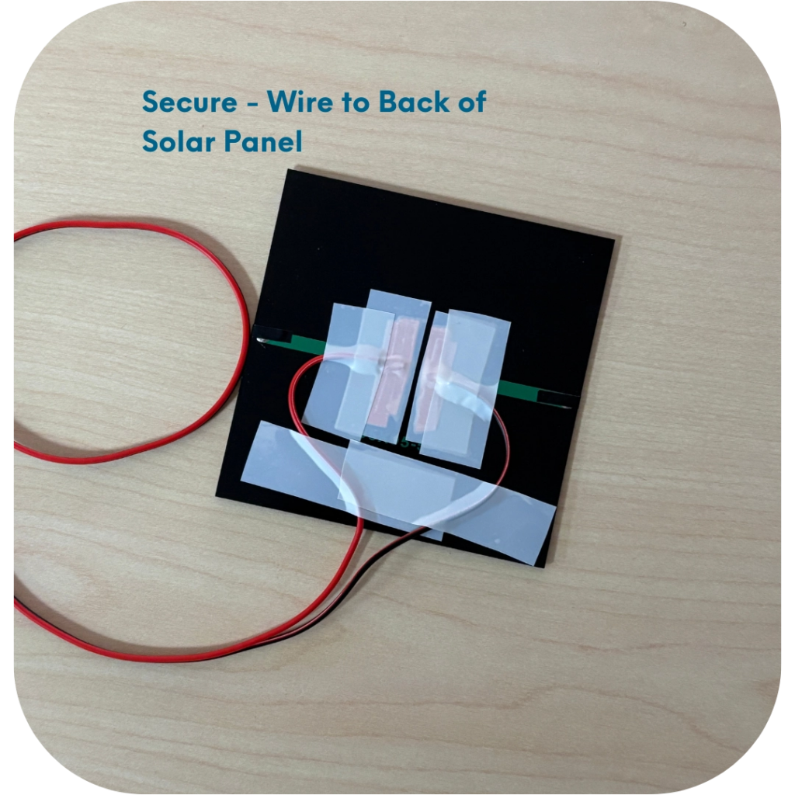
STEP 10 OF 18
Solar Panels | Step 7
Secure the Connection
After you confirm your connection is good, it is time to secure the wires to the back of the solar panel.
• Locate the electrical tape
• Cut two strips of electrical tape approximately 2″ each.
• Use the tape to secure the wires to the back of the solar panel.

Slide 17
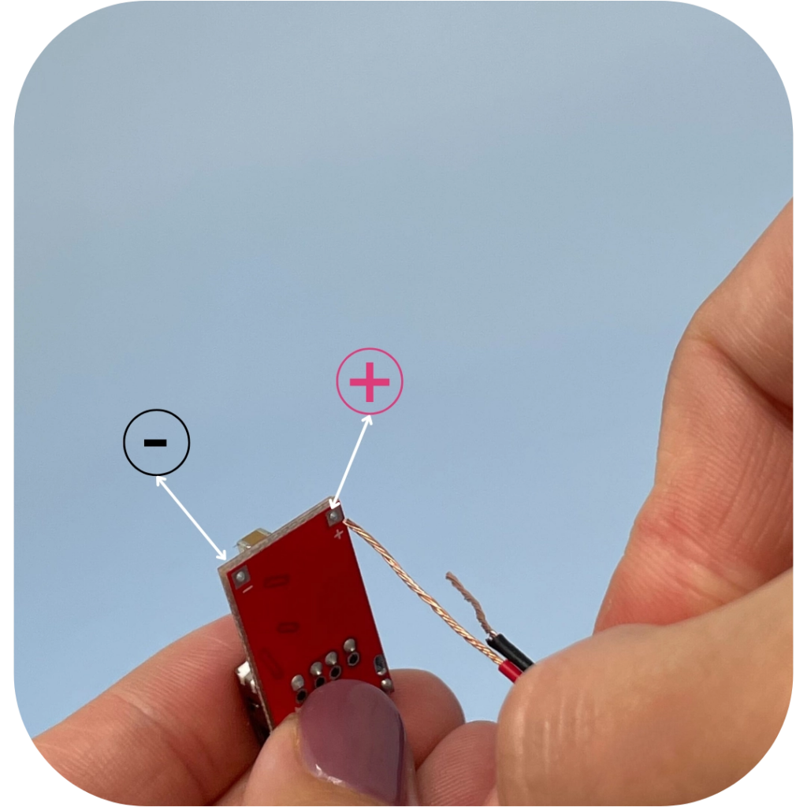
STEP 11 OF 18
Solar Panels | Step 8
Connect the Charging Board
• Locate the USB Charging Board
• Gray wire connectors are optional.
• Find the positive (+) and negative (-) connections on the back of the USB Charging Board.
• Connect the wires to the USB Charging Board
• Tightly roll the ends of the wire so they slide into the small openings of the USB Charging Board.
• First, put the red wire into the positive (+) opening.
• Put the wire halfway into the opening and loop it to twist the wire around itself to secure it in place.
• Next, put the black wire into the negative (-) opening.

Slide 18
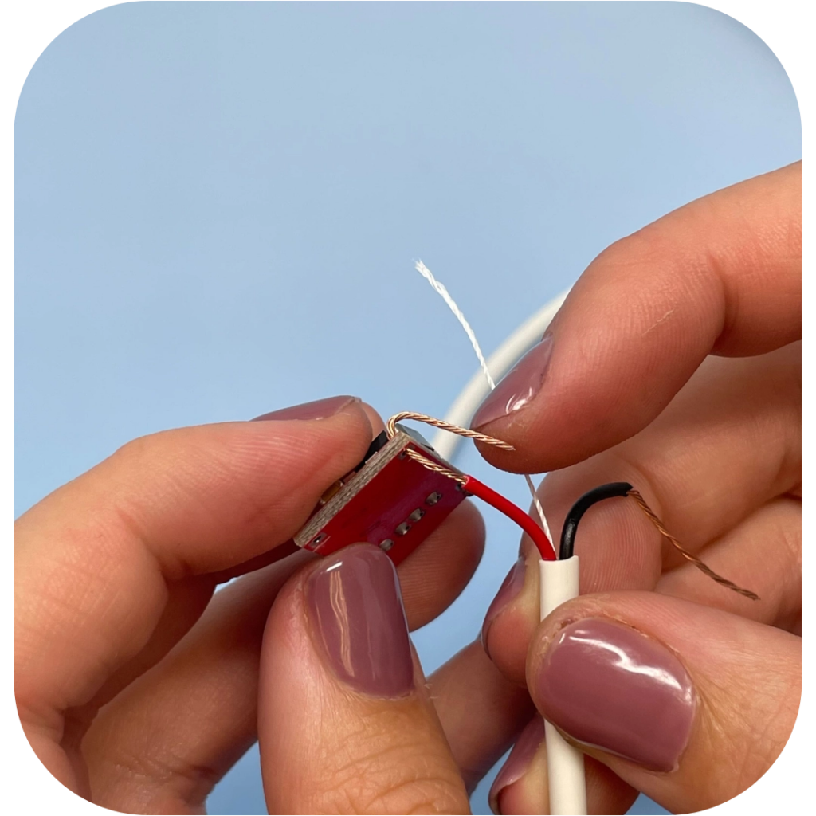
STEP 11 OF 18
Solar Panels | Step 8 (continued)
• Again, put the wire halfway into the opening and loop it to twist the wires around itself to secure it in place.

Slide 19
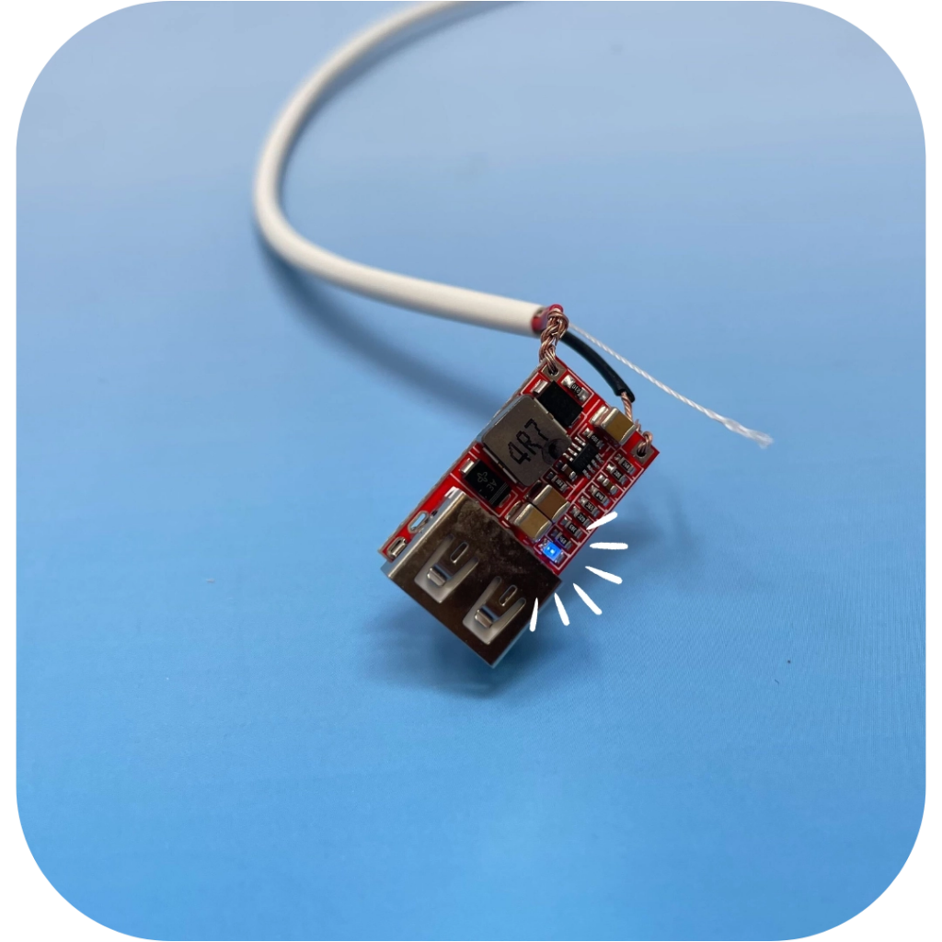
STEP 12 OF 18
Solar Panels | Step 9
Confirm the USB Charging Board Connection
• Hold solar panel under direct & strong light source.
• If the connections are secure and your panel is capturing enough light, the small red LED on the top of the USB Charging Board will light up.

Slide 20
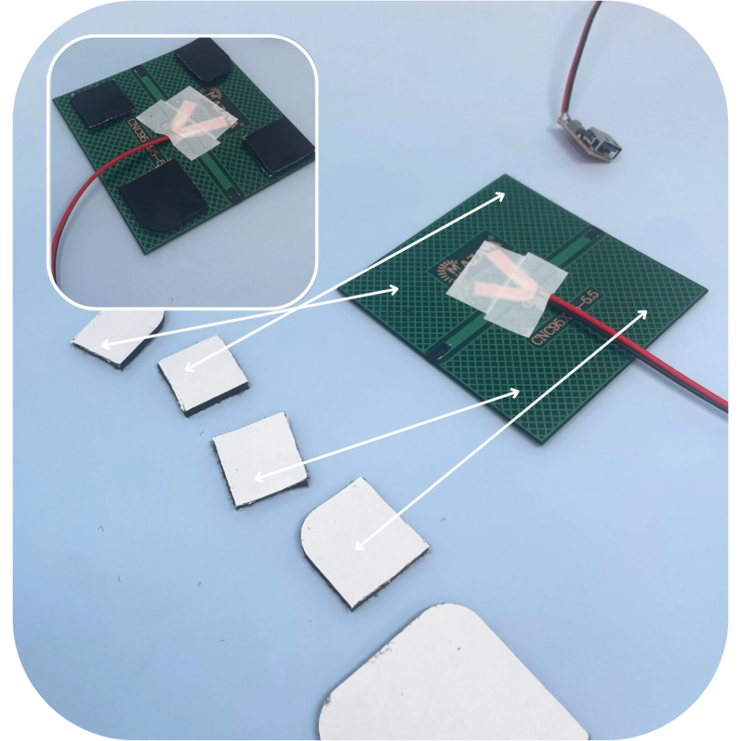
STEP 13 OF 18
Solar Panels | Step 10
Attach the Solar Panel to the Case
• Find the following items:
• Completed Solar Panel & USB Charger
• Protective Box
• Velcro
• Cut the velcro into smaller pieces.
• Remove the white backing and place velcro on the back of the solar panel.
• Secure the solar panel in the bottom of the case.
• Position the solar panel so the wire is running into the bottom of the box.
• Press down firmly on the corners to secure the velcro to the box.
• Place the wire splitters along the inner side of the case.
• Test that the box closes with the solar panel attached to the lid.

Slide 21
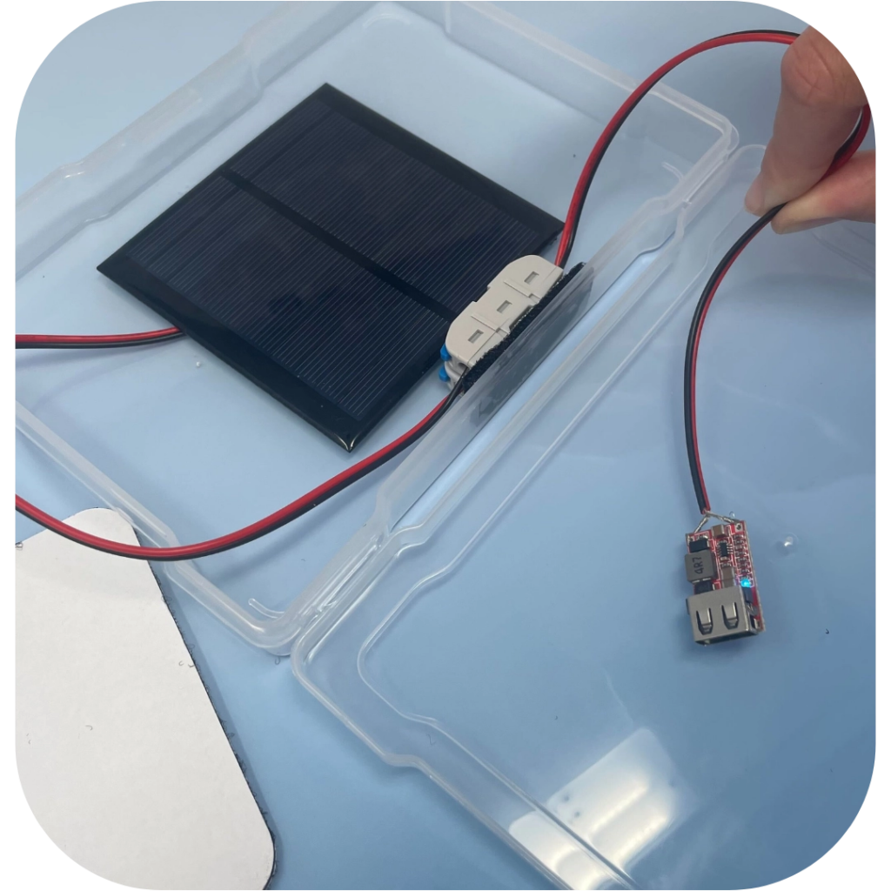
STEP 13 OF 18
Solar Panels | Step 10 (continued)

Slide 22
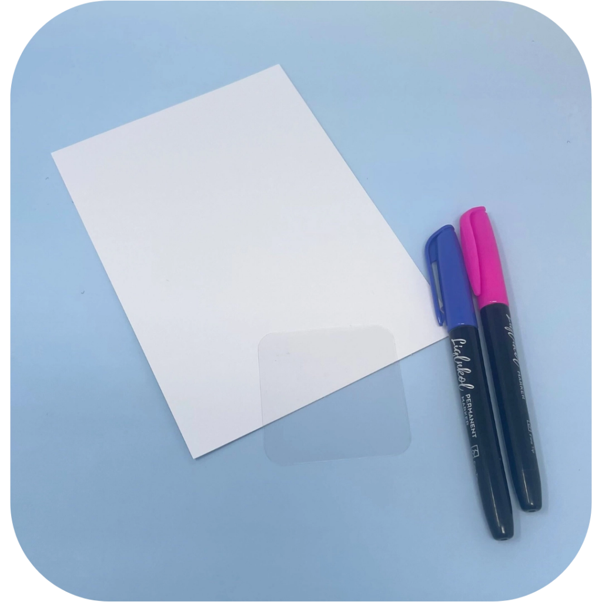
STEP 14 OF 18
Solar Panels | Step 11
Make a Cover
Using the blank piece of paper, markers, and clear, double-sided sticker, make a cover for your case.
• Decorate the paper.
• Cut the clear adhesive into four pieces and stick them to each corner of the paper.
• Place the paper facing down inside the lid of the case. This will make sure you can see your masterpiece on the outside!

Slide 23
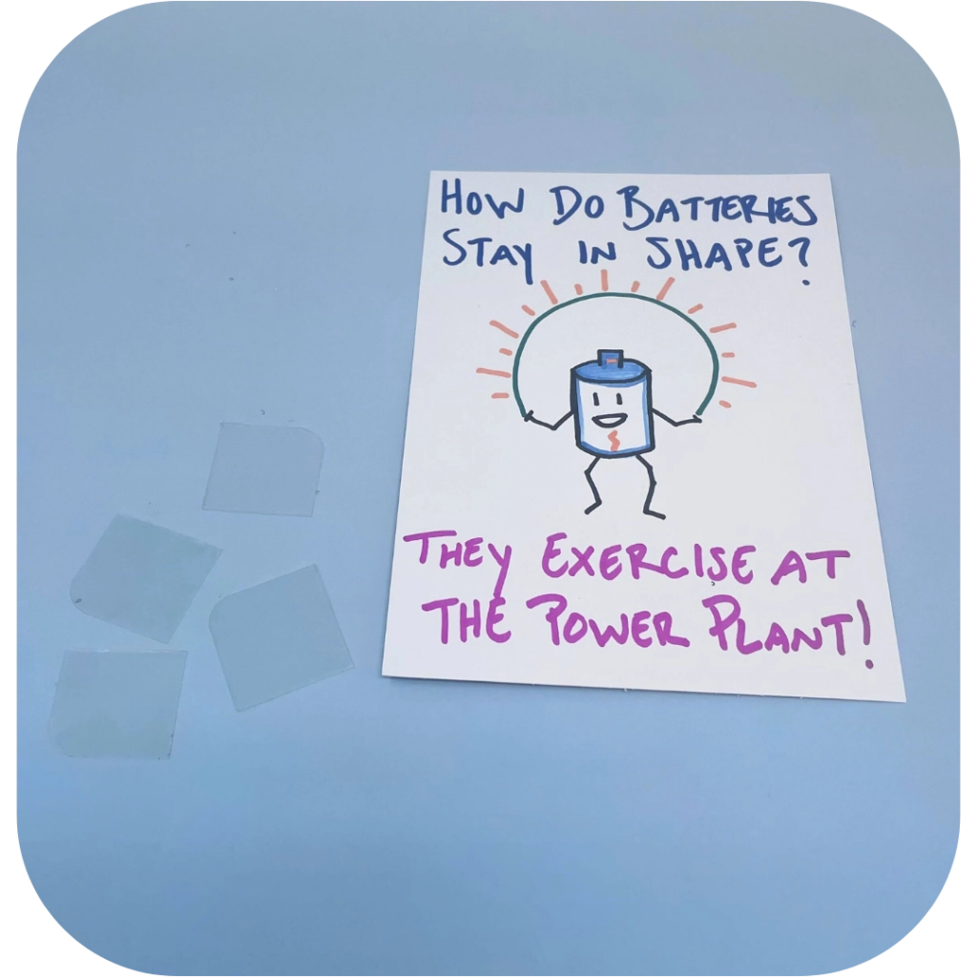
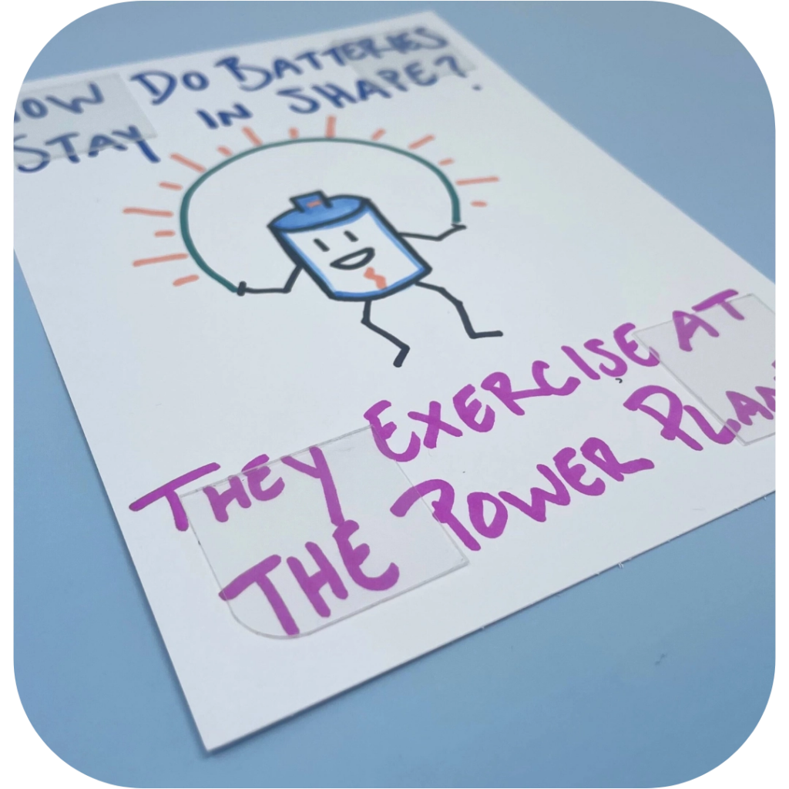
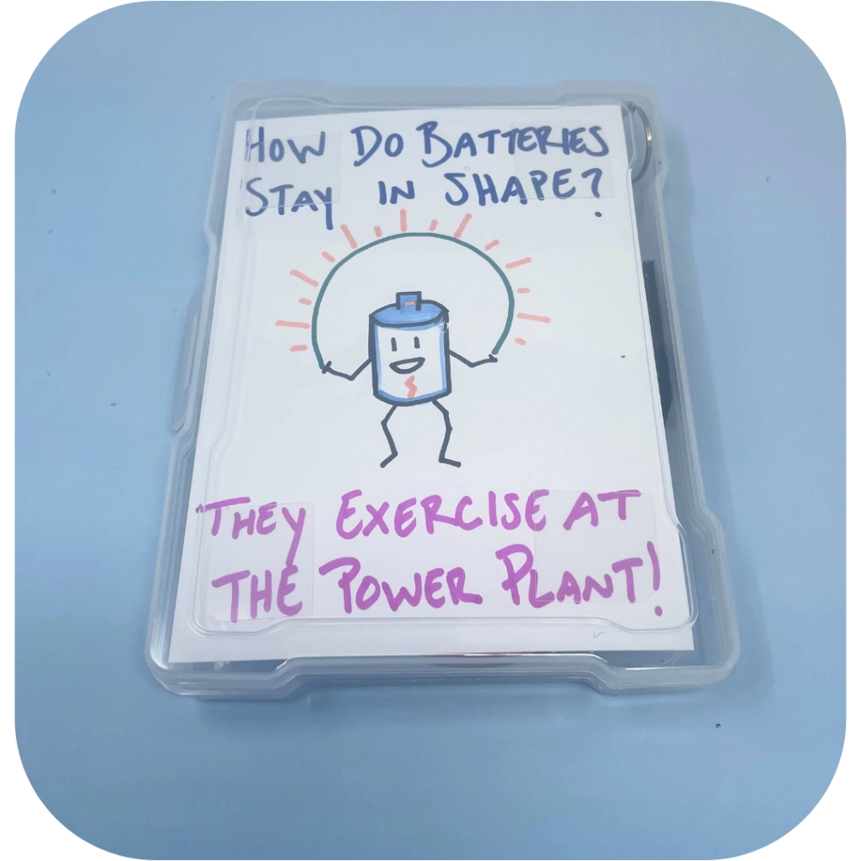
STEP 14 OF 18
Solar Panels | Step 11 (continued)

Slide 24
STEP 15 OF 18
Solar Panels | Step 12
Trouble Shooting
Wire Prepping
• If you mess up, you have enough wire included in your kit to cut everything off, and restart
Diode is Not Lighting Up
• Make sure your positive and negative wires and copper tape do not cross or touch
• Make sure the red wire is attached securely the positive and the black is attached securely to the negative.
• Your wires should not be exposed, they should be fully covered by conductive tape.
USB is Not Lighting Up
• Reconnect your wires through the USB

Slide 25
STEP 15 OF 18
Solar Panels | Step 12 (continued)
• Make sure it is a secure connections by putting the wire through the holes, and then twisting them around each other for a secure connection.
• Make sure black wire goes through the negative and red wire goes through the positive.

Slide 26
STEP 16 OF 18
Pack the Skill: Solar Kit
• Close the case and place it in the original box.
• Include any leftover materials in the original box.

Slide 27
STEP 17 OF 18
Register My Kit (Optional)
Register your kit. To register and track your kits, you must visit the online instructions. Registering your kit is optional.

Slide 28
STEP 18 OF 18
Thank You!
When you build a Kynd Kit, you create layers of impact for yourself and the community. We appreciate your time and your support of our mission.
Cheers,
The Project Helping team

