Slide 1

PLUS
Teacher Appreciation [Plus]
11 STEPS

Slide 2

STEP 1 OF 11
About Project Helping
Kynd Kits are a program of Project Helping, a mental wellness nonprofit. Our mission is to make it ridiculously easy to volunteer because doing good is good for your mental wellness!
Learn More at ProjectHelping.org
When You Build a Kynd Kit - The Cycle of Impact

Slide 3

STEP 2 OF 11
Tips for Building Your Kit
Helpful Tip for Building Your Kynd Kit
• Avoid politics and religion entirely.
• Use appropriate humor.
• Can't think of what to write, draw a picture!
• Use words of affirmation!
• Place a piece of paper in any canvas bag before drawing on the outside. This way, the marker will not bleed through the other side of the bag.
• Please keep your designs gender-neutral, inclusive, and age-appropriate.
Spanish Translation Options

Slide 4
STEP 3 OF 11
Teacher Appreciation [+]
Before You Build
Nearly three-fourths of teachers and 85 percent of principals are experiencing frequent job-related stress, compared to just a third of working adults. Fifty-nine percent of teachers and 48 percent of principals say they’re burned out, compared to 44 percent of other workers.
Teachers play a pivotal role in our society. They work endlessly to provide students with education and life skills. We aim to show our appreciation to the teachers who are working hard to continue to create a safe and impactful learning experience for students.

Slide 5

STEP 4 OF 11
Write a Note to the Recipient and Decorate the Envelope
Write a card and decorate the envelope using the enclosed materials. Express your encouragement and include a hopeful message.
Please ensure your message is age-appropriate and avoids references to religion or politics.

Slide 6

STEP 4 OF 11
Write a Note to the Recipient and Decorate the Envelope (continued)

Slide 7
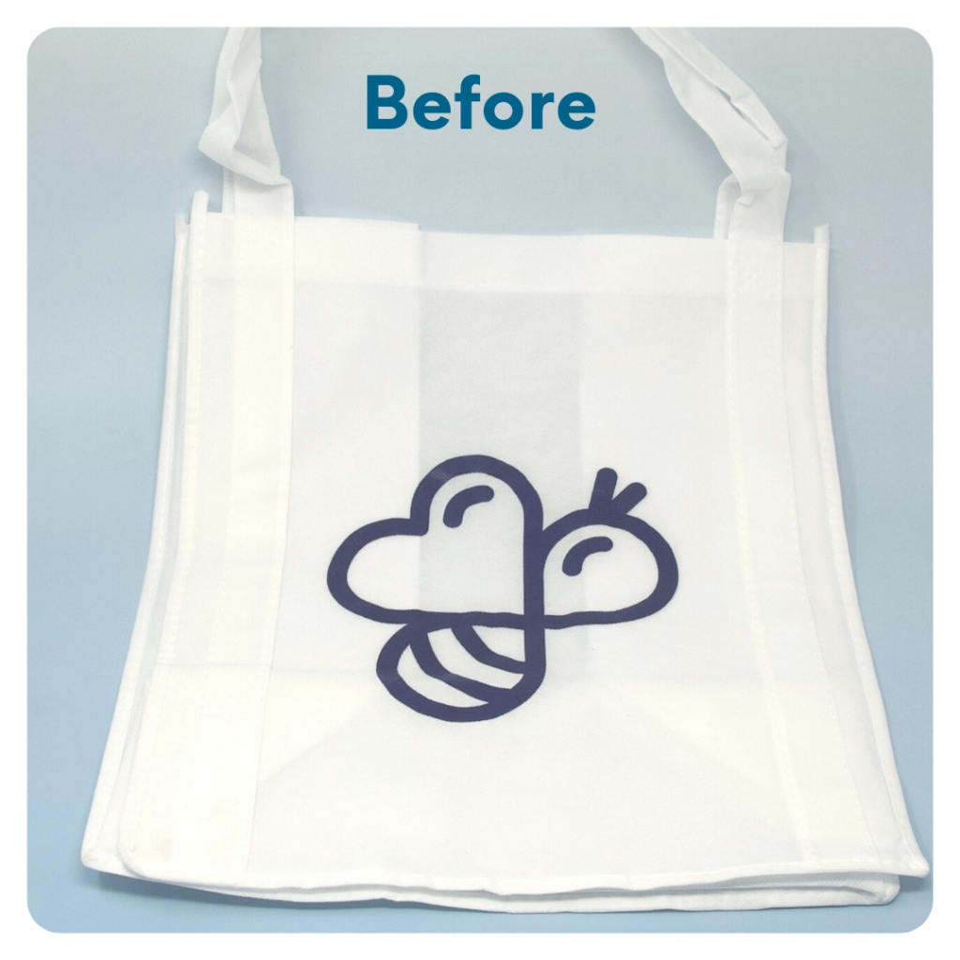
STEP 5 OF 11
DIY Tote Bag
Decorate the Canvas Tote
Decorate the canvas tote to make it fun and colorful! Tip: place a piece of paper in the tote before decorating. This will prevent the marker from bleeding through the tote.

Slide 8

STEP 5 OF 11
DIY Tote Bag (continued)

Slide 9

STEP 6 OF 11
Surprise Kyndness Notebook
Decorate the outside of the journal with a picture or uplifting message. Use random pages in the journal to write short, uplifting messages, draw small, colorful images, or create fun writing prompts for the recipient.

Slide 10

STEP 6 OF 11
Surprise Kyndness Notebook (continued)

Slide 11

STEP 7 OF 11
Affirmation Notebook
DIY Affirmations
Find the mini affirmation notebook in your kit. Decorate the front cover with drawings, stickers, or a positive message. Then, open it up and write 3–6 affirmations inside—more if you'd like! These can be encouraging words, self-love reminders, or anything that lifts the spirit.
Do you still have affirmation cards in your kit? If your kit includes affirmation cards instead of a notebook, go ahead and write a special affirmation on each card.

Slide 12


STEP 7 OF 11
Affirmation Notebook (continued)

Slide 13
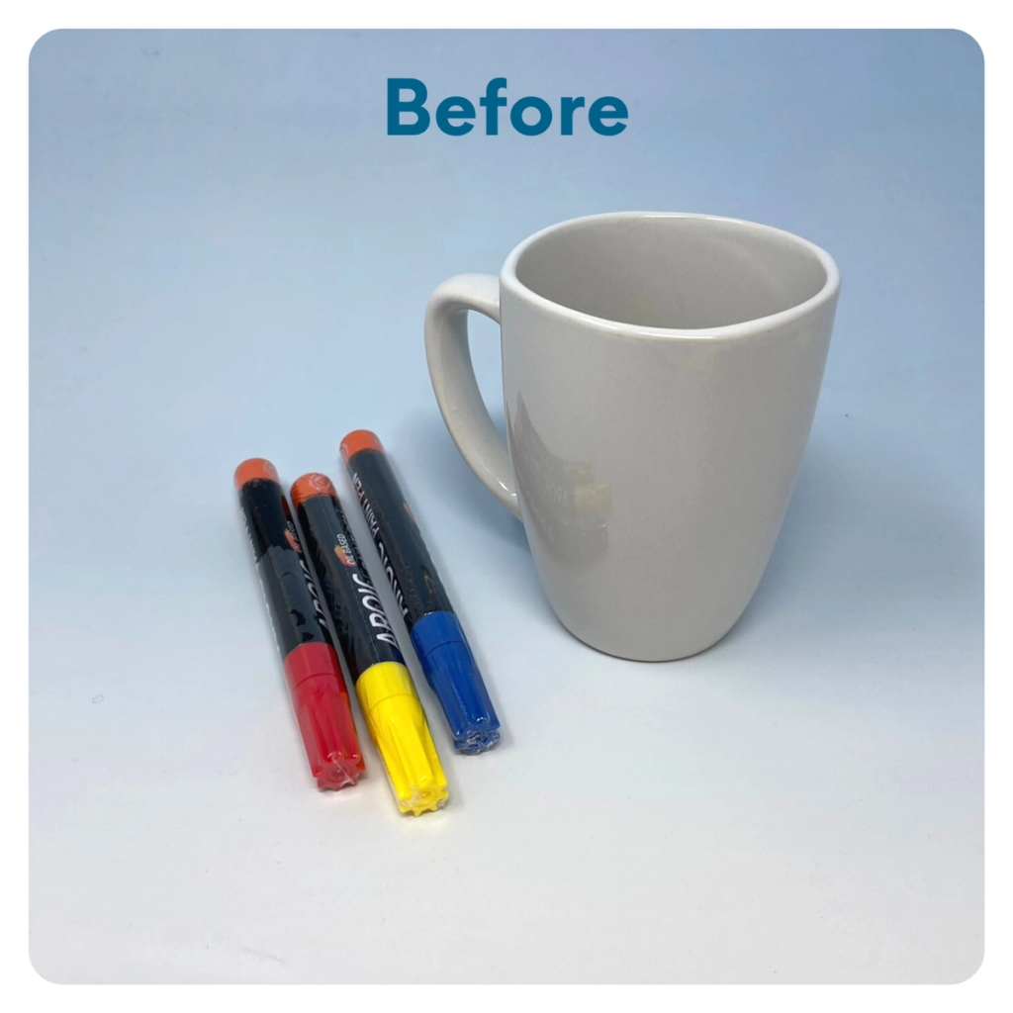
STEP 8 OF 11
Decorate the Coffee Mug
Using paint pens, decorate the mug. Write a message or draw something. Get creative! After you’re done decorating, place the mug in the oven before preheating. Then, preheat the oven to 350 degrees. Once preheated, set the timer for 30 min. Once the time is over, turn off your oven and let the mug cool off inside for an additional 30 min before taking it out.
WARNING: Mug may be hot. Use caution when removing!

Slide 14
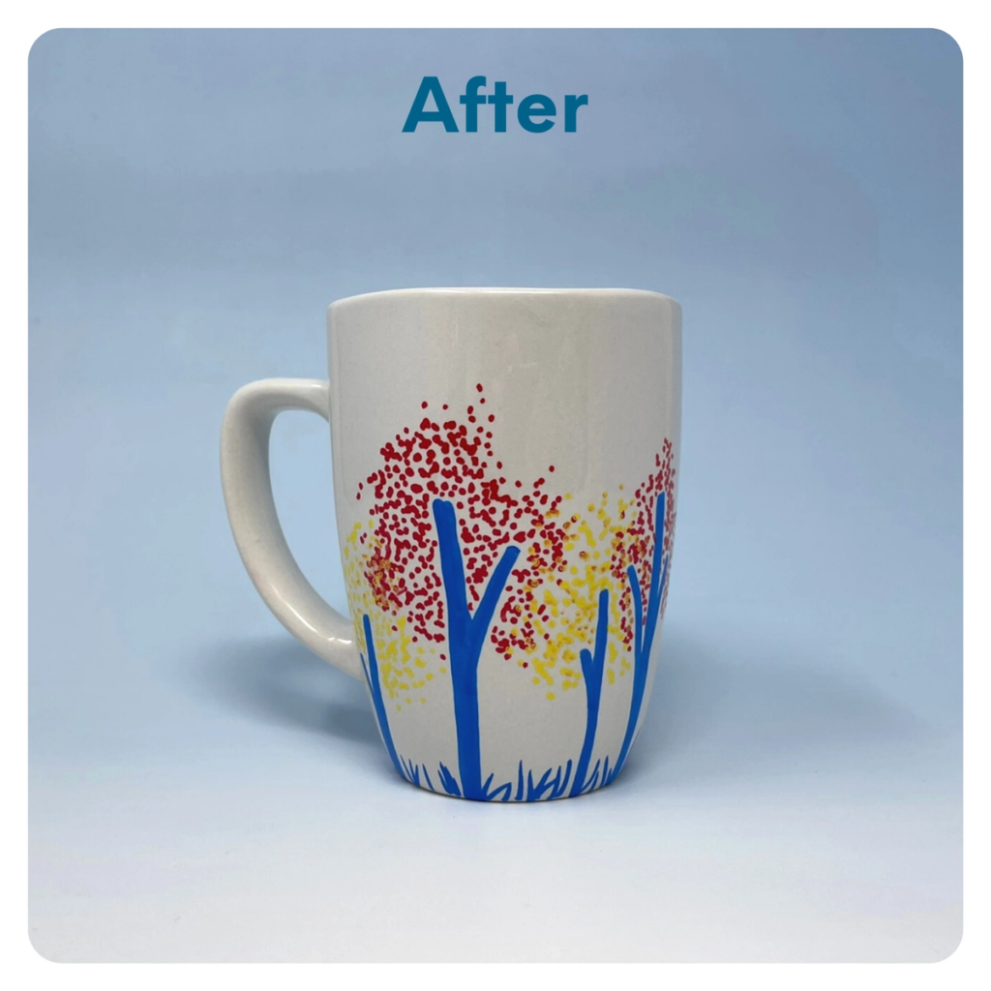
STEP 8 OF 11
Decorate the Coffee Mug (continued)

Slide 15
STEP 9 OF 11
Pack the Teacher Appreciation [+] Kit
Pack all of the materials into the original box
• Please only include items that are UNOPENED and UNUSED
• Add any optional items you would like.
Optional Items to Add:
• Desk supplies and accessories
• Disinfectant wipes
• Snacks, gum, or mints
• Tea or coffee
• Gift Cards
Items not to include:
• Perishable items
• Sharp objects
• Nut food products
• Religious or political items

Slide 16
STEP 10 OF 11
Register My Kit (Optional)
Register your kit. To register and track your kits, you must visit the online instructions. Registering your kit is optional.

Slide 17
STEP 11 OF 11
Thank You!
When you build a Kynd Kit, you create layers of impact for yourself and the community. We appreciate your time and your support of our mission.
Cheers,
The Project Helping team

