Slide 1
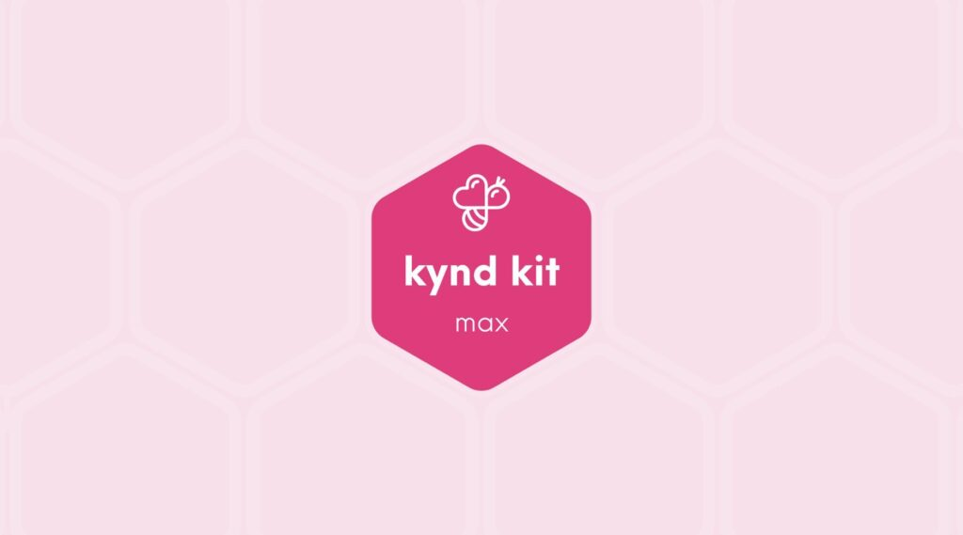
MAX
Ukulele [Max]
14 STEPS

Slide 2

STEP 1 OF 14
About Project Helping
Kynd Kits are a program of Project Helping, a mental wellness nonprofit. Our mission is to make it ridiculously easy to volunteer because doing good is good for your mental wellness!
Learn More at ProjectHelping.org
When You Build a Kynd Kit - The Cycle of Impact

Slide 3

STEP 2 OF 14
Tips for Building Your Kit
Helpful Tip for Building Your Kynd Kit
• Avoid politics and religion entirely.
• Use appropriate humor.
• Can't think of what to write, draw a picture!
• Use words of affirmation!
• Place a piece of paper in any canvas bag before drawing on the outside. This way, the marker will not bleed through the other side of the bag.
• Please keep your designs gender-neutral, inclusive, and age-appropriate.
Spanish Translation Options

Slide 4
STEP 3 OF 14
Make a Ukulele Kit
Before You Build
The Make a Ukulele Kit brings the joy of music to those who need it most. By building and decorating a ukulele, you’re creating an instrument that will benefit communities through organizations like Ukulele Sprouts and Soldier Songs & Voices, inspiring creativity, healing, and connection through music.
Why is your time valuable?

Slide 5
STEP 3 OF 14
Make a Ukulele Kit (continued)
Your time is valuable because you’re not just building an instrument—you’re building an opportunity for someone to learn, heal, and express themselves through music. Whether working solo or as a team, your effort will bring joy and connection to those who receive the finished ukulele.

Slide 6
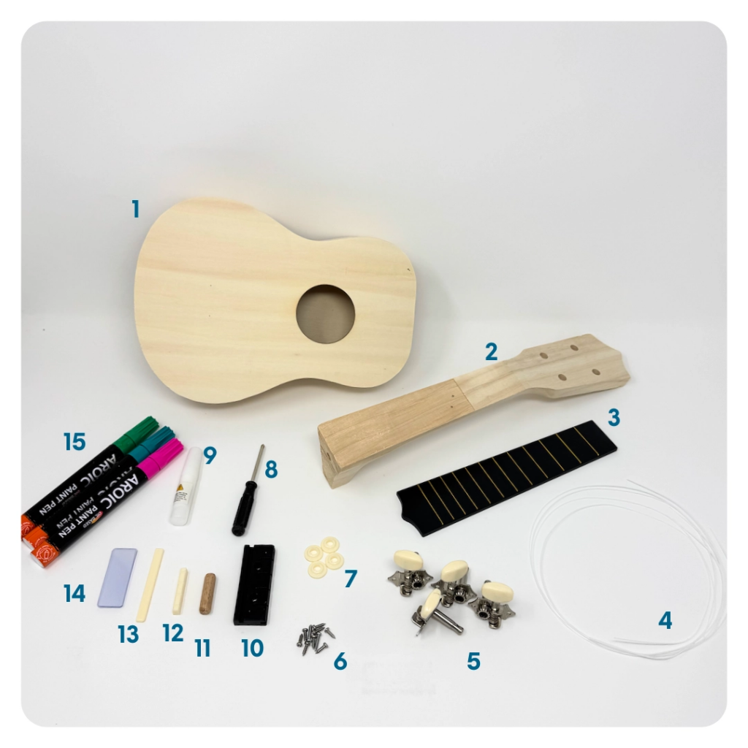
STEP 4 OF 14
Ukulele | Step 1
Check Your Kit Parts
• Ukulele Body
• Ukulele Neck
• Fretboard
• Strings
• Tuners
• Screws (2 long, 8 short)
• Bushings
• Screwdriver
• Glue
• Bridge
• Wooden Dowel
• Nut
• Saddle
• Double Sided Adhesives
• Paint Pens

Slide 7
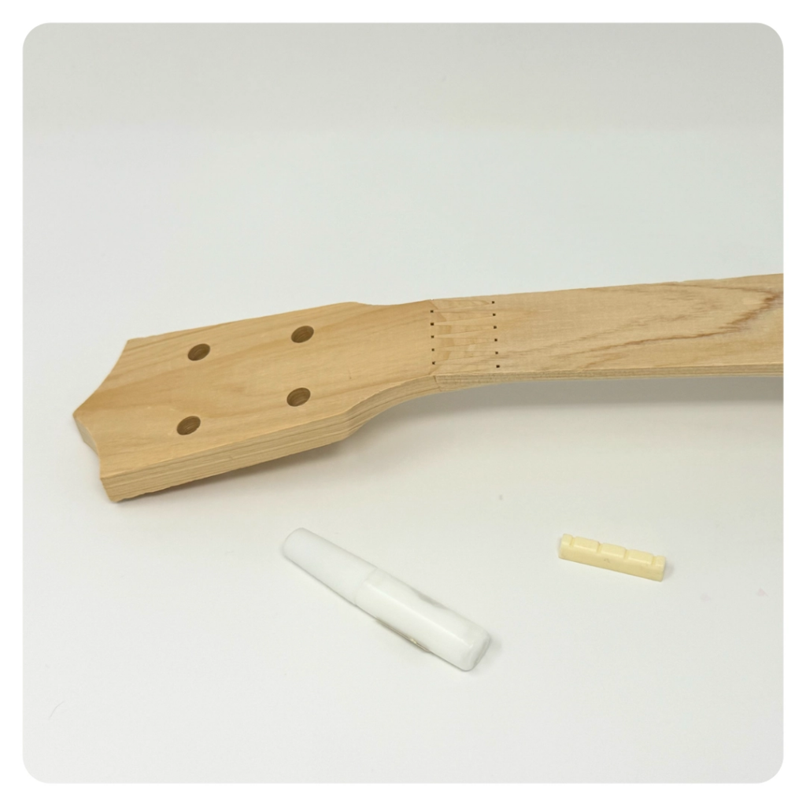
STEP 5 OF 14
Ukulele | Step 2
Gluing the Nut
Take the nut and place it on the neck, where the headstock starts to go down from the neck. Mark the nut position with a pencil.
• If your neck is pre-marked, glue the nut to the first row of dots (closest to the tuner location)
Make sure the nut is glued down at a right angle, on the flat side, to the direction of the strings.

Slide 8
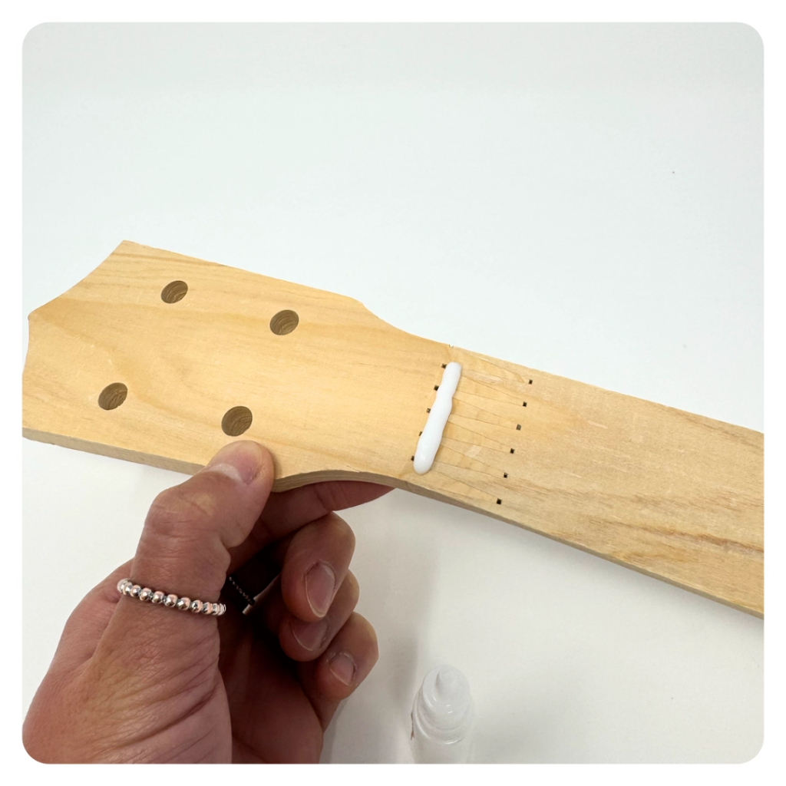
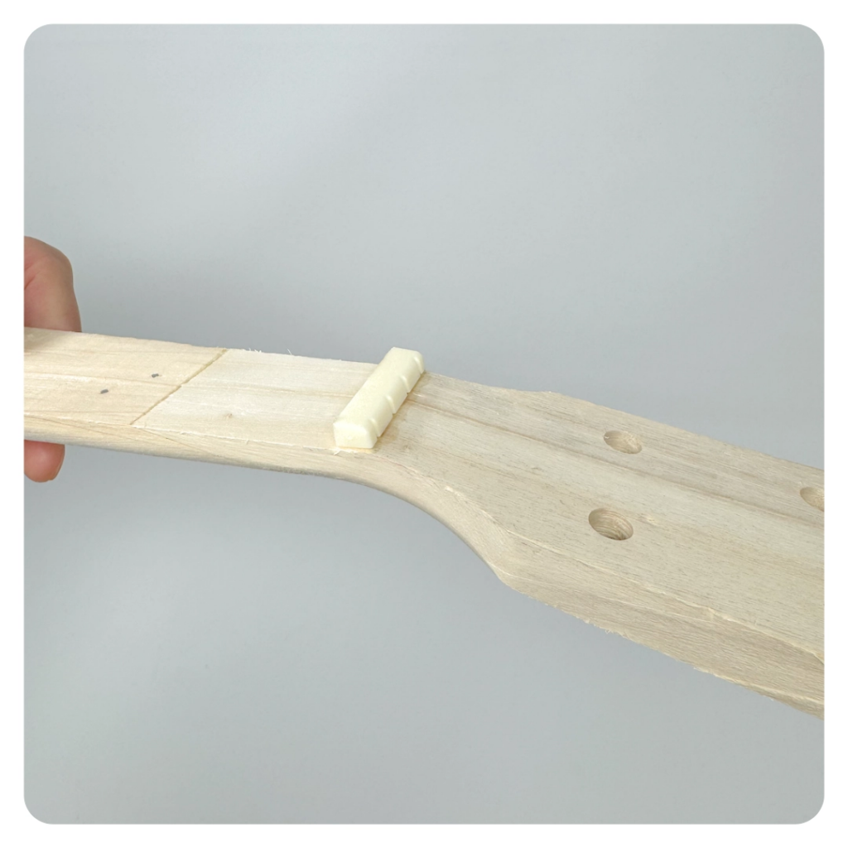
STEP 5 OF 14
Ukulele | Step 2 (continued)

Slide 9
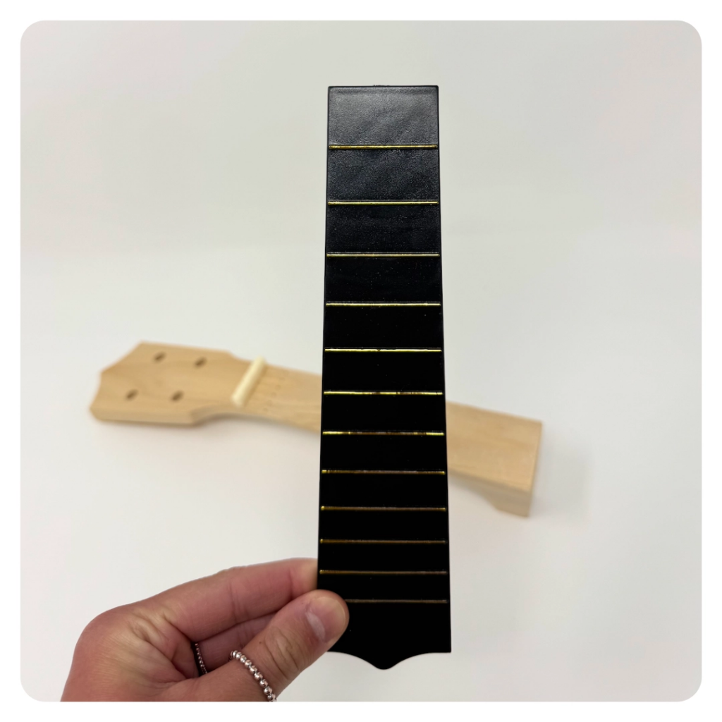
STEP 6 OF 14
Ukulele | Step 3
Attach the Fretboard
Using 3 double-sided adhesives, attach the fretboard to the neck.
• Press for 2-3 minutes for a stronger hold
• Glue can be used if needed, however not necessary, and may require a longer dry time.

Slide 10
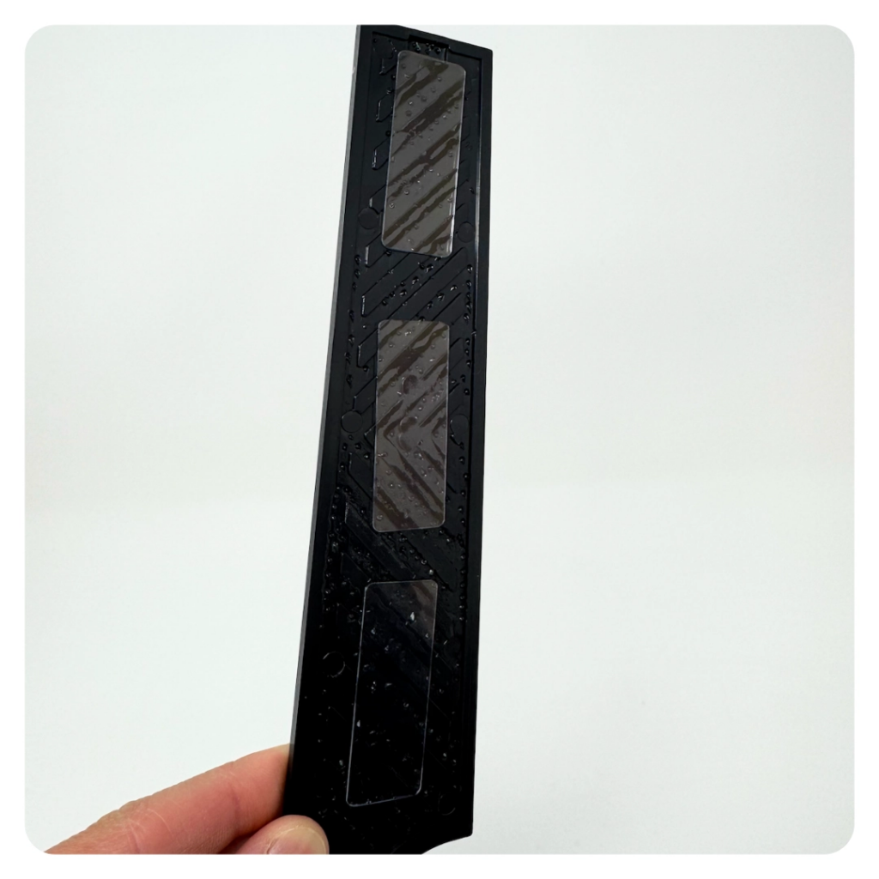
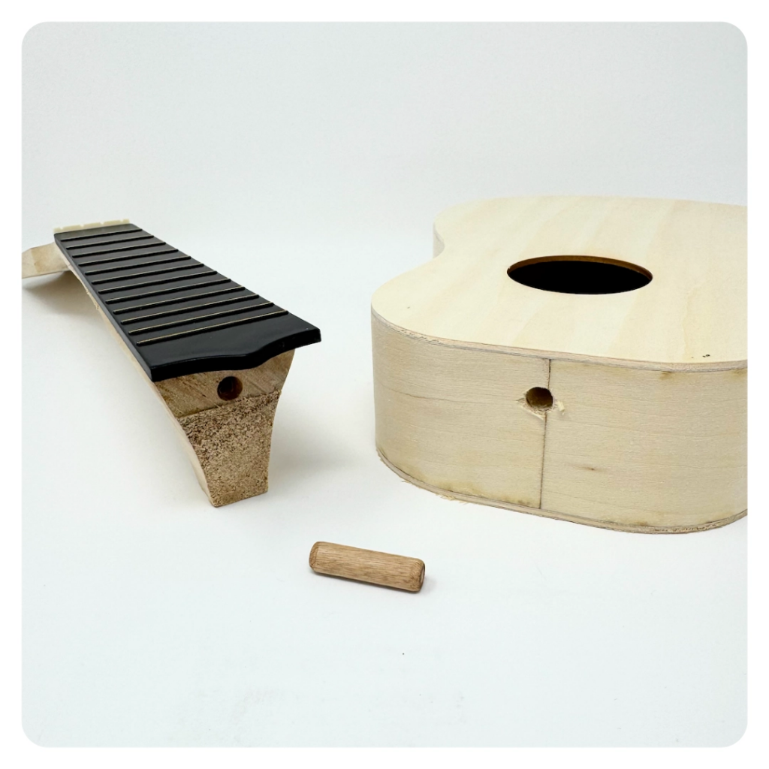
STEP 6 OF 14
Ukulele | Step 3 (continued)

Slide 11
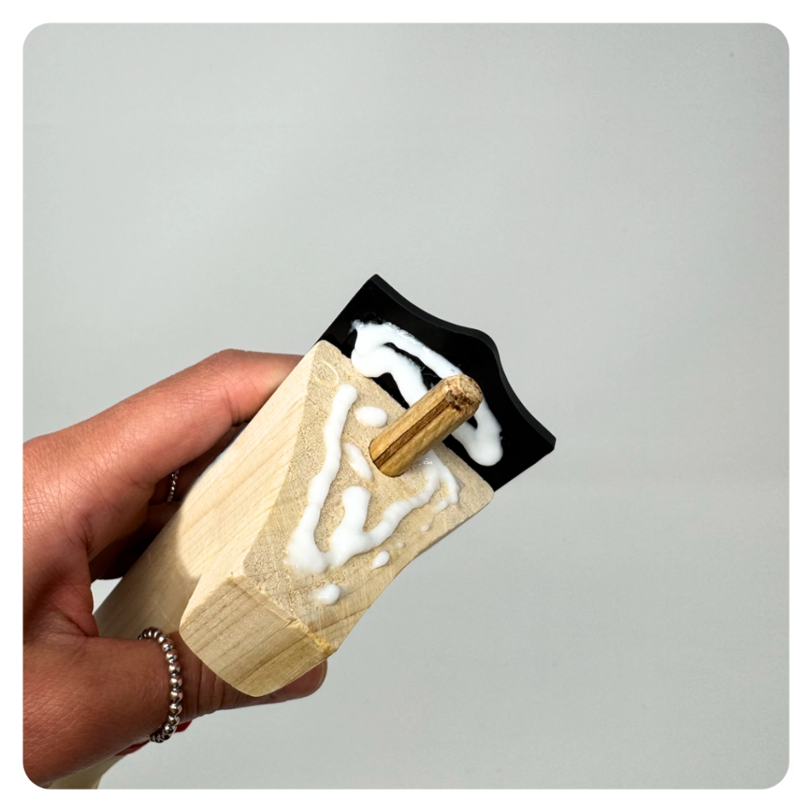
STEP 7 OF 14
Ukulele | Step 4
Connect the Neck
Use the wooden dowel and glue to attach the neck to the body.

Slide 12
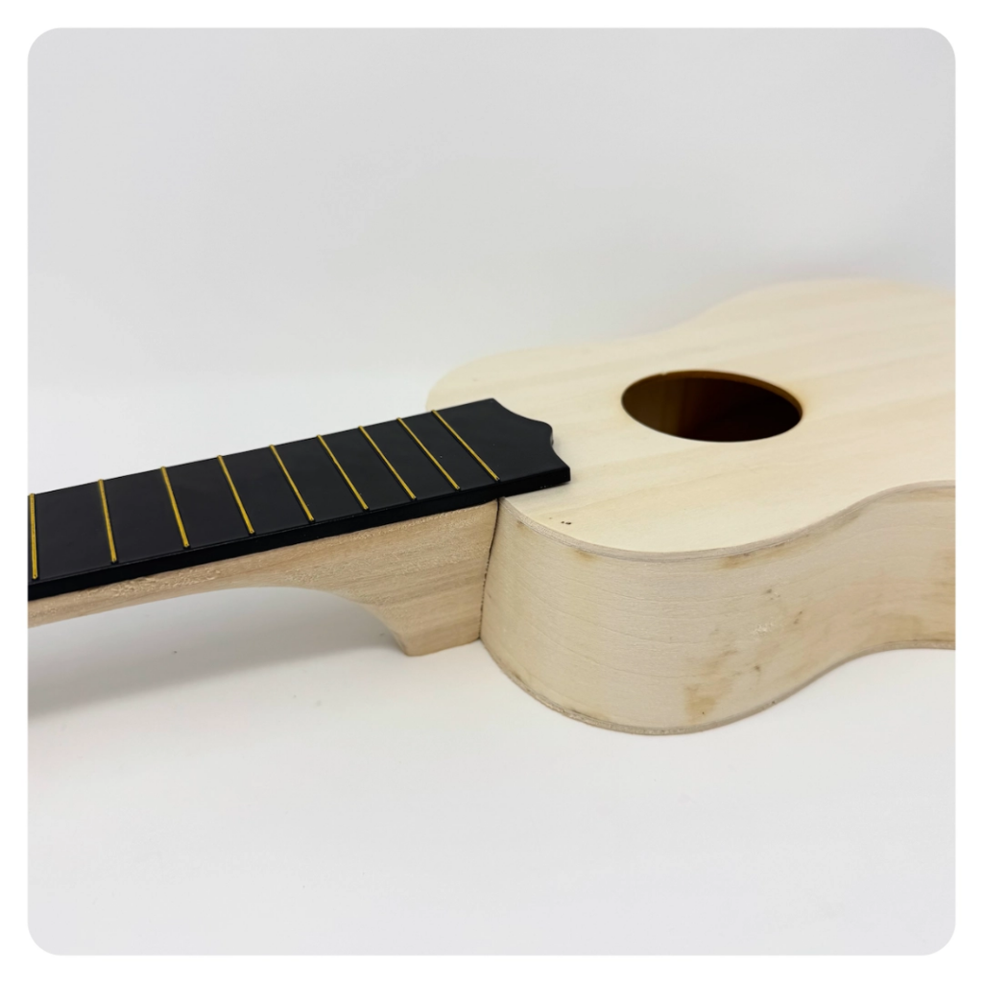
STEP 7 OF 14
Ukulele | Step 4 (continued)

Slide 13
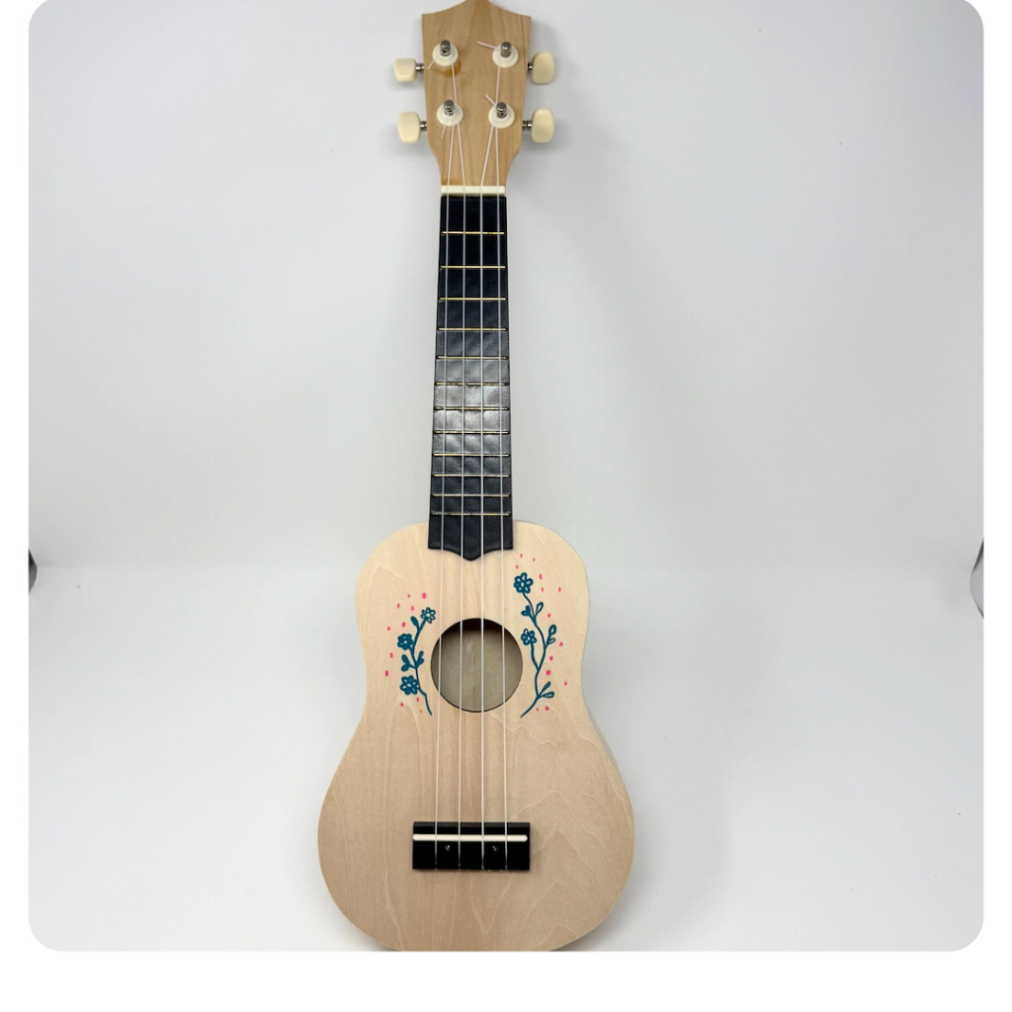
STEP 8 OF 14
Ukulele | Step 5
Decorate!
Before moving on, use the included paint pens to decorate the ukulele.
• Avoid religion and politics entirely
• Use words of affirmation or colorful images
• Please keep your designs gender-neutral, inclusive, and age-appropriate

Slide 14
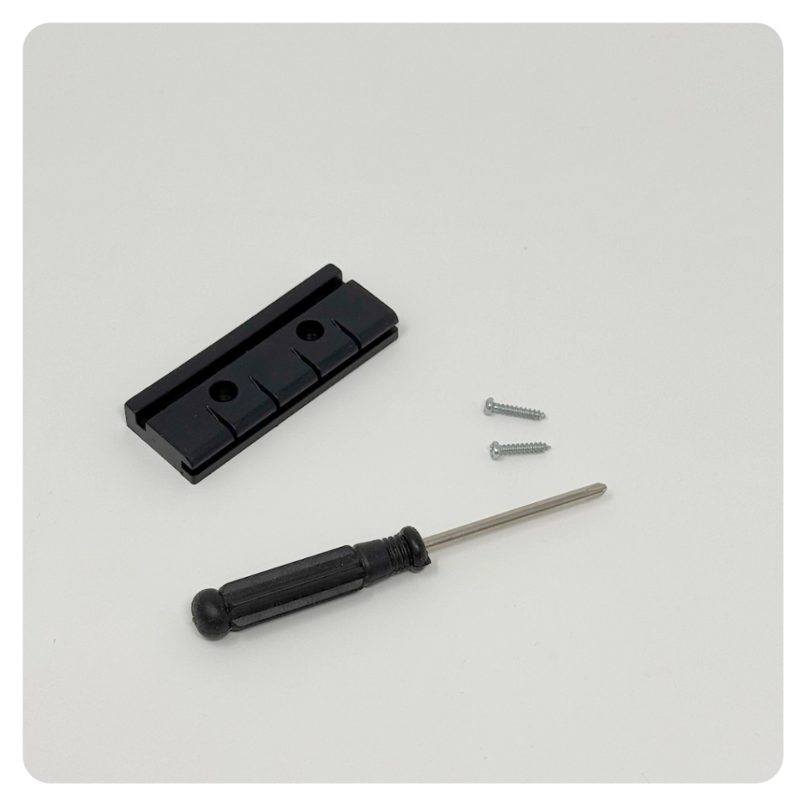
STEP 9 OF 14
Ukulele | Step 6
Attach the Bridge
Attach the bridge to the body using the screwdriver and 2 long screws, and slide in the saddle.
• Use the pre-marked holes as a guide
• Optional to use the small circular white covers to hide the screws. These can be glued in place with a drop of glue.

Slide 15
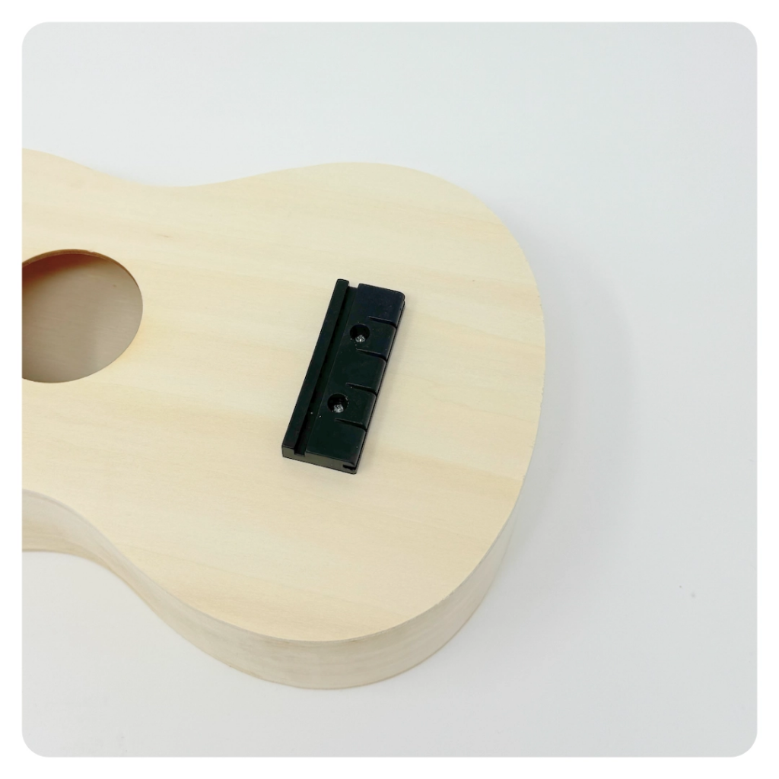
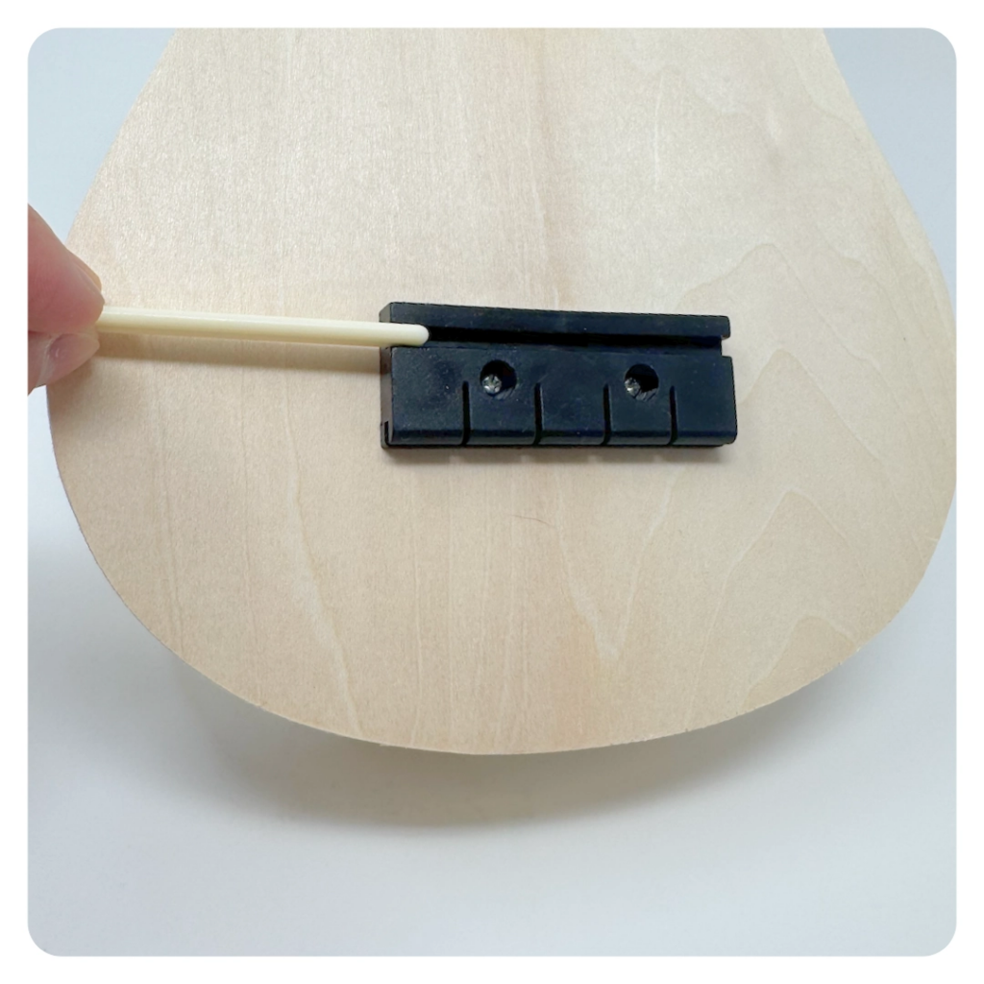
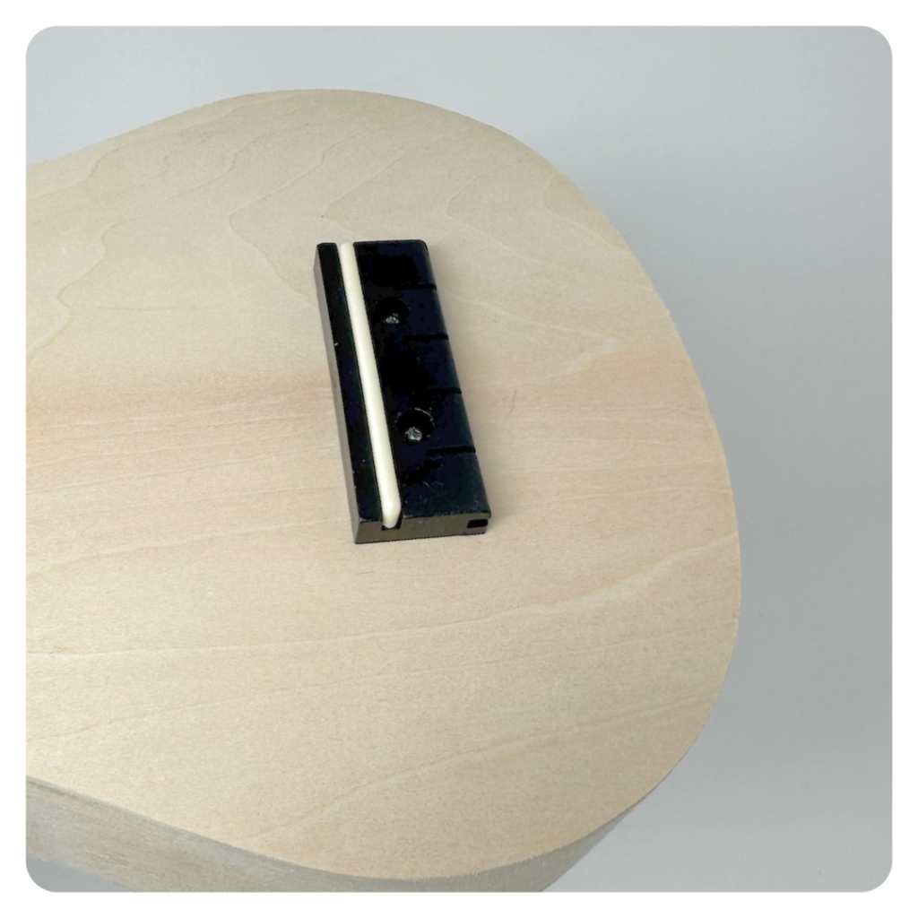
STEP 9 OF 14
Ukulele | Step 6 (continued)

Slide 16
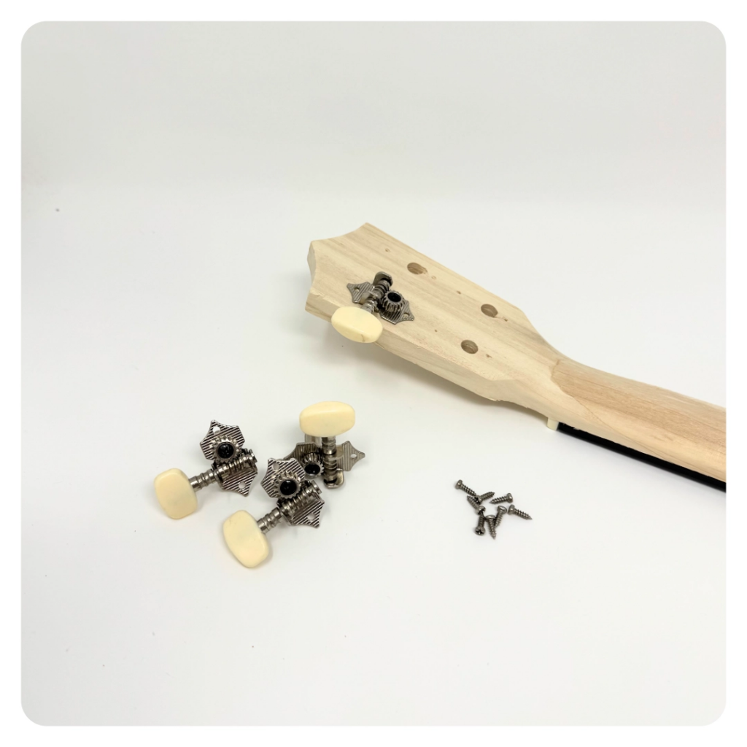
STEP 10 OF 14
Ukulele | Step 7
Mount the Tuners
The kit has 4 tuners to be installed, 2 left and 2 right. Push the tuning pins through the hole from the back of the headstock and line up with the guided screw holes. Screw into place using the screwdriver and remaining screws.
Add the 4 bushings to the front of the headstock and use a small amount of blue to fix in place.

Slide 17
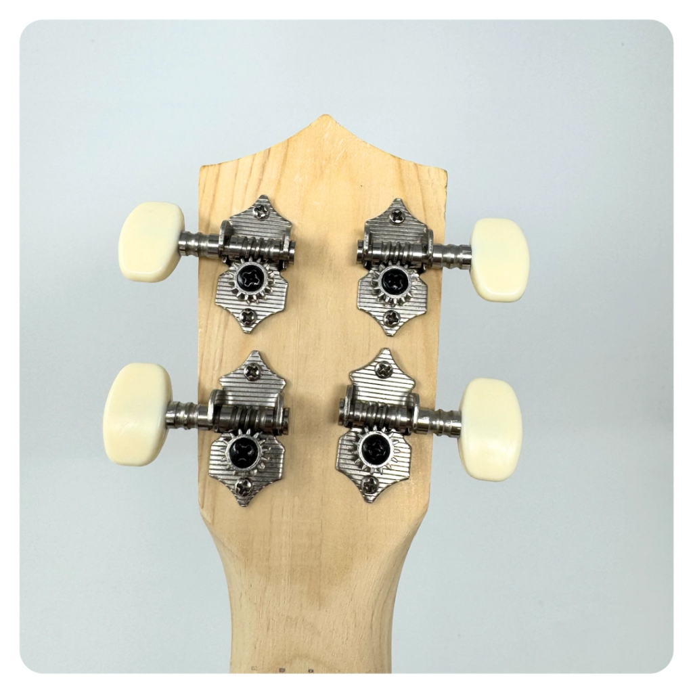
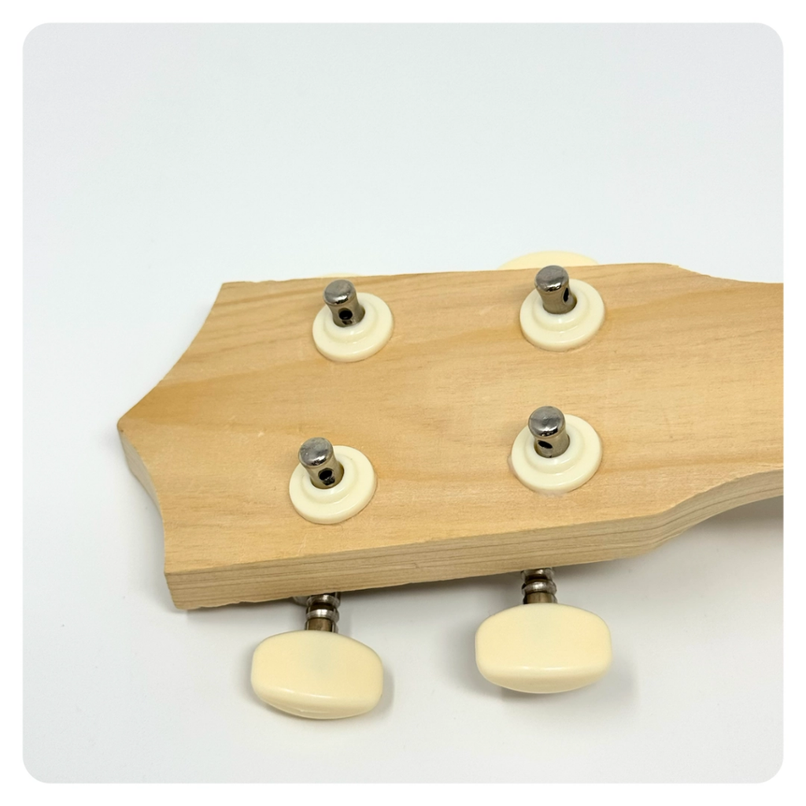
STEP 10 OF 14
Ukulele | Step 7 (continued)

Slide 18
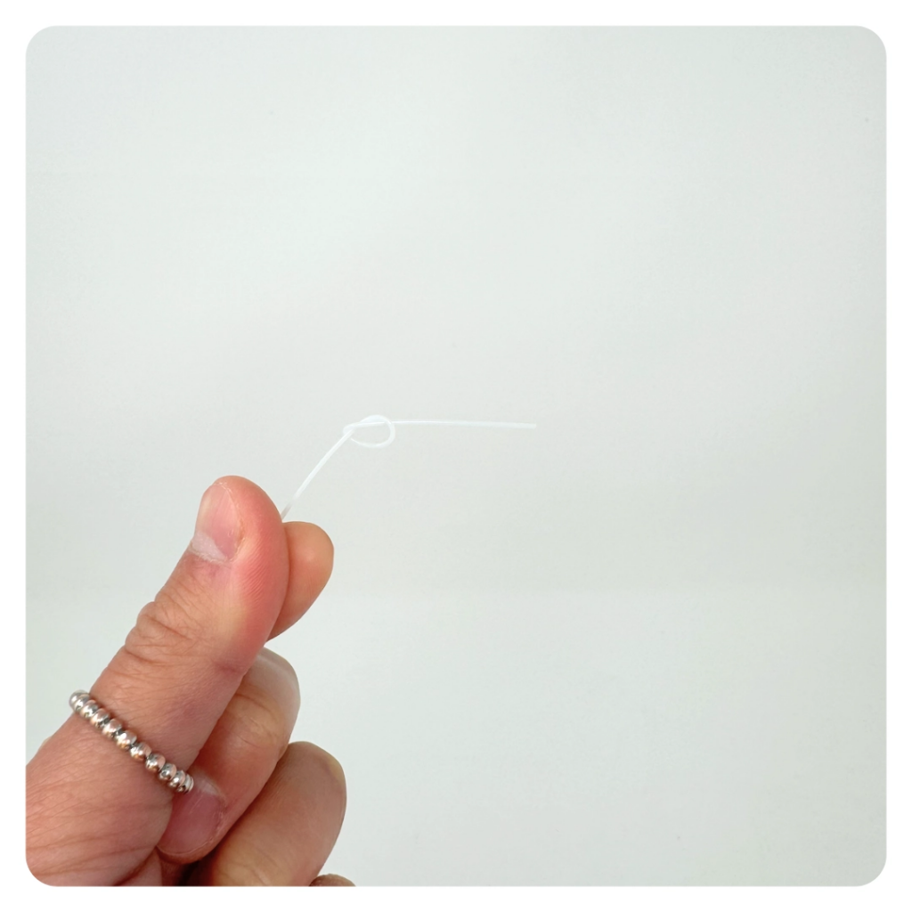
STEP 11 OF 14
Ukulele | Step 8
String the Ukulele
Tie a knot in the end of the 4 included strings and feed the other end through the bridge slot designated for that string. Pull the string through the bridge slot until it is stopped by the knot, then bring it up over the saddle and down the neck to the nut. Pass the string through the nut slot into the tuning peg. Turn the tuning peg until the string has no slack.
• Do not over tighten
• Leave enough slack in the string to achieve 2-3 complete windings on the tuner peg

Slide 19
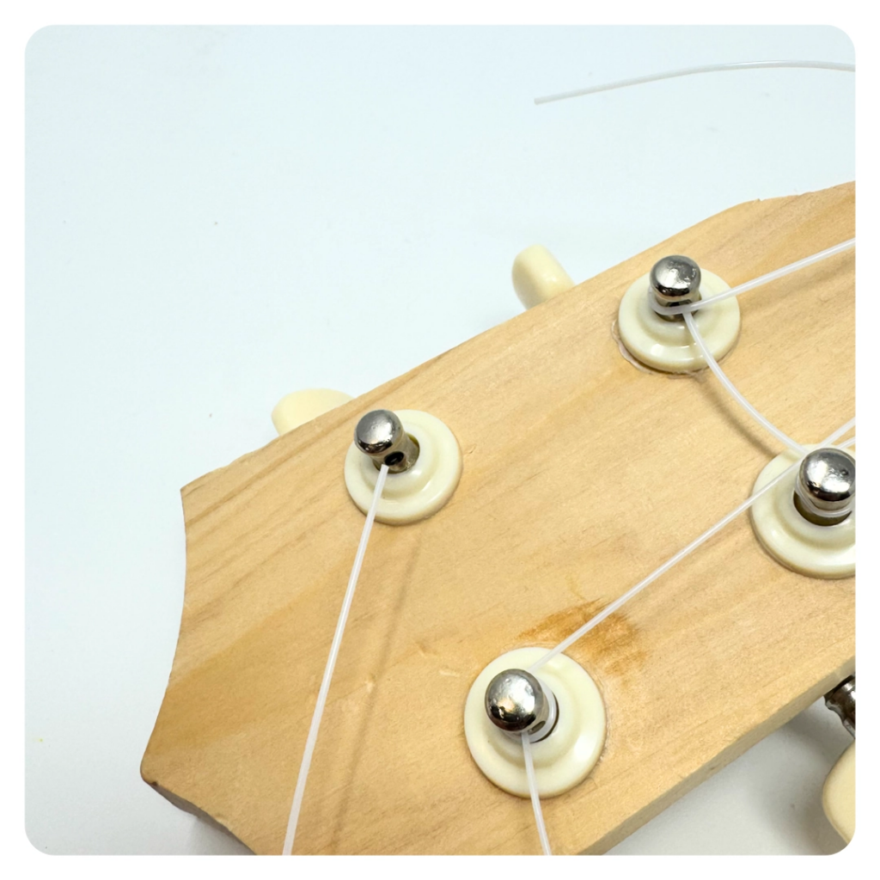
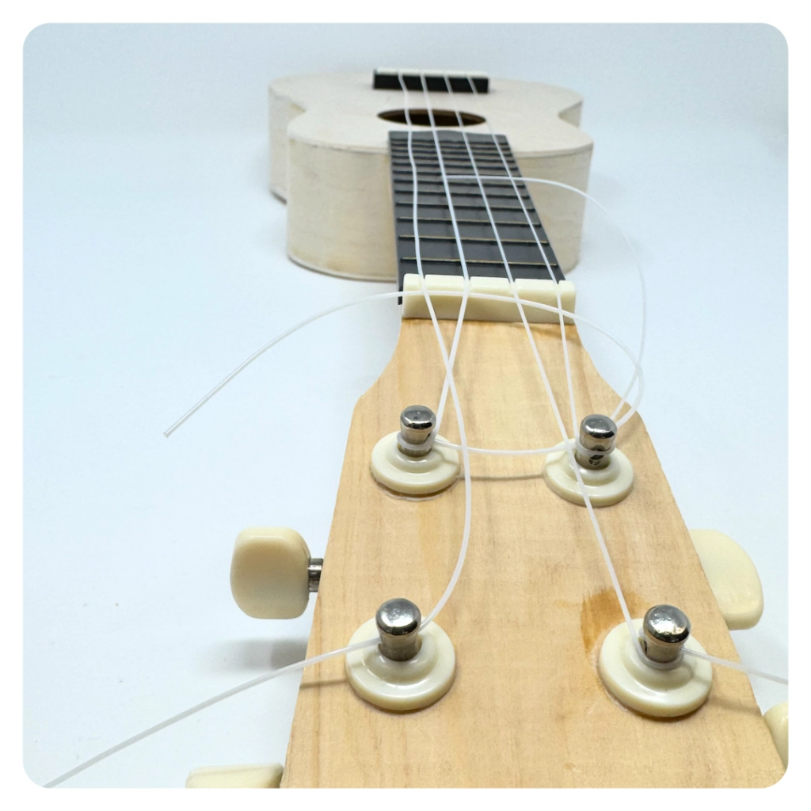
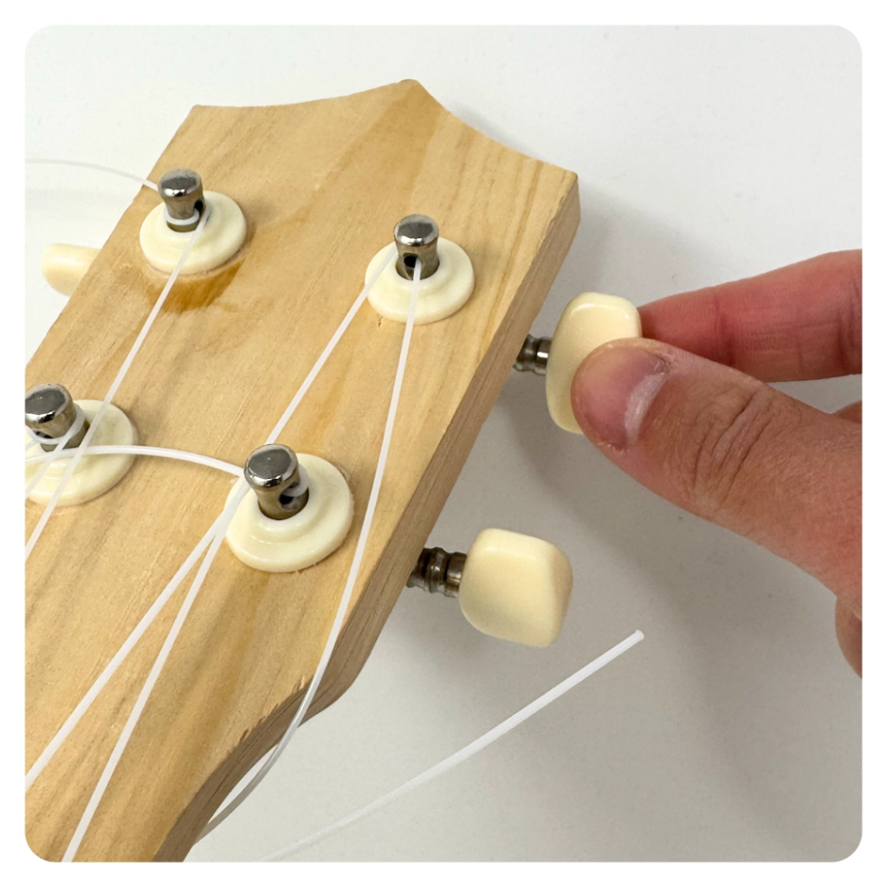
STEP 11 OF 14
Ukulele | Step 8 (continued)

Slide 20
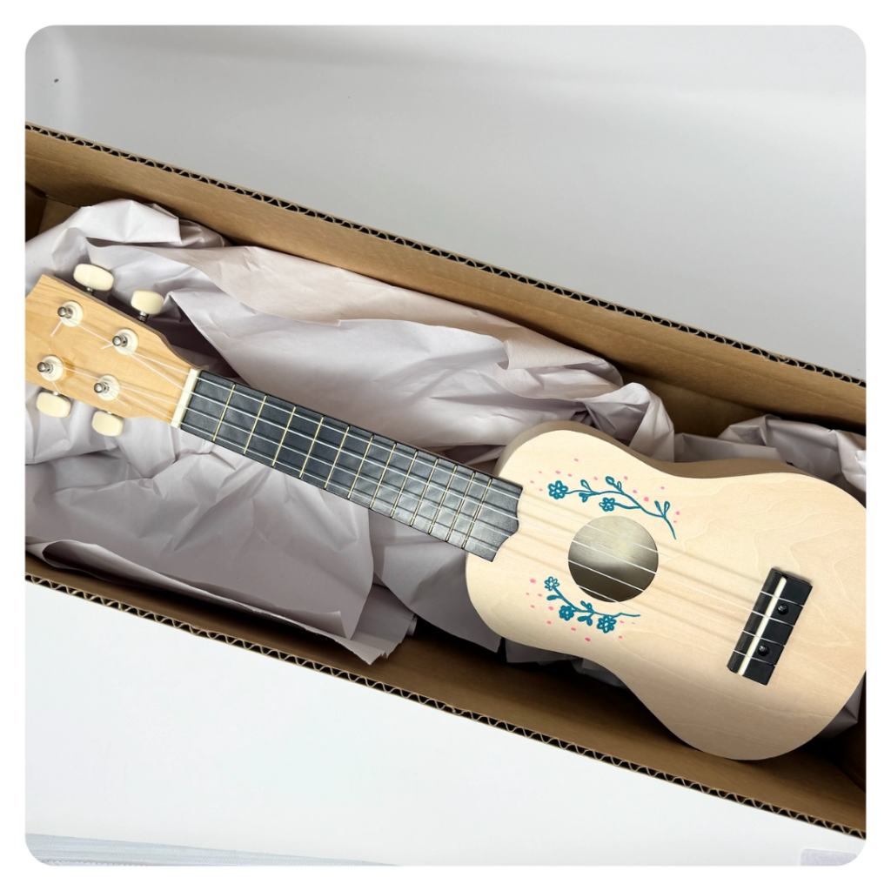
STEP 12 OF 14
Pack the Ukulele Kit
Using the box and packaging paper you received your kit in, pack your completed Ukulele ensuring padding is under and and top of the ukulele.
Pack all materials back into the original box.
Feel free to decorate the box to make it like a gift for someone to open.
• Please only include items that are UNOPENED and UNUSED
• Add any optional items you would like.
Optional Items to Add:
• Journals
• Music books
Items not to include:
• Perishable items
• Sharp objects
• Nut food products
• Religious or political items

Slide 21
STEP 13 OF 14
Register My Kit (Optional)
Register your kit. To register and track your kits, you must visit the online instructions. Registering your kit is optional.

Slide 22
STEP 14 OF 14
Thank You!
When you build a Kynd Kit, you create layers of impact for yourself and the community. We appreciate your time and your support of our mission.
Cheers,
The Project Helping team

