Slide 1

CLASSIC
Veteran Affairs Hospital 4.0 [Classic]
13 STEPS

Slide 2

STEP 1 OF 13
About Project Helping
Kynd Kits are a program of Project Helping, a mental wellness nonprofit. Our mission is to make it ridiculously easy to volunteer because doing good is good for your mental wellness!
Learn More at ProjectHelping.org
When You Build a Kynd Kit - The Cycle of Impact

Slide 3

STEP 2 OF 13
Tips for Building Your Kit
Helpful Tip for Building Your Kynd Kit
• Avoid politics and religion entirely.
• Use appropriate humor.
• Can't think of what to write, draw a picture!
• Use words of affirmation!
• Place a piece of paper in any canvas bag before drawing on the outside. This way, the marker will not bleed through the other side of the bag.
• Please keep your designs gender-neutral, inclusive, and age-appropriate.
Spanish Translation Options

Slide 4
STEP 3 OF 13
Veteran Affairs Hospital Care [Classic]
Before You Build
About the Recipient
The Veterans Health Administration (VHA) is the largest integrated healthcare system in the United States. They provide care at 1,293 healthcare facilities, including 171 VA Medical Centers and 1,112 outpatient sites of care of varying complexity (VHA outpatient clinics) to over 9 million Veterans enrolled in the VA healthcare program.
VHA Medical Centers provide a wide range of services, including traditional hospital-based services such as surgery, critical care, mental health, orthopedics, pharmacy, radiology, and physical therapy.

Slide 5
STEP 3 OF 13
Veteran Affairs Hospital Care [Classic] (continued)
Help support the Veteran Affairs Hospitals’ mission by creating a care package for a veteran staying at one of their facilities. Most importantly, sending letters is a powerful way to bring love and laughter to someone who has a lasting impact.
Include a letter of gratitude in your care package, thanking a veteran for their service and letting them know how much they are appreciated.

Slide 6

STEP 4 OF 13
Decorate the Bag
Decorate the kraft bag(s). This is what the final kit is distributed in, so try to make this fun and colorful for the recipient to open.
Please note: we are currently transitioning from plastic ziplock bags to kraft bags. Some kits may still include the plastic bag for you to decorate while we complete this transition.

Slide 7



STEP 4 OF 13
Decorate the Bag (continued)

Slide 8

STEP 5 OF 13
Write a Note to the Recipient and Decorate the Envelope
Write a card and decorate the envelope using the enclosed materials. Express your encouragement and include a hopeful message.
Please ensure your message is age-appropriate and avoids references to religion or politics.

Slide 9

STEP 5 OF 13
Write a Note to the Recipient and Decorate the Envelope (continued)

Slide 10
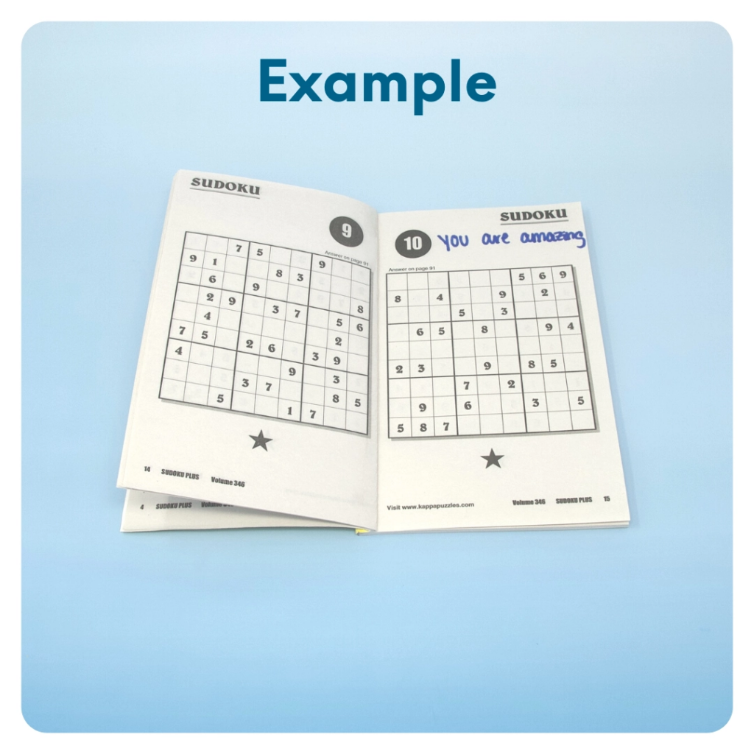
STEP 6 OF 13
Surprise Kyndness Puzzle Book
Go through the pages of the Sudoku or puzzle book and write uplifting messages, draw small, colorful images, or create fun writing prompts for the recipient.

Slide 11
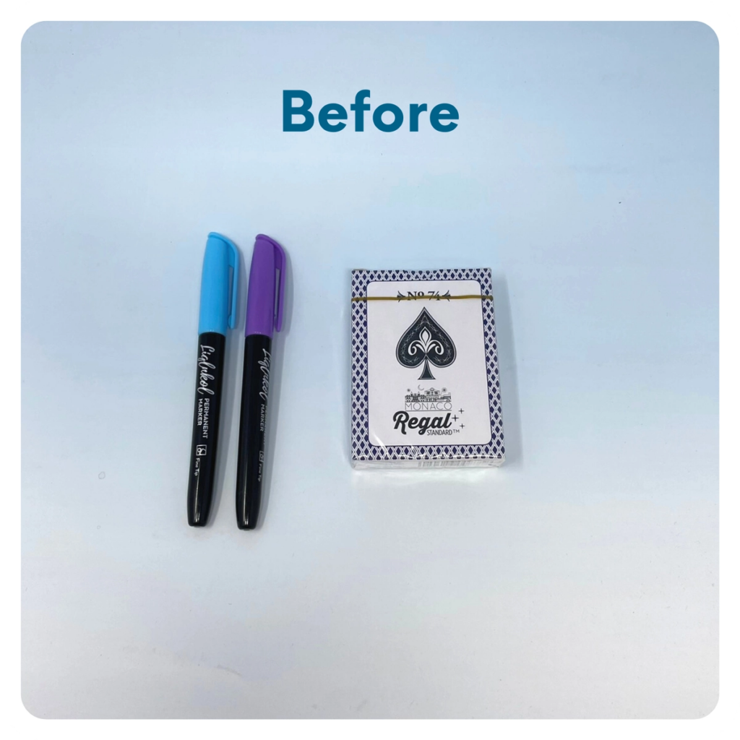
STEP 7 OF 13
Decorate the Playing Cards
Write encouraging messages, affirmations, jokes, or pictures on the faces of the playing cards for players to see when they are playing a card game.

Slide 12
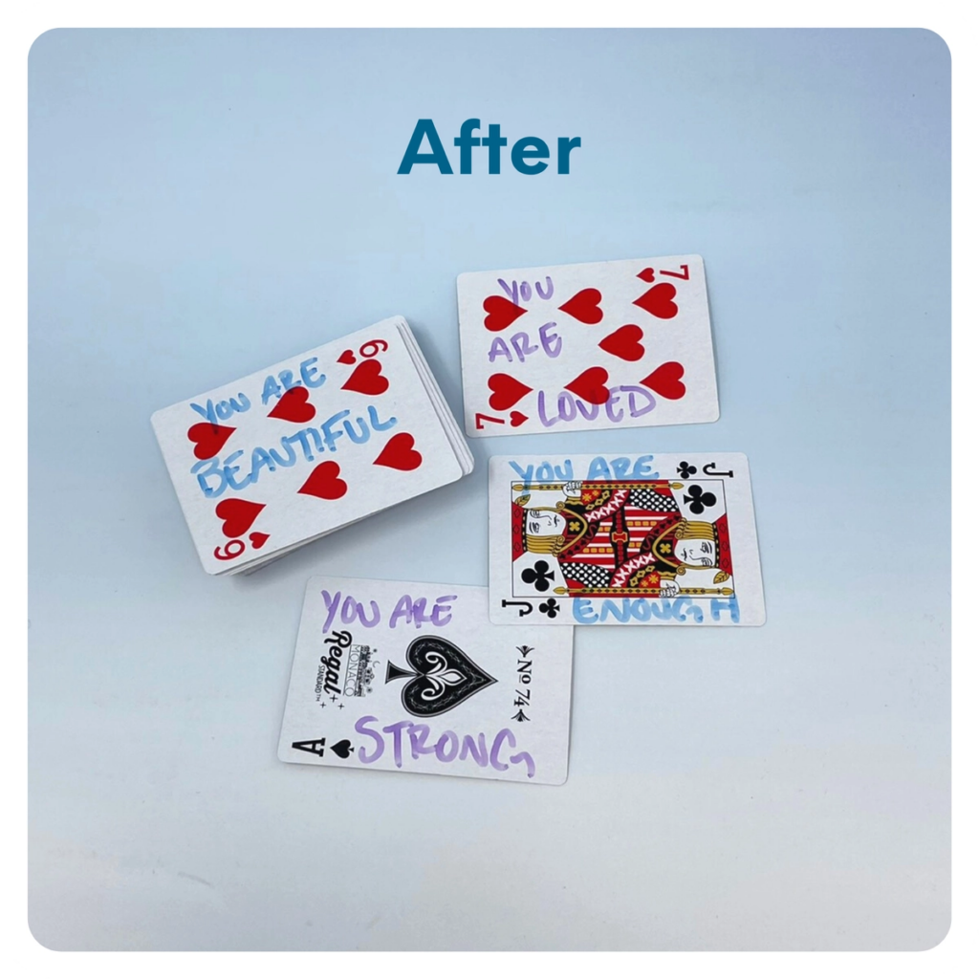
STEP 7 OF 13
Decorate the Playing Cards (continued)

Slide 13
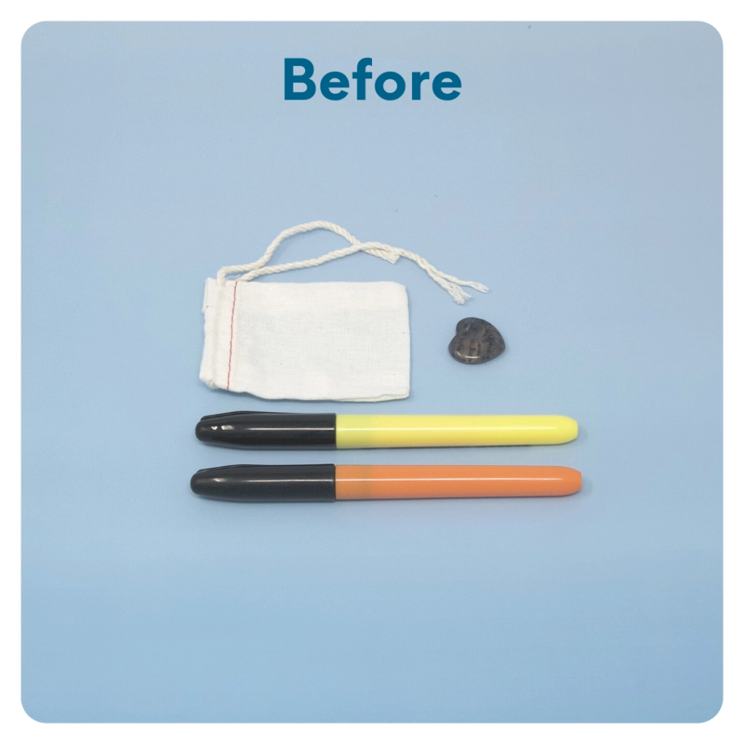
STEP 8 OF 13
Worry Stone
Worry stones are smooth, polished rocks used for relaxation or anxiety relief to help one feel grounded. The stone is meant to be kept in one’s pocket. The physical act of massaging a worry stone for several minutes is proven to provide therapeutic & psychological benefits that help soothe your nervous system, reduce stress and anxiety, and help clear your mind so you can focus and think clearly.
On one side of the drawstring bag write an inspirational or calming word. Examples: hope, love, grow, breathe, dream, courage, wonder.

Slide 14
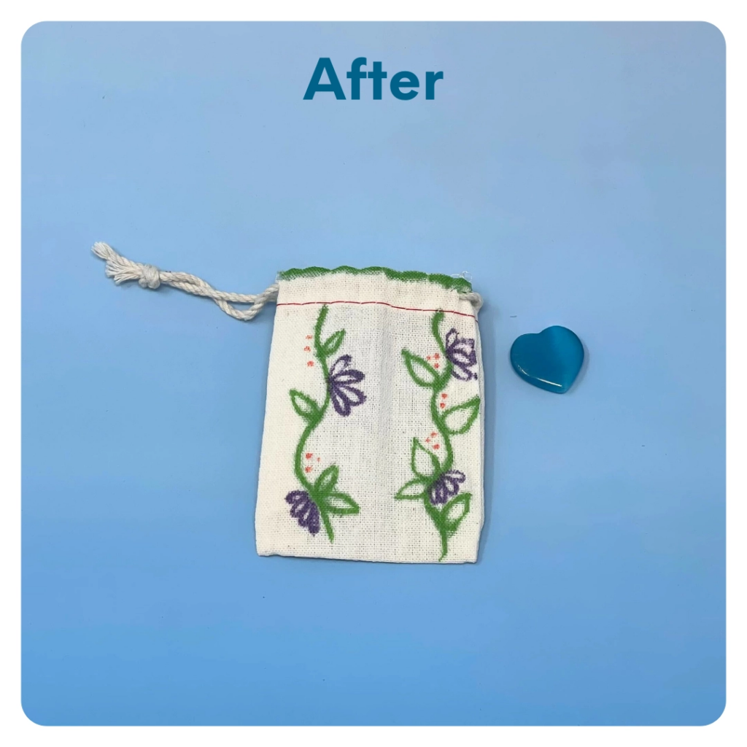
STEP 8 OF 13
Worry Stone (continued)
Tip: Place a piece of paper or cardboard in the bag before decorating to prevent the marker from bleeding through.

Slide 15
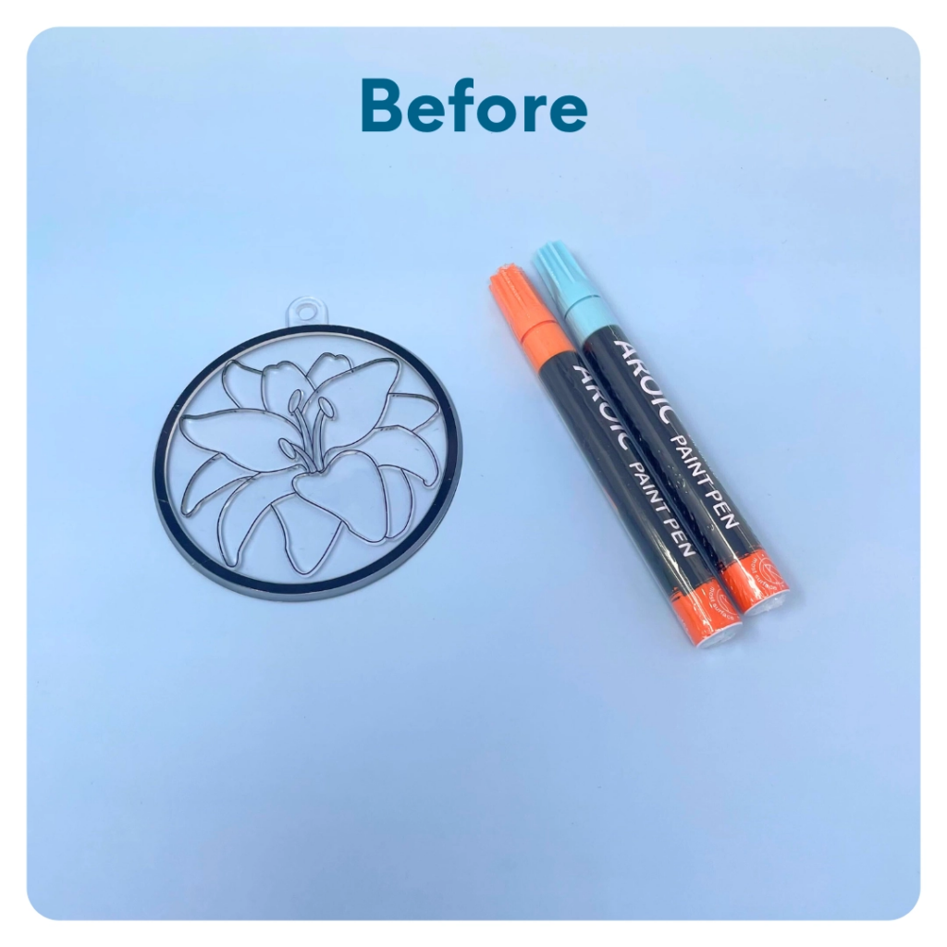
STEP 9 OF 13
Sun Catcher
Use paint pens to decorate the ridged side of the clear suncatcher.

Slide 16
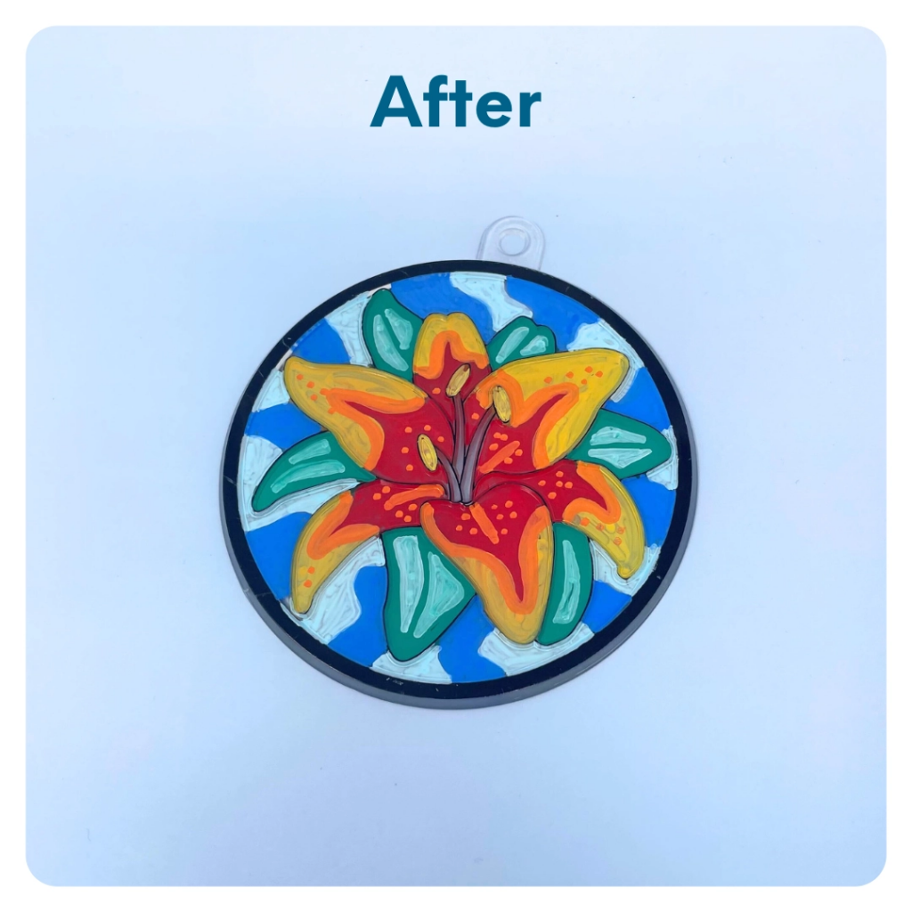
STEP 9 OF 13
Sun Catcher (continued)

Slide 17

STEP 10 OF 13
Affirmation Notebook
DIY Affirmations
Find the mini affirmation notebook in your kit. Decorate the front cover with drawings, stickers, or a positive message. Then, open it up and write 3–6 affirmations inside—more if you'd like! These can be encouraging words, self-love reminders, or anything that lifts the spirit.
Do you still have affirmation cards in your kit? If your kit includes affirmation cards instead of a notebook, go ahead and write a special affirmation on each card.

Slide 18


STEP 10 OF 13
Affirmation Notebook (continued)

Slide 19
STEP 11 OF 13
Pack the Veterans Affairs Kit
Pack all of the materials into the decorated plastic bag and put it back into the original box.
• Please only include items that are UNOPENED and UNUSED
• Add any optional items you would like.
Optional Items to Add:
• Caffeine-free tea (like Peppermint, Chamomile, Ginger and Lemon Tea)
• Mints
• Gum
• Warm and comfy clothing
• Fuzzy socks
• Lotion
• Blankets
• Puzzle books
• Card games
Items not to include:
• Perishable items
• Sharp objects
• Nut food products
• Religious or political items

Slide 20
STEP 12 OF 13
Register My Kit (Optional)
Register your kit. To register and track your kits, you must visit the online instructions. Registering your kit is optional.

Slide 21
STEP 13 OF 13
Thank You!
When you build a Kynd Kit, you create layers of impact for yourself and the community. We appreciate your time and your support of our mission.
Cheers,
The Project Helping team

