Slide 1
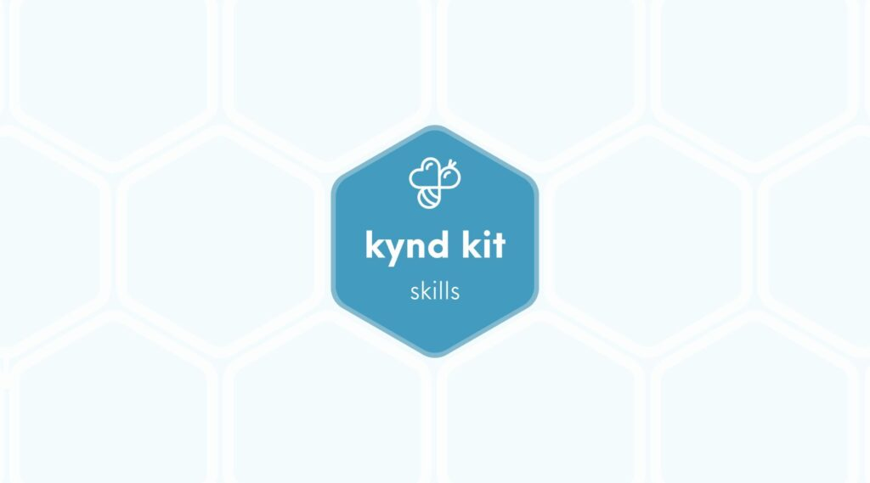
SKILLS
Wax Melting [Skills]
8 STEPS

Slide 2

STEP 1 OF 8
About Project Helping
Kynd Kits are a program of Project Helping, a mental wellness nonprofit. Our mission is to make it ridiculously easy to volunteer because doing good is good for your mental wellness!
Learn More at ProjectHelping.org
When You Build a Kynd Kit - The Cycle of Impact

Slide 3

STEP 2 OF 8
Tips for Building Your Kit
Helpful Tip for Building Your Kynd Kit
• Avoid politics and religion entirely.
• Use appropriate humor.
• Can't think of what to write, draw a picture!
• Use words of affirmation!
• Place a piece of paper in any canvas bag before drawing on the outside. This way, the marker will not bleed through the other side of the bag.
• Please keep your designs gender-neutral, inclusive, and age-appropriate.
Spanish Translation Options

Slide 4
STEP 3 OF 8
Skill: Wax Melting
Before You Build
The Skills Kits were created for you, as the volunteer, to learn a new skill and use it to give back to your community. Learn how to make lip balm and candles to give to someone struggling with their mental health to use as a self care tool. You can then use this new skill of wax melting to keep giving back to your own community by creating other self care items!

Slide 5
STEP 4 OF 8
Making Lip Balm
Make Four Lip Balms
Items you will need:
• Small, silver tin canisters x4
• Beeswax
• Essential oil
• Stir stick
• Shea butter
• Coconut oil
Before You Begin
Measure your Ingredients: One tablespoon of beeswax, one tablespoon of coconut oil, and one tablespoon shea butter
Prepare your double boiler: To make a double boiler, fill a cooking pot full of water and place a heat-safe bowl into the water. Combine your beeswax, coconut oil, and shea butter into the heat-safe bowl.
Let’s get started!
• Prep the Canisters: Set all of your canisters out with the lids off.

Slide 6
STEP 4 OF 8
Making Lip Balm (continued)
• Melt the Wax: Heat the ingredients over medium-high heat until all of the ingredients are completely melted, stirring occasionally
• Remove from Burner & Add Essential Oils: Turn off the heat and remove the pot from the heat before adding essential oils.
• Fill Container: Carefully pour the hot wax into the canisters.
• Let Sit: Let the wax cool completely.
• Add Lid: Once the lip balm has completely cooled and hardened, add lids.
• Continue Making Self-Care Items!

Slide 7
STEP 5 OF 8
Make Two Candles
Items you will need:
• Black tin canister x2
• Soy wax
• Essential oil
• Wick
• Stir stick
• Scissors
Before You Begin
Measure your soy wax: To measure your soy wax, use your candle canister as a scoop/measuring cup. Two scoops of unmelted soy wax will fill your canister with the proper amount of melted soy wax.
Measuring Equation: 2:1 ratio
2 full canister of unmelted soy wax = 1 full canister of melted soy wax
Prepare your double boiler: To make a double boiler, fill a cooking pot full of water and place a heat safe bowl into the water. Put the soy wax into the heat safe bowl.

Slide 8
STEP 5 OF 8
Make Two Candles (continued)
Let’s get started!
• Prep the Containers: Set all your black tin canisters out with the lids off. Peel the sticker off the bottom of the wick and stick it inside the canister at the bottom in the center.
• Melt the Wax: Heat the ingredients over medium-high heat until all of the ingredients completely melt, stir occasionally
• Remove from Burner & Add Essential Oils: Turn off heat and remove the pot from the heat before adding essential oils.
• Fill Container: Carefully pour the hot wax into the canister. Use the extra popsicle sticks to help keep the wick in place.
• Let Sit: Let the wax cool completely and then trim the wick down to size using a scissors.
• Add Lid: Once the candle has completely cooled and hardened, add lids.
• Continue Candle Making! Reuse old containers or candles to keep making more candles to help those you love practice self care!
Make sure your reused containers are not flammable. Some may have flammable paint or other elements.

Slide 9
STEP 6 OF 8
Wax Melting Kit Delivery Option
This kit is designed to be distributed to someone you know who is struggling and could benefit from practicing self-care, as it is good for your mental health.

Slide 10
STEP 7 OF 8
Register My Kit (Optional)
Register your kit. To register and track your kits, you must visit the online instructions. Registering your kit is optional.

Slide 11
STEP 8 OF 8
Thank You!
When you build a Kynd Kit, you create layers of impact for yourself and the community. We appreciate your time and your support of our mission.
Cheers,
The Project Helping team

