Slide 1

CLASSIC
Women’s Care Kit [Classic]
10 STEPS

Slide 2

STEP 1 OF 10
About Project Helping
Kynd Kits are a program of Project Helping, a mental wellness nonprofit. Our mission is to make it ridiculously easy to volunteer because doing good is good for your mental wellness!
Learn More at ProjectHelping.org
When You Build a Kynd Kit - The Cycle of Impact

Slide 3

STEP 2 OF 10
Tips for Building Your Kit
Helpful Tip for Building Your Kynd Kit
• Avoid politics and religion entirely.
• Use appropriate humor.
• Can't think of what to write, draw a picture!
• Use words of affirmation!
• Place a piece of paper in any canvas bag before drawing on the outside. This way, the marker will not bleed through the other side of the bag.
• Please keep your designs gender-neutral, inclusive, and age-appropriate.
Spanish Translation Options

Slide 4
STEP 3 OF 10
Women's Care [Classic]
Before You Build
About the Recipient
Around 186,388 people who identify as women, transgender, and nonbinary in the United States are experiencing homelessness on a given night, according to the most recent national point-in-time estimate.
The most basic needs can make a world of difference to those experiencing homelessness. By making a women's hygiene bag, you can impact someone with a meaningful, thoughtful action.

Slide 5

STEP 4 OF 10
Decorate the Bag
Decorate the kraft bag(s). This is what the final kit is distributed in, so try to make this fun and colorful for the recipient to open.
Please note: we are currently transitioning from plastic ziplock bags to kraft bags. Some kits may still include the plastic bag for you to decorate while we complete this transition.

Slide 6



STEP 4 OF 10
Decorate the Bag (continued)

Slide 7

STEP 5 OF 10
Write a Note to the Recipient and Decorate the Envelope
Write a card and decorate the envelope using the enclosed materials. Express your encouragement and include a hopeful message.
Please ensure your message is age-appropriate and avoids references to religion or politics.

Slide 8

STEP 5 OF 10
Write a Note to the Recipient and Decorate the Envelope (continued)

Slide 9
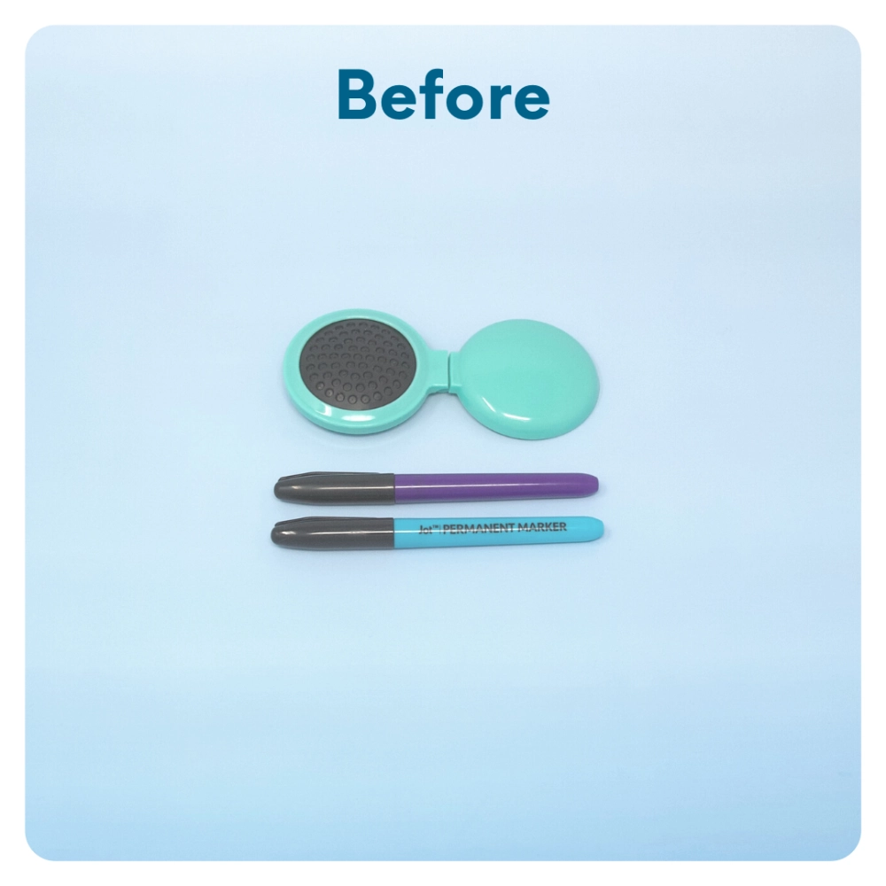
STEP 6 OF 10
Uplifting Self-Image
Decorate the comb or hairbrush with an uplifting message that the recipient will see each time they use it.

Slide 10
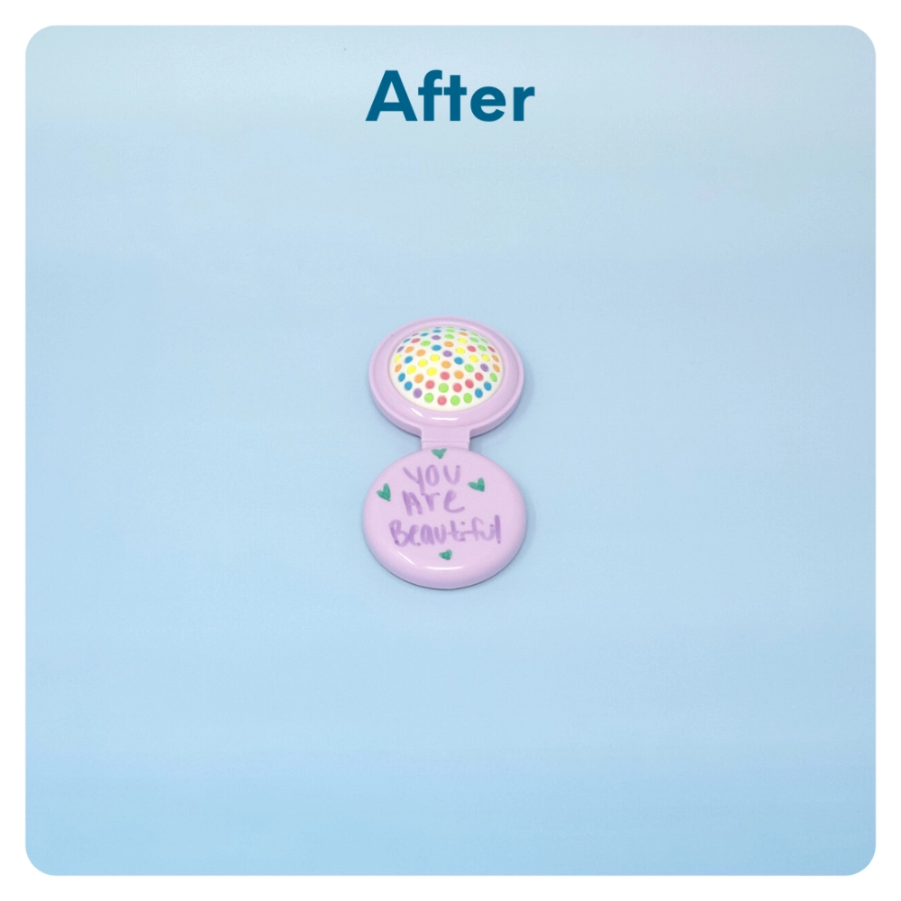
STEP 6 OF 10
Uplifting Self-Image (continued)

Slide 11

STEP 7 OF 10
Decorate the Canvas Bag
Use the permanent markers to decorate the canvas bag.
Tip: Place a piece of paper in the bag before decorating to prevent the markers from bleeding through.

Slide 12

STEP 7 OF 10
Decorate the Canvas Bag (continued)

Slide 13
STEP 8 OF 10
Pack the Women's Care Kit
Pack all feminine hygiene products into the decorated cosmetic bag. Then, pack all the materials into the plastic bag.
• Please only include items that are UNOPENED and UNUSED
• Add any optional items you would like.
Optional Items to Add:
• Self-care items
• Toiletries
• Socks
• High protein snack items
• Feminine hygiene items
Items not to include:
• Perishable items
• Sharp objects
• Nut food products
• Religious or political item

Slide 14
STEP 9 OF 10
Register My Kit (Optional)
Register your kit. To register and track your kits, you must visit the online instructions. Registering your kit is optional.

Slide 15
STEP 10 OF 10
Thank You!
When you build a Kynd Kit, you create layers of impact for yourself and the community. We appreciate your time and your support of our mission.
Cheers,
The Project Helping team

