Slide 1

CLASSIC
Youth Mental Health [Classic]
11 STEPS

Slide 2

STEP 1 OF 11
About Project Helping
Kynd Kits are a program of Project Helping, a mental wellness nonprofit. Our mission is to make it ridiculously easy to volunteer because doing good is good for your mental wellness!
Learn More at ProjectHelping.org
When You Build a Kynd Kit - The Cycle of Impact

Slide 3

STEP 2 OF 11
Tips for Building Your Kit
Helpful Tip for Building Your Kynd Kit
• Avoid politics and religion entirely.
• Use appropriate humor.
• Can't think of what to write, draw a picture!
• Use words of affirmation!
• Place a piece of paper in any canvas bag before drawing on the outside. This way, the marker will not bleed through the other side of the bag.
• Please keep your designs gender-neutral, inclusive, and age-appropriate.
Spanish Translation Options

Slide 4
STEP 3 OF 11
Youth Mental Health [Classic]
Before You Build
About the Recipient
The prevalence of youth mental health struggles are on the rise. Based on teacher and parent reports, about 1 in 6 students had enough behavioral or emotional symptoms and impairment to be diagnosed with a childhood mental disorder.
The completed Kynd Kit can be delivered to any youth, local elementary school, or community center. They can be used to reduce stress and anxiety, create positive mental health coping tools, and give youth support when they might be struggling.

Slide 5

STEP 4 OF 11
Decorate the Bag
Decorate the kraft bag(s). This is what the final kit is distributed in, so try to make this fun and colorful for the recipient to open.
Please note: we are currently transitioning from plastic ziplock bags to kraft bags. Some kits may still include the plastic bag for you to decorate while we complete this transition.

Slide 6



STEP 4 OF 11
Decorate the Bag (continued)

Slide 7

STEP 5 OF 11
Write a Note to the Recipient and Decorate the Envelope
Write a card and decorate the envelope using the enclosed materials. Express your encouragement and include a hopeful message.
Please ensure your message is age-appropriate and avoids references to religion or politics.

Slide 8

STEP 5 OF 11
Write a Note to the Recipient and Decorate the Envelope (continued)

Slide 9

STEP 6 OF 11
Decorate the Canvas Bag
Use the permanent markers to decorate the canvas bag.
Tip: Place a piece of paper in the bag before decorating to prevent the markers from bleeding through.

Slide 10

STEP 6 OF 11
Decorate the Canvas Bag (continued)

Slide 11

STEP 7 OF 11
Affirmation Notebook
DIY Affirmations
Find the mini affirmation notebook in your kit. Decorate the front cover with drawings, stickers, or a positive message. Then, open it up and write 3–6 affirmations inside—more if you'd like! These can be encouraging words, self-love reminders, or anything that lifts the spirit.
Do you still have affirmation cards in your kit? If your kit includes affirmation cards instead of a notebook, go ahead and write a special affirmation on each card.

Slide 12


STEP 7 OF 11
Affirmation Notebook (continued)

Slide 13
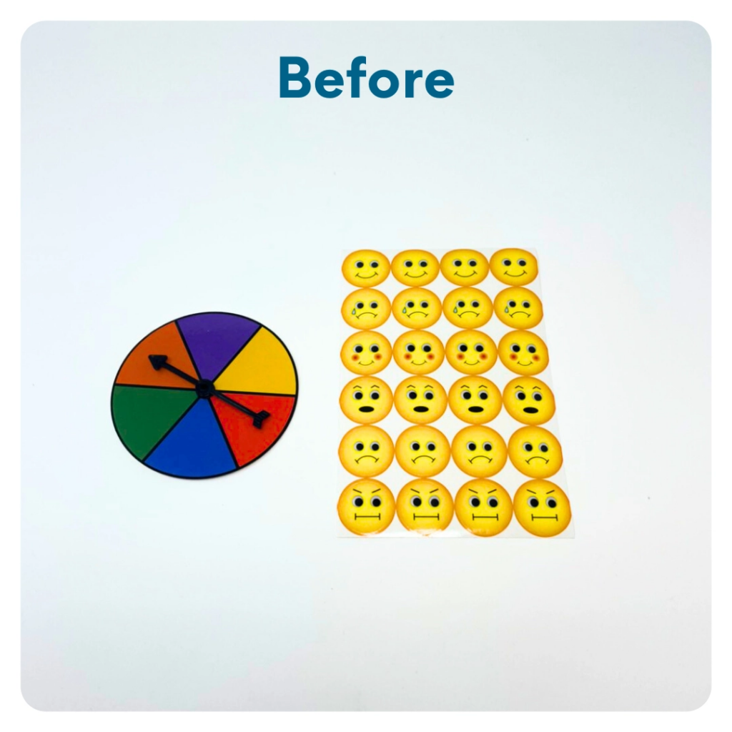
STEP 8 OF 11
DIY Emotions Wheel
Use the included stickers and markers to create an emotions wheel. This is intended to sit on the youth's desks at school to let their peers and teachers know how they are feeling for the day and also help them stay in tune with their emotions.

Slide 14
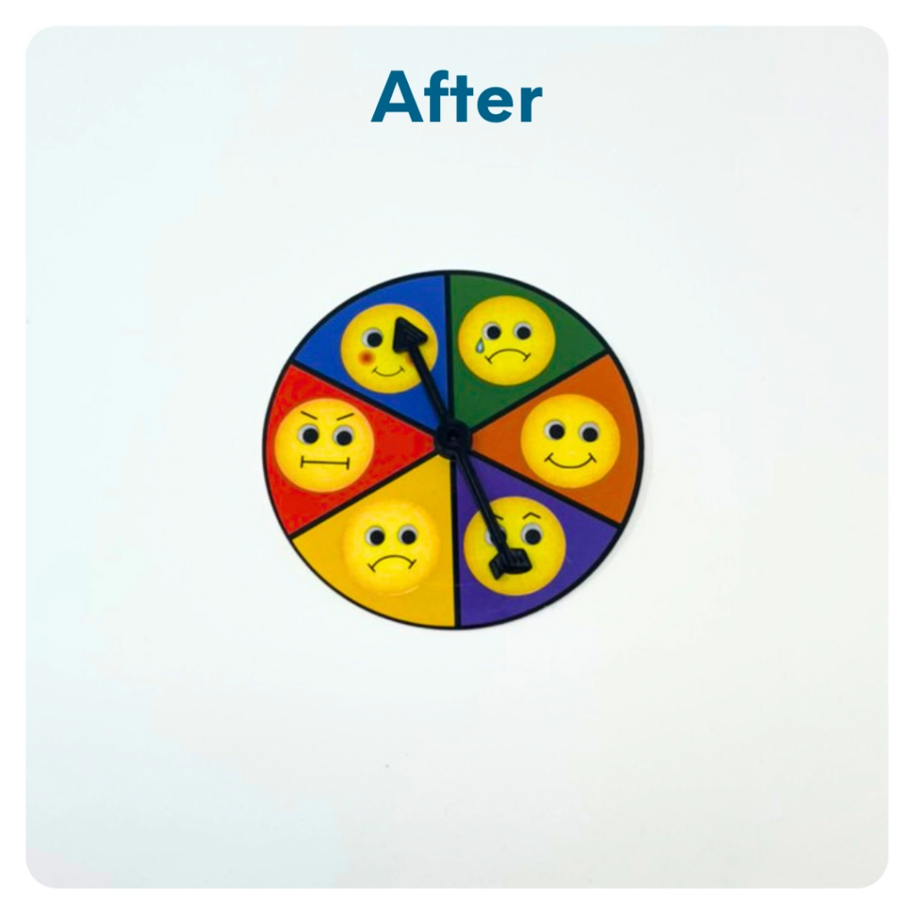
STEP 8 OF 11
DIY Emotions Wheel (continued)

Slide 15
STEP 9 OF 11
Pack the Youth Mental Health Kit
Pack all of the materials into the decorated plastic bag and put it back into the original box.
• Please only include items that are UNOPENED and UNUSED
• Add any optional items you would like.
Optional Items to Add:
• Playing cards/games
• Stickers
• Journals
• Coloring/writing utensils
Items not to include:
• Perishable items
• Sharp objects
• Nut food products
• Religious or political items

Slide 16
STEP 10 OF 11
Register My Kit (Optional)
Register your kit. To register and track your kits, you must visit the online instructions. Registering your kit is optional.

Slide 17
STEP 11 OF 11
Thank You!
When you build a Kynd Kit, you create layers of impact for yourself and the community. We appreciate your time and your support of our mission.
Cheers,
The Project Helping team

